Slide 1
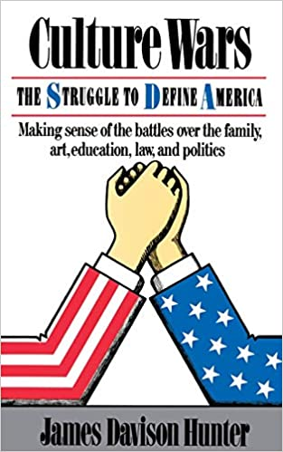
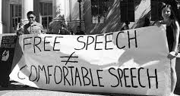
Chapter 6: Culture wars in the US = free speech v. social justice concerns

Slide 2
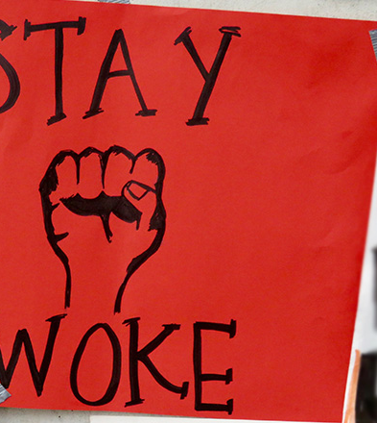
wokism
A term added to the Oxford English Dictionary in 2017
first used in the 1940s, the term “woke” (= being awake, not asleep) has resurfaced in recent years as a concept that symbolises awareness of social issues and movement against injustice, inequality, and prejudice = the umbrella purpose for movements like #blacklivesmatter, the #MeToo movement, and the #NoBanNoWall movement.
Martin Luther King « There is nothing more tragic than to sleep through a revolution […] The wind of change is blowing, and we see in our day and our age a significant development […] The great challenge facing every individual graduating today is to remain awake through this social revolution. » (Commencement address at Oberlin College « Remaining Awake Through a Great Revolution » June 1965)

Slide 3
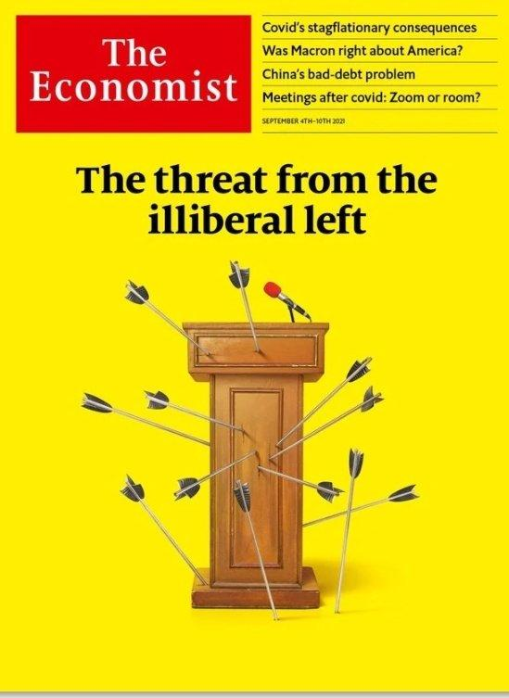
What is ‘cancel culture’?
It refers to a form of ostracism in which someone is thrust out of social or professional circles – whether it be online, on social media, or in person
It designates a form of censorship exerted by the ‘new puritans’ of the American left (notably on college campuses)
// “political correctness” = the idea of being "politically correct," having the most morally upstanding opinion on complicated subjects and the least offensive language with which to articulate it, gained popularity in the 1990s before people on the outside weaponized it against the community it came from.
1991 President Bush "We find free speech under assault throughout the United States, including on some college campuses, […] The notion of political correctness has ignited controversy across the land."
In a similar way, ‘cancel culture’ became a derogatory term used by Conservative America to disparage their political opponents : left-wingers

Slide 4
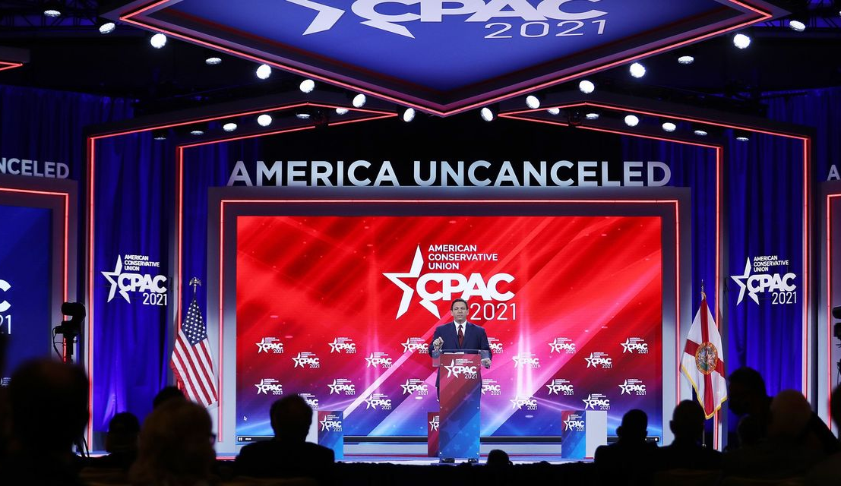
30 years after Bush, the fight against ‘political correctness’ became Donald Trump’s trademark
When Donald Trump ran for president, one of the core pillars of his pitch to the public was : Political correctness is a cancer eating away at the body politic.
“And this political correctness is just absolutely killing us as a country. You can't say anything. Anything you say today, they'll find a reason why it's not good.” (August 2015)
When Trump announced his lawsuit against Facebook, Twitter and Google after being banned from them (Jan 2021): "We're demanding an end to the shadow-banning, a stop to the silencing and a stop to the blacklisting, banishing and canceling that you know so well".

Slide 5
Undoubtedly, the biggest difference between discussions of political correctness in the '90s and cancel culture today is the way social media creates access to both public and private individuals and puts their dialogue on equal footing.
One reason that cancel culture has become such a hot national topic is people in powerful positions are unaccustomed to having to answer to marginalized people who, through social media, have greater access to them than ever.
Social media helped solidify cancel culture, with viral hashtags and campaigns where users would organize to boycott certain people or brands.
Undoubtedly, the biggest difference between discussions of political correctness in the '90s and cancel culture today is the way social media creates access to both public and private individuals and puts their dialogue on equal footing.
One reason that cancel culture has become such a hot national topic is people in powerful positions are unaccustomed to having to answer to marginalized people who, through social media, have greater access to them than ever.
Social media helped solidify cancel culture, with viral hashtags and campaigns where users would organize to boycott certain people or brands.

Slide 6
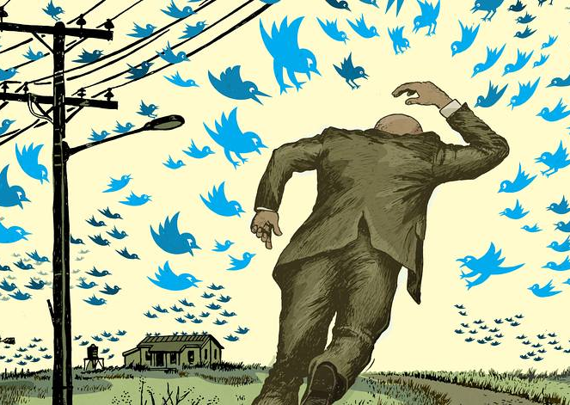
The Internet = empowering ‘the little guy’ or ‘the Twitter mob’?

Slide 7
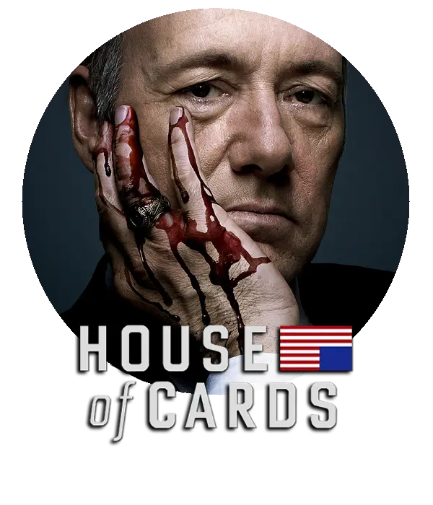
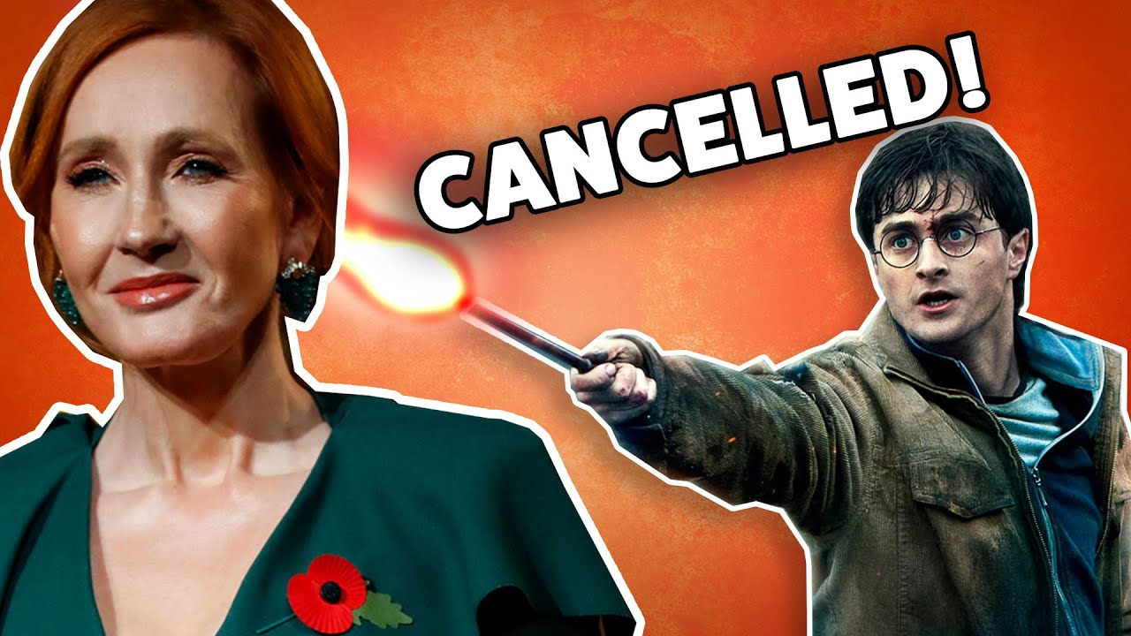
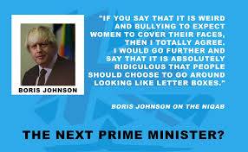
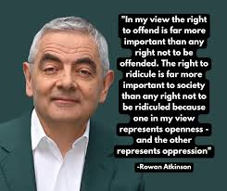
Calling out high-profile personalities online:
true accountability or public shaming?

Slide 8
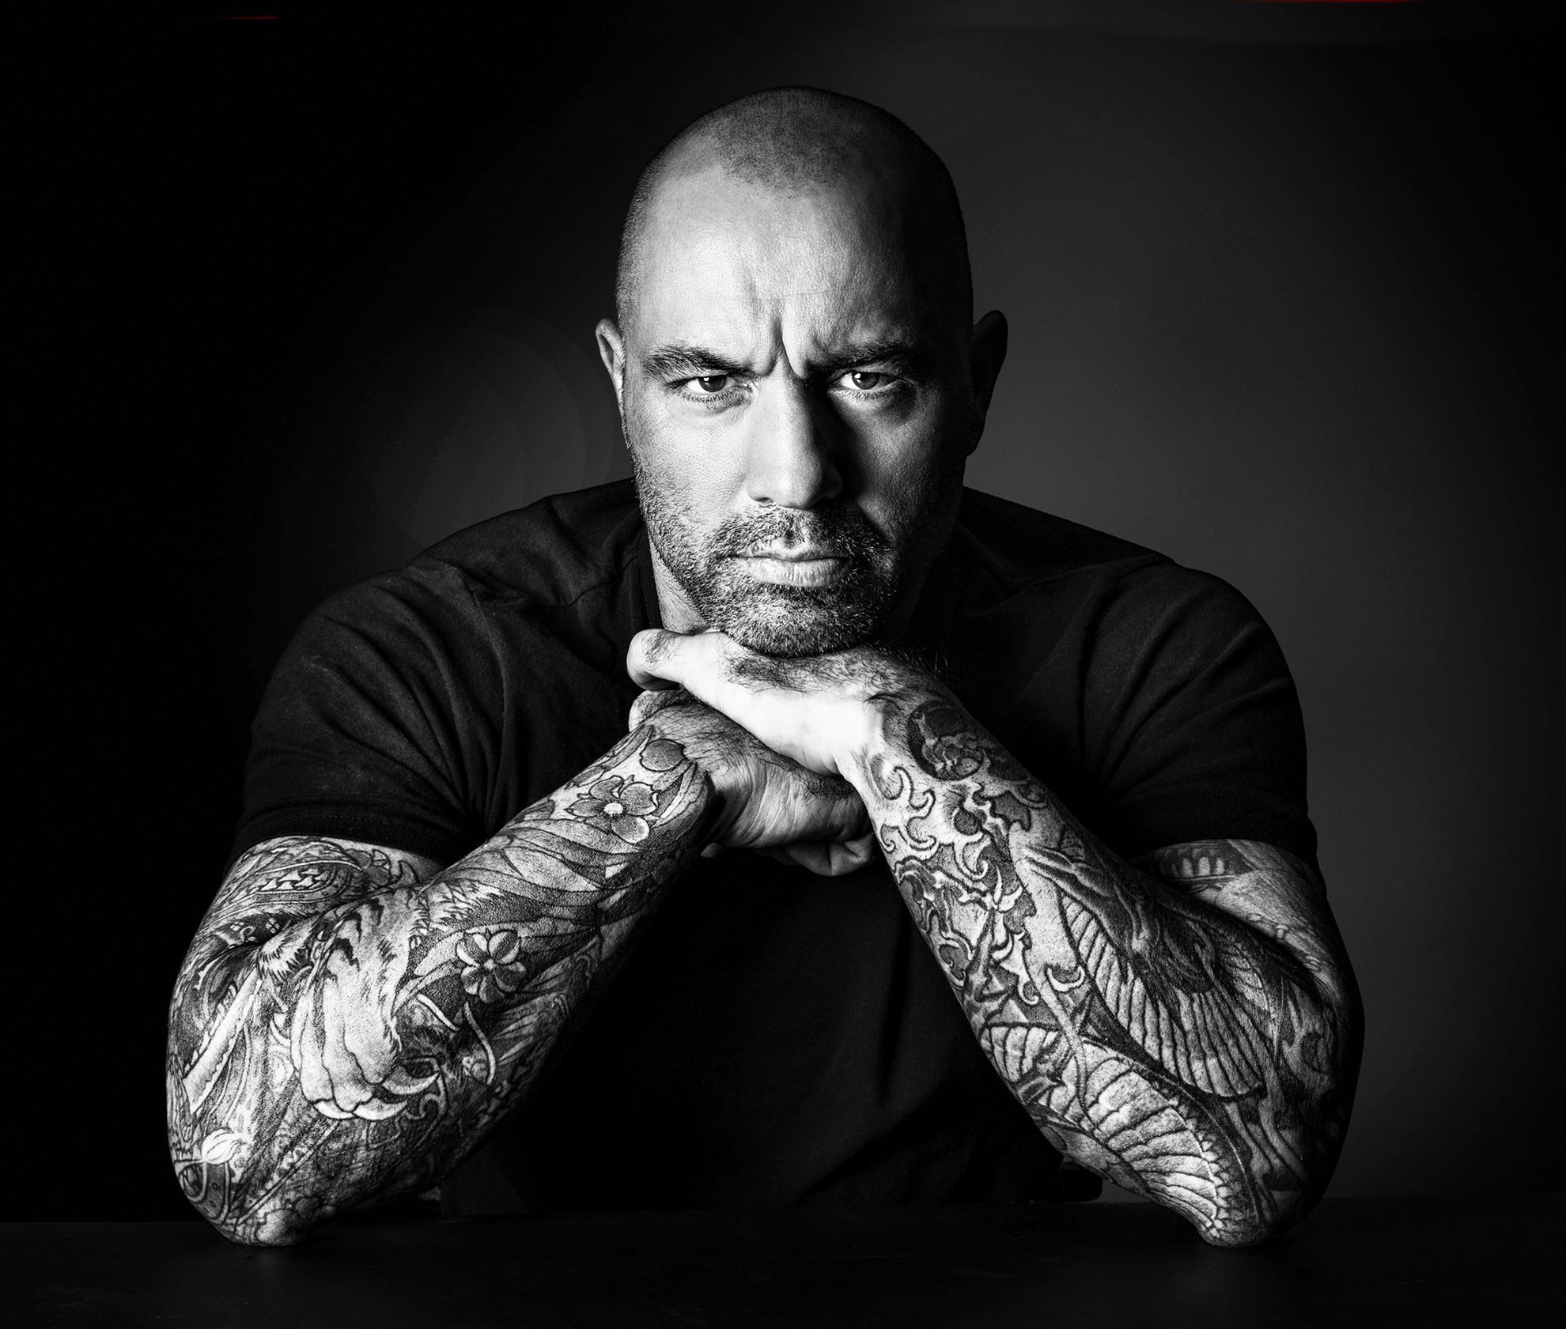
Joe Rogan, a case in point
Mr. Rogan, 53, is a comic, podcaster and one of the most consumed media products on the planet — with the power to shape tastes, politics, medical decisions
The show was licensed to Spotify in an estimated $100 million deal in 2020. 11 million people routinely listen to the show.
He suggested in the spring 2021 that young healthy people need not get vaccinated against the coronavirus — before later stressing that he is “not an anti-vaxxer” and shouldn’t be considered a medical authority
His comments drew condemnations from the Biden administration, Prince Harry, and Neil Young who asked the platform to remove Joe Rogan’s podcasts.

Slide 9
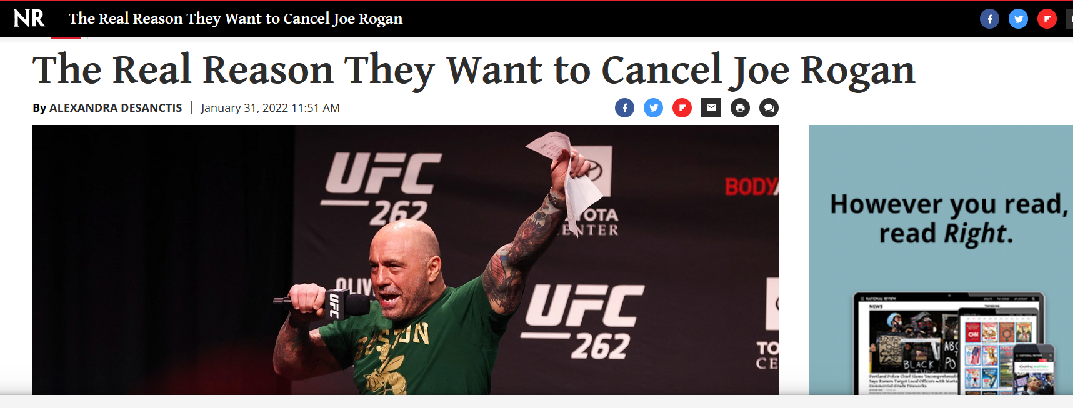

Slide 10
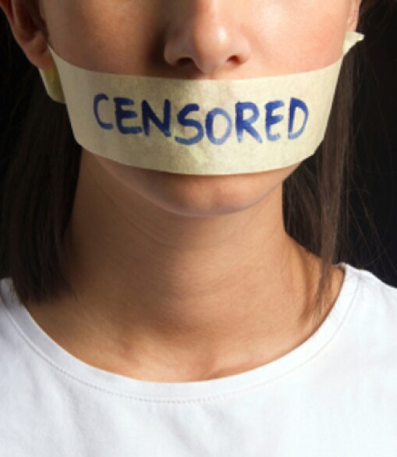
Who is cancelling who?
Acdg to conservative America, a new ‘woke generation’ is trying to cancel them
Feminists / LGBTQ activists
Black Lives Matter activists
Liberals in general
= equality advocates / new generations threatening conservative people’s value system
Is anyone cancelling anyone?
A PERCEIVED SENSE OF CENSORSHIP according to progressive America

Slide 11
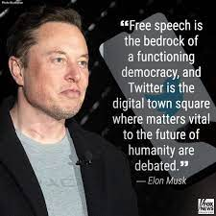
Elon Musk, a self-described ‘free speech absolutist’

Slide 12
Cultural reminder FREE SPEECH
In the USA, free speech is protected by the first amendment to the constitution.
Contrary to Europe, this includes hate speech to a certain degree : people may express hateful views in public unless it is intended, and likely, to cause imminent and serious injury.
NB: As a private company, Twitter/X is not required to follow the First Amendment, which applies only to federal and state governments.
Yet until recently = most social media platforms moderated public discourse more tightly than states.
WHY? business model = “enrage to engage”
Inflammatory posts based on passion travel further and faster than arguments based on reason. Because of this = some critics are suggesting that America’s free-speech tradition should be reconsidered.

Slide 13
WEB FREEDOM v ACCOUNTABILITY
Section 230 of the Communications Decency Act (1996 federal law)
“No provider or user of an interactive computer service shall be treated as the publisher or speaker of any information provided by another information content provider.”
That means that social media platforms cannot be held legally responsible for the comments that their users post online.
(Arguably, this does not motivate social media tycoons to crack down on hate speech / minsinformation)

Slide 14
What people can and can’t say online — and the role of Big Tech in making those calls =
a critical fault line in American politics.
The left cries for content moderation to tamp down disinformation, racism and misogyny. | The right cries censorship and demands the right to free speech.

Slide 15
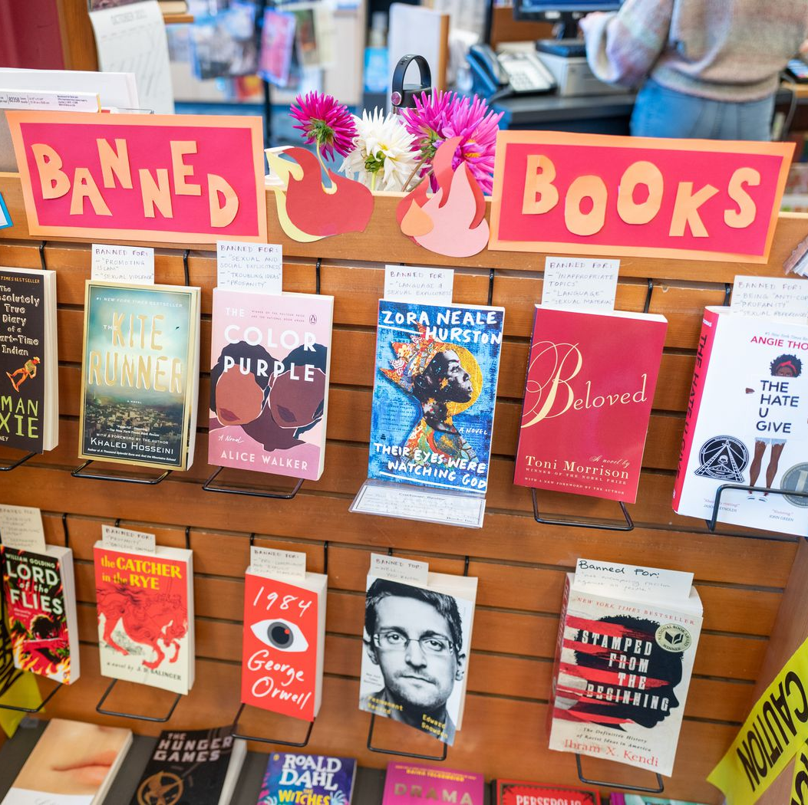
The irony?
A conservative-driven school book banning movement is heating up across the country
sweeping pieces of legislation are being introduced by the GOP to ban whole categories of books addressing sex, sexual preferences, sexual identity, gender identity, racial identity or ban certain topics from school curricula (Florida’s recent Don’t say gay bill which forbids instruction on sexual orientation and gender identity from kindergarten through third grade)

Slide 16
https://www.youtube.com/watch?v=OPKmS-JHvIY
Follow-up reading: https://www.theguardian.com/us-news/2025/feb/24/trump-book-bans-school-libraries

Slide 17
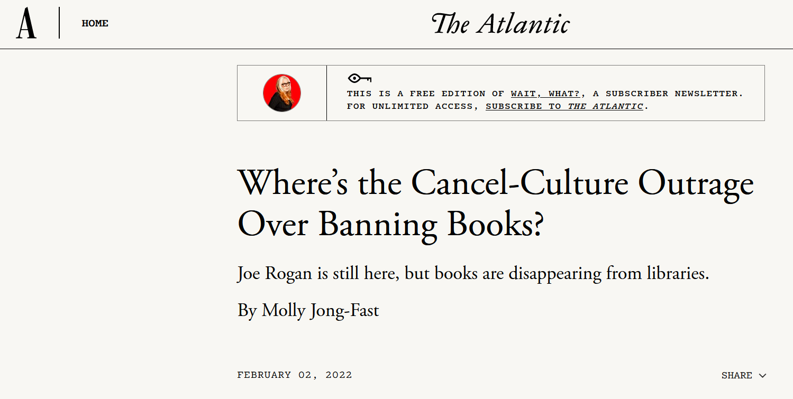

Slide 18
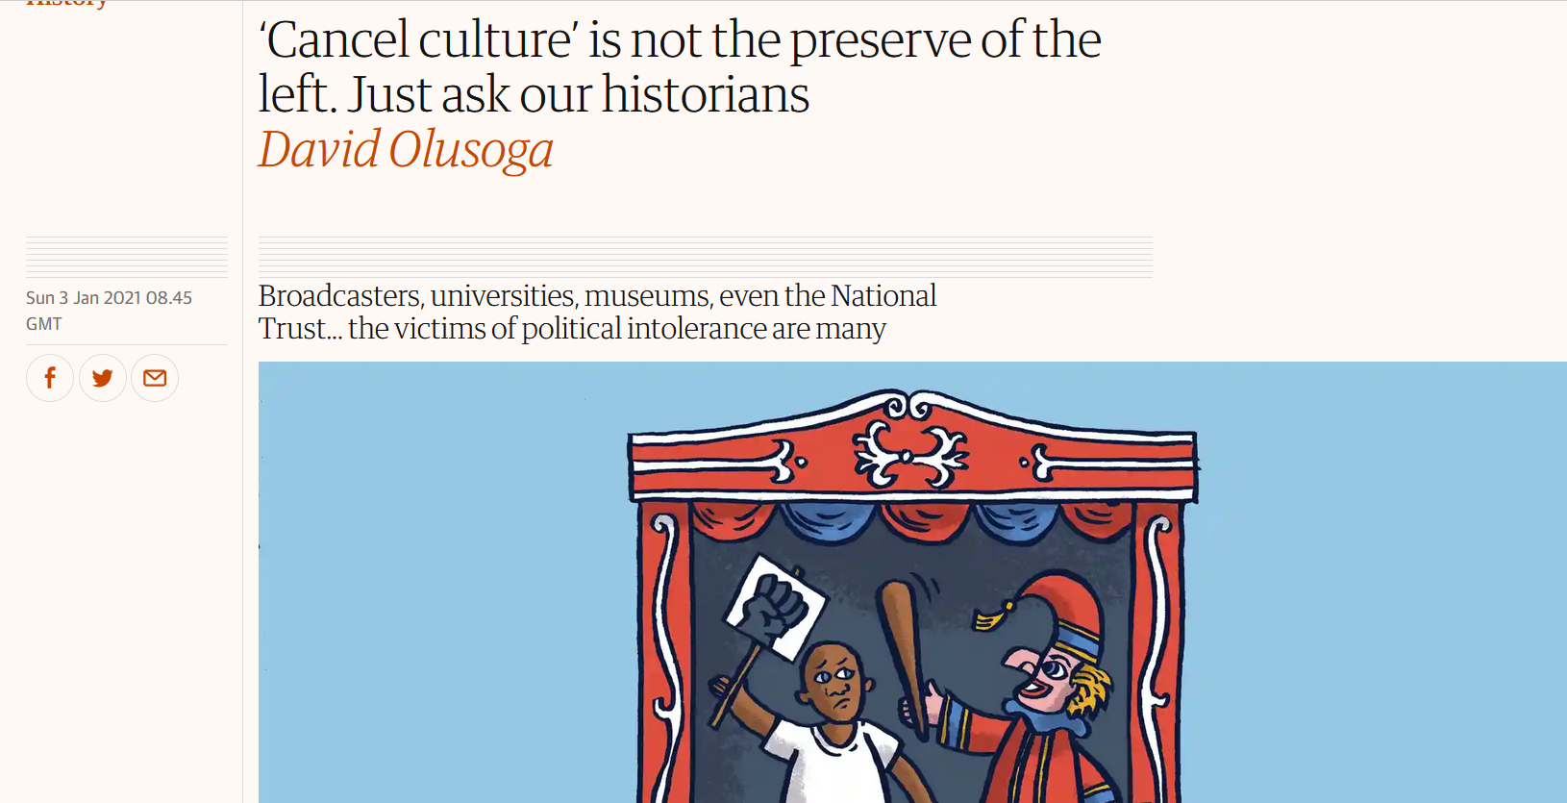
According to the left-wing (here the Guardian), political intolerance is not the preserve of the left

Slide 19
Critical Race Theory: touching a nerve
the most recent slew of conservative book bans is responding to a real change in the way American history is taught. That change was most famously codified by The 1619 Project, a New York Times essay series spearheaded by Nikole Hannah-Jones that reframes the American story as one beginning in 1619, when the first slave ships came to America. And this new narrative challenges a heroic narrative of liberty and freedom.
PBS 15min documentary https://www.youtube.com/watch?v=Q14BTdS6BRc

Slide 20
Follow-up: Trump rewriting history (March 2025)
https://www.youtube.com/watch?v=TesxayiTvqs

