Slide 1
Do you believe the USA
still stands as a
champion of democracy
today?
Write 10 keywords / key notions you think are central to this issue

Slide 2
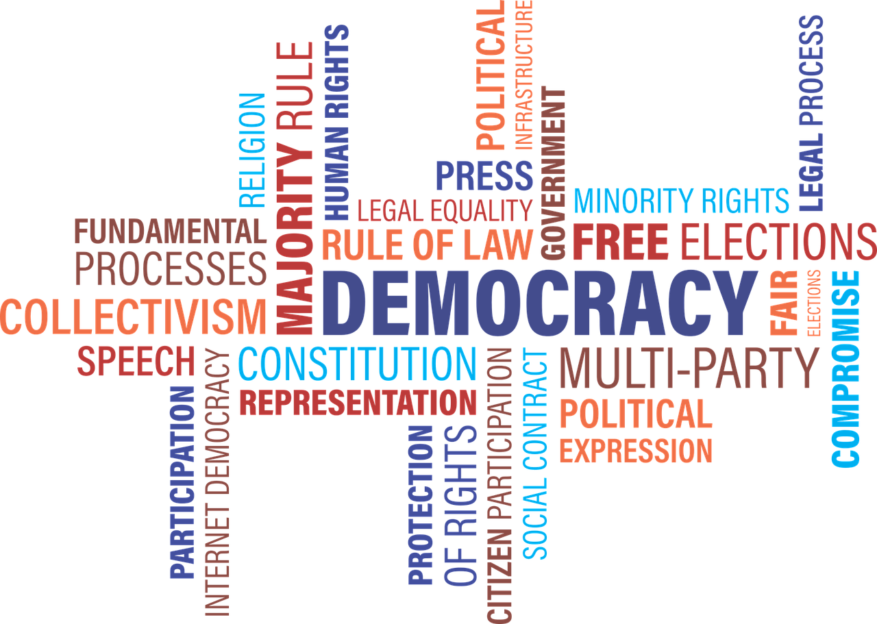

Slide 3
I. Democracy, a definition and some key notions
DEFINITION = a system of government by the WHOLE population typically through elected representatives.
Mention representativeness / the history of the electoral system
Mention accountability / who do elected officials answer to?
What are the safeguards/bulwarks against tyrannical abuse of power?
(system of checks and balances)
Mention equality (equal rights / equality of opportunity)
(one person = one vote?)
(Voting Rights Act 1965)

Slide 4
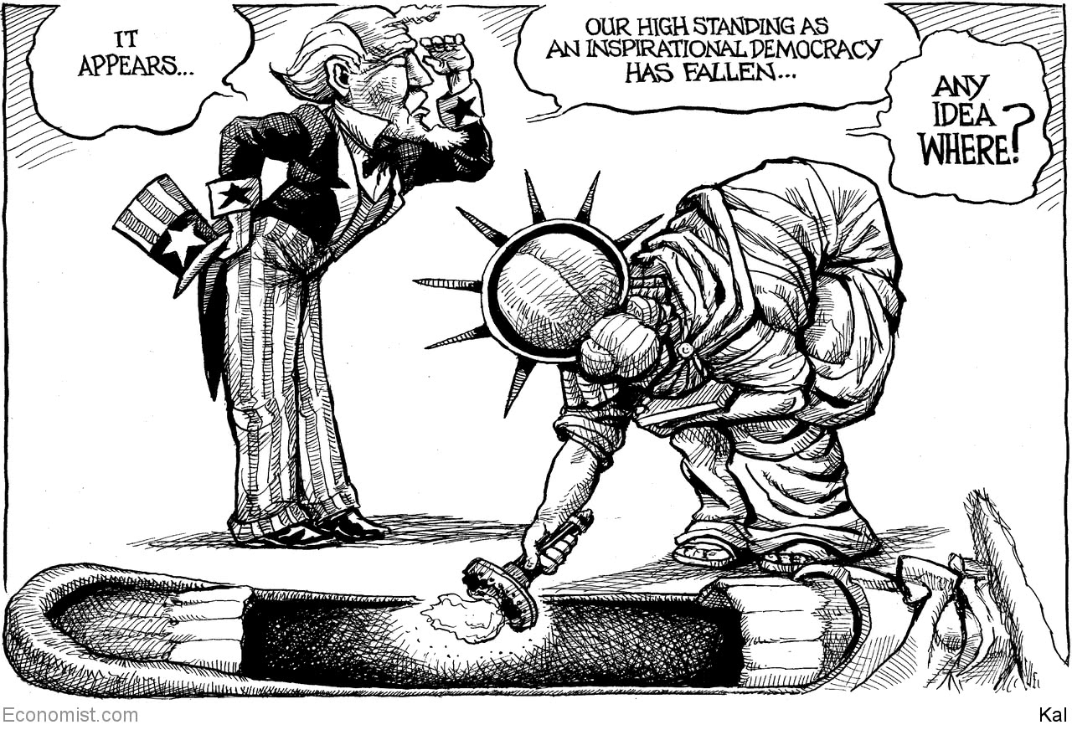
II. THE USA and democracy: a role model ?
October 3rd, 2020 The Economist

Slide 5
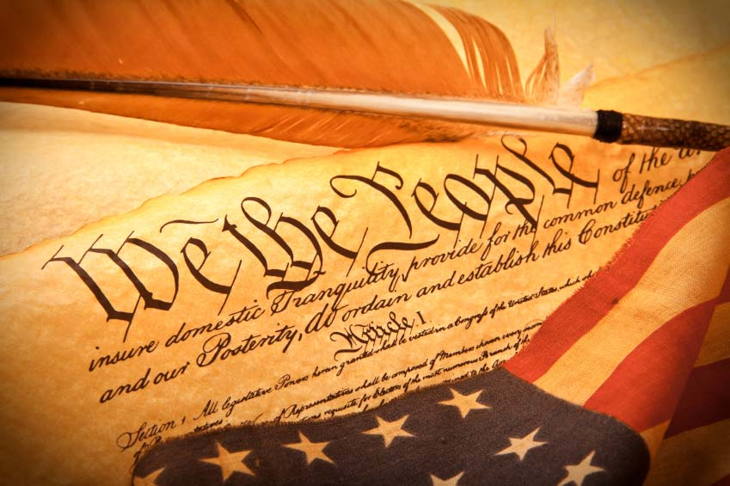
the world’s oldest / greatest constitutional democracy and its key texts
“All men are created equal” (Declaration of Independence)
= equality / rejection of monarchy and inherited privilege
“We, the People of the United States, in Order to form a more
perfect Union, establish Justice, insure domestic Tranquility,
provide for the common defense, promote the general Welfare,
and secure the Blessings of Liberty to ourselves and our Posterity,
do ordain and establish this Constitution for the USA” (Preamble of the Constitution)
= will of the people at the heart of the system
“The dead shall not have died in vain, this nation, under God, shall have a new birth of freedom—and government of the people, by the people, for the people, shall not perish from the earth” (A. Lincoln, Gettysburg Address, 1863)
“Congress shall make no law respecting an establishment of religion, or prohibiting the free exercise thereof; or abridging the freedom of speech, or of the press; or the right of the people peaceably to assemble, and to petition the government for a redress of grievances.” (First Amendment, Bill of Rights)
= firm establishment of freedom of speech in the United States

Slide 6
AS A RESULT =
ADMIRATION FROM AROUND THE WORLD
Especially from French thinkers of The Enlightenment
A few years later : Alexis de Toqueville Democracy in America (1840s)
[in which Tocqueville speaks highly of the U.S. Constitution and the collapse of aristocracy that he observed in the USA but also warns about the risk of ‘tyranny of the majority’]

Slide 7
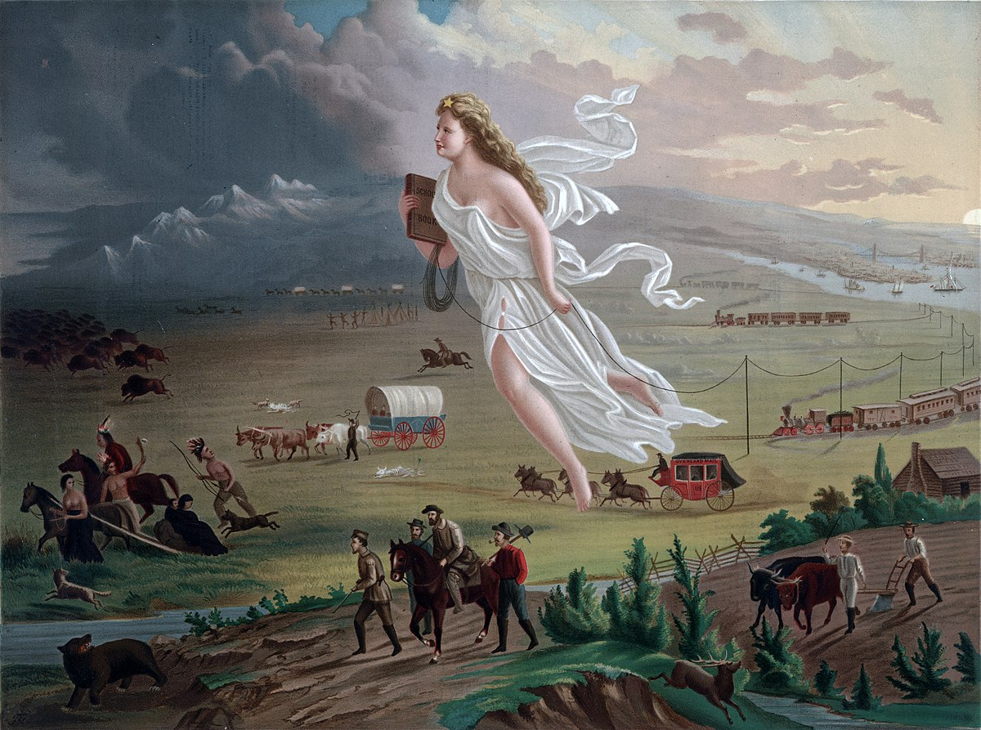
ONE MISSION in the 19th + 20th centuries :
the promotion of democracy around the world
= a founding myth : Manifest Destiny (https://www.youtube.com/watch?v=YLmUhT9QOlE)
American progress
1872 painting by John Gast

Slide 8
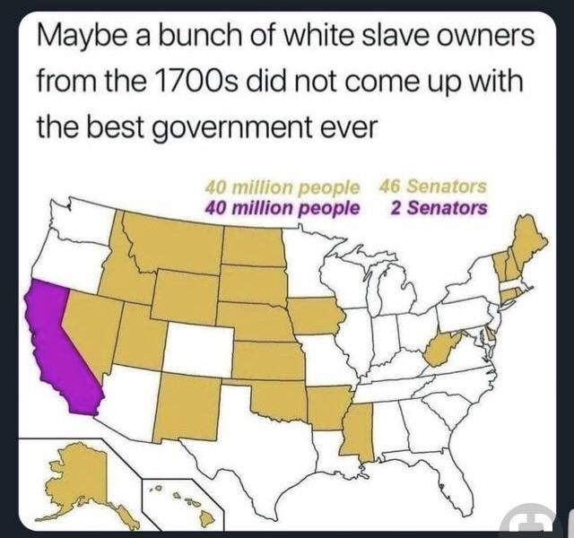
III. Some structural flaws
The undemocratic nature of US institutions
1) The SENATE:
massive over-representation of some (rural, less populous, often conservative) states and under-representation of others

Slide 9
No senator from Puerto Rico or Washington DC (two areas with a large black population)
= the Senate gives the average black American only 75% as much representation as the average white American
and the average Hispanic American 55% as much representation!
« one person = one vote »

Slide 10
21st century : a few numbers testifying to the fact that the Republican party is given a structural advantage by the US electoral system
The GOP = in power 12 years out of 20 despite only winning the popular vote once! (G.W. Bush 2004)
In 2018, despite 9 million more votes in the Midterms, Democrats lost the Senate by 2 seats.
The impact of this hold-up is significant : ex Trump has stacked courts with over 200 conservative judges (105 should have been appointed by Barack Obama but were blocked by Republican Senate majority). These judges are likely to impose their conservative views to a country whose inhabitants will consider out of touch with theirs.

Slide 11
To sum up, now that Amy Coney Barret has been confirmed as the 9th Associate Justice of the Supreme Court, we can say that :
A President (who has lost the popular vote) will have picked
1/4 of the judiciary + 1/3 of the Supreme Court
and his choices will have been rubberstamped by a Republican Senate majority representing 15 million fewer people than the Democratic « minority ».

Slide 12
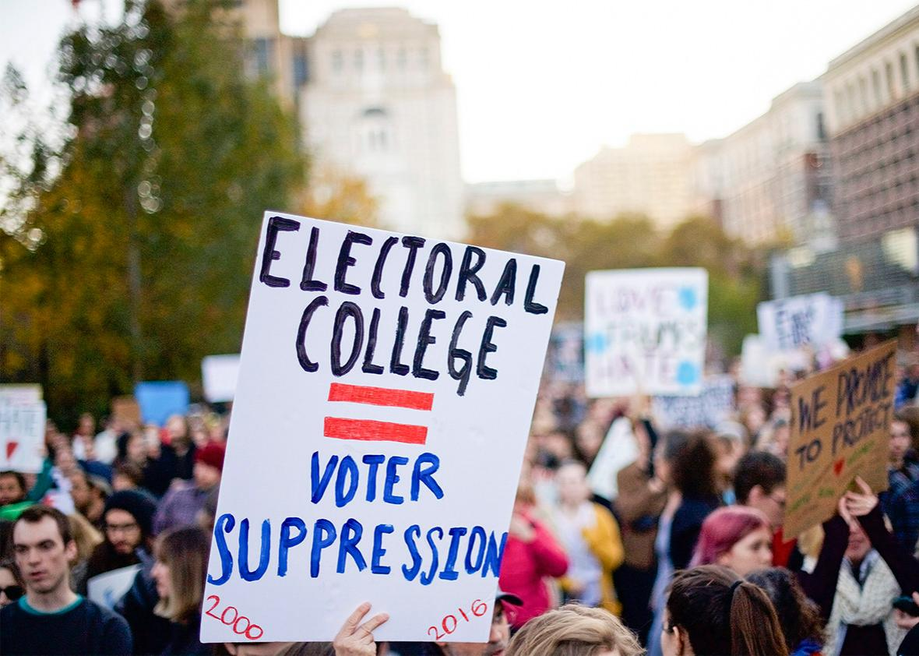
III. 2) THE ELECTORAL COLLEGE

Slide 13
The Electoral College explained:
https://www.youtube.com/watch?v=ajavsMbCapY (1’ to 4’30)

Slide 18
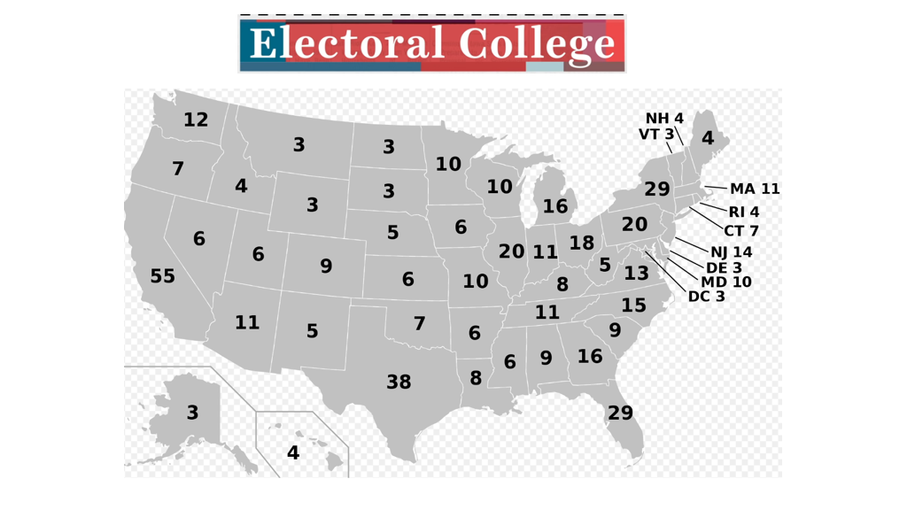

Slide 19
In TX, an Electoral delegate represents three times the amount of people as one in VT. This makes each individual vote in Vermont a lot more influential .

Slide 20
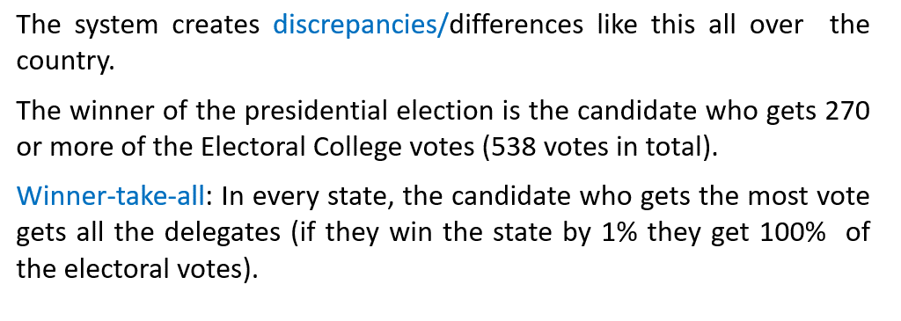

Slide 23
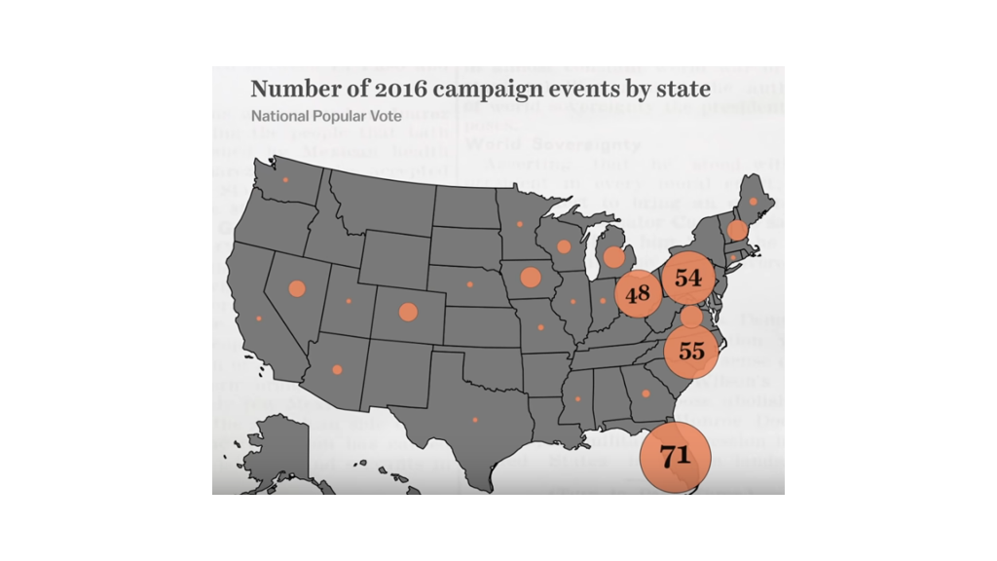

Slide 25
States like New York and North Dakota are valued the exact same way under the current system = NOT AT ALL (they're reliably Republican or Democratic).
The only way to put urban voters on an equal footing with rural voters and rural voters at parity with urban voters is to make every voter in this country politically relevant in presidential elections.
NOBODY should be treated like a second-class citizen.

Slide 26
IV. Some circumstantial flaws
1) related to Trump and his authoritarian impulses
Disregard of system of checks and balances (impeachment = a ‘witch-hunt’, pressure on Attorney General William Barr to commute his friends’ prison sentences…)
Constant disparaging of the media
Intolerance of dissent
Violent quelling of (BLM) protests
Divisive rhetoric (stoking white supremacists’ anger and resentment)
Refusal to pledge to peaceful transfer of power
Raising the specter of voter fraud / fearmongering to cling to power = propaganda
Waging legal battle to restrict of mail-in ballots = voter suppression

Slide 27
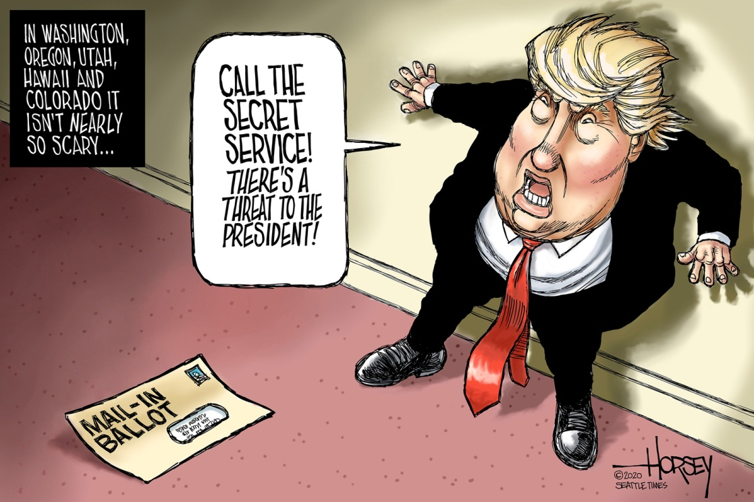

Slide 28
REACTIONS AROUND THE WORLD : the DEMISE of US democracy
“What country are we in?” Joe Biden asked on Sept. 24 (2020) after Trump declined at a press conference to commit himself to a peaceful transfer of power so long as people are allowed to vote via mail-in ballots.
The chaotic, vituperative TV debate left many watching from outside the U.S. aghast. The German newspaper Die Welt called it a “manifestation of how far America has fallen in the Trump era.”
Australia’s Sydney Morning Herald said it painted a vivid portrait “of a democracy and global superpower in deep trouble, and possibly long-term decline.”
China’s Global Times could only gloat at what it said showed a superpower grown unattractive and “in recession.”

Slide 29
2) Contextual flaws unrelated to Trump
a. Rise of fake news and disinformation : undermining the traditional media’s legitimacy
b. 21st century crises and political disenchantment = low voter turnouts
(Brexit = « tyranny » of older citizens’ vote?)
NOT in the 2020 US presidential election though : record voter turnout of 66.9 per cent (the highest turnout rate since 1900)
c. Voter suppression: a long-standing tradition in the US
ID laws 36 states have identification requirements at the polls (but 21 million U.S. citizens do not have government-issued photo identification).
- voter purges : states often conduct purges from the registration rolls but some do so using inaccurate data (ex: in 2016, Arkansas purged thousands of voters for so-called felony convictions, even though many of the voters had never been convicted at all)
felony disenfranchisement laws (5.1 million voting-age US citizens were disenfranchised for the 2020 presidential election)
fewer polling sites

Slide 30
How much do you know about the history of voting rights in the USA?
https://www.youtube.com/watch?v=P9VdyPbbzlI
1789 : universal suffrage? only white male property-owners were allowed to vote (6% of the population!)
1820s-1830s : ?
1850 : ?
1861 : ?
1892 : ?
1920 : ?
in the 1940s : ?
1965 : ?
1971 : ?

Slide 31
Voting rights
Mandating federal oversight : imposer une surveillance fédérale
1965 Voting Rights Act : sought to end backdoor discrimination practices by mandating federal oversight of electoral processes in jurisdictions with a history of discriminatory voting practices.
2013 : the US Supreme Court decided it was no longer necessary to enforce it, so they gutted it (Shelby County v. Holder), setting the stage for a new era of white hegemony
They gutted it : Ils l’ont supprimé.
« Throwing away your umbrella in a rainstorm because you are not getting wet. » Ruth Bader Ginsburg

Slide 32
Which remedies to fix US democracy?
REFORMS!!!
push for statehood for the District of Columbia and Puerto Rico
abolish the Electoral College
implement the National Popular Vote Interstate Compact
abolish the filibuster
abolish gerrymandering
reform SCOTUS (term limits, nb of Justices)
lower voting age

Slide 33
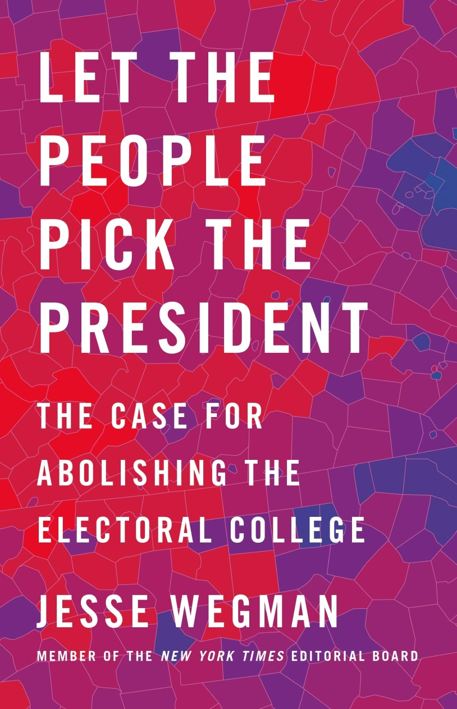

Slide 34
C) implement the National Popular Vote Interstate Compact

Slide 36
C) The filibuster = the weird rule that broke US politics

Slide 37
https://www.vox.com/videos/2019/6/17/18681798/filibuster-senate-broke-video
LISTEN CAREFULLY AND COLLECT AS MUCH INFORMATION AS POSSIBLE ON THE FOLLOWING ELEMENTS:
What is a filibuster?
Where does it take place?
When did it start being used regularly?
How does it undermine democracy?
Concrete example?

Slide 38
What is a filibuster?
A filibuster is a method of delaying or preventing a vote in a legislature.
A minority of 41 Senators can block a vote until the end of the session in order to defeat a bill.
The US Senate requires a supermajority to pass any bill — 60 votes. But technically, it’s not the actual bill that requires 60 votes. It’s the vote to end debate, which is required to get to the vote.
NB: filibustering a key nomination is now impossible.

Slide 39
2. Where does it take place?
It used to take place in the two chambers of Congress but now only exists in the Senate.
(The House of Representatives got rid of it in 1998.)

Slide 40
3. When did it start being used regularly?
In the late 1960s / 1970s
+ the number of filibusters skyrocketted in the 2000s when the two parties realised they can gain more politically by fighting than by cooperating.

Slide 41
4. How does it undermine democracy?
An individual Senator holding the Senate hostage is inherently undemocratic (minority > majority)
Furthermore, bipartisanship is harder to achieve (particularly true since Barack Obama was elected), which blocks the Senate from doing any work / passing any ambitious reform.
As a result, the US government becomes less efficient.

Slide 42
5) A concrete example?
The longest filibuster in US history lasted 24 hours and 18 minutes and was carried out by Southern Senator Strom Thurmond from South Carolina, in protest against the Civil Rights Act of 1957.

Slide 43
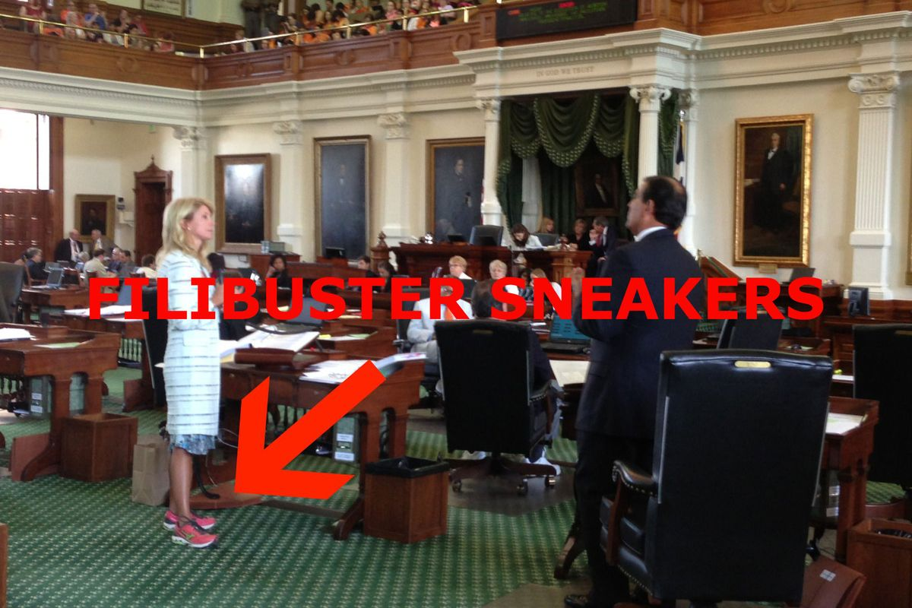
ANOTHER EXAMPLE : Texas state senator Wendy Davis in June 2013
Davis spoke for more than 10 hours against a bill to greatly restrict access to abortions, drawing on her experiences as a teenage single mother. This sparked a debate on the difficulty of predominantly male legislators making laws controlling women’s bodies, and resulted in huge media scrutiny of the bill.

Slide 44
D) What is gerrymandering?
https://www.youtube.com/watch?v=bGLRJ12uqmk
LISTEN CAREFULLY AND COLLECT AS MUCH INFORMATION AS POSSIBLE ON THE FOLLOWING ELEMENTS:
What is gerrymandering?
Who gets to decide how election districts are drawn?
Concrete example?
What’s wrong with this practice?

Slide 45
1) Merriam-Webster DEFINITION :
"to divide (a territorial unit) into election districts to give one political party an electoral majority in a large number of districts while concentrating the voting strength of the opposition in as few districts as possible."

Slide 46
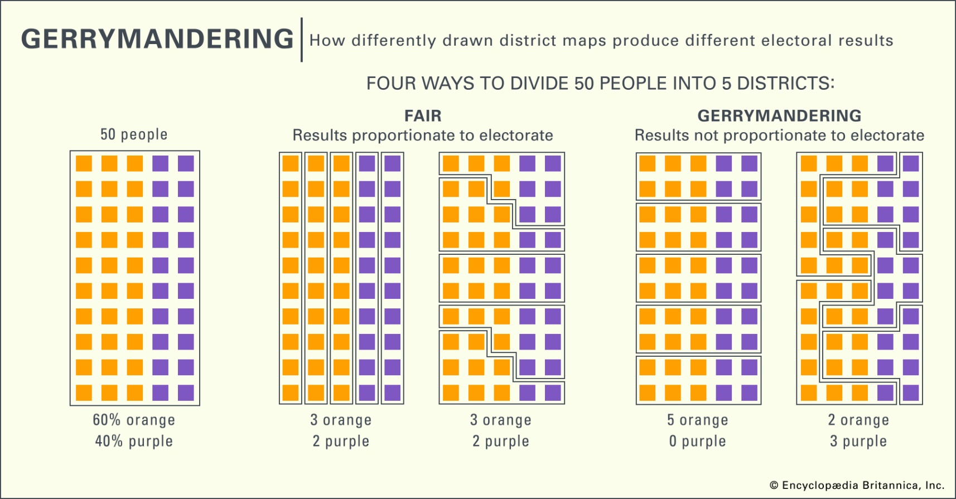
There are tricky ways in which to draw election districts to give advantage to one party over another even if it is NOT proportionate to the electorate

Slide 47
2) Who gets to decide how election districts are drawn?
the state government

Slide 48
3) Concrete example?

Slide 49
4) What’s wrong with this practice?
It is unfair + an easy way for the party in power to steal the election and refuse a key aspect of democracy : plurality / possible change in power.

