Slide 1
The summer in brief
Summer news recap

Slide 2
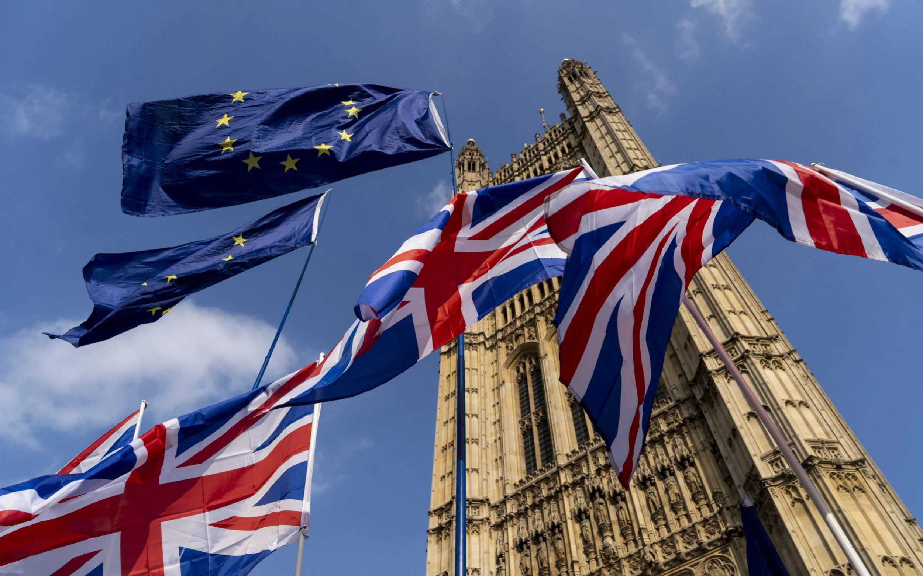
British Politics and the Monarchy

Slide 3
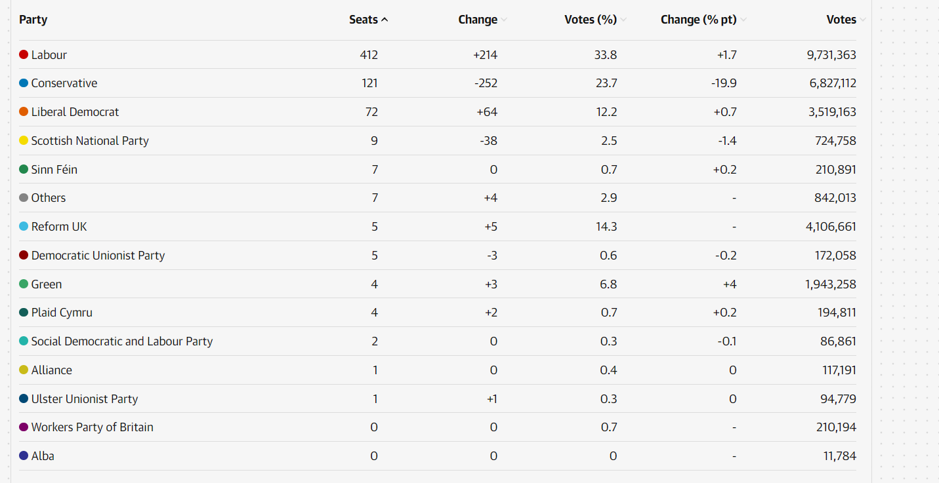
July 4th : General elections : Labour landslide -> Keir Starmer becomes Prime Minister
Problem of first-past-the post system
Record 335 new MPs and record number of women.

Slide 4
July 16th: Welsh 4-month-long First Minister, Vaughan Gething resigned due to controversy over campaign donations

Slide 5
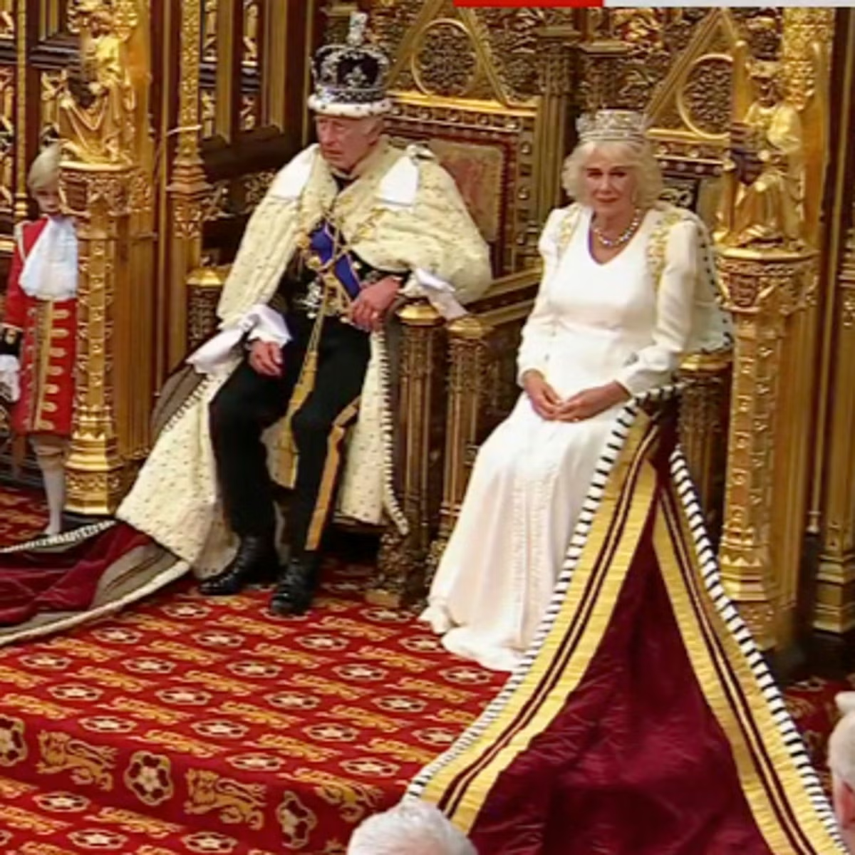
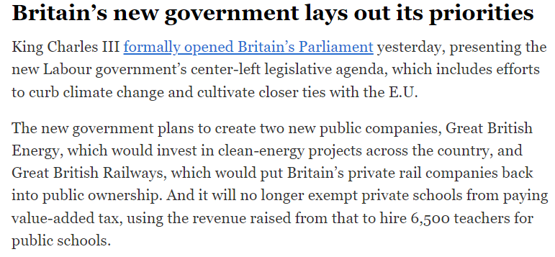
July 17th: The King’s Speech
Outlined Labour’s plans for its new government. Introduced 40 bills, focusing on environmental transition and energy, transport, infrasctructure, housing, English devolution, constitutional reform (House of Lords), immigration, and Tobacco and Vapes bill…

Slide 6
July 14th: Princess Kate attends men’s Wimbledon final

Slide 7
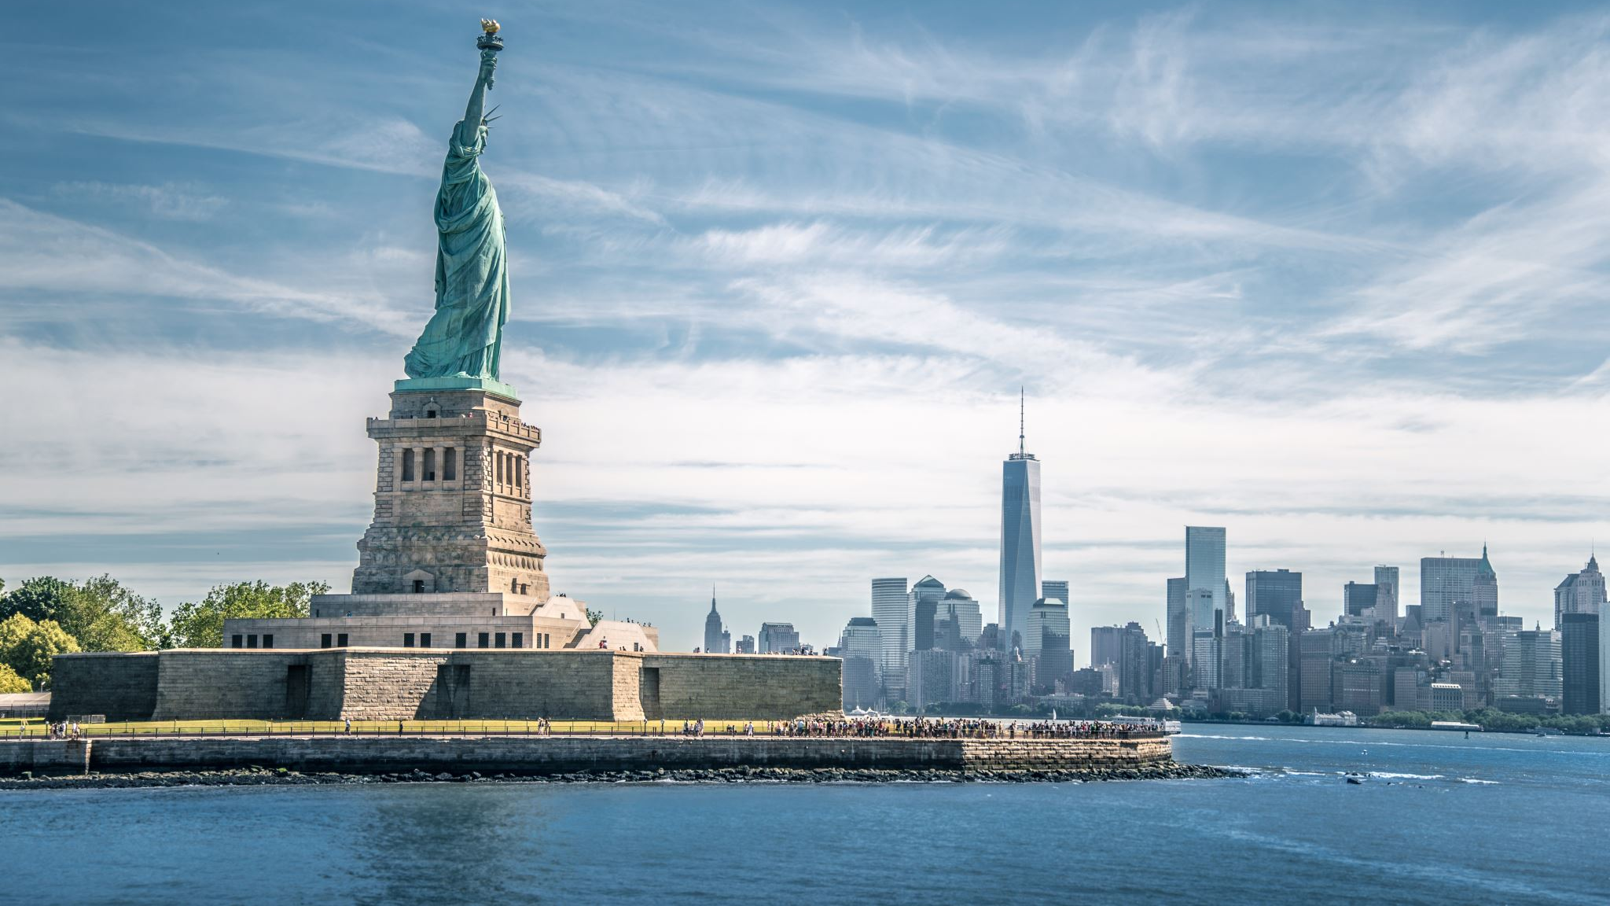
American politics

Slide 8
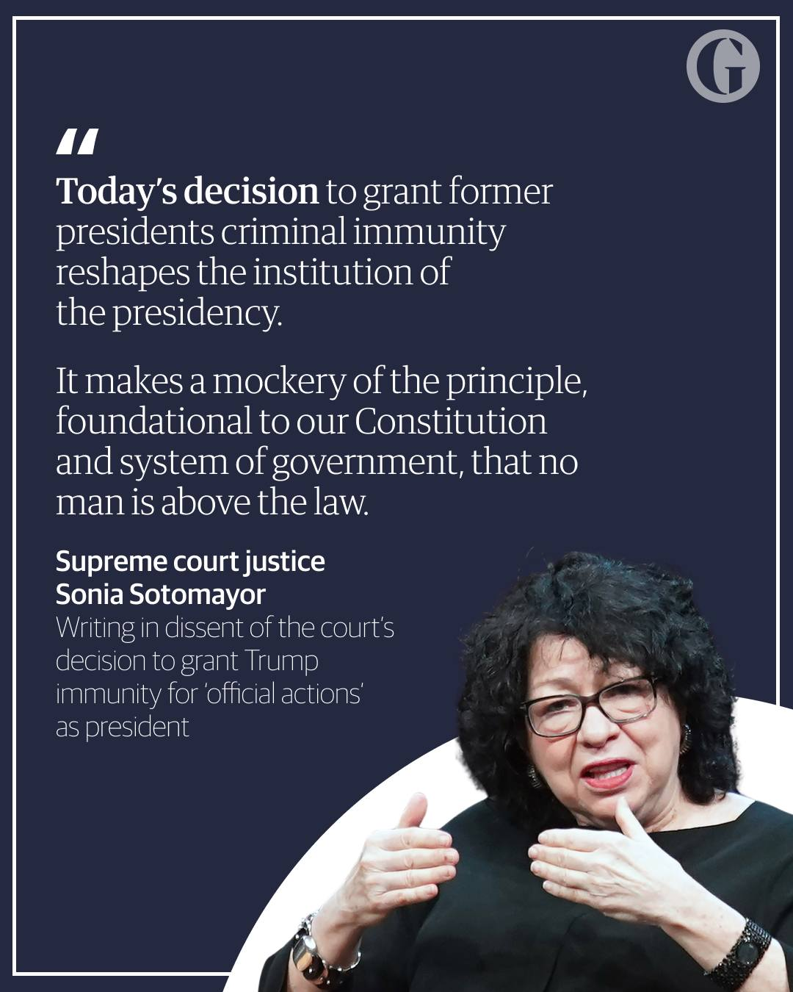
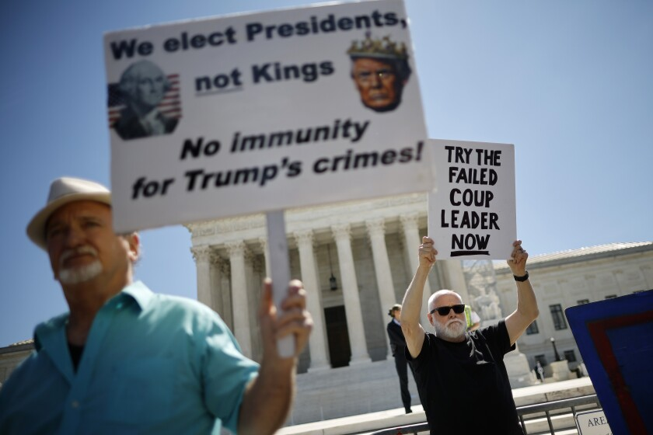
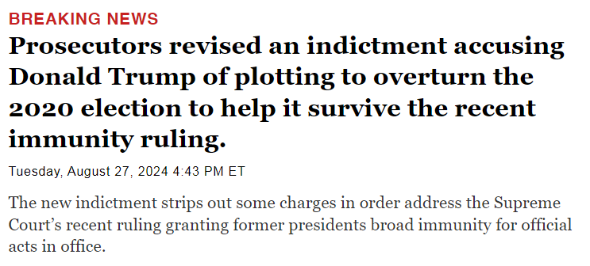
July 1st : Trump’s immunity in Jan 6th case

Slide 9
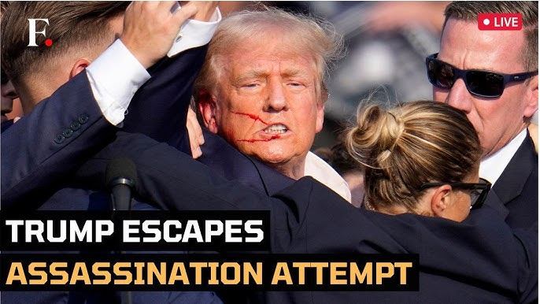
July 13th: Trump’s assassination attempt at rally in Pennsylvania – One dead + shooter

Slide 10
Trump’s classified documents case is dismissed. But links with Supreme Court justice…

Slide 11
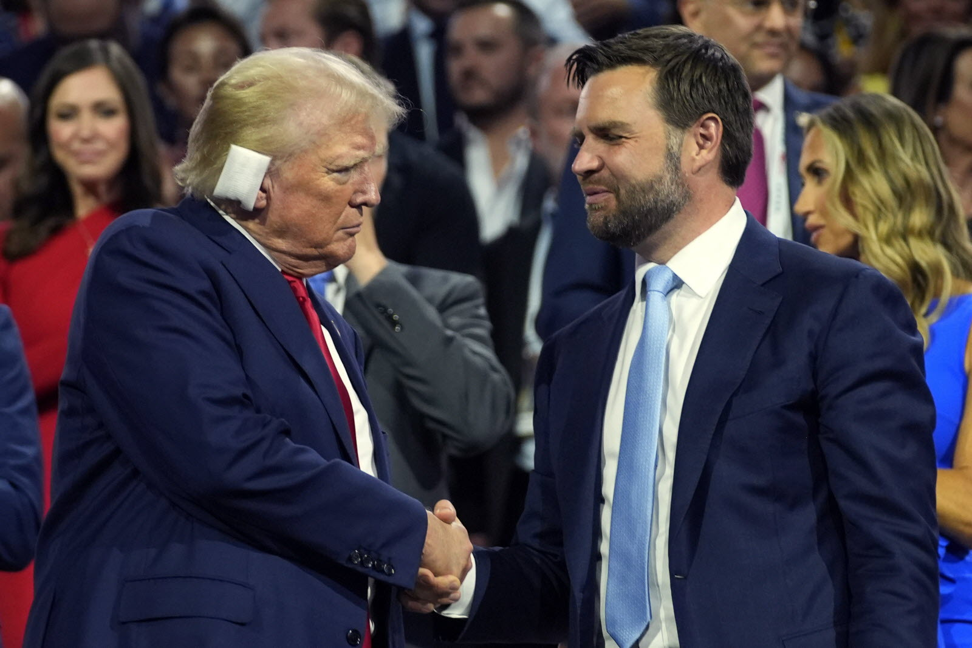
Donald Trump chooses J.D. Vance, a former critic as VP

Slide 12
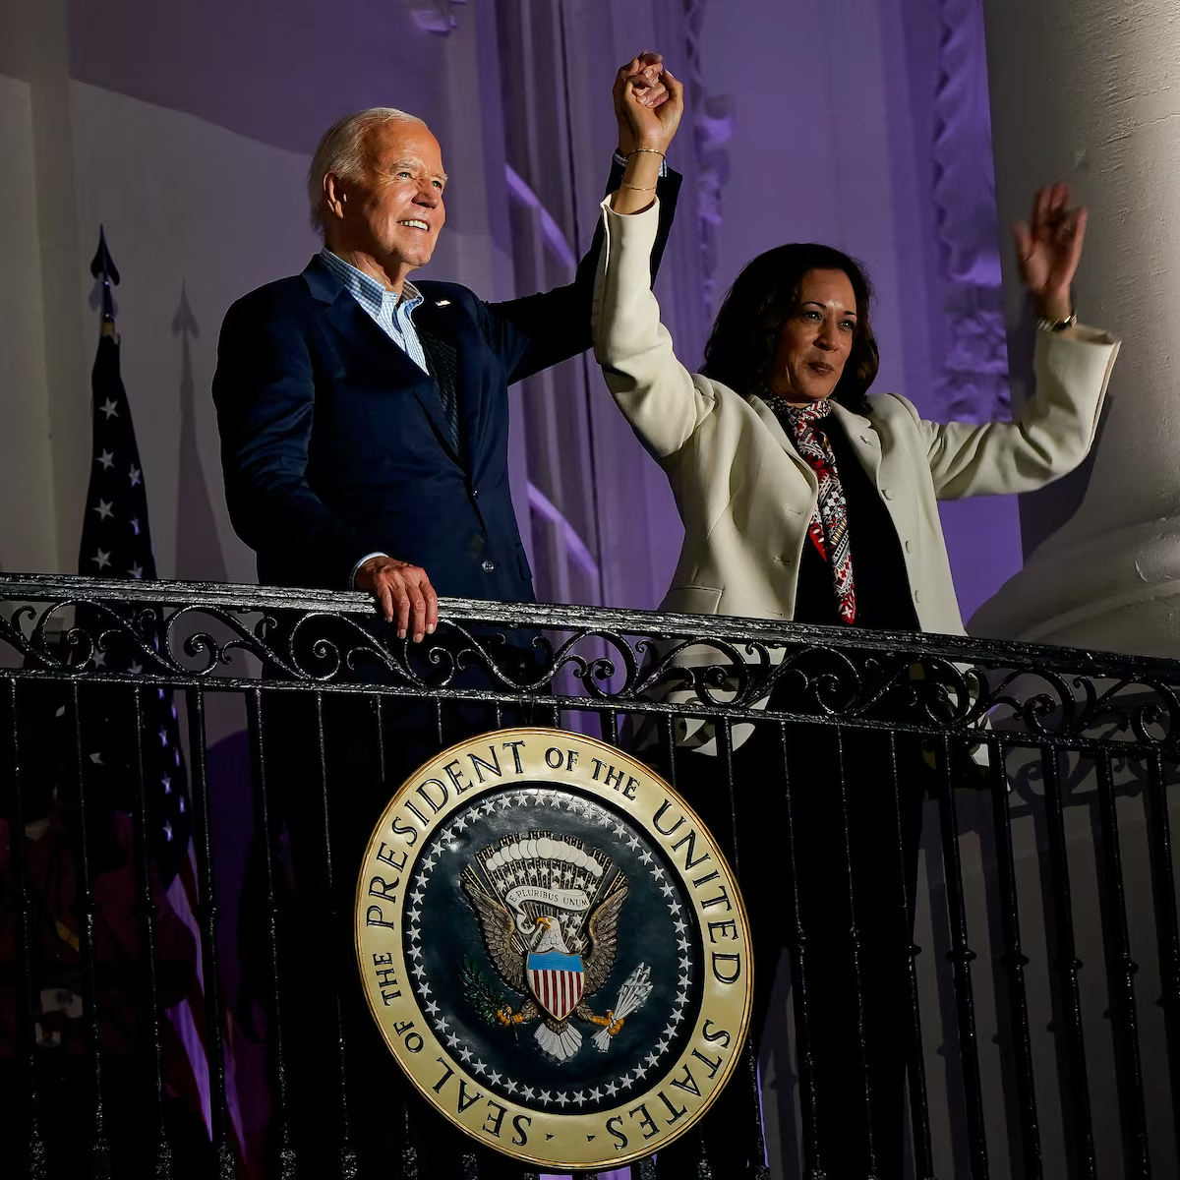
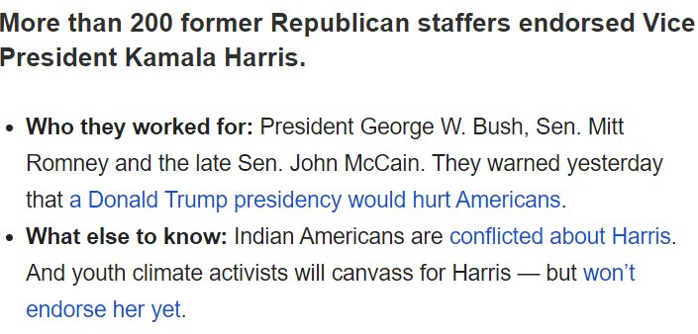
July 21: Biden steps down and endorses Kamala Harris
In the first weeks following Kamala Harris’s candidacy, polls shift in a tighter race. Record funds are raised. Trump attacks her on the fact she does not have children, that she is a woman, and about her race.
On Aug 6, she chose Tim Walz, Governor of Minnesota, as VP (rural roots and liberal policies).

Slide 13
Biden proposes changes to the Supreme Court.

Slide 14
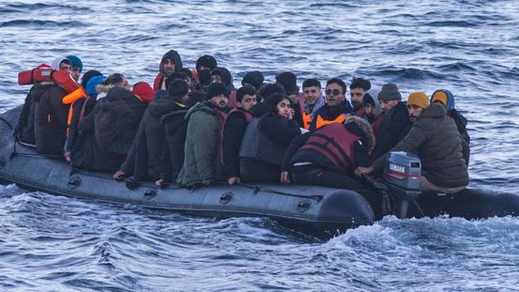
Immigration

Slide 15
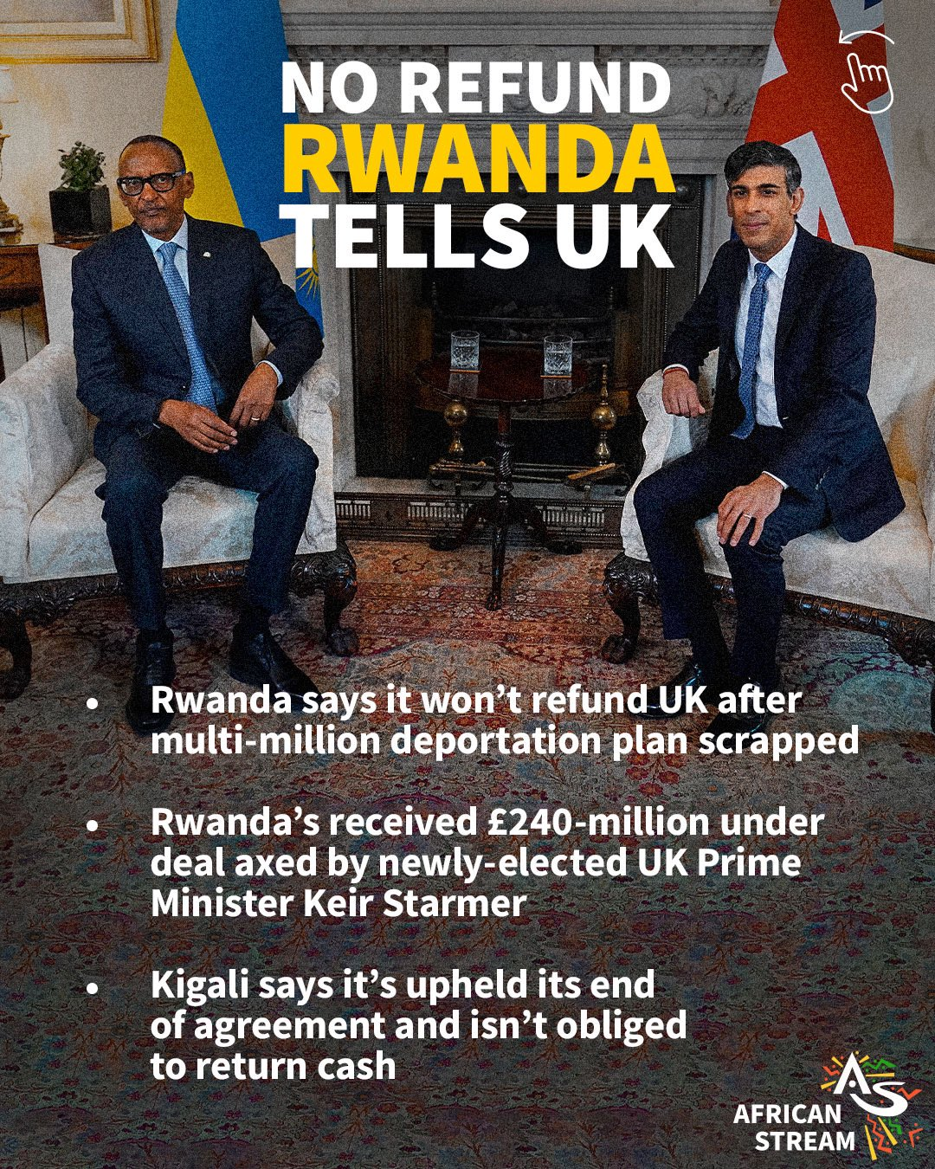
Keir Starmer puts an end to Rwanda deportation plan – Rwanda refuses to refund the UK

Slide 16
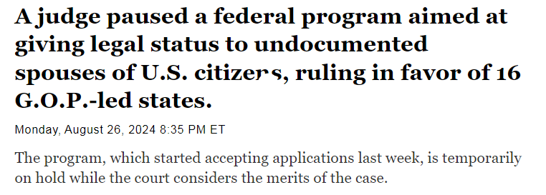
Immigration in the US

Slide 17
Sports

Slide 18
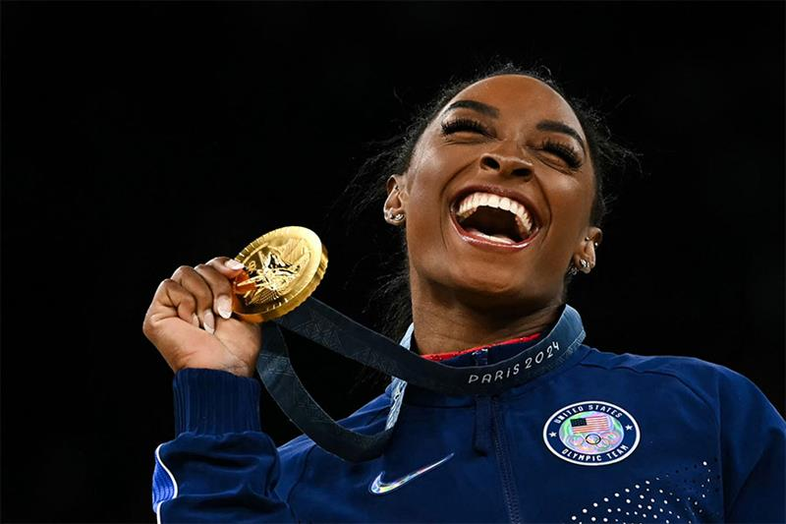
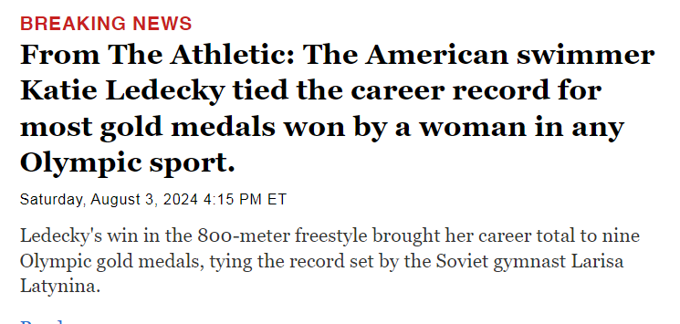
Olympic Games 2024
Simone Biles makes an impressive return, 3 years after she dropped out of the Tokyo Games about mental health issues.

Slide 19
Environment

Slide 20
Heat waves
Early July : heat waves throughout the US: Deaths due to record temperatures
Late July : Park Fire in California.
Wildfires in Greece around Athens.

Slide 21
Violence

Slide 22
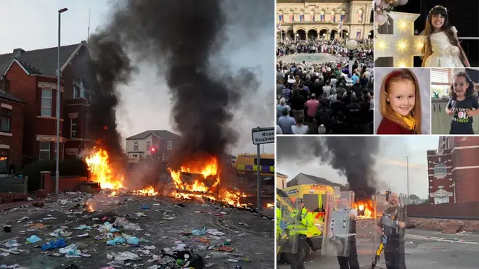
July 29: 3 children killed and others injured in Southport, UK.
At a dance class, a 17-year-old stabbed children, killing 3 and injuring 10 others.
Following misinformation as to the killer, anti-immigrant riots led by far-right activists erupted and spread throughout the country (attacks on mosques, asylum-seeker hotels…)

Slide 23
Space

Slide 24
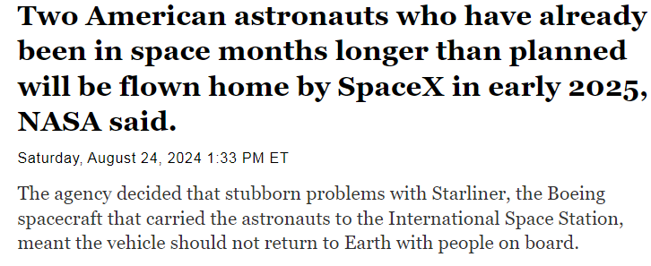
July 9th: Ariane 6 launched successfully

Slide 25
Miscellaneous

Slide 26
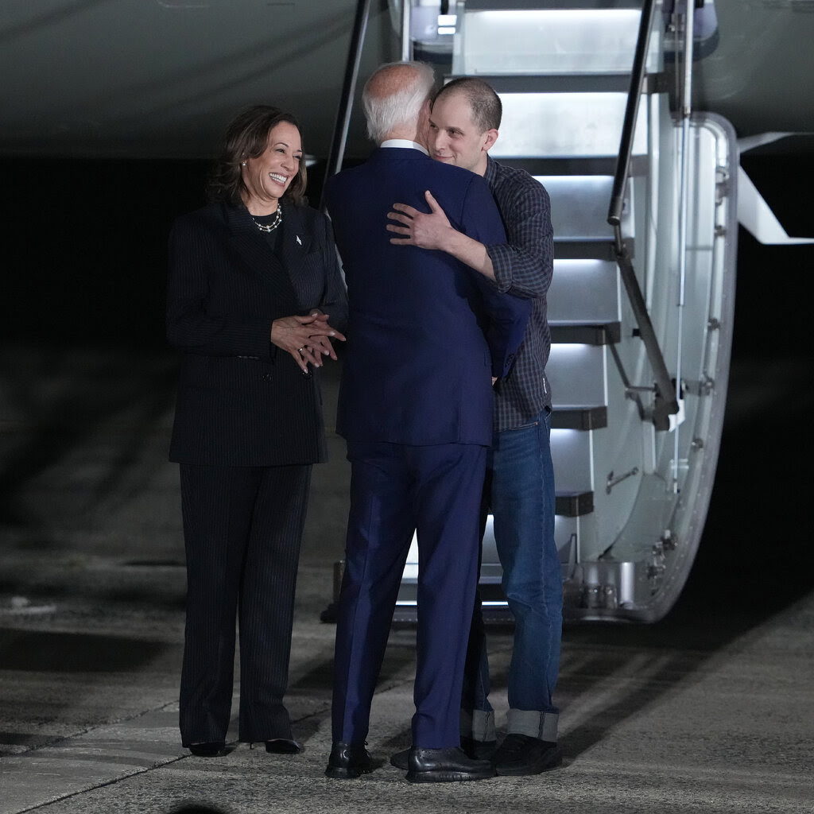
Major prisoner swap between the US and Russia
On August 2, prisoners were swapped, in a first since the Cold War. In exchange for 8 Russians imprisoned in the US and Europe, Russia released 16 prisoners, including reporters.

Slide 27
It’s up to you now!
Every week, you need to keep up with the news.
Two of your classmates will focus on an important event in the English-speaking world on Mondays but you should also stay informed as regularly as possible.
Why? Because, at the concours, you are expected to know about what happens in the English-speaking countries and you will need examples, either for your essays or oral examinations.
How?
1) every week, complete your « livret de colles » with the pieces of news given each week by your classmates.
2) all year long, prepare some fiches about the most recurrent themes in the concours (cf next slide)

Slide 28
Racism and violence against African Americans (what is systemic racism? redlining? calls for reparations?)
Gender equality (pay gap, #metoo, abortion in the US, female political leadership, women in sports)
Biden’s presidency (foreign policy vs Russia or China, domestic policy: Inflation Reduction Act, CHIPS act) vs the lasting influence of Trumpism on American politics (ongoing support from MAGA mvt despite lawsuits, Freedom Caucus, …)
Immigration (the politicization of the border in the US, the Rwanda plan in the UK, multiculturalism in the UK)
Gun control (what still hinders it today? what is vigilantism? what is Gavin Newsom’s 28th amendment about?)
Healthcare systems (the NHS crisis, the opioid crisis, Medicare-for-all)
The rise of (Scottish, Irish, but also English) nationalism in the UK (a disUnited Kingdom? victory of Sinn Fein in Northern Ireland but decline of SNP in Scotland, the death of the queen = the end of a common British identity?)
British monarchy: a fragilized institution? (a nation in mourning, an institution mired in scandals, can Charles III save the day?)
Environmental concerns (COP 29, radicalization of environmental activism, rise of veganism among the young, lab meat, fast fashion…)
The world of work and business (telecommuting: here to stay? the gig economy, the 4-day week v the hustle culture, the revival of trade unionism)
Higher education (student debt relief, affirmative action, precariousness, food banks, mental health issues)
Globalisation (post-COVID19 world = supply chains crisis, de-globalisation of trade, protectionism)
The media, social media (the “4th estate”, Facebook/Cambridge Analytica, section 230, Elon Musk/Twitter, free speech vs cancel culture, Rupert Murdoch, Tiktok ban)
New technology (Artificial Intelligence, facial recognition, drones, transhumanism…)
The recognition of Indigenous rights (Australia, New Zealand, The United States, Canada…)
Religion and politics (Christian nationalism in the USA, religious teachings in US schools)

