Slide 1
Canada

Slide 2
What we will talk about
I) History of Canada
II) Justin Trudeau
III) US / Canada relations (Pré et Post Trump 2024)

Slide 3
History
-1534: Jacques Cartier arrived to Quebec
-1759 : war lost by France against UK. Canada became a British colony
-1931: Full independence (Statute of Westminster)

Slide 4
Political system
-Constitutional Monarchy
-First minister is elected for 4 years.
-Federal state (10 provinces (equivalent of a state in the USA) and 3 Territories)
-Territories are less autonomous than provinces and more wild.

Slide 5
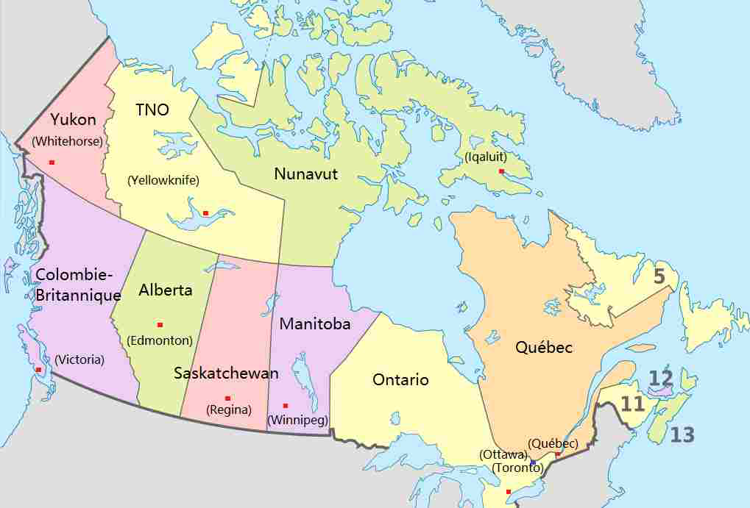
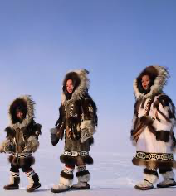
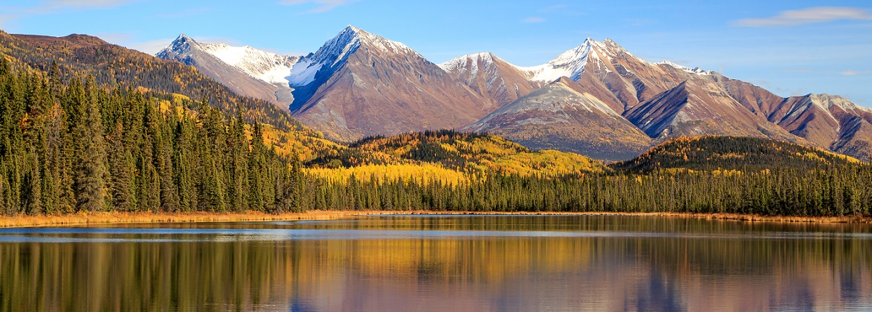

Slide 6
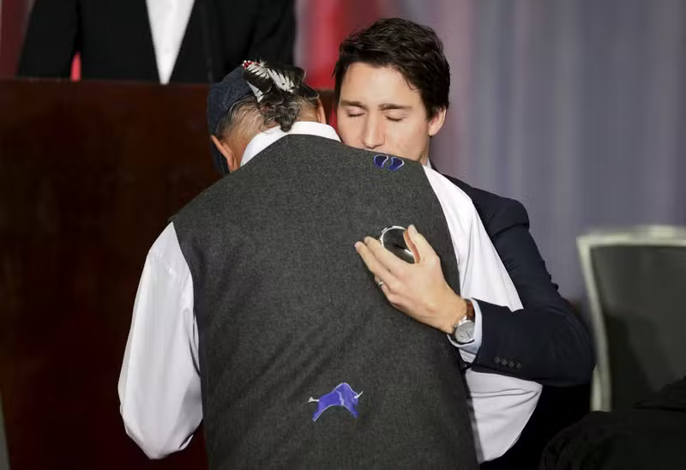

Slide 7
Some facts
-Multicultural country (French English official languages / 20 % of the population is foreign-born.)
-Importance of immigration (Almost 100% of Canada’s labor force growth / 75% of Canada’s population growth and helps “regenerating” the population. 430 000 immigrants in 2022)
-Strong economy (Ressources / oil sands/ / 70% of the world's maple syrup production)

Slide 8
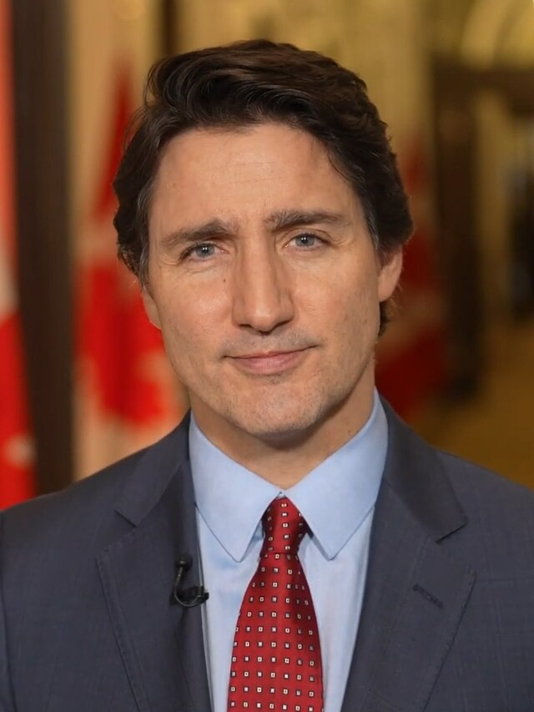
The current PM Justin Trudeau
Prime Minister since 2015, led the Liberal Party to a majority government.
Main priorities: Climate action, job creation, affordability, community safety, Indigenous reconciliation.
Economic situation: Post-pandemic recovery, job growth, but high inflation impacting affordability.
Social progress: Poverty reduction (-56%), lower income inequality, reduced youth unemployment.
Immigration: Major driver of economic growth, key to addressing labor shortages.
Challenges: Housing crisis, rising costs, healthcare shortages, high medication prices.

Slide 9
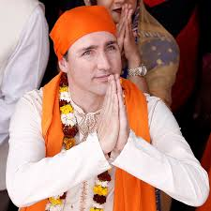
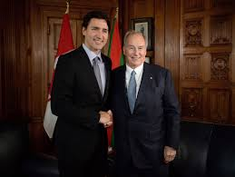
Trudeau’s controversies

Slide 10
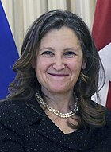
2024-25 Canadian political crisis
Deputy Prime Minister (2019), First Female Finance Minister (2020)
Trudeau’s close ally, played a key role in economic policy, COVID-19 response, and U.S. trade negotiations
Tensions in 2024: Rising inflation, cost-of-living crisis, and declining public confidence in the Liberals
Freeland opposed Trudeau’s $250 checks to workers, calling them a "costly political gimmick"
Warned of a potential trade war with Trump, who threatened 25% tariffs on Canadian exports
Resigned on December 16, 2024, after Trudeau removed her as Finance Minister
Her departure weakened Trudeau, came just before the fall economic statement revealing a $61.9B deficit
Polls showed 67% of Canadians wanted Trudeau to resign; Liberal support fell to 20%
Trudeau announced his resignation on January 6, 2025, citing internal divisions
Chrystia Freeland

Slide 11
US / CANADA Relation
Always had close ties (to have a close tie = avoir un lien étroit / rapport d’égalité / être proche de.. )
-geographic proximity
-cultural proximity
-a lot of trade trade through NAFTA (a free trade zone with Mexico)
-Canada is the United States' leading partner and vice versa
-Canada sells water and oil to the USA
-good relations

Slide 12
BUT in 2024 …

Slide 13
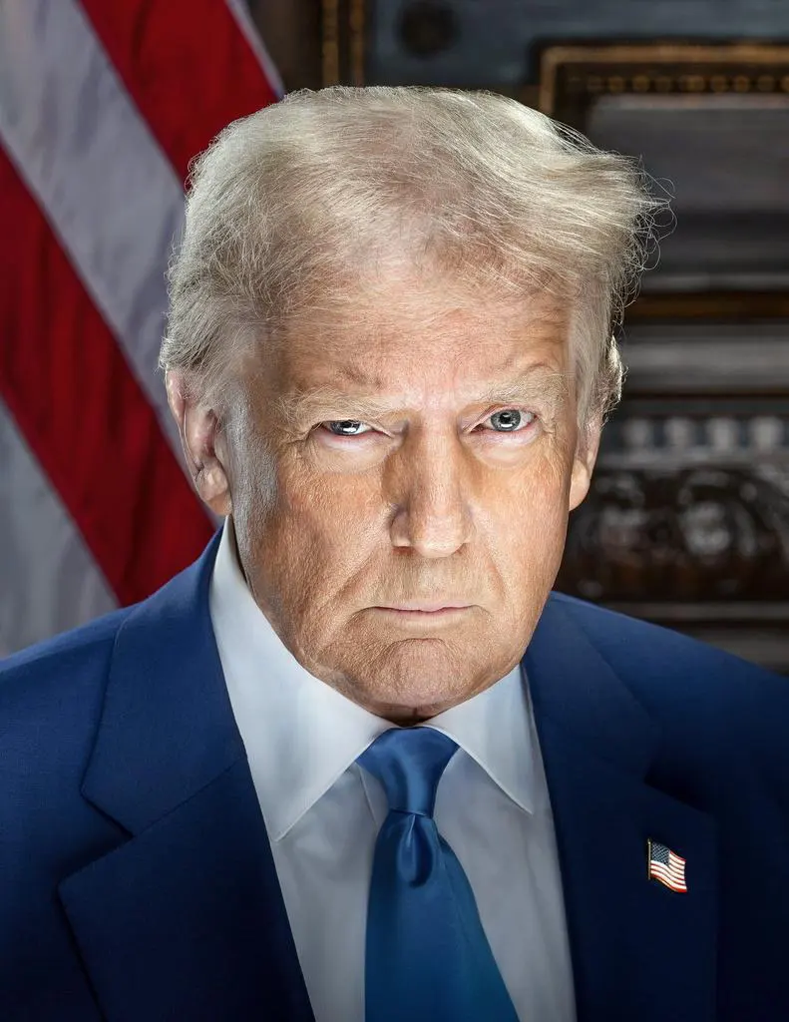

Slide 14
Trump’s Tariff Plan
25% tariff on Canadian & Mexican goods, 10% on Canadian energy
Justified by Trump as a way to curb undocumented migration, fentanyl trafficking, and trade deficits
Economists warn of inflation, supply chain disruptions, and a potential Canadian recession in 2025
Canada & Mexico represent 32% of U.S. exports, making North America’s economy highly interconnected
Canada plans counter-tariffs on key U.S. industries in response
The 51st State Idea
No official policy from Trump to annex Canada, but the idea appears in political rhetoric and online discussions
Some American conservatives argue for economic integration & resource access, but the idea is unrealistic
Legal, economic, and political obstacles make annexation impossible
Canada’s strong national identity & sovereignty ensure no serious movement exists in either country
Any such move would violate international law & self-determination principles

Slide 15
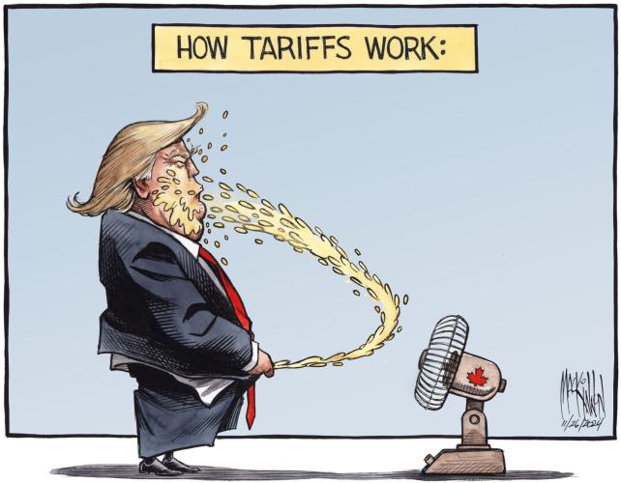

Slide 16
Conclusion
U.S. suspends tariffs on Canada & Mexico for one month after both countries strengthen border security to combat fentanyl trafficking
Trump supports the decision, calling it a positive step
Canada faces political change: Trudeau’s successor will be announced March 9
Pierre Poilievre’s Conservative Party leads polls ahead of the next federal election
The coming weeks will be critical for Canada’s economic stability & international relations

