Slide 1
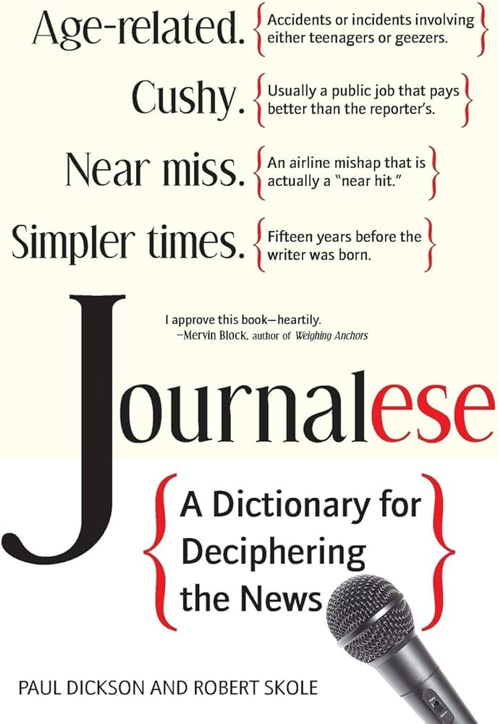

Slide 2
The campaign
For the first time in months, despite his many legal entanglements in New York and elsewhere, it was Trump, not his opponent, President Joe Biden, who seemed to have been thrown off balance as he whipsawed between the courtroom and the functions of his campaign.
→ malgré ses démêlés judiciaires à NY et ailleurs … c’est Trump qui a semblé être déstabilisé alors qu’il faisait des va-et-vients…
Trump's first indictment and only conviction in the New York hush money trial only bolstered his poll numbers and his fundraising, solidifying his control over the Republican Party in the early stages of the primary campaign. Within 24 hours of his conviction, he raised over $52.8 million.
→ Sa mise en examen puis son unique condamnation dans le cadre l’affaire des paiements cachés n’a fait que renforcer / améliorer ses bons résultats dans les sondages et augmenter ses collectes de fonds
After Trump and Mr. Biden clinched their respective nominations, their debate, hosted by CNN, was scheduled for June 27. It became the most consequential debate in U.S. history when Mr. Biden's performance, marred by gaffes, unfinished sentences and mumbling, caused Democratic leaders and voters to question his ability to serve another term because of his age.
→ Après que Trump et Biden aient remporté / sécurisé leur nomination respectives, … Le débat télévisé du mois de juin est devenu le débat le plus marquant de l'histoire des États-Unis lorsque la performance de M. Biden, entachée de maladresses, de phrases inachevées et de marmonnements,

Slide 3
After his withdrawal from the race, Biden came to grips with a diminished role on the campaign trail. This was both due to the need to familiarize voters with Harris and to distance her from an outgoing president whose approval rating had been underwater for much of his term as the cost of living soared.
→ Après son retrait de la course, Biden a dû accepter/ a fini par accepter de jouer un rôle moins important sur le terrain de la campagne… prendre ses distances avec un président sortant dont la cote de popularité était en chute libre pendant une grande partie de son mandat, alors que le coût de la vie augmentait fortement.
Kamala Harris chose him as her running mate because he could help her make inroads in rural states. Even though only a fifth of Americans live outside the big towns and cities, the rightward drift of the American countryside over the past 25 years has been remarkable. But for Democrats, the rural vote is still worth fighting for, particularly where even small gains in already tight states just might make the difference.
→ Kamala Harris l'a choisi comme colistier parce qu'il pouvait l'aider à gagner du terrain dans les États ruraux… notamment là où même de faibles progrès dans des États déjà serrés pourraient bien faire toute la différence.
In this closely fought US election, vice-presidential candidates JD (James David) Vance and Tim Walz were picked to sway Midwestern and rural voters who might be hesitating over Donald Trump or Kamala Harris.
→ Dans cette élection américaine très disputée, les candidats à la vice-présidence JD Vance et Tim Walz ont été choisis pour convaincre les électeurs du Midwest et des zones rurales…

Slide 5
After graduating from High School, J D Vance joined the US Marine Corp(s), where he served from 2003 to 2007 as a combat correspondent, with six months in Iraq. He attended Ohio State University afterwards, graduating in 2009, then graduated in 2013 from Yale Law School, where he was an editor of The Yale Law Journal.
In 2016, Vance published his bestselling memoir Hillbilly Elegy, about the socioeconomic problems of his hometown of Middletown, Ohio and about his family history of poverty and manual jobs. The book received considerable press attention and was adapted into a feature film in 2020. A hillbilly = un plouc, un bouseux / elegy = poem, ode.
Vance became senator for Ohio in 2022. Initially opposed to Donald Trump's candidacy in the 2016 election, Vance has become a strong Trump supporter since Trump's presidency. In July 2024, Trump selected Vance as his running mate for vice president.
His political positions include opposition to abortion, same-sex marriage, gun control, and gender-affirming care for minors. He also opposes continued American military aid to Ukraine.

Slide 7
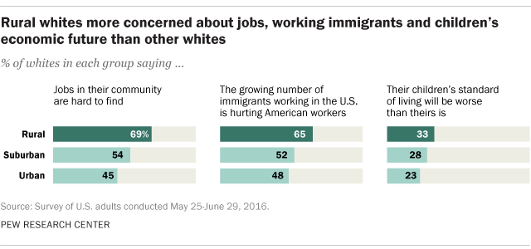
2016 Trump won small towns and rural America easily, claiming 62% of the votes while Democratic candidate Hillary Clinton received 34%.
2020 Biden won only 28 percent of that voting bloc in 2020.

Slide 9
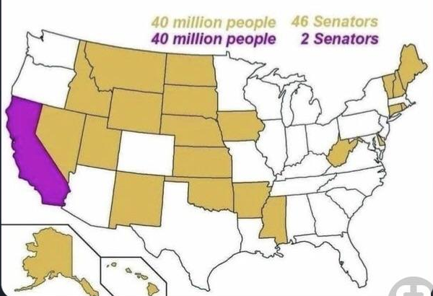
“The rural skew in especially the Senate and the electoral college is really shaping our institutions in a way that I don’t think people fully comprehend,” said Matt Hildreth, executive director of the progressive group RuralOrganizing.org.
In the US Senate: over-representation of some rural, less populous, often conservative states and under-representation of populous states.
This system is meant to guarantee the federal structure of the country.

Slide 11
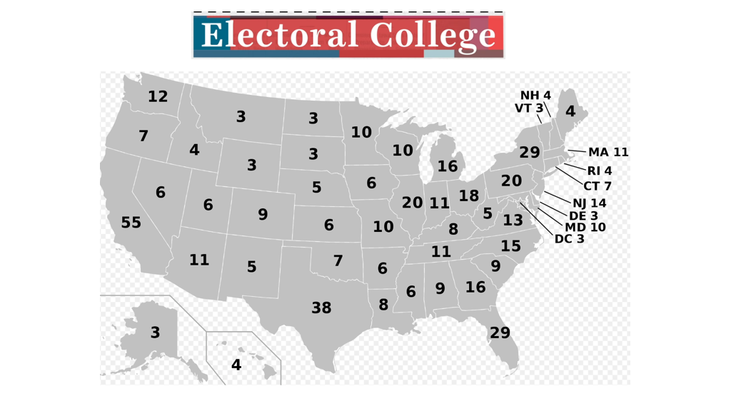

Slide 12
In TX, an Electoral delegate represents three times the amount of people as one in VT. This makes each individual vote in Vermont a lot more influential .

Slide 13
A Republican senator from Ohio, J.D. Vance is the author of a fine autobiography, “Hillbilly Elegy”, in which he wrote: “I identify with the millions of working-class white Americans of Scotch-Irish descent who have no college degree. Americans call them hillbillies, rednecks or white trash.”
→ J.D. Vance, est l’auteur d’une excellente autobiographie, Hillbilly Elegy, dans laquelle il écrit : « Je m’identifie aux millions d’Américains blancs de la classe ouvrière, d’ascendance écossaise-irlandaise, qui n’ont pas de diplôme universitaire. »
His comments about Haitian immigrants eating pets, based on unsubstantiated internet rumours, were repeated by Trump during the presidential debate and caused huge upheaval in Springfield, with critics arguing the VP was stoking America’s political violence.
→ ses propos… basés sur des rumeurs infondées circulant sur Internet, … ont provoqué un énorme tollé à Springfield, les critiques accusant le vice-président d’attiser la violence politique en Amérique.
By virtue of her identity, Kamala Harris could make history: as the first female president, the first female and black president, the first Indian-American president. Yet she has wisely taken a page from Mr Obama and introduced herself by emphasizing not her identity but her experience as a prosecutor, the issues (that) she is running on and her ambitions for the whole country, rather than any group.
→ Kamala Harris pourrait entrer dans l’histoire en tant que... Mais elle a judicieusement suivi l’exemple de M. Obama en se présentant non pas à travers son identité, mais en mettant en avant son expérience de procureure, les sujets sur lesquels elle fait campagne et ses ambitions pour l’ensemble du pays plutôt que pour un groupe en particulier.

Slide 14
For good or ill, political campaigning is often about finding wedge issues to stir up your base. If wonkery and reams of policy papers were the secret to electoral success, Hillary Clinton would not have lost in 2016.
→ Pour le meilleur ou pour le pire, les campagnes électorales consistent souvent à identifier des sujets clivants pour mobiliser sa base électorale. Si l’obsession des politiques publiques et les montagnes de dossiers détaillés était la clé du succès électoral, Hillary Clinton n’aurait pas perdu en 2016.
Mid-July was a turning point in the 2024 race, upending the presidential campaign. On July 13, Trump survived an assassination attempt in Butler, Pennsylvania, when his ear was grazed by a bullet after a gunman fired several times at him during a rally just before the Republican convention.
→ … qui a bouleversé la campagne présidentielle… après qu’un tireur a tiré plusieurs coups de feu lors d’un meeting

Slide 15
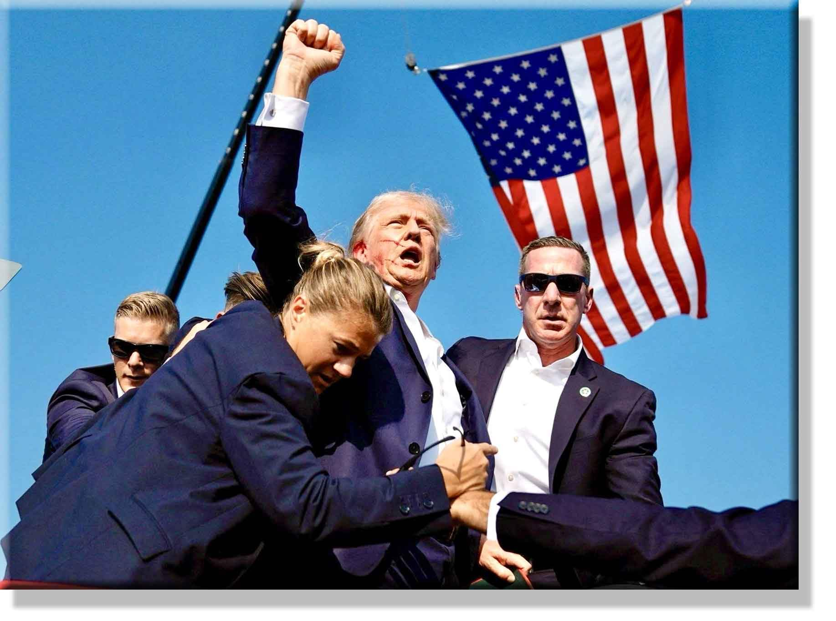
To what extent can one say this photograph is iconic?

Slide 16
Immigration was a constant in all of three of Trump's bids for the White House. He promised mass deportations for migrants and promised to establish the death penalty for any migrant who kills a U.S. citizen.
→ L'immigration a été un thème récurrent dans chacune des trois campagnes de Trump pour la Maison-Blanche. Il a promis des expulsions massives de migrants et s'est engagé à instaurer la peine de mort pour tout migrant qui tuerait un citoyen américain.
In the final week before the election, Trump’s campaign was embroiled in controversy. His rally at New York's Madison Square Garden was overshadowed by comments made by comedian Tony Hinchcliffe, who referred to Puerto Rico as a "floating island of garbage," among other racist jokes.
→ la campagne de Trump a été entachée de controverse(s). Son meeting au Madison Square Garden de New York a été éclipsé par les propos du comédien Tony Hinchcliffe, qui a qualifié Porto Rico de « île flottante de déchets », parmi d'autres blagues racistes.

Slide 17
Elon Musk’s daily $1 million lottery for registered swing state voters who sign his super PAC’s petition falls into a legal gray area and could potentially violate election law, according to legal experts. The petition, created by Musk’s America PAC, comes amid the entrepreneur's larger campaign over the last week to register conservative voters in swing states.
→ La pétition s'inscrit dans une campagne plus large menée par l'entrepreneur au cours de la dernière semaine (de la campagne) pour inscrire des électeurs conservateurs dans les États clés.
KEY ISSUES
Abortion rights.
Ten US states will vote for laws regulating abortion rights as the issue looms large over the presidential race between Kamala Harris and Donald Trump.
→ la question joue un rôle clé / déterminant dans la campagne présidentielle
Online, people predicted the 2024 US election would be Roevember. According to a 2024 Pew Research Center poll, 63% of Americans believe abortion should be legal in all or most cases, which is up four percentage points from 2021. Many predicted it would mean huge numbers of women turned out in support of Kamala Harris and the Democrats. That did not happen. In fact, exit polling indicates that while women of colour overwhelmingly voted for Harris, a majority of white women voted for Donald Trump.
→ Beaucoup avait prédit que cela entraînerait un grand nombre de femmes à aller voter pour Harris et les Démocrates / une mobilisation massive des femmes en faveur de

Slide 18
Yet simultaneously, because abortion had become politically toxic for Republicans, Trump distanced himself from the bans that had swept the nation. He insisted abortion regulation was now exclusively a state matter. After months of questioning, Trump indicated he would veto a federal abortion ban (a promise few put any stock in).
→ Trump a pris ses distances avec les interdictions qui avaient déferlé sur le pays. Après des mois de questions de la part des journalistes, Trump a laissé entendre qu’il opposerait son veto à une interdiction fédérale de l’avortement (une promesse à laquelle peu ont accordé de crédit).
Donald Trump's tactic of delivering ambiguous statements on the subject paid off. The results of the November 5 elections showed that it remained central to the concerns of a majority of voters, but that abortion no longer functioned as an effective springboard for the Democratic candidates also on the ballot. Two Republican strongholds passed measures protecting abortion while otherwise massively supporting Trump in the presidential race: Missouri and Montana, with over 58% of the vote.
→ La tactique de Donald Trump, consistant à faire des déclarations ambiguës sur le sujet, a porté ses fruits. Les résultats des élections du 5 novembre ont montré que la question restait centrale pour une majorité d’électeurs, mais que l’avortement ne constituait plus un levier efficace pour les candidats démocrates également en lice.

Slide 19
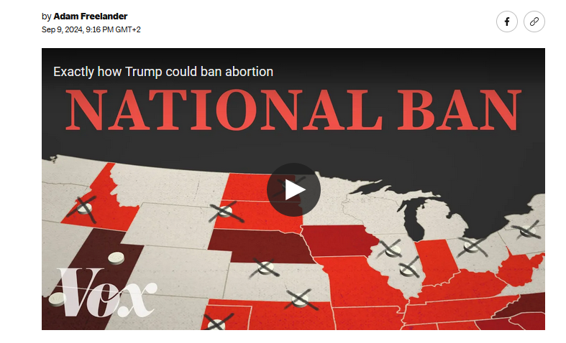
https://www.vox.com/videos/370668/how-trump-could-ban-abortion-medication-president
What has happened in the US since Roe v Wade was overturned?
Why has this increased the sale of Mifepristone?
What is the Comstock Act?
4) Why could it play an instrumental role in the future of reproductive rights policies?
5) What about the 14th amendment? How can it become a tool in the hands of pro-life activists?

Slide 20
Mass deportation.
Trump will most likely have to secure more funding from Congress to make good on his promises for mass deportations. He pledged in his inaugural address to deport “millions and millions” of immigrants back to their home countries. But ICE is already short $230 million to fund its current level of deportations, which removed over 230,000 migrants last year.
→ Il est plus probable que Trump doive obtenir davantage de fonds de la part du Congrès pour tenir ses promesses au sujet des expulsions de masse (d’immigrés en situation irrégulière). Mais il manque déjà 230 millions de dollars à l’ICE…
On his first day in office, President Trump issued an order that seeks to end birthright citizenship for children born in the United States to undocumented immigrants. That right has been enshrined in the Constitution for more than 160 years by the Fourteenth amendment, and experts say that stripping it away would require a constitutional amendment.
→ a publié un décret présidentiel visant à mettre fin au droit du sol pour les enfants nés aux États-Unis de parents immigrés en situation irrégulière… les experts affirment que le supprimer / l’éliminer nécessiterait une modification de la constitution

Slide 21
The economy. The economy ranks as the most important of 22 issues that U.S. registered voters said influenced their choice for president. it’s the pinch of high food and housing costs that seems to be shaping their sentiment rather than the robust growth and low unemployment.
→ L'économie est classée comme la question la plus importante parmi 22 sujets qui, selon les électeurs américains inscrits, ont influencé leur choix pour la présidence. C'est la pression des coûts élevés de l'alimentation et du logement qui semble façonner leur opinion, plutôt que la forte croissance et le faible taux de chômage.
Trade.
The former president brought the era of US free trade to a halt when he became president, but his tariffs on Chinese imports were largely retained and even expanded by Joe Biden. This time around he has proposed new 10-20% tariffs on most foreign goods with imports from China bearing the brunt at 60%. It is part of his attempt to promote homegrown manufacturers and stop outsourcing, but some economists have warned this could push up prices for consumers.
→ L'ancien président a mis fin à l'ère du libre-échange américain lorsqu'il est arrivé au pouvoir, […] Cette fois-ci, il a proposé de nouveaux droits de douane de 10 à 20 % sur la plupart des biens étrangers, les importations en provenance de Chine étant les plus touchées à hauteur de 60 %.
Israel – Gaza war. Trump has positioned himself as a staunch supporter of Israel and condemned pro-Palestinian supporters on US college campuses.
→ un fervent défenseur d’Israël / partisan d’Israël

Slide 22
What has Donald Trump suggested regarding the future of the Gaza Strip?
A) That the United States should send troops to stabilize the region. B) That United States should take full control and turn the area into the “Riviera of the Middle East”. C) That Gaza should be placed under international administration. D) That Palestinian leaders should be given more autonomy to govern.

Slide 23
Ukraine. The Republican has an isolationist foreign policy and wants the US to disentangle itself from conflicts elsewhere in the world. He has pledged to end the war in Ukraine “within 24 hours” through a negotiated settlement with Russia, a move that Democrats say would embolden Vladimir Putin.
→ Le républicain adopte une politique étrangère isolationniste … une initiative que les démocrates estiment de nature à encourager Vladimir Poutine.
RESULTS After defeating Kamala Harris—and not just narrowly, but by a wide margin—America’s 45th president will become its 47th.
→ Après avoir battu KH, et de loin / et ce, avec une marge confortable
In what was supposed to be a knife-edge election, Mr Trump carried most of the battleground states. Thanks to big swings in states that were never in doubt, including Florida, New Jersey and New York, he also won the popular vote. As the polls predicted, he enjoyed a big surge in support from Latino men. But women, whom Ms Harris had expected to move to her, also swung towards Mr Trump.
→ Dans une élection qui s'annonçait serrée, M. Trump a remporté la plupart des États clés. […] Comme l'avaient prédit les sondages, il a bénéficié d'une forte progression du soutien des hommes latinos. Mais les femmes, que Mme Harris espérait rallier à sa cause, se sont également tournées vers M. Trump.
Exit polling shows Trump won overwhelmingly among White voters without a college education and made inroads with Black and Latino men.
→ Les sondages à la sortie des urnes montrent que Trump a largement gagné parmi les électeurs blancs sans diplôme universitaire et a fait des progrès auprès des hommes noirs et latinos.

Slide 24
Republicans Maintain House Majority, Clinching Trifecta of Government Control. In yet another blow to Democrats, Donald Trump will begin his presidency with a trifecta of Republican control in Washington. The GOP not only regained control of the White House and the Senate but also managed to hold onto a narrow majority in the House. While their priorities are still being outlined, Republicans will be positioned to confirm Trump’s appointees, pass tax reform, fund border security, overhaul the Affordable Care Act, and legislate other parts of their agenda.
→ Les républicains conservent la majorité à la Chambre des représentants, réalisant ainsi un triplé gagnant de contrôle du gouvernement. […] Le parti Républicain n'a pas seulement récupéré la Maison Blanche et le Sénat, mais a également réussi à maintenir une majorité étroite à la Chambre des représentants. Bien que leurs priorités soient encore en cours de définition, les républicains seront en position de confirmer les nommés de Trump, de passer une réforme fiscale, de […] SMALLEST MAJORITY IN THE HOR SINCE THE GREAT DEPRESSION
American presidential transitions are unusually fraught, in part because they are lengthy. For more than 70 days the world’s greatest power is in a twilight zone between two presidents: one in power but with dwindling influence; the other triumphant but not yet at the Resolute Desk.
→ Les transitions présidentielles américaines sont exceptionnellement délicates, en partie parce qu'elles sont longues. Pendant plus de 70 jours, la plus grande puissance mondiale se trouve dans une zone de crépuscule entre deux présidents : l'un au pouvoir mais avec une influence en déclin ; l'autre triomphant mais encore loin du Bureau Ovale.

Slide 25
SOME EXPLANATIONS
Trump also ran hard on immigration — as he has for nearly a decade — and vowed at nearly every campaign event that he'd carry out mass deportations if he's reelected. Exit polling showed that voters also believed Trump would do a better job of confronting illegal immigration at the southern border.
→ Trump a également mené une campagne tambour battant sur l'immigration // a fait de l’immigration l’un des sujets clés de sa campagne
Biden did not manage to tout the US’s good economic data, even if Bidenomics was working. When he took office the pandemic was raging and the economy was reeling. Today, the U.S. has the highest economic growth rate, leading the world economies since the pandemic.
→ Biden n'a pas réussi à vanter les bons résultats économiques des États-Unis, même si Bidenomics fonctionnait. BIDENOMICS: https://www.youtube.com/watch?v=AAway0Fqcu0
Presidenting is still seen as a manly occupation. Some 30% of Americans think Ms Harris’s sex will hurt her chances of winning. She therefore downplayed her sex, while Mr Trump has doubled down on projecting traditional masculinity.
→ La présidence est encore perçue comme un métier masculin. Environ 30 % des Américains pensent que le sexe de Mme Harris nuira à ses chances de gagner. Elle a donc minimisé son identité féminine, tandis que M. Trump a insisté sur l'image d'une masculinité traditionnelle // a redoublé d’efforts pour projeter une masc…

Slide 26
Republican vice presidential nominee Sen. JD Vance’s criticism of prominent Democrats as “childless cat ladies” has unleashed fury among women, with many now reclaiming the age-old sexist trope as a call to action this election season. Vance was already facing scrutiny as former president Donald Trump’s newly minted running mate, in part for his stance on various family policies. He has called falling U.S. birth rates a “civilizational crisis,” and advocated in recent years that adults without children should pay higher taxes and have fewer voting rights.
→ La critique du sénateur républicain et candidat à la vice-présidence, JD Vance, qualifiant les démocrates influents de 'femmes sans enfants et amatrices de chats' a déclenché la colère des femmes, dont beaucoup se sont réapproprié ce vieux stéréotype sexiste pour appeler (leurs consœurs) à l'action cette saison électorale.
The Biden administration promoted a view of culture that is out of step with most Americans, especially on sex and gender, which featured in a lot of Trump campaign ads. Most damaging of all, voters throughout the country were infuriated by the Democrats’ failure to stop people crossing the southern border illegally. The party compounded its errors by covering up Mr Biden’s disqualifying frailty until it was undeniable. By then they had no time to find a political talent capable of beating Mr Trump.
→ …qui est en décalage par rapport à celle de la plupart des Américains […] Le parti a aggravé ses erreurs en dissimulant la fragilité disqualifiante de M. Biden jusqu'à ce qu'elle devienne indéniable.
Throughout his two-year campaign, Trump hammered President Biden, and later Harris, on inflation and the economy. It's a message that resonated with voters, whose views on the economy are more negative now than they were in 2020, despite the pandemic that brought the economy to a halt during his presidency. Nationally and across the battleground states, on the question of whether voters are better off now than they were four years ago, more voters said they are financially worse off.
Cats — coded as passive and associated with the home, as opposed to more active, masculine dogs — was a symbol of anti-suffragist propaganda in the 19th and early 20th century.

Slide 27
Throughout his two-year campaign, Trump hammered President Biden, and later Harris, on inflation and the economy. It's a message that resonated with voters, whose views on the economy are more negative now than they were in 2020, despite the pandemic that brought the economy to a halt during his presidency. Nationally and across the battleground states, on the question of whether voters are better off now than they were four years ago, more voters said they are financially worse off.
→ Tout au long de sa campagne de deux ans, Trump a attaqué le président Biden, puis Harris, sur l'inflation et l'économie. C'est un message qui a résonné auprès des électeurs, dont les opinions sur l'économie sont plus négatives aujourd'hui qu'elles ne l'étaient en 2020, […] concernant la question de savoir si les électeurs sont mieux lotis aujourd'hui qu'ils ne l'étaient il y a quatre ans, plus d'électeurs ont répondu qu'ils sont financièrement moins bien lotis.
NEW PARTNERS TikTok faces an eternal uphill battle to convince Washington that it’s not controlled by the Chinese Communist Party. Even in so-called free speech havens such as America, the lords of media and tech in Trump’s age are expected to bow and kiss the ring. Social media companies kowtow to Trump.
→ TikTok est engagé depuis toujours dans un âpre combat visant à convaincre Washington qu'il n'est pas contrôlé par le Parti communiste chinois. Même dans de soi-disant bastions de la liberté d'expression comme l'Amérique, sous l’ère Trump, les seigneurs des médias et de la technologie sont censés s'incliner et embrasser la bague. Les entreprises de médias sociaux se soumettent // font des courbettes devant Trump.
Tiktok realized the advantage of bowing to autocrats. The tech barons at Trump’s inauguration are following suit.
→ Tiktok a compris l’intérêt qu’il y avait à courber l’échine / s’incliner devant les autocrates … suivent l’exemple.

Slide 28
Corporate America is now cosying up to Trump. From Silicon Valley’s biggest names to streaming giants, the US election has prompted the nation’s business behemoths to change their tune.
→ Le monde des affaires américain se rallie à Trump // fait ami-ami avec lui // se met dans ses petits papiers. Des plus grands noms de la Silicon Valley aux géants du streaming, l'élection américaine a incité les mastodontes du monde des affaires à changer de discours.
In an unexpected display of fealty, the tech industry curried favor with the president-elect, jockeying through brandished checks and compliments for the President-elect.
→ l'industrie technologique a cherché à gagner les faveurs du président élu, en jouant des chèques brandis et des compliments à son égard.
To jockey for = to vie with sb for = to compete for
Concerns
Whatever guardrails were in place from Congress and Trump’s Cabinet in his first term have been lowered.
→ Les garde-fous qui existaient au Congrès et dans le cabinet de Trump lors de son premier mandat ont été abaissés.
Trump will return to the White House with new muscle, notably through the court’s decision shielding him from prosecution for any challenged conduct taken during official acts.
→ Trump reviendra à la Maison Blanche plus fort encore, notamment grâce à la décision de la cour qui le protège de toute poursuite pour des actes contestés accomplis pendant ses fonctions officielles

Slide 29
The second election of Mr. Trump will hearten authoritarians abroad.
→ La réélection de M. Trump encouragera/enhardira les autoritaires à l'étranger.
It is a wake-up call for the rest of the world, if one were needed, that the “tariff man” is back in power.
→ C'est un signal d'alarme / avertissement / électrochoc pour le reste du monde, s'il en fallait un, que « l'homme des droits de douane » est de retour au pouvoir.
An irascible, transactional president also frightens allies—particularly if he is intent on levying tariffs of 10-20% on all countries, friend or foe.
→ … en particulier s'il a l'intention d'imposer des droits de douane de 10 à 20 % sur tous les pays, qu’ils soient amis ou ennemis.

Slide 30
https://www.youtube.com/watch?v=U8ZfeVNkFuQ

Slide 31
Biden’s last-day-in-office pardons were an unprecedented effort to protect their recipients from the wrath and retribution of an incoming administration.
→ Les grâces accordées par Biden le dernier jour de son mandat constituaient une tentative sans précédent de protéger leurs bénéficiaires de la colère et des représailles d'une nouvelle administration.
Biden said the Jan. 6 committee members and others “do not deserve to be the targets of unjustified and politically motivated prosecutions.” He restated his belief in the rule of law and his optimism “that the strength of our legal institutions will ultimately prevail over politics,” even as he acted in a way that reflected neither that belief nor that optimism.
→ Il a réaffirmé sa foi en l'État de droit et son optimisme « que la force de nos institutions juridiques finira par l'emporter sur la politique »,

Slide 32
It will take time for the full significance of Mr Trump’s victory to sink in. America remains the pre-eminent power. Despite the debasement of its politics, its economy is world-beating—at least for now. It dominates artificial intelligence. It is rich and its armed forces are second-to-none, even if the People’s Liberation Army is catching up.
Il faudra du temps pour que la pleine portée de la victoire de M. Trump soit comprise/perçue/tout à fait saisie. […] Elle est riche et ses forces armées sont inégalées, même si l'Armée de libération du peuple rattrape son retard.
In the uncertain period before the next administration takes over, America’s allies are scrambling to mitigate some of the risks that may arise from the election of a president who regards allies as a burden and approaches mutual defence with the calculus of a gangster. “They want protection, they don’t pay us money for the protection,” Mr Trump has said. Europe’s response will be to try to Trump-proof aid to Ukraine and to bolster the region’s ability to defend itself without American help.
Pendant la période incertaine avant la prise de fonction de la prochaine administration, les alliés de l'Amérique s'efforcent de réduire certains des risques qui pourraient découler de l'élection d'un président qui considère les alliés comme un fardeau. […] La réponse de l'Europe sera de tenter de protéger l'aide (financière) à l'Ukraine de l'influence de Trump / de s’assurer que l’aide (financière) à l’Ukraine ne dépende pas du bon-vouloir de Trump et de renforcer la capacité de la région à se défendre sans l'aide américaine.

Slide 33
Over the past year Mr Macron has become one of the continent’s most outspoken hawks on Ukraine, refusing to rule out putting boots on the ground there and arguing for the use of French SCALP missiles to strike military targets in Russia.
Au cours de l'année écoulée, M. Macron est devenu l'un des plus ardents partisans de l’engagement militaire de l'Ukraine sur le continent, refusant d'écarter la possibilité d'envoyer des troupes sur le terrain et plaidant pour l'utilisation de missiles SCALP français pour frapper des cibles militaires en Russie
A hawk = un faucon
hawkish = in favour of the war (belliqueux, va-t-en guerre)
President-elect Donald Trump opened the possibility that the U.S. may leave NATO during his incoming administration, renewing an issue from his first term in office when he threatened to leave the military alliance over issues with other allies’ defense spending. Some might feel that under Trump, Americans can get on with their lives free from the weight of foreign responsibilities.
Le président élu Donald Trump a laisser entrevoir la possibilité que les États-Unis quittent l'OTAN […] Certains pourraient avoir l’impression qu'avec Trump, les Américains pourraient continuer leur vie sans s’encombrer du fardeau des responsabilités étrangères / libérés du poids des responsabilités internationales.

Slide 34
Inauguration day
Trump’s executive order marathon was mostly just political theater.
Le marathon des décrets présidentiels de Trump était surtout du théâtre politique / de l’esbrouffe
The Trump administration ordered that officials overseeing diversity, equity and inclusion efforts across federal agencies be placed on leave.
L'administration Trump a ordonné que les responsables supervisant les initiatives en matière de diversité, d'équité et d'inclusion au sein des agences fédérales soient mis en congé.
As Trump's team settles in, other officials who worked under the Biden administration are expected to continue leaving in droves.
Alors que l'équipe de Trump s'installe, d'autres fonctionnaires ayant travaillé pour/dans le gouvernement de Biden devraient continuer à partir/démissionner en masse.
President Trump's plan to roll back the constitutionally protected right to birthright citizenship is just one of several executive actions that are likely to face pushback from judges and could be struck down by the Supreme Court.
Le projet du président Trump de revenir sur le droit du sol, protégé par la Constitution, n'est qu'une des nombreuses mesures exécutives qui risquent de rencontrer une opposition des juges et pourraient être annulées par la Cour suprême.

