Slide 1
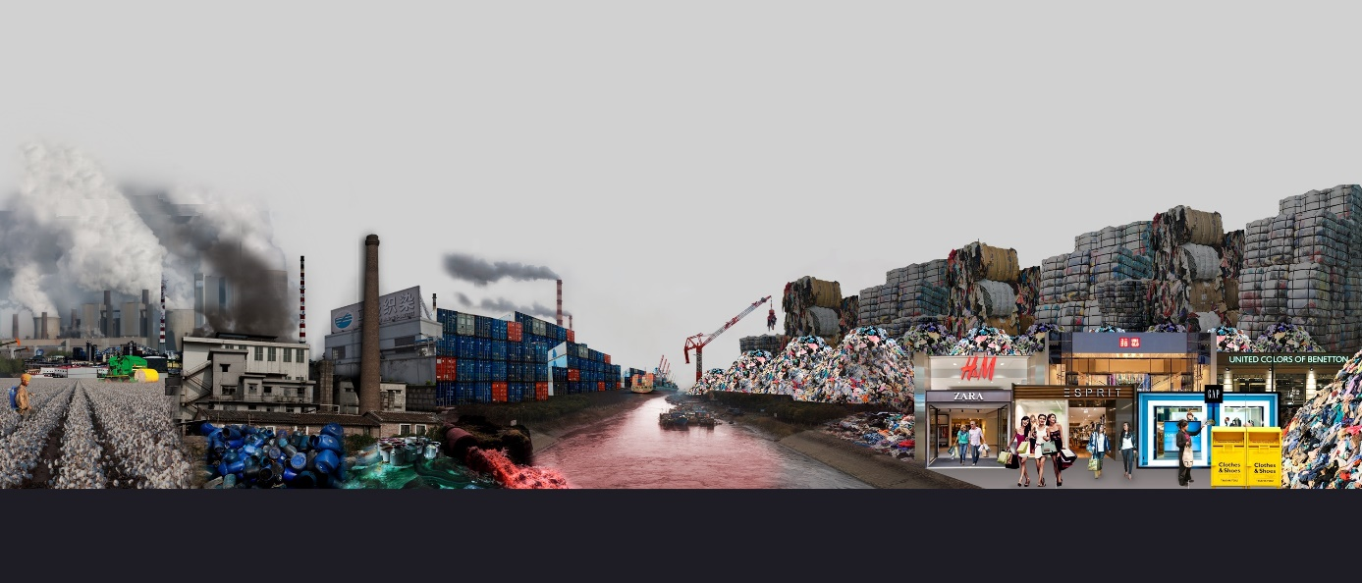

Slide 2
DESCRIBE

Slide 3
Left: grey / gloomy / smoke-filled / chimneys / factories / growing of cotton / cotton picker / farm machinery / use of pesticides and fertilisers / oil is refined to produce energy / energy and chemicals used to make textiles / clothes are packed into containers / transported by container ship / hazardous chemicals pollute water and air
Right: background: a crane is lifting a bale / a mountain of used / discarded clothes / unwanted garments / made into bales / ready for shipment / foreground: fast fashion stores / shoppers / recycling bins

Slide 4
ANALYZE (general message/aim)

Slide 5
It depicts the process and manufacture of fast fashion while lambasting the effects it has on the environment just to make trendy and cheap clothes people will throw away/dispose of.
Not only is fast fashion responsible for water and air pollution but also for encouraging a never-ending vicious circle of consuming.
The fashion industry is a major global polluter and source of greenhouse gas emissions, driven in large part by the “fast fashion” business model that treats cheap clothing as a perishable good that can be disposed of after brief use.

Slide 6
The fact that the brand H&M is visible acts as a forms of public shaming hence at making H&M accountable for the damage done.
Globalization has aided this trillion-dollar trend, allowing brands to outsource different links of their supply chains to countries with little to no environmental and labor protections in order to keep costs down.
That has led to widespread pollution and labor rights abuses, particularly against women workers. Today more and more people advocate for a return to a more sustainable “slow fashion” model . The “Fashion Revolution Week.” was launched in 2020.

Slide 7
IDEAS OF ISSUES IN CONNECTION TO FAST FASHION?
Economic profits -versus- environmental and ethical concerns
To what extent is capitalism/globalization a hurdle in the fight against climate change?
To what extent is it difficult to raise people’s awareness about climate change?
….

