Slide 1
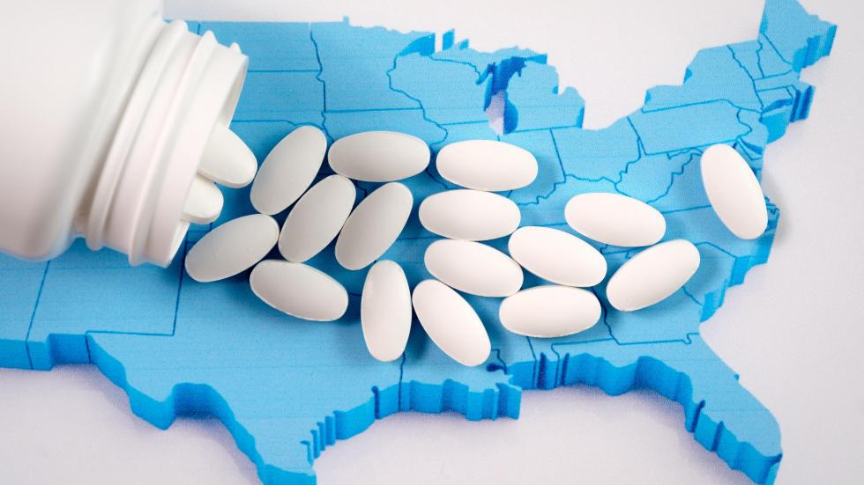
The Opioid Crisis

Slide 2
What are opioids?
Opioids are moderately strong to very strong painkillers. They are legal medicines (US: drugs) that can be prescribed by doctors.
The most famous ones are sold under the name OxyContin and Percocet - they’re oxycodone
Fentanyl is a synthetic opioid. There are two types of fentanyl: pharmaceutical fentanyl and illicitly manufactured fentanyl.

Slide 3
Why is it a crisis?
It is a crisis, it is also considered an epidemic, because of the number of deaths that resulted from taking these medicines. Opioid-involved overdose deaths rose from 49,860 in 2019 to 81,806 in 2022 with a significant decrease to 79,358 in 2023
Because this medicine is addictive and it induces euphoric feelings, it has resulted in a recreational use of opioids. That’s why it is similar to a recreational drug.
Because of its addictive quality, it often leads to seeking stronger drugs, like heroin.

Slide 4
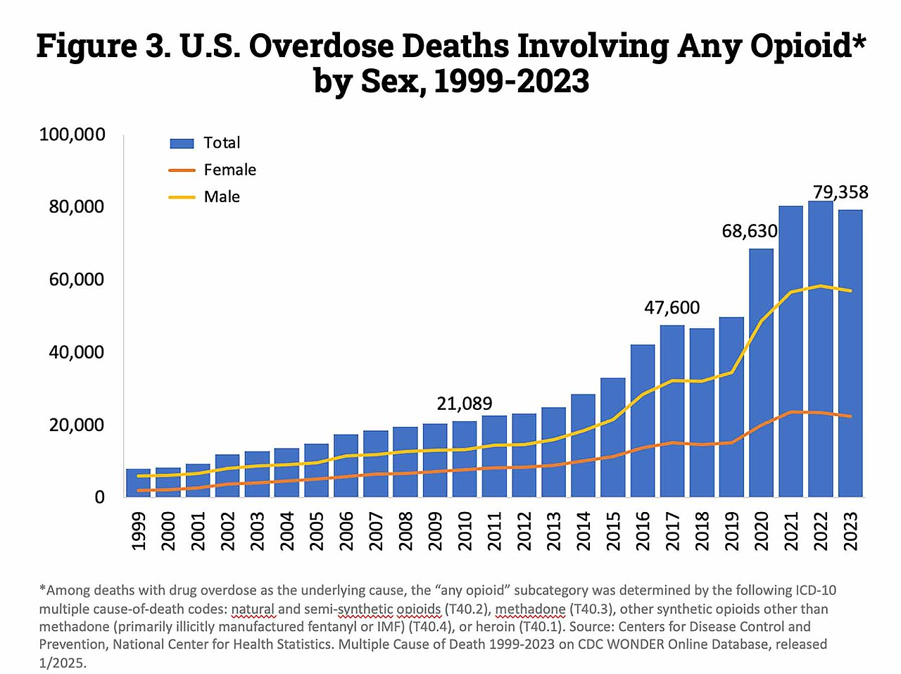

Slide 5
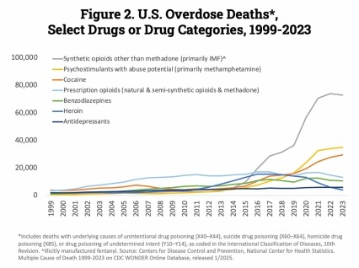

Slide 6
What happened?
The main cause is a tremendous increase in prescriptions of painkillers. Between 1991 and 2011, painkiller prescriptions in the US tripled.
Big pharmaceutical companies are also blamed for the crisis.
In October 2017, The New Yorker published a story on Mortimer Sackler and Purdue Pharma regarding their ties to the production and manipulation of the oxycodone markets. Purdue Pharma is the pharmaceutical company which marketed OxyContin

Slide 7
An American issue?
It has been pointed out that this crisis is mainly an American issue because of the US healthcare system which results in patients pursuing short-term (cheap) remedies to chronic diseases.

Slide 8
Measures
In 2010, the US government began cracking down on pharmacists and doctors who were overprescribing opioid painkillers. An unintended consequence of this was that those addicted to prescription opiates turned to heroin
The Obama administration authorized funding for opioid research and treatment
In 2017, President Trump declared the opioid crisis a « national emergency ».
In 2018, New York City sued « Big Pharma » for fueling the opioid crisis.
On 15 December 2025, Trump designated illicit fentanyl as a weapon of mass destruction. Link: DESIGNATING FENTANYL AS A WEAPON OF MASS DESTRUCTION – The White House

