Slide 1
Welcome back!

Slide 2
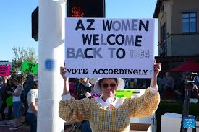
1864 (before Arizona was even a state!)
- revival of a law that has gone unenforced for half a century = ‘zombie laws’
- only allows abortions to save the mother’s life
- no exceptions for rape or incest
Trump’s stance:
- an Arizona law that criminalizes nearly all abortions (a near-total ban) goes too far
- the issue should be left to the states
- he will not sign a federal abortion ban if one comes to his desk (despite supporting one at 20 weeks during his first term)

Slide 3
The Comstock Act = an 1873 anti-obscenity law, named after anti-vice crusader Anthony Comstock.
The law calls for banning the mailing or shipping of "every obscene, lewd, indecent, filthy or vile article, device, or substance."
+ it specifically outlaws mailing "every article or thing designed, adapted, or intended for producing abortion.”
the law's abortion provisions : rendered moot by Roe v. Wade in 1973
but with the Supreme Court overturning Roe in 2022, opponents of abortion rights started viewing Comstock = a way to restrict abortion, without the need for Congress or the courts to do anything.
that policy is promoted by "Project 2025” = 800-page policy roadmap readymade for a Republican president to enact upon taking office to further curb abortion
Potential to effectively be a nationwide prohibition against abortion
Stopping the shipment of pills = catastrophic : medication abortions account for the majority of all abortions in the U.S.
Stopping the shipment of medical equipment used by abortion providers = the end of abortion in the USA?
A roadmap: une feuille de route, un plan d’action

Slide 4
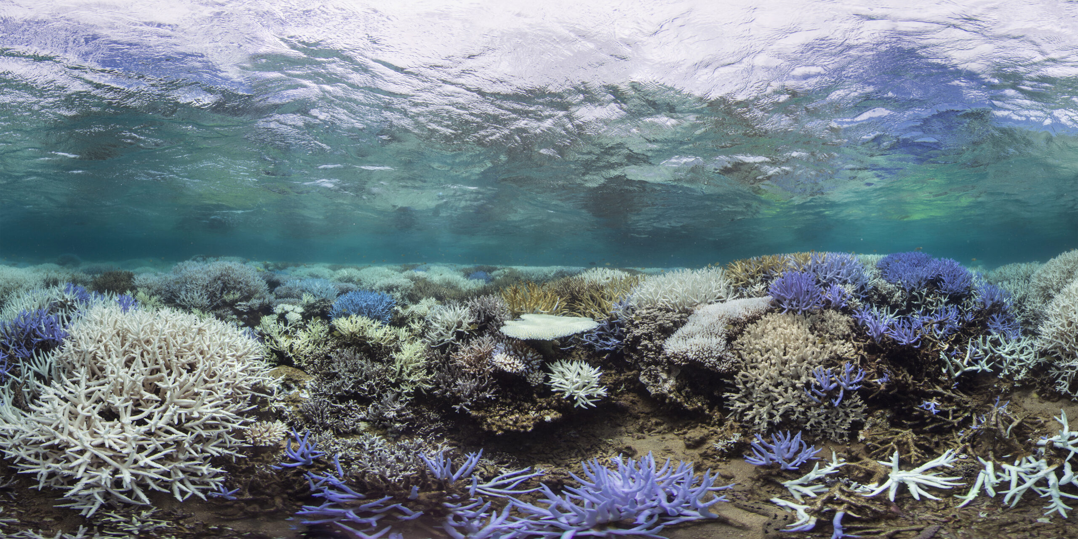
to bleach: to whiten

Slide 5
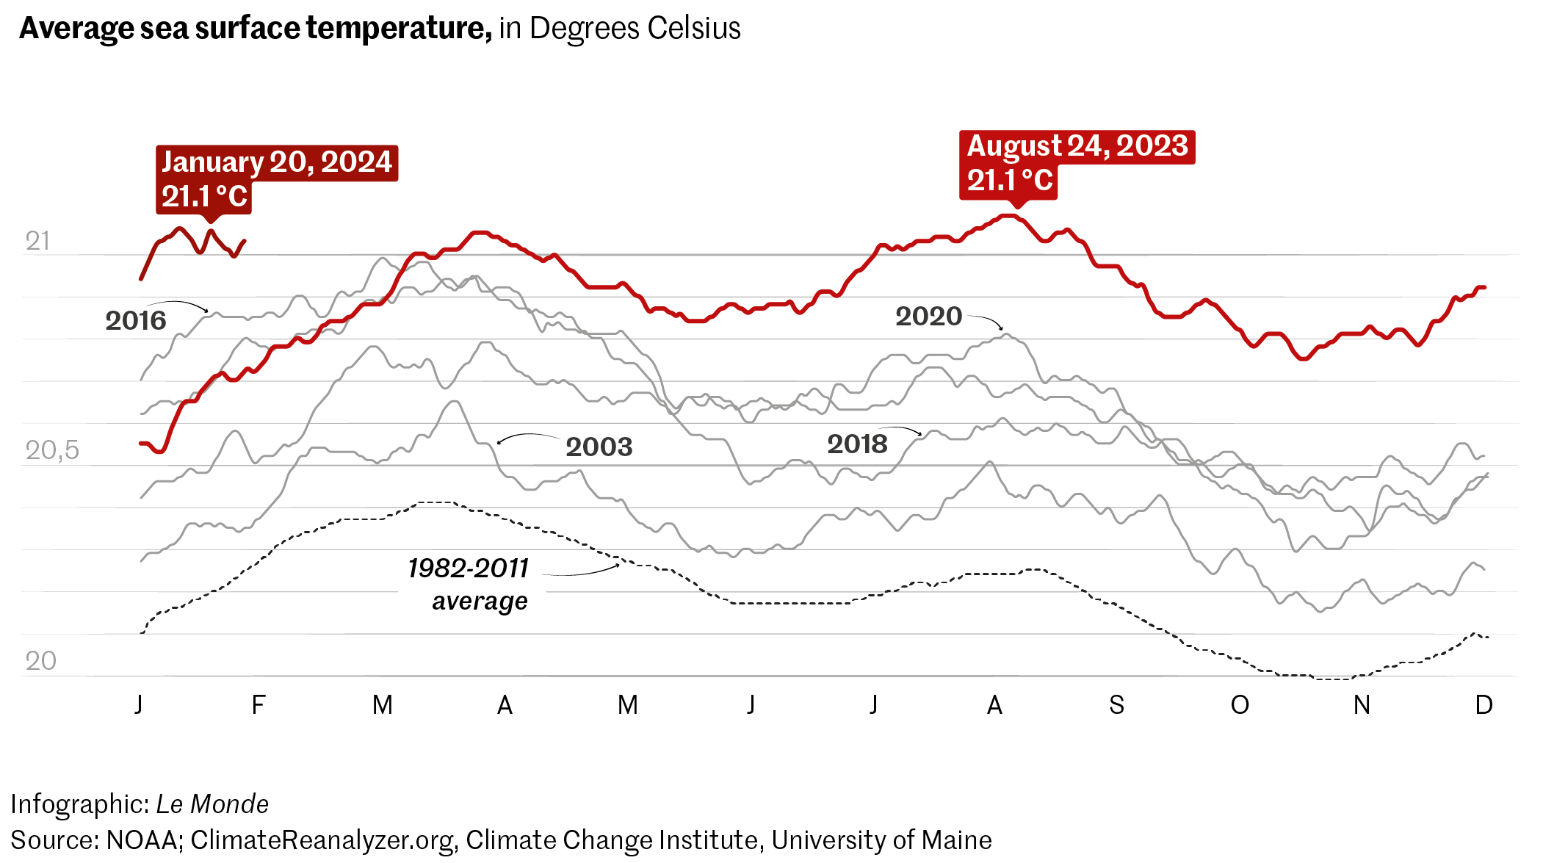
REMINDER: a buoy off Florida in August 2023 read 101.1 degrees Fahrenheit (= 38 Celsius) = possible world record for sea surface temperatures + stark indication of the brutal marine heat wave that's threatening the region's sea life and marine CO2 storage
Some scientists have developed "super corals" that can handle heat better.
They want to use these corals to restore reefs hit by climate change.
This isn't a "get out of jail free" card: these corals can only buy a little more time for reefs to hang on until humans can slow climate change.
DEBATE Is science the answer to global warming?

Slide 6
- a 2021 shooting that killed four fellow students and injured others at a Michigan high school
- a historic verdict
- parents found guilty of involuntary manslaughter
in relation to their son Ethan’s actions
Can parents be held liable for the actions of teenage gunmen? The court’s answer = YES
DEBATE Is this good news in your opinion?
- The decision sets a legal precedent
- The parents zoomed past many red flags:
failed to secure the firearms in their home + did not pursue “reasonable care” to prevent their son from engaging in harmful acts
Some states = laws requiring gun owners to keep their firearms away from children.
Ex: Michigan has a “safe storage” law that requires guns to be secured if a minor is present.

Slide 7
April 20, 2024
The US House of Representatives finally approved $95 billion in foreign aid for Ukraine, Israel and Taiwan as Democrats and Republicans banded together after months of political turmoil over renewed American support for repelling Russia's invasion.
The “Protecting Americans from Foreign Adversary Controlled Applications Act” seeks to cut any ties between TikTok, its current parent company and the Chinese government, which allegedly abuses the platform to “surveil and influence the American public” in a way that poses a threat to national security. ByteDance must sell the app within 270 days if it wants to continue to operate in the US.

Slide 8
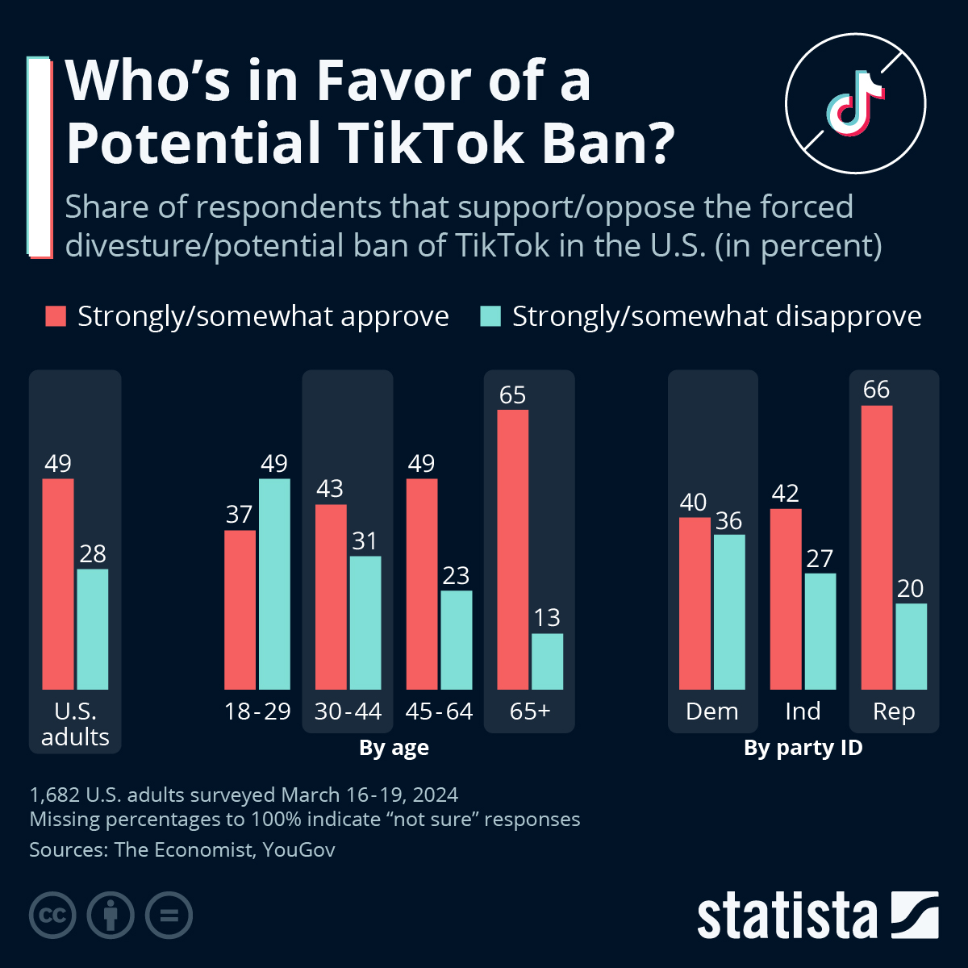
Finish the sentence:
The younger the respondents are…
TikTok’s has maintained it is independent of the Chinese government, while parent company ByteDance has said it has no plans to sell the business.
May 7th: TikTok filed a lawsuit aiming to block the law
= “an extraordinary intrusion on free speech rights” of the company and its 170 million American users

Slide 9
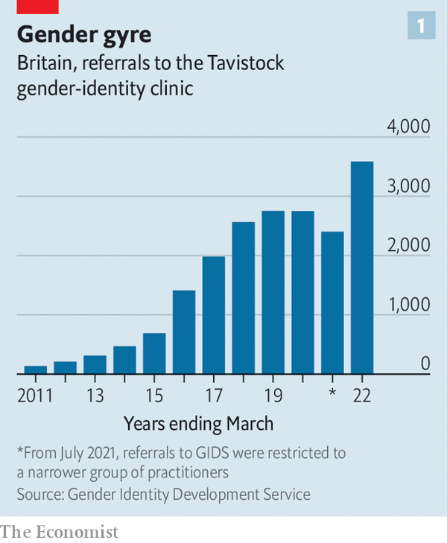
Gender dysphoria = a feeling of intense discomfort with one’s sexed body
- once a rare diagnosis, it has exploded over the past decade
but treatment, pioneered in the Netherlands, “gender-affirming care”, which combines puberty-blocking drugs = has grown controversial
Britain 5th European nation to restrict the use of the drug to those under 18 citing a lack of research on the treatment’s long-term effects
another front in the culture wars
Several American states (Florida and Utah) have passed laws banning gender-affirming care in children.
Joe Biden = such laws :“close to sinful”

Slide 10
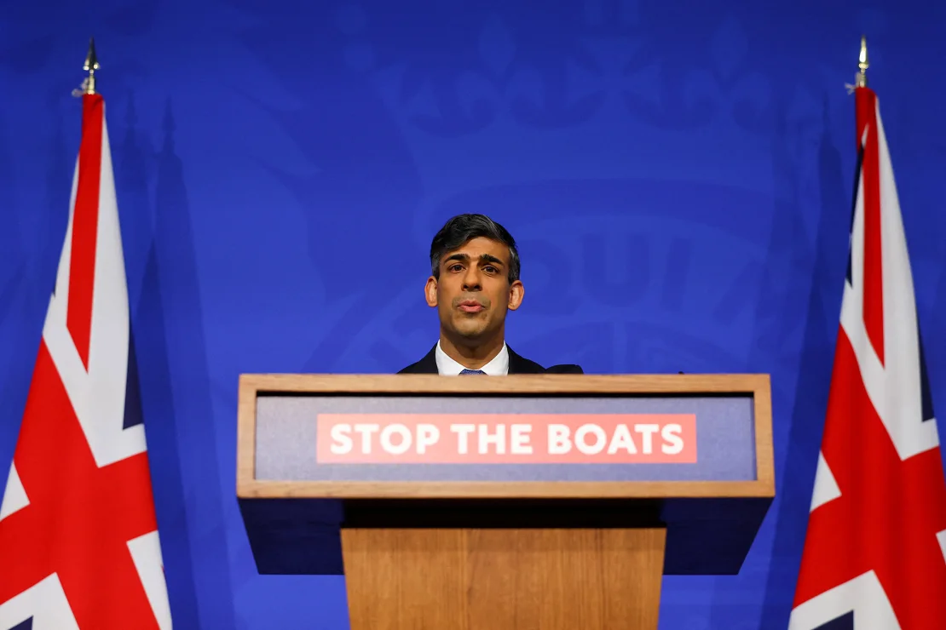
April 22, 2024
UK passes controversial bill to send asylum seekers to Rwanda after two years of challenges
after peers eventually backed down on amending it
= first tranche of asylum seekers to be sent to east Africa in July
CONTEXT = wider debate around the UK leaving the ECHR (the European Court of Human Rights) should deportations be blocked by the European court after the bill passes.
Sunak has vowed not to let a “foreign” court block the policy to send irregular migrants to Rwanda.

Slide 11
REMINDER :
The ECHR : created after WWII and the Holocaust
The UK = one of the States that drafted the ECHR and was one of the first States to ratify it in 1951.
Winston Churchill = a key early advocate
Since the UK signed the Convention in 1951, it has protected Britons from things like torture, killing, and slavery and assures freedom of speech, assembly, religion, privacy…
Until the Human Rights Act was passed in 1998, the only way that people in the UK could enforce their rights was to take a case against the Government to the ECHR in Strasbourg
Withdrawing from it would leave the UK without a codified and legally binding human rights document!

Slide 12
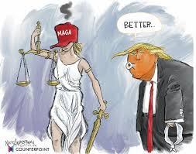
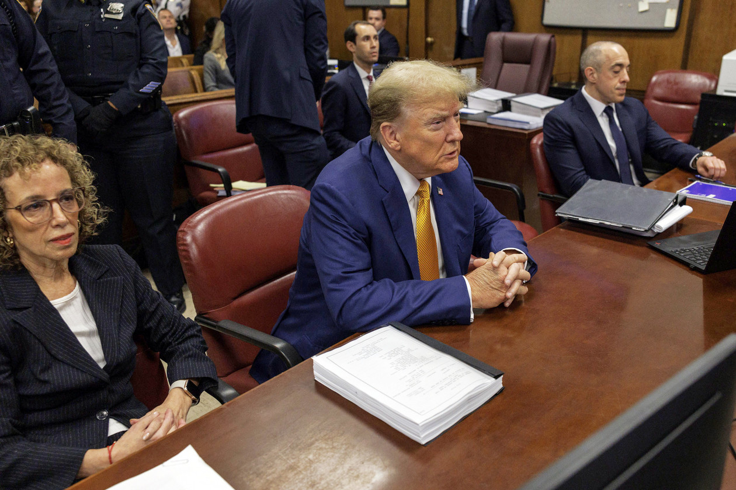
a wall of legal obstacles → a few speed bumps
has avoided accountability so far
no devastating political blow to Trump’s presidential prospects contrary to what was announced for months last year
pileup of postponements
the only trial that Trump will face before the election is the ongoing one in Manhattan: the hush money case, which many lawyers view as the least serious of the four
DEBATE Given these elements, do you believe Trump’s electoral chances will be affected by the charges weighing against him?
To stall: caler, retarder
A postponement: un report, un ajournement

Slide 13
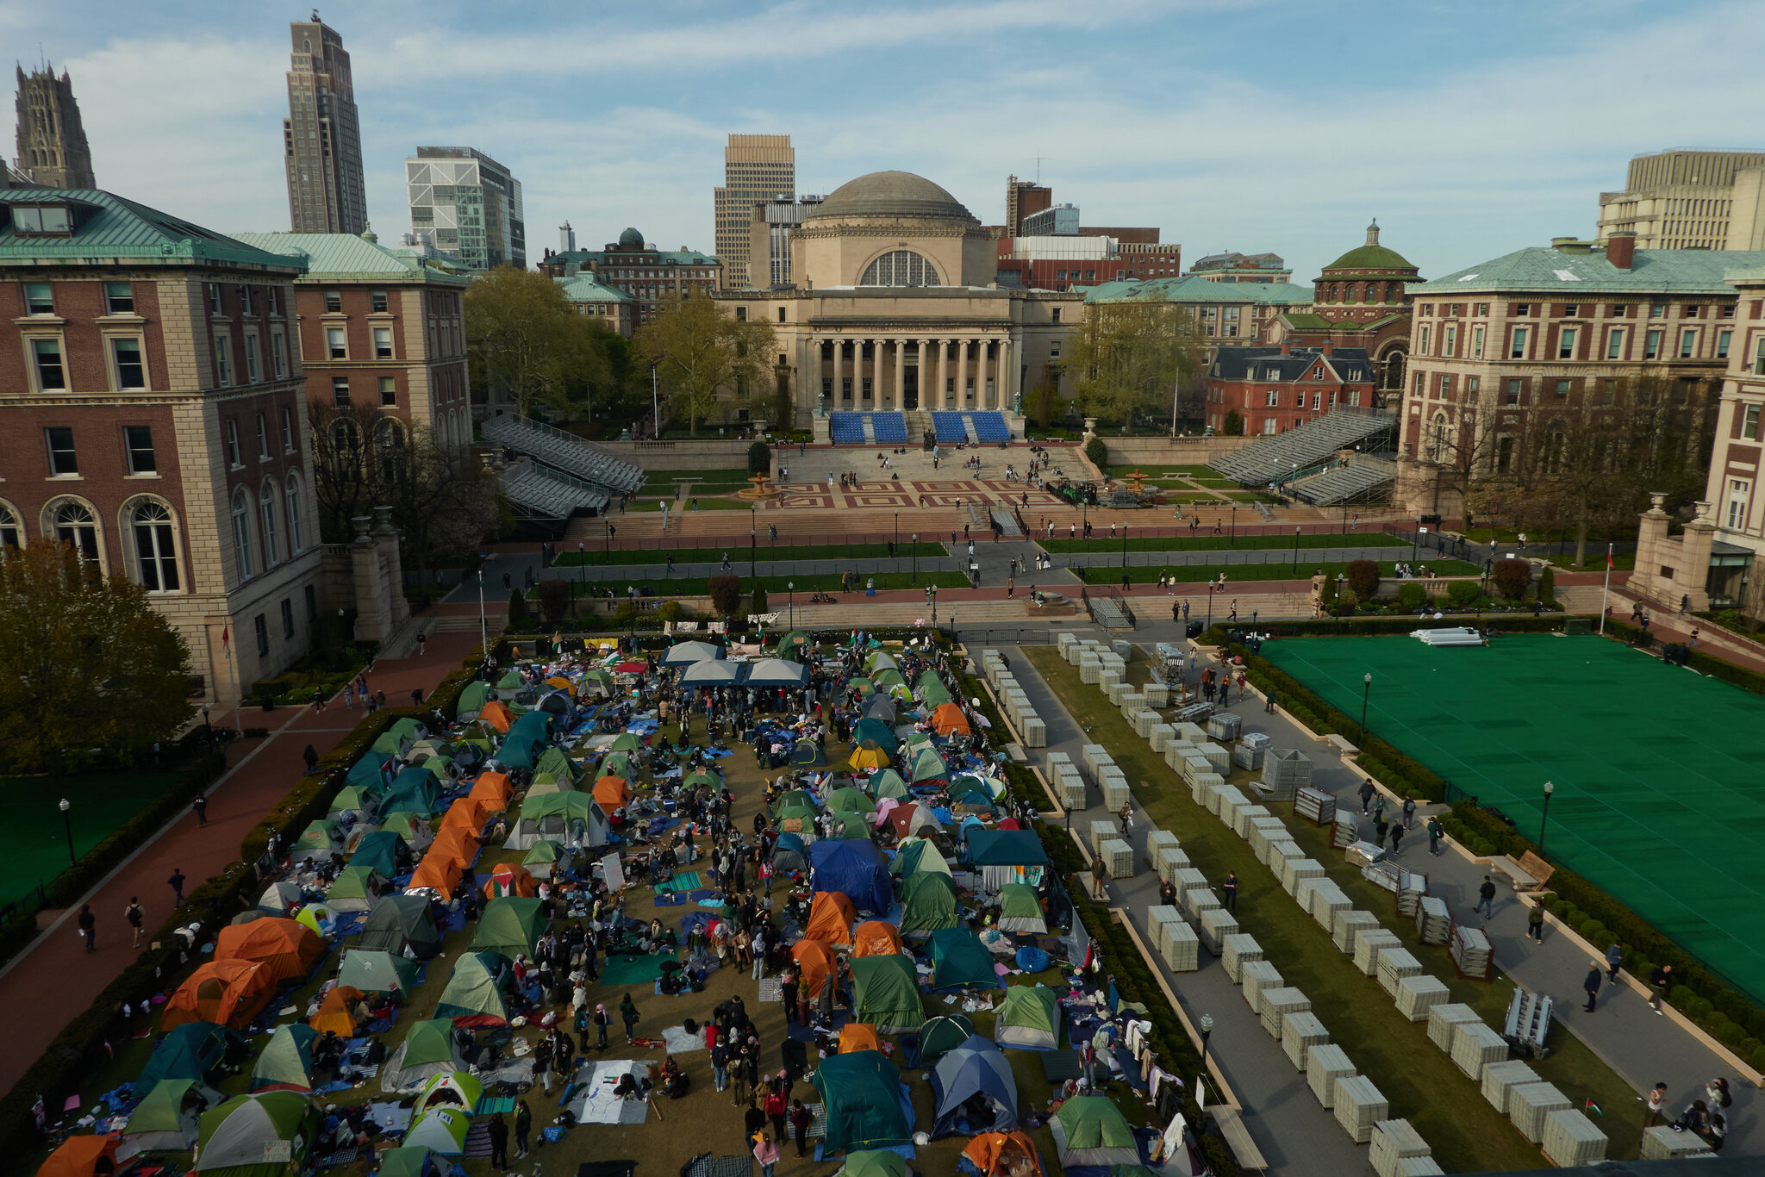
Police raided Columbia University after pro-Palestinian protesters occupied Hamilton Hall, a building that has been at the center of several protests over the years.
→ What were students protesting during the first major occupation of the hall?
It’s the Vietnam War. Hundreds of students seized the hall in April 1968 during protests over the Vietnam War.

Slide 14
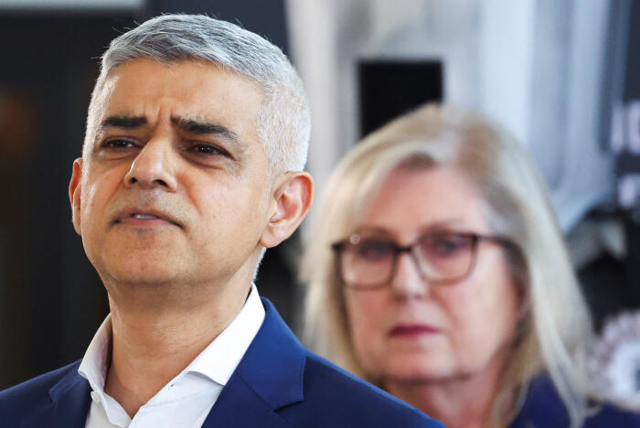
May 4th, 2024
London Mayor Sadiq Khan wins record third term for Labour as Tories routed in local polls
Khan comfortable victory with 43% of the votes after promising free school meals for pupils, a freeze on travel fares and more building of homes
Susan Hall 32% had campaigned to reduce the area covered by London’s Ultra Low Emission Zone (introduced by BoJo + expanded by Khan)
= a strategy which had paid off to replace BoJo in Parliament (Uxbridge by-election in July 2023) and had led Sunak to weaken Britain’s climate change targets
+ criminality rate in London
To be routed: être mis en déroute

Slide 15
a new setback to Britain’s governing Conservative Party ahead of a looming general election
"Let's turn the page on decline and usher in national renewal with Labour," party leader Keir Starmer told supporters in the East Midlands, where the party won the mayoral race.
They were defending nearly 1,000 council seats, many secured in 2021 when they led nationwide polls before the implosion of Johnson's premiership and his successor Liz Truss's disastrous 49-day tenure. With almost all those results in by Saturday afternoon, the Tories had lost close to half and finished third behind the smaller centrist opposition Liberal Democrats.

Slide 16
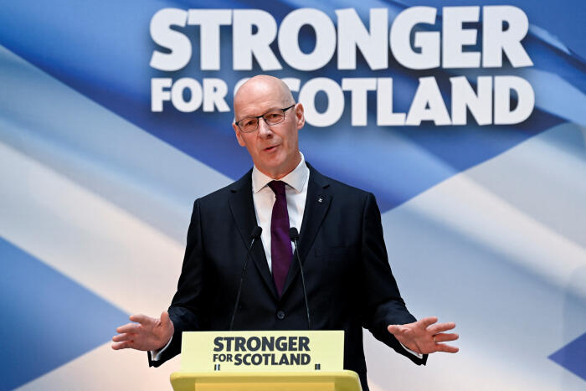
CONTEXT:
Yousaf faced a confidence vote in the Scottish parliament that he was set to lose, having ditched his coalition partners, the Scottish Green Party, in a row over climate policy.
Swinney’s agenda:
advancing the case for Scottish independence +
eradicating child poverty
Struggle to rebuild momentum
The SNP = expected to lose several seats in the UK parliament at Westminster to a resurgent Labour party later this year.
Critics have accused the SNP, in power in the devolved parliament in Edinburgh for 17 years, of focusing on pursuing independence at the expense of issues like the cost-of-living crisis and health.
May 7, 2024
John Swinney: newly-minted leader of the ruling pro-independence Scottish National Party. Swinney succeeds Humza Yousaf, who formally resigned after just over a year in charge

