Slide 1
COMMON ACRONYMS
DOGE Department of Government Efficiency
WHO the World Health Organization
FDA the Food and Drug Administration
DOJ the Department of Justice
BRICs Brazil Russia India China
CCTV Closed Circuit Television
EPA the Environmental Protection Agency
GDP the Gross Domestic Product
a GP a General Pratitioner
a BA a Bachelor of Arts (higher education) / an MA a Master of Arts (higher education)
an MP a Member of (the British) Parliament
an MEP a Member of the European Parliament / an MSP a member of the Scottish Parliament
MIT the Massachussets Institute of Technology (Boston)
UCLA the University of California (Los Angeles)
NATO North Atlantic Treaty Organization
an NGO a non-governmental organization
the NHS the National Health Service
a PhD a Doctor of Philosophy degree
a PTA a Parent-Teacher Association in the USA
VAT Value Added Tax
a WASP a White Anglo-Saxon Protestant
the GOP the Grand Old Party (= the Republicans)

Slide 2
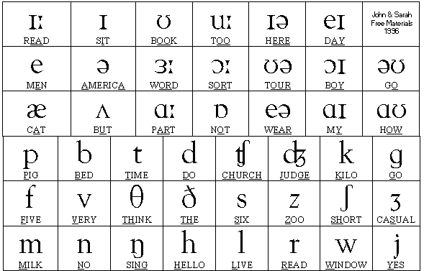

Slide 3
Though / tough / thought /ðəʊ/ ≠ /tʌf/ ≠ /θɔːt/
City /ˈsɪtɪ/
Comfortable /ˈkʌmftəbl/
Basically /ˈbeɪsɪklɪ/
Psychological / honest / half /ˌsaɪkəˈlɒdʒɪkl/ [ˈɒnɪst] [ˈhɑːf]
Women /ˈwɪmɪn/
Russia /ˈrʌʃə/
Measure /ˈmeʒə/
Enough /ɪˈnʌf/
Home /həʊm/
Arrival /əˈraɪvl/
Vehicle /ˈviːɪkl/

Slide 4
advertize,
again,
appreciate,
amazing,
cigarette,
commerical,
to consider,
a contrast but to contrast,
economy, but economic,
an increase but to increase,
Japan but Japanese,
necessary,
photograph but photographer,
political,
politics,
punishment,
refugee,
refusal,
science but scientific and scientist,
unhappy,
volunteer,
widen

Slide 5
FAUX-AMIS
NOUNS
Affluence richesse a crowd
Agenda ordre du jour a diary
Bid une offre the belly / the stomach
Bribe un pot-de-vin a scrap
Chance le hasard luck
College l’université middle-school / high-school
Commodity une marchandise usefulness
Demonstration une manifestation a demonstration
Drug(s) des médicaments drugs
Executive cadre (en entreprise) executive
Exhibition une expo exposure
Figure une silhouette, un chiffre a face
Hazard un danger chance
Journey un voyage a day
Lecture une conférence reading
Location le lieu rental
Occupation le métier occupation, activity
Pensioner le retraité a boarder
Physician le médecin the physicist
Preservative un conservateur a condom
Relative un membre de la famille relative
Résumé un CV a summary
Survey sonder to watch, monitor, keep an eye on

