Slide 1
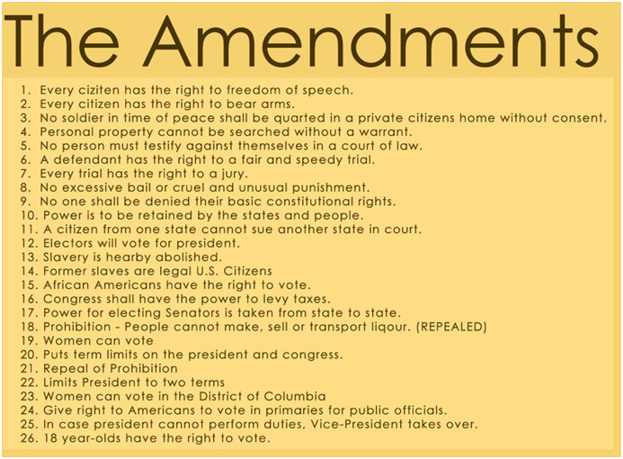

Slide 2
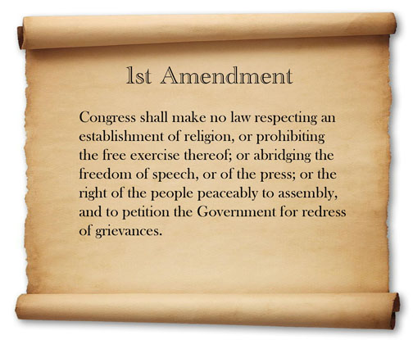

Slide 3
https://www.youtube.com/watch?v=Jh5FfSSBWw4

Slide 4
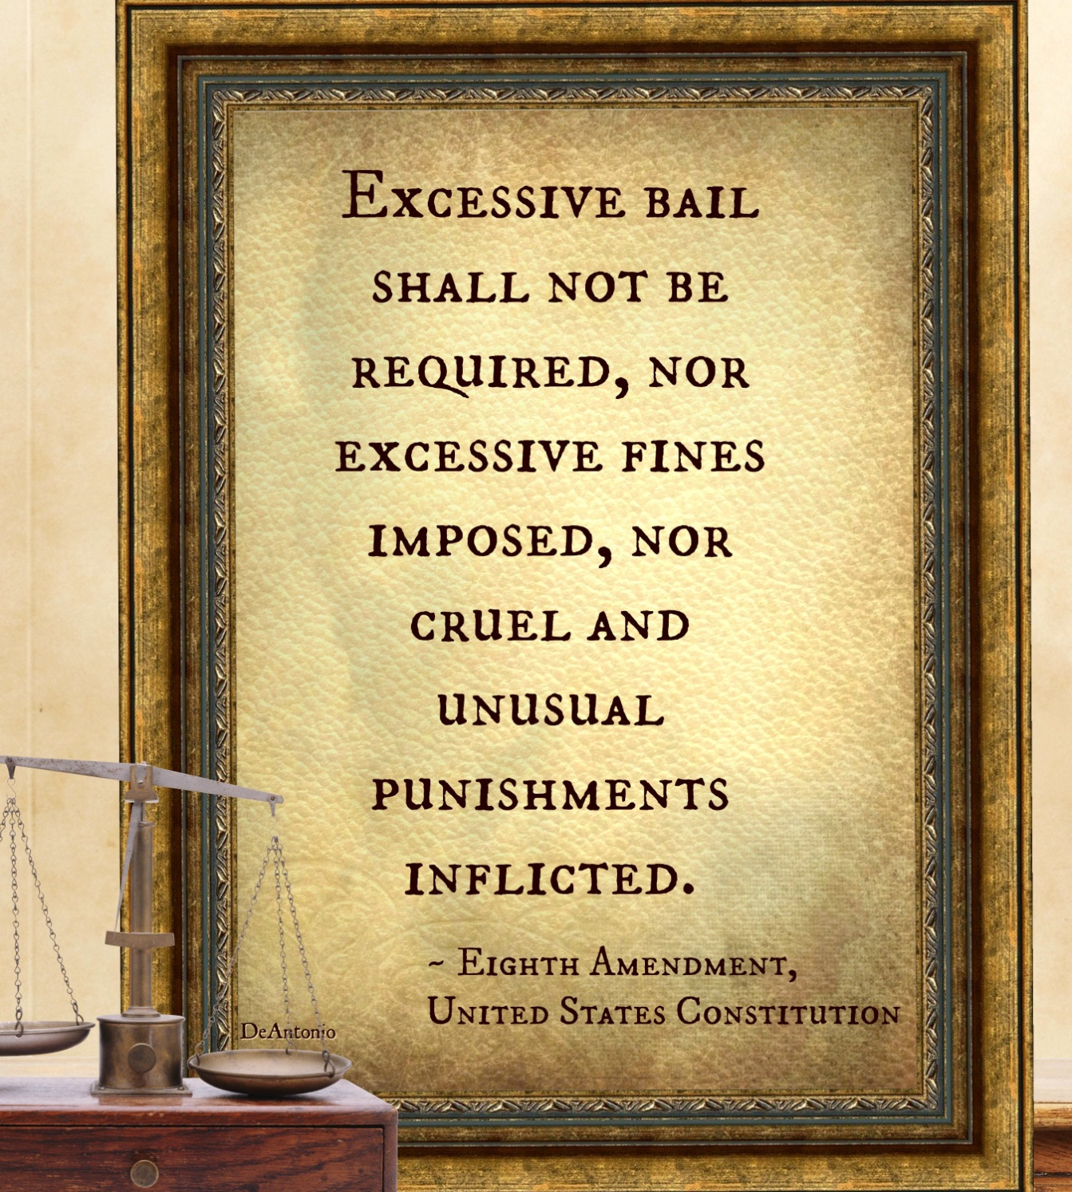

Slide 5
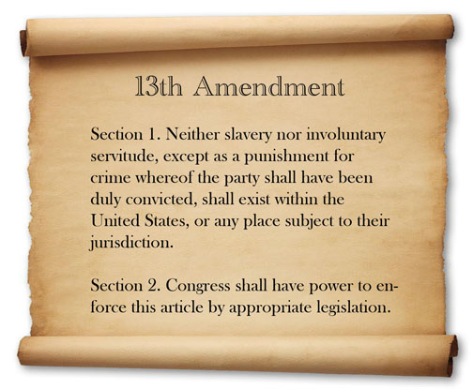
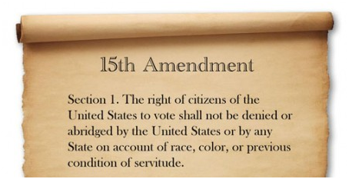

Slide 7
https://www.youtube.com/watch?v=wsXhPic9hnA

Slide 8
https://www.youtube.com/watch?v=FwREAW4SlVY

