Slide 1
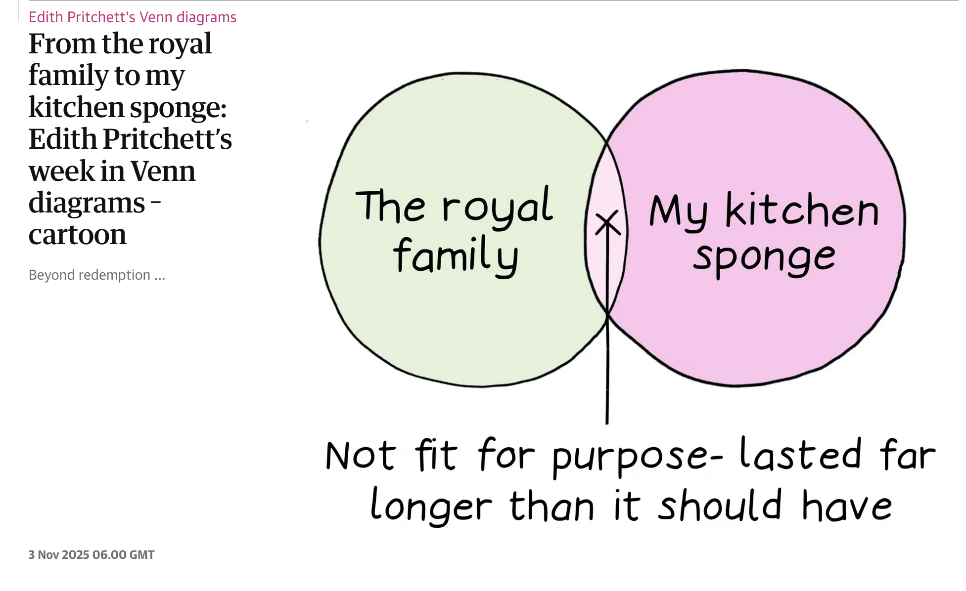
A dis-United Kingdom ? - Part 1 : The Monarchy

Slide 2
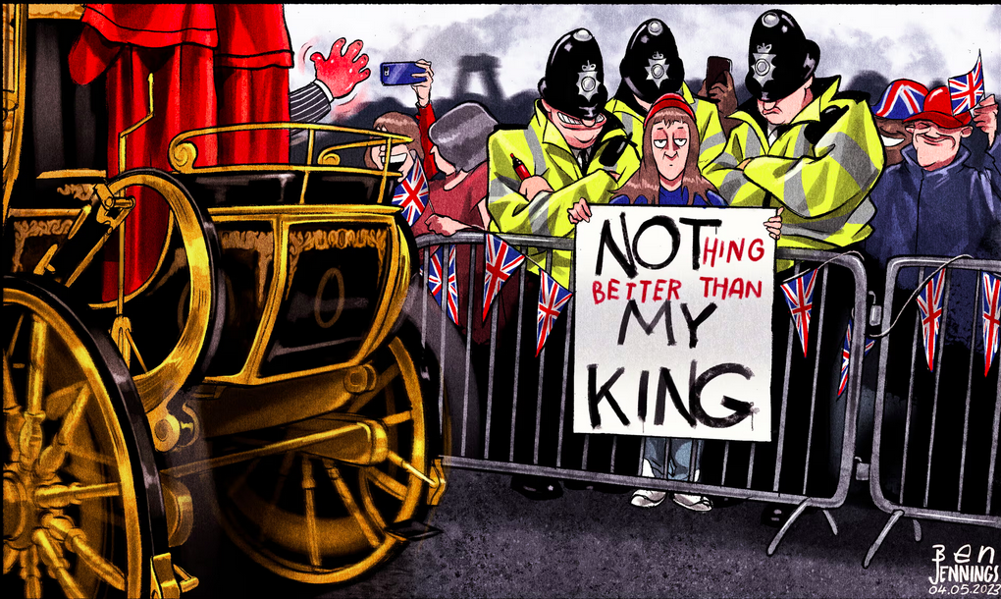

Slide 3
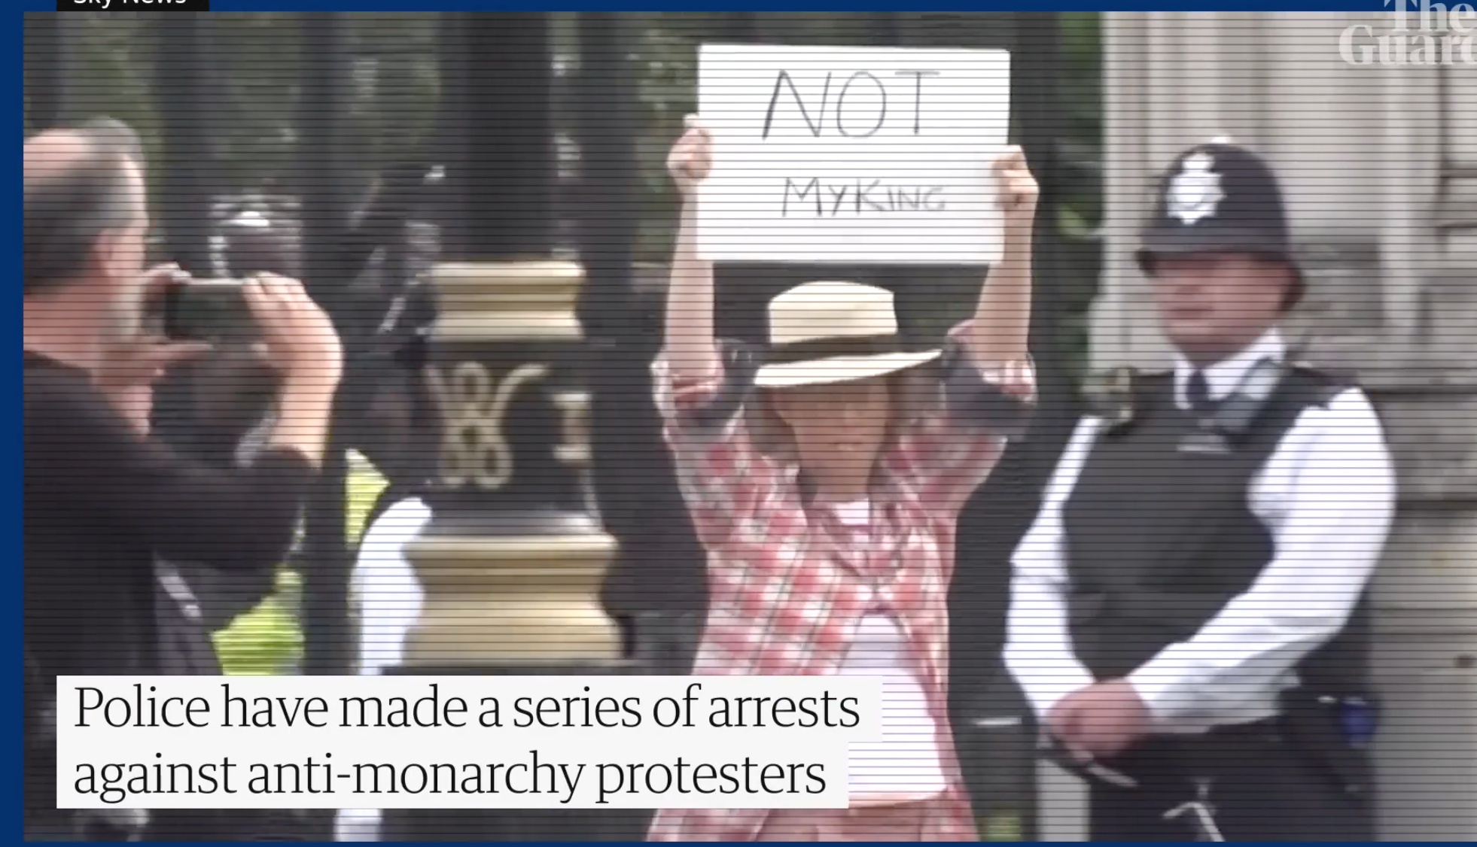
2a) The anti-monarchy protesters among mourners threatened with arrest: 'Not my King' - The Guardian 13/09/2022 https://www.youtube.com/watch?v=sSleul0RJsU
2b) King's Coronation: Metropolitan Police 'regret' arrest of six anti-monarchists
SkyNews 8th May 2023 https://www.youtube.com/watch?v=dEwoAZkfWkM

Slide 4
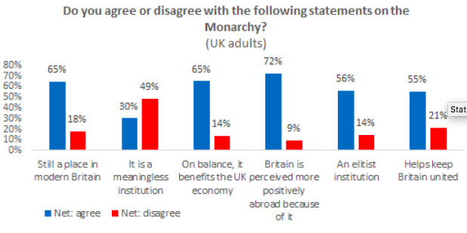
3a

Slide 5
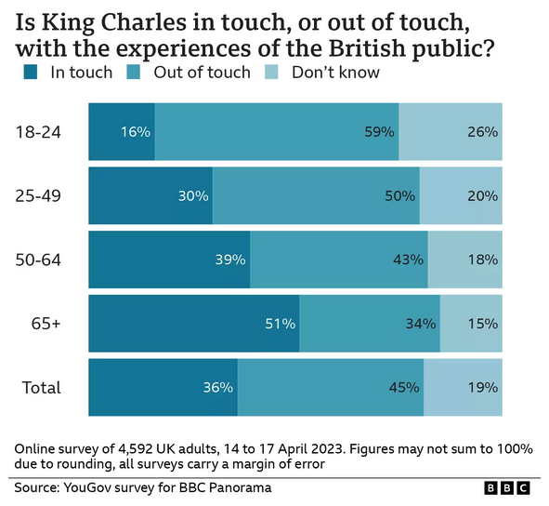
3b

Slide 6
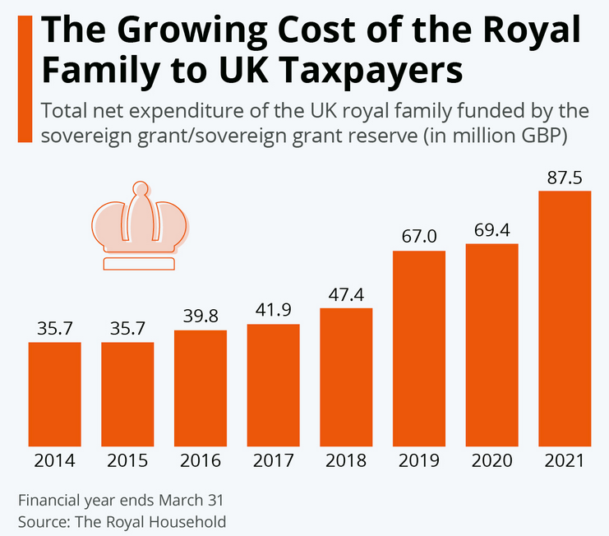
3c

Slide 7
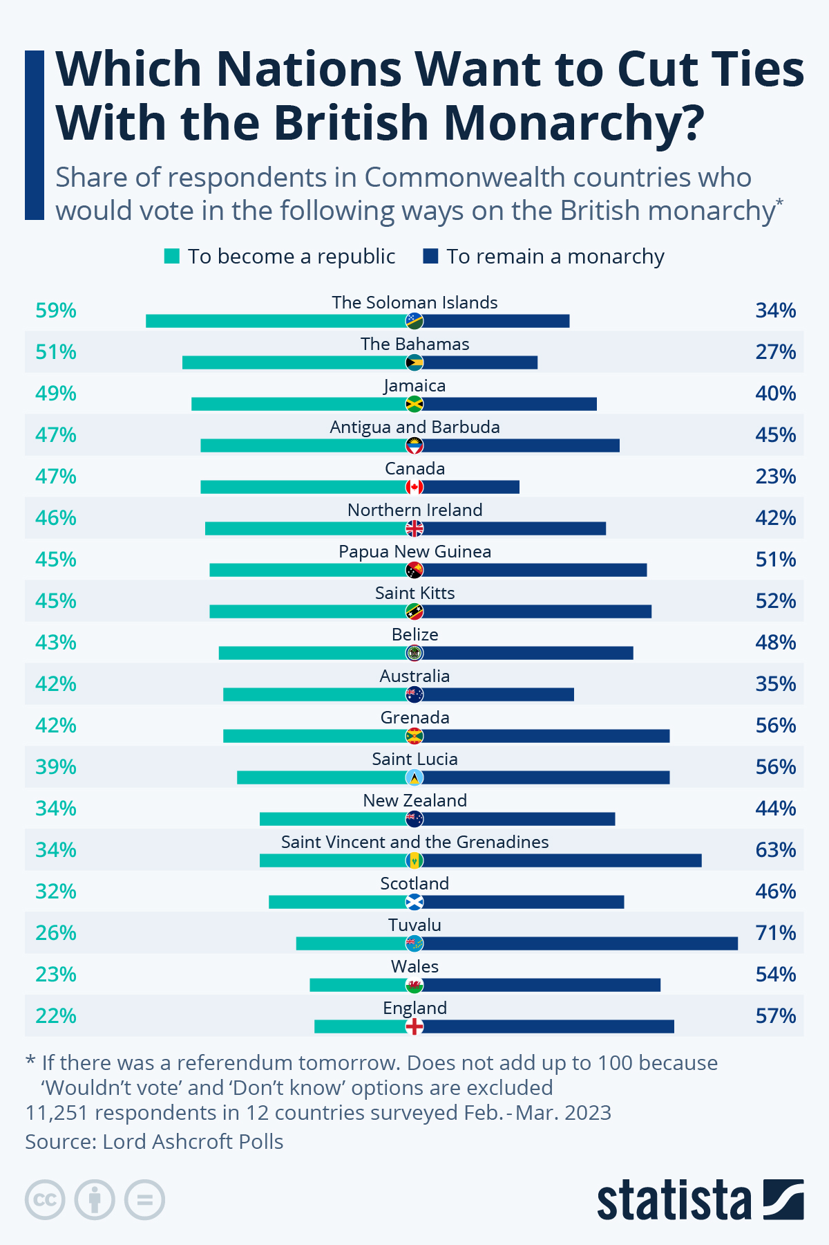
3d

Slide 8
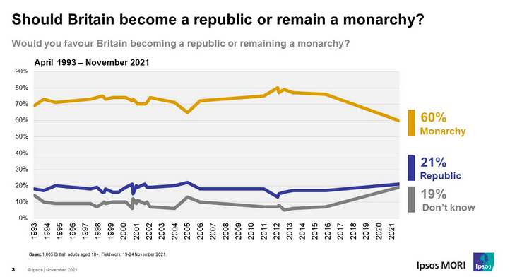
3e

Slide 9
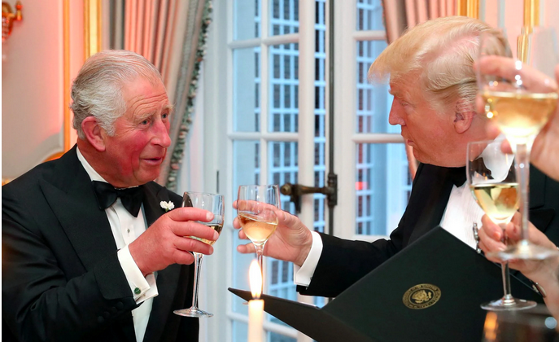
DOCUMENT 4
Trump state visit shows the King has won the battle for Canada
Hannah Furness – The Telegraph – 25th June 2025
Find words and expressions in the text which belong to the lexical field of ROYALTY / CEREMONY / SOFT POWER corresponding to the definitions:
To use something to maximum advantage : ……………………………
Idiom: to end or resolve a concern : ……………………………
Influence through attraction rather than coercion : ……………………………
To reject or disallow a decision : ……………………………
Elaborate and formal display (often in official events) : ……………………………
Idiom: with all possible features or ceremonies : ……………………………
To take control of a territory : ……………………………
To reduce the intensity or importance of something : ……………………………

Slide 10
2. Reported and direct speech – Discours indirect et indirect
a) Les phrases extraites du texte sont des exemples de discours indirect. Réécrivez ces phrases en discours direct. Attention au temps / pronoms / marques de temps + le temps peut rester le même si les actions sont
A Downing Street spokesman denied that Sir Keir Starmer had “overruled” him when negotiating with the White House.
British diplomats noted that Mr Carney risked breaching the convention
One senior palace source said it was intended as “thought-provoking, not provocative”.
b) Les phrases extraites du texte sont des exemples de discours direct. Réécrivez ces phrases en discours in direct (attention au temps / pronoms / marques de temps)
Asked by CNN whether the US president is still threatening to annex Canada, Mark Carney said: “No, he is not.” “He admires Canada,” he added. “I think it’s fair to say maybe for a period of time [he] coveted Canada.”
One source asked of the past few weeks: “We haven’t heard much about Canada, have we?”

Slide 11
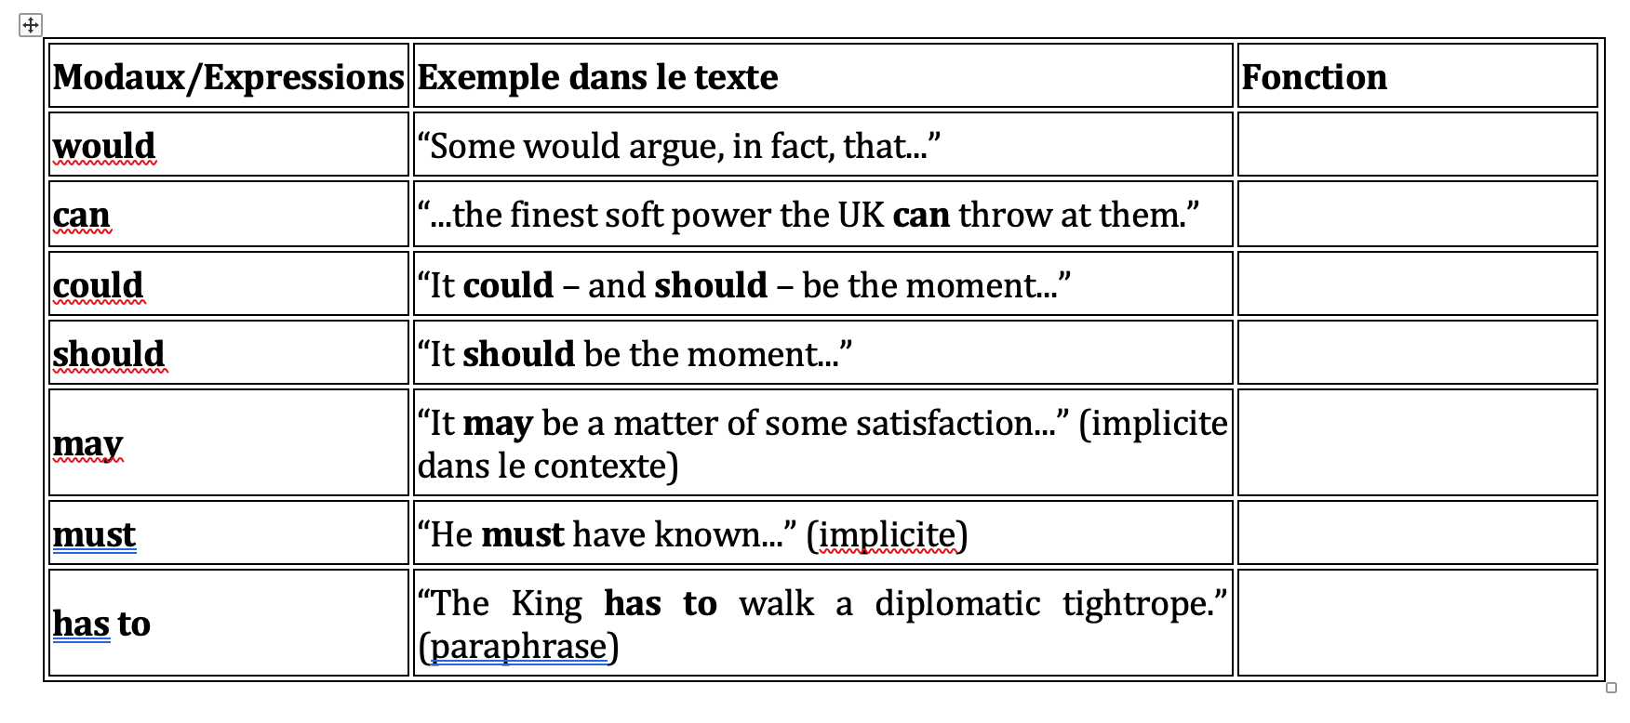

Slide 12
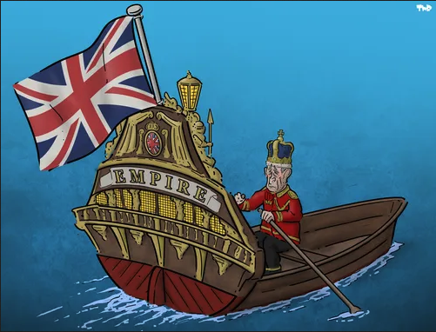

Slide 13
