Slide 1
The U.K. in Europe
PART ONE – Territories - borders

Slide 2
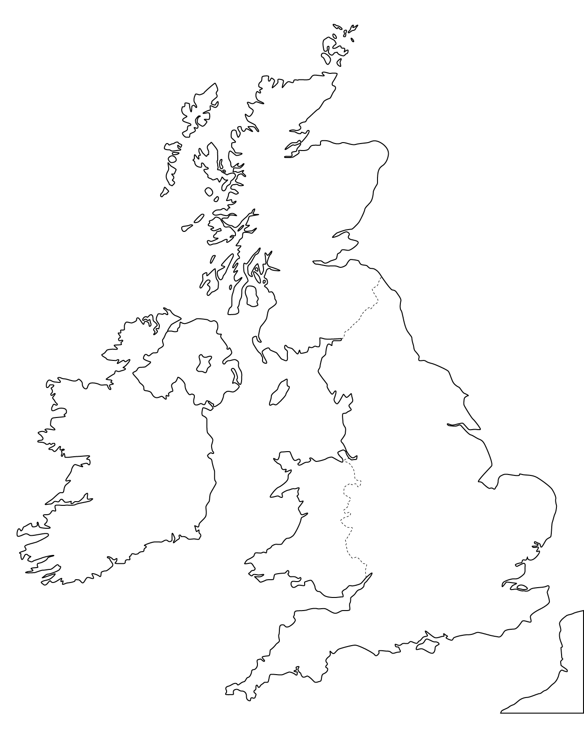

Slide 3
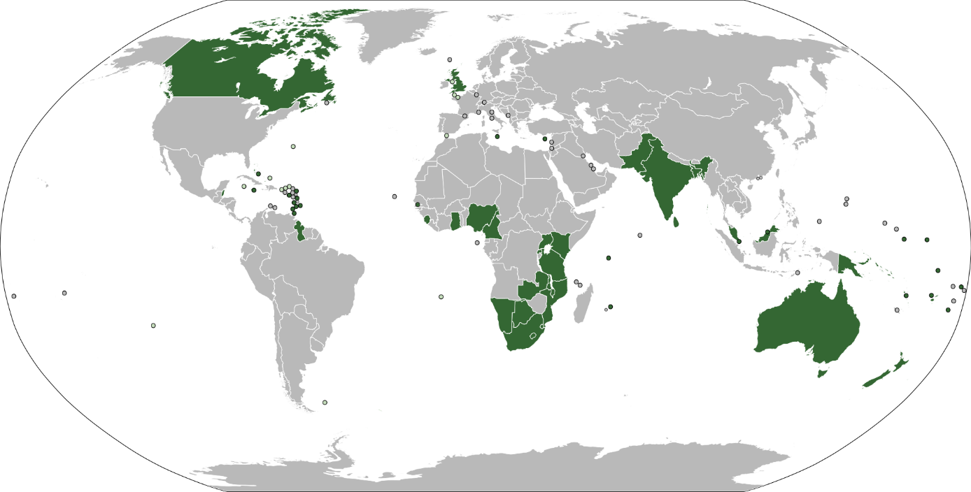

Slide 4
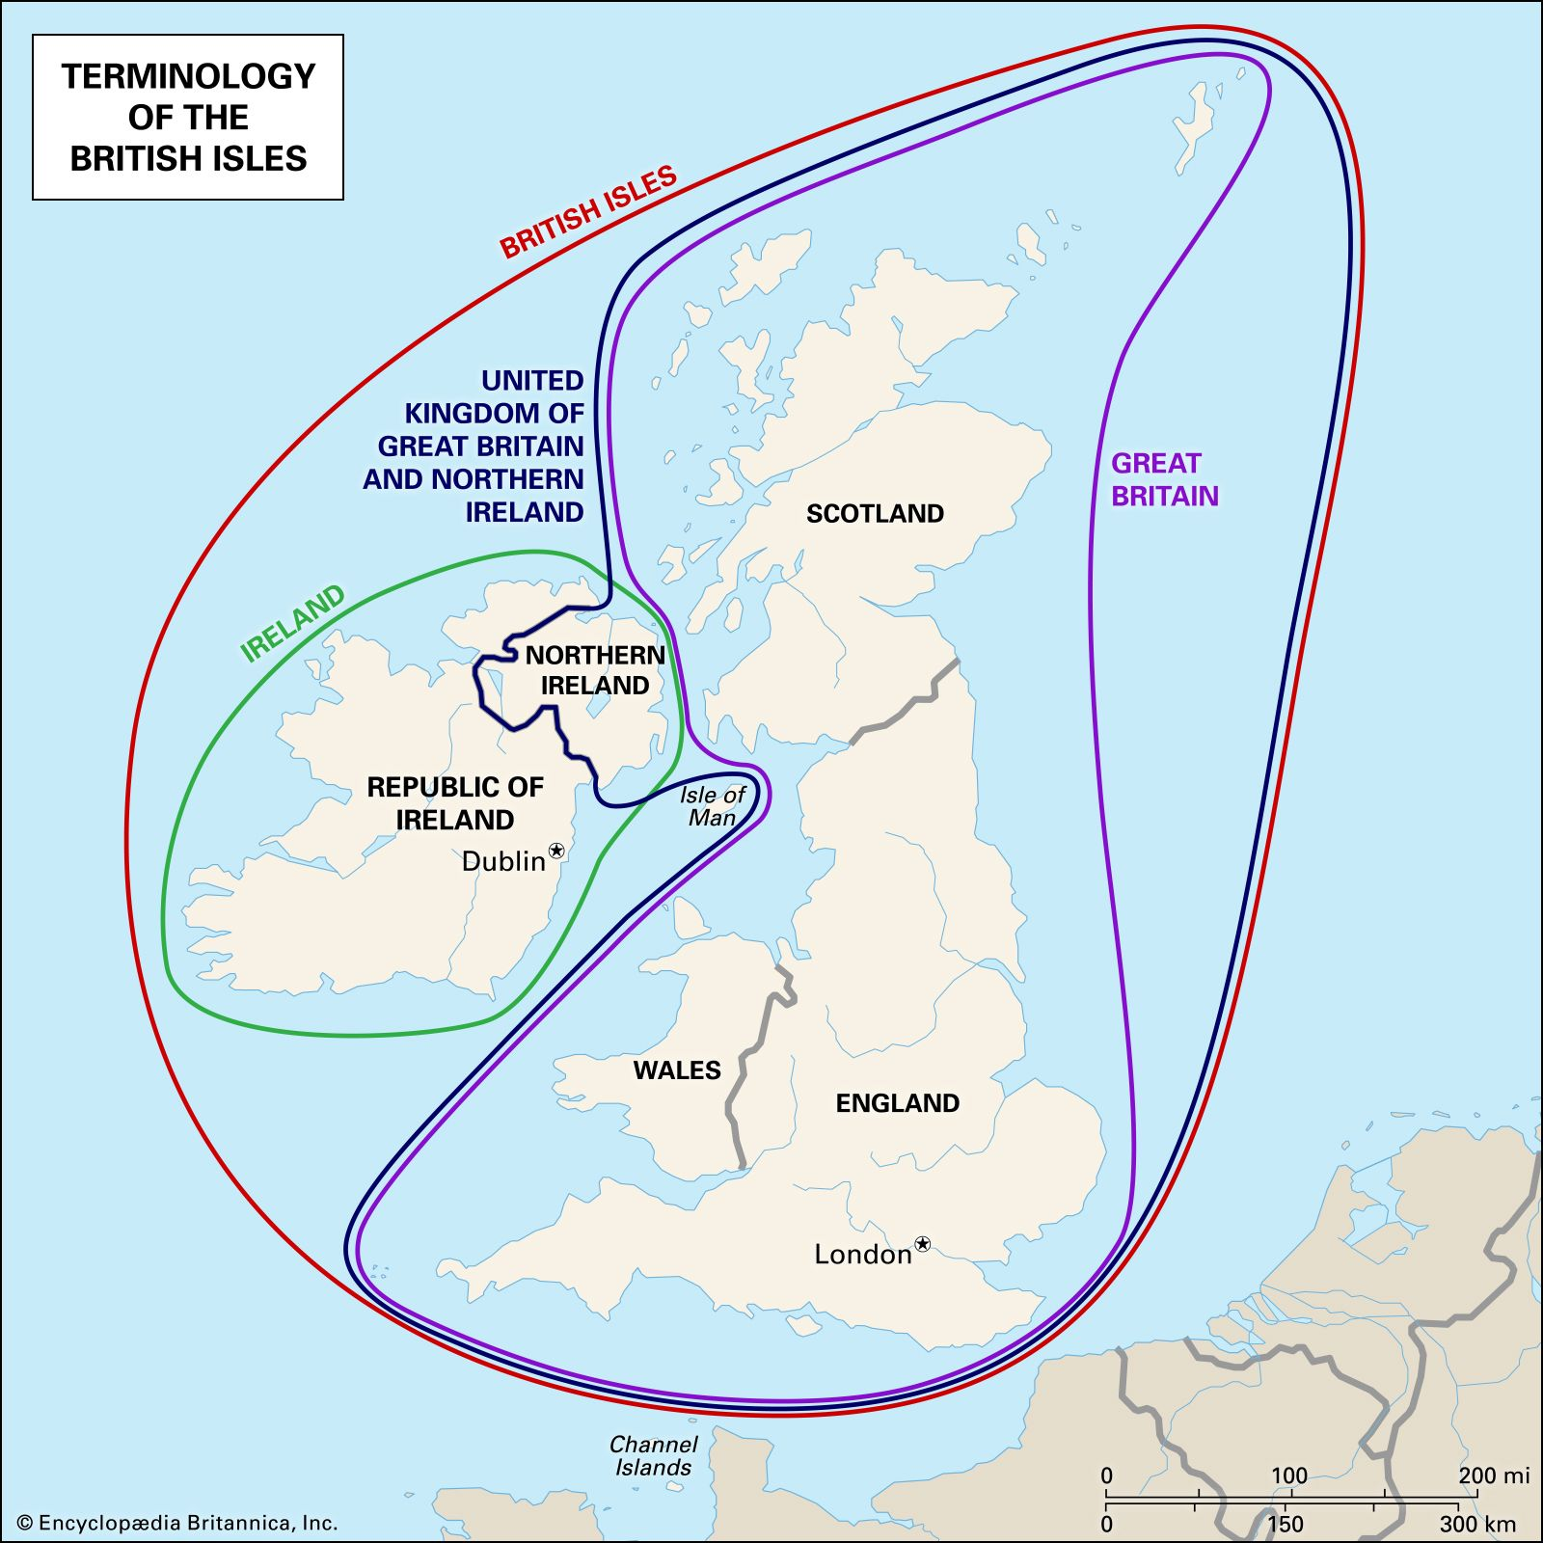

Slide 5
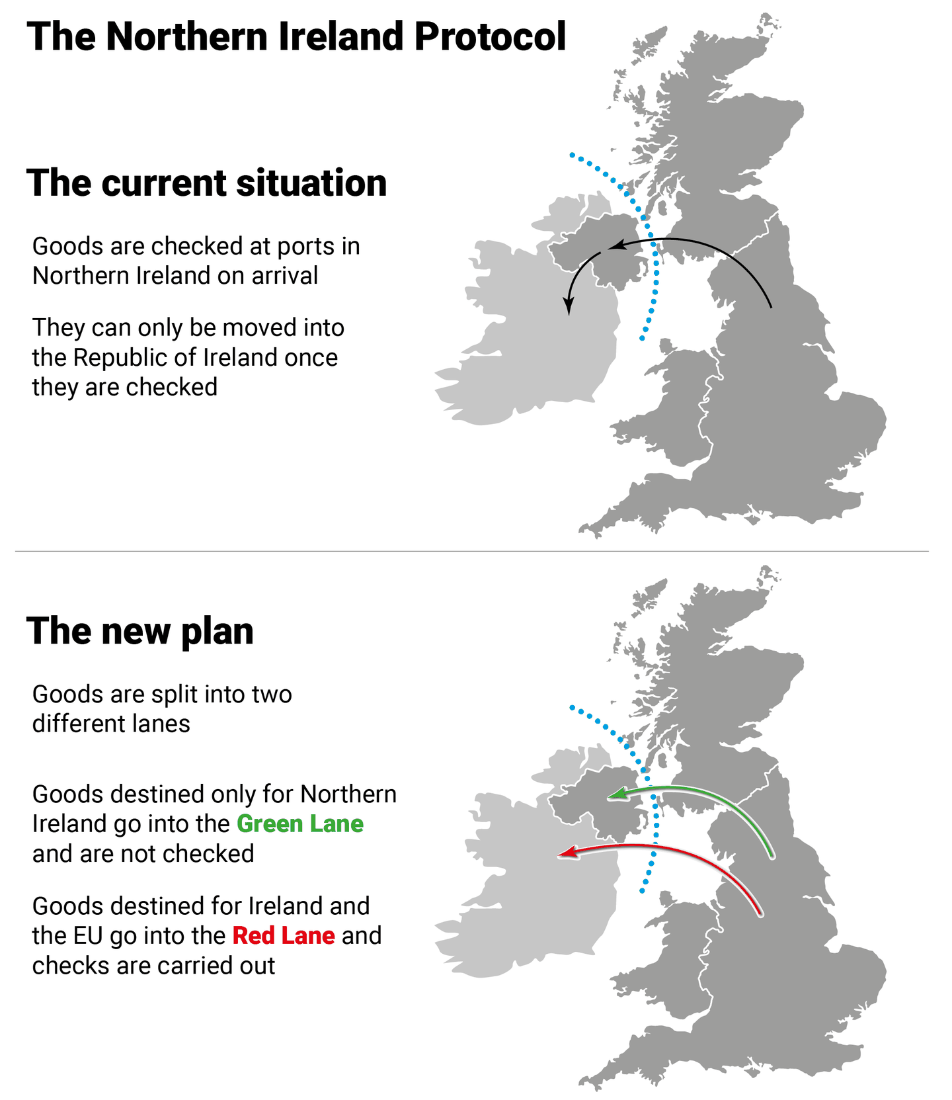

Slide 6
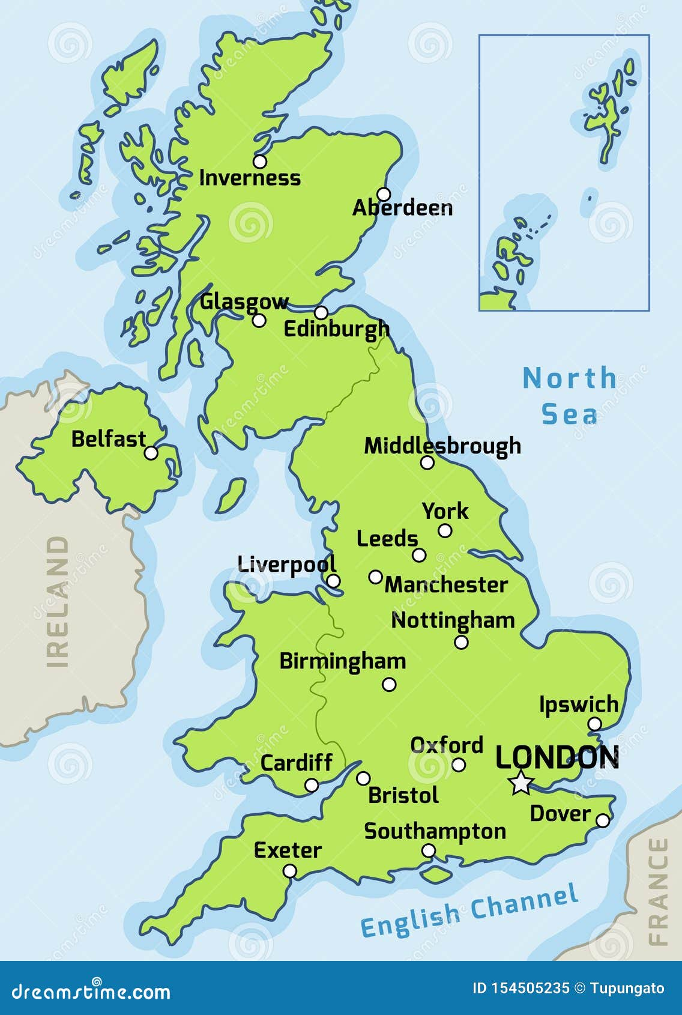

Slide 7
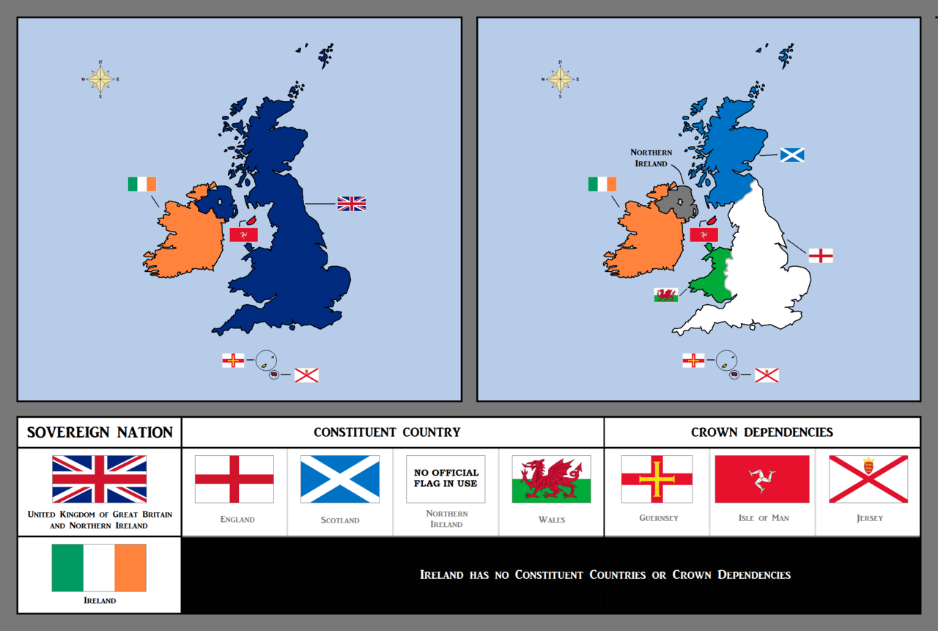

Slide 8
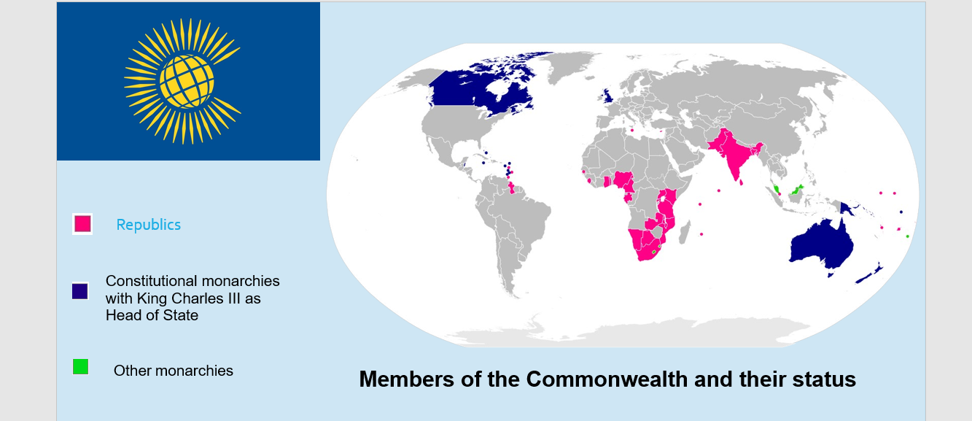

Slide 9
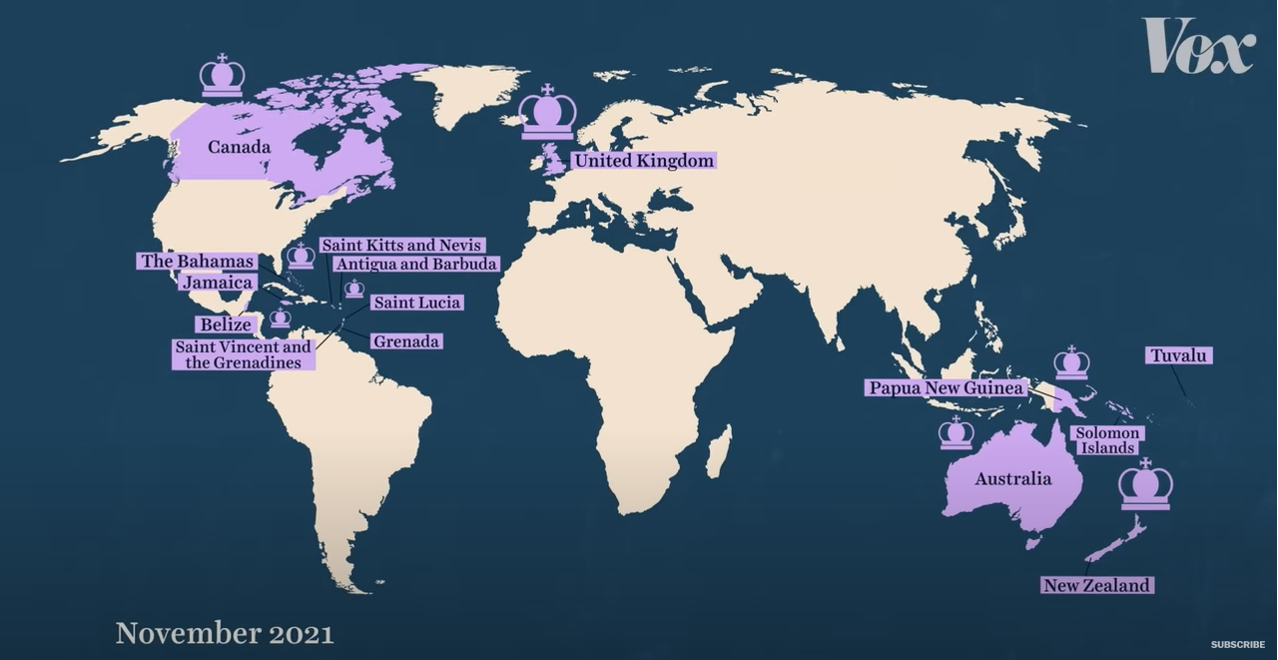

Slide 11
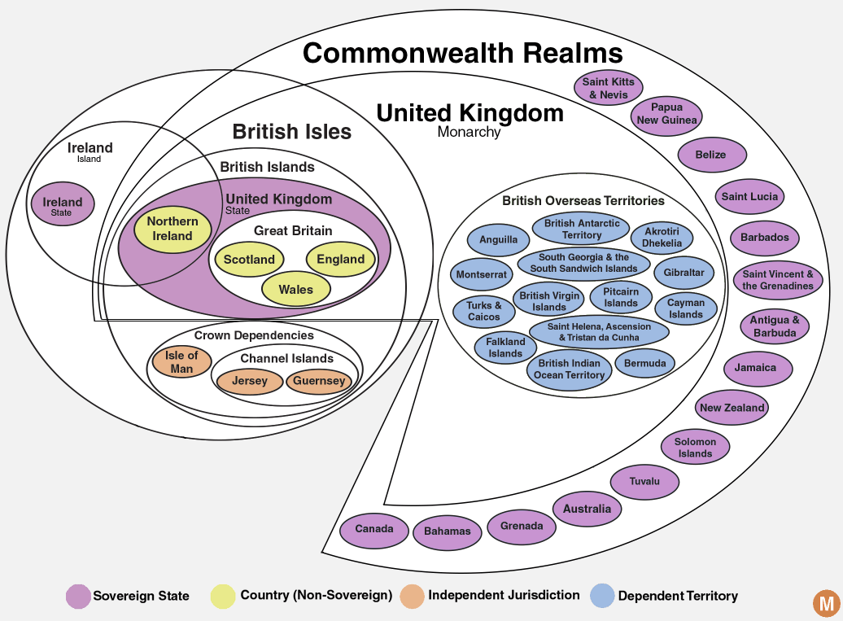

Slide 12
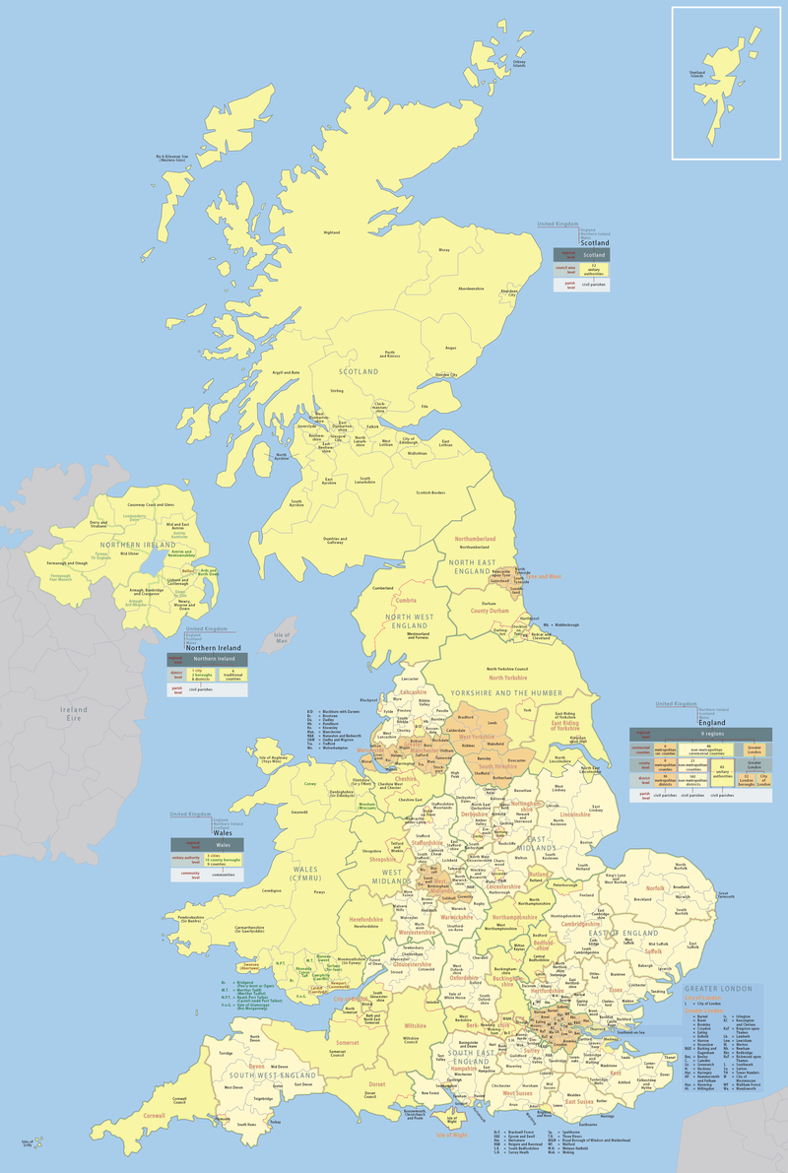

Slide 13
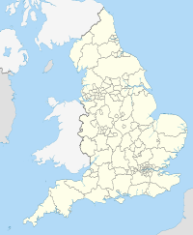
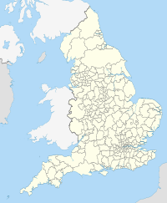

Slide 14
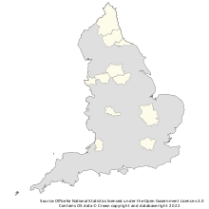
The Greater London Authority and 10 combined authorities of England, as of December 2021.

Slide 15
The Overseas Territories
The British Overseas Territories are the fourteen territories which are under the United Kingdom's sovereignty, but are not part of the United Kingdom itself.
Before 1981 the territories were known as colonies or Crown colonies. The British Overseas Territories are also referred to as overseas territories of the United Kingdom, UK overseas territories, or when the context is clear, simply the Overseas Territories.
Each of the British Overseas Territories have a parliament, government and prime minister to make all laws, except laws about defence and foreign affairs. The British government manages their defence and foreign affairs.
If the British Overseas Territory is ruled badly, the government of the British Overseas Territory can be taken over by the British government and ruled directly by it, without the agreement of the British Overseas Territory.

Slide 16
The Crown Dependencies are three island territories in the British Islands that are self-governing possessions of the British Crown: the Bailiwick of Guernsey and the Bailiwick of Jersey, both located in the English Channel and together known as the Channel Islands, and the Isle of Man in the Irish Sea between Great Britain and Ireland.
They are not part of the United Kingdom (UK) nor are they British Overseas Territories. They have the status of "territories for which the United Kingdom is responsible", rather than sovereign states. As a result, they are not member states of the Commonwealth of Nations. However, they do have relationships with the Commonwealth and other international organizations, and are members of the British–Irish Council. They have their own teams in the Commonwealth Games.

Slide 17
For several hundred years, each has had its own separate legislature, government and judicial system. However, as possessions of the Crown they are not sovereign nations in their own right and the British Government is responsible for the overall good governance of the islands and represents the islands in international law. Acts of the UK Parliament are normally only extended to the islands only with their specific consent. Each of the islands is represented on the British-Irish Council.

