Slide 1
BREXIT
June 23 2016

Slide 2
Events Leading up to the referendum

Slide 3
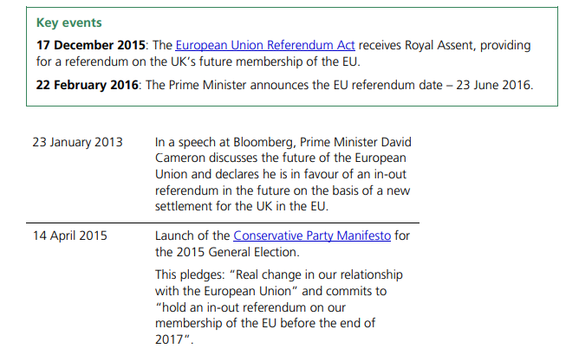
https://www.bbc.com/news/uk-politics-21170265

Slide 4
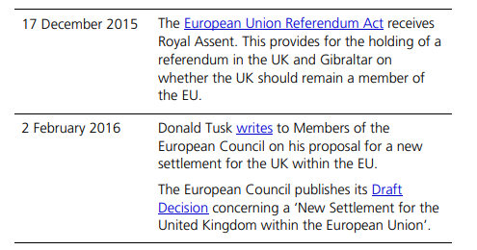
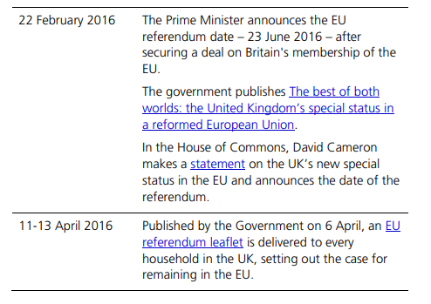
https://www.gov.uk/government/publications/why-the-government-believes-that-voting-to-remain-in-the-european-union-is-the-best-decision-for-the-uk/why-the-government-believes-that-voting-to-remain-in-the-european-union-is-the-best-decision-for-the-uk

Slide 5
The bloomberg speech ten years on
January 23 2023
It’s a decade on from David Cameron making his ‘Bloomberg speech’, so named because it was at the Bloomberg office in London where – on the 23rd January 2013 – Cameron committed to a policy of renegotiating the UK’s membership of the EU, followed by an in/out referendum in the next Conservative party manifesto.
Cameron won a majority at the 2015 general election, on that manifesto, and duly commenced his renegotiation and referendum strategy.
The renegotiation he achieved – while significant to the then prime minister and his team – was judged underwhelming and swiftly forgotten in the referendum campaign that followed. When ‘Leave’ won the referendum, Cameron announced his resignation as prime minister – a little over a year after winning a majority, and three and a half years after the Bloomberg speech.
WHY DID HE COMMIT TO A REFERENDUM?

Slide 6
There are broadly three main pressures David Cameron faced as Prime Minister when he reached this decision
A 'party' pressure - that is from increasing Euroscepticism on the Conservative backbenches.
An 'electoral' pressure - often centred on perceptions that Nigel Farage and UKIP would damage the Conservative Party's chances at a general election.
A lesser-known 'policy' pressure - where Cameron became increasingly concerned that an 'ever closer union' within the EU risked the UK's interests.

Slide 7
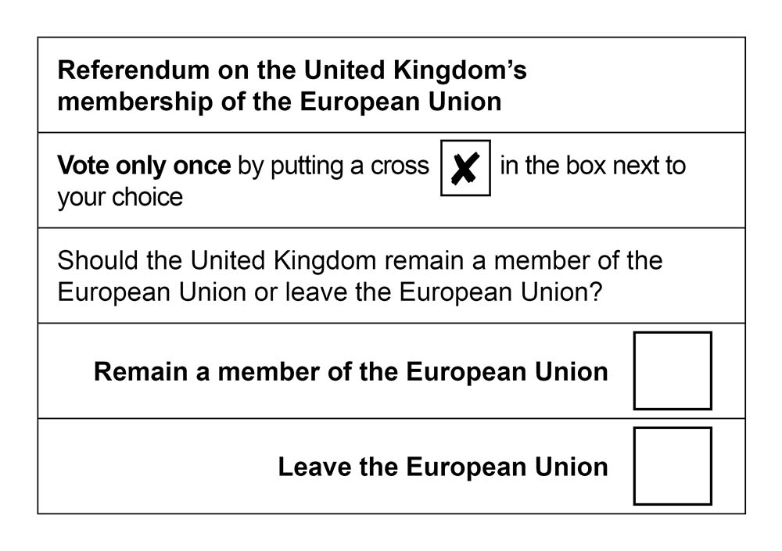
The Question

Slide 8
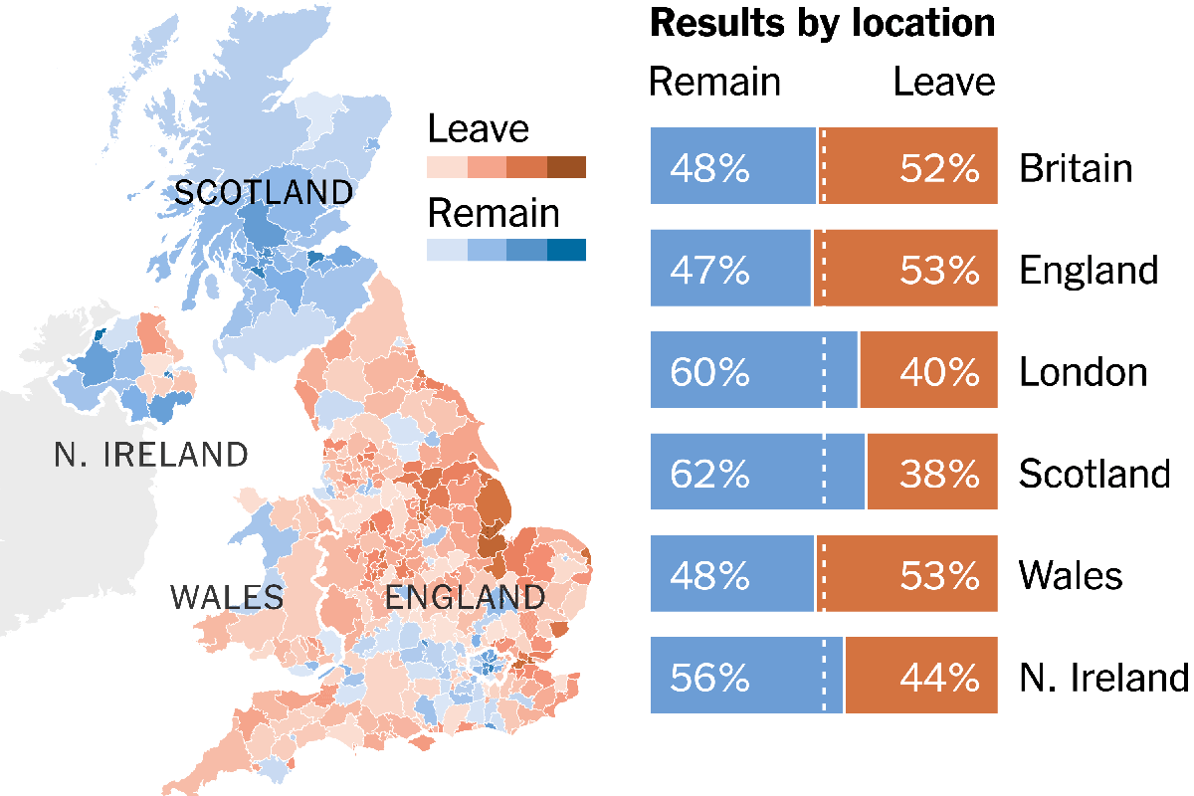
The Results

Slide 9
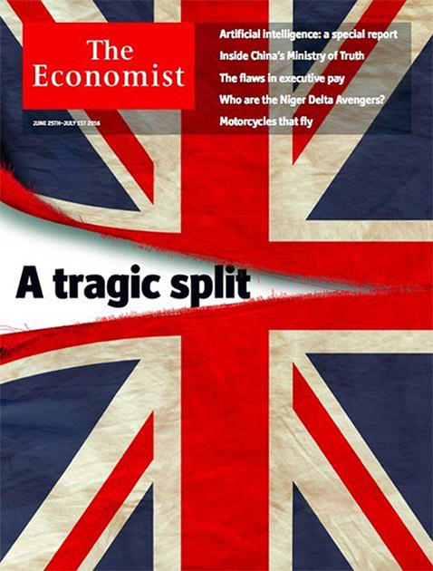
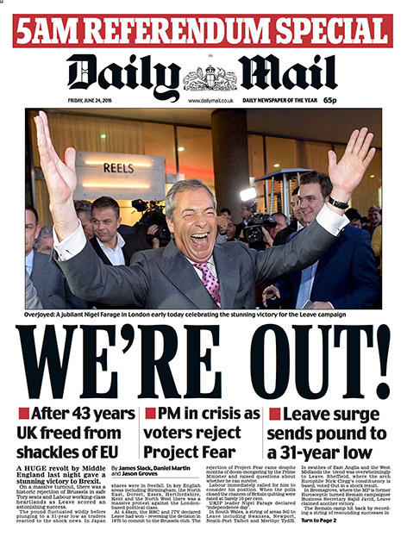
Front pages on June 24 2016

Slide 10
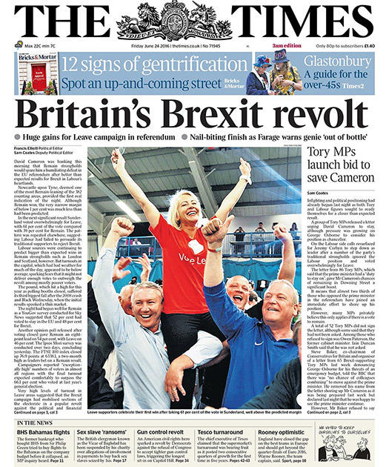
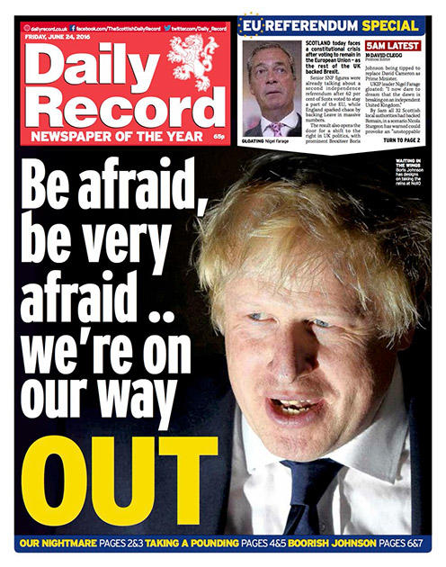
The Brexiteers

Slide 11
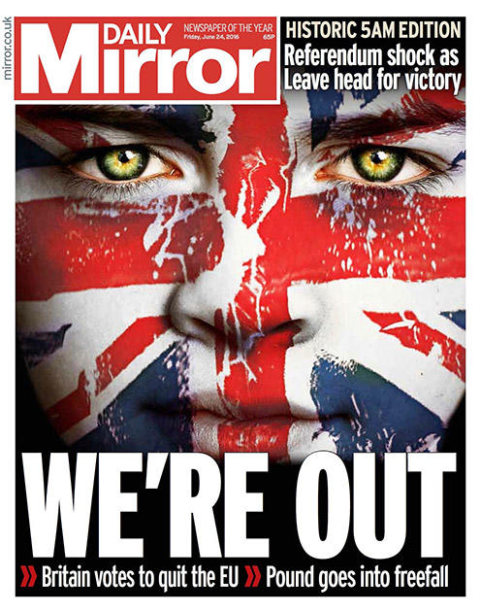
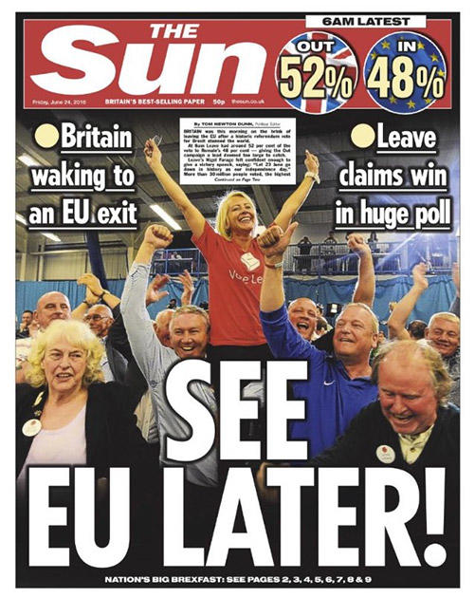
The Leave camp – Brexiteers / ters

Slide 12
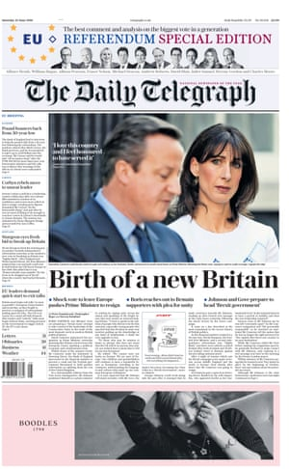
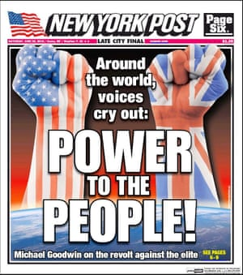

Slide 13
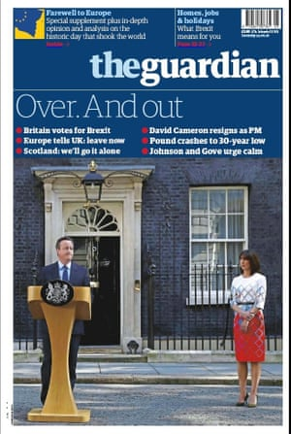
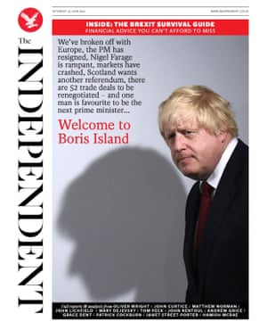
The Remain Camp – The Remainers

Slide 14
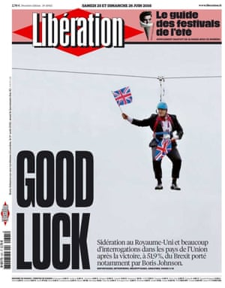
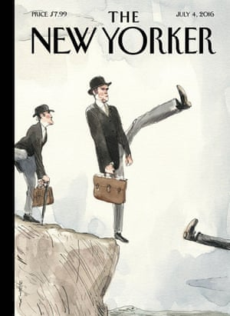

Slide 15
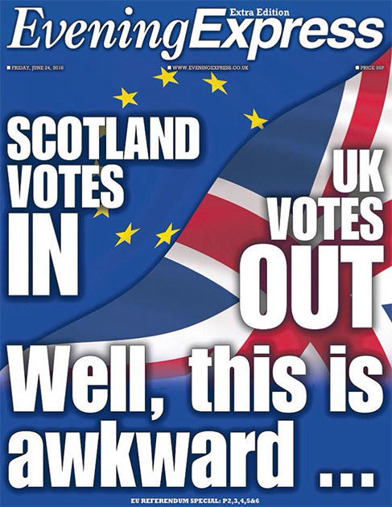
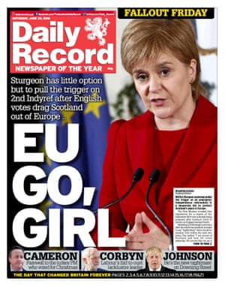
In Scotland

Slide 16
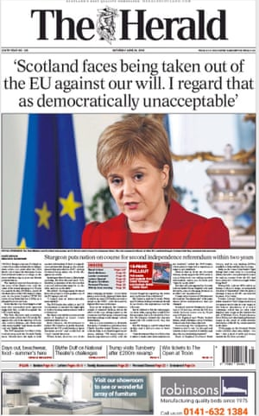

Slide 17
A few Headlines
‘Brexit’ Upsets Londoners Who Find Harmony in a Cultural Cacophony
British Politics Gives a Sense of Government by Old School Chums
The Brexit vote reveals a country split down the middle
The results paint a picture of an angry country divided by class, age and region
Irish Times view: Brexit a bewildering act of self-harm
What we cannot and will not accept is that the EU is the problem
We have woken up in a different country Jonathan Freedland
For the 48% who voted to remain, and for most of the watching world, Britain has changed in a way that makes the heart sink

Slide 18
On a different note
SUN SAYS Rage of the working class
THE people have spoken. We have woken up to a new Britain.
It is a momentous turning-point in our history.
For the first time in 43 years our nation will stand on its own feet, free from the European Union.
What David Cameron experienced yesterday was an explosion of anger from millions of working class people who cannot now be ignored.
Some was directed at the EU he campaigned with such cynicism to stay in.
More it was a howl of rage at the increasing hopelessness of their lives, their neglected communities and the gulf between them and the rich, ­powerful governing class which this Referendum has so starkly exposed.
Our population has just rocketed by 513,273 in one year, 335,600 from migration. It is not racist to protest at the calamitous effect this is having on working people who bear the brunt of it.
Prosperous middle class home owners in London love all the Polish plumbers and cleaners. For working people the influx has meant low pay, stagnant for a decade as housing costs have soared. It means schools and surgeries are full up.
It means being branded “thick” by ­supposedly educated Remain supporters too dim themselves to see that the rational desire for our Government to control immigration has nothing — zero — to do with prejudice or narrow-mindedness.
Liberals champion all disadvantaged people EXCEPT poor Brits. For them, they cannot hide their contempt.

Slide 19
BREXIT
How did the Uk end up voting leave the European union?

Slide 20
Tory Eurosceptics gaining ground
The long read
Brexit: how a fringe idea took hold of the Tory party
Two decades ago the idea of Britain leaving the EU was almost unthinkable. How did a generation of Tory Eurosceptics bring it back?
by Matthew d'Ancona

Slide 21
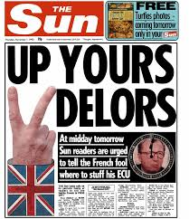
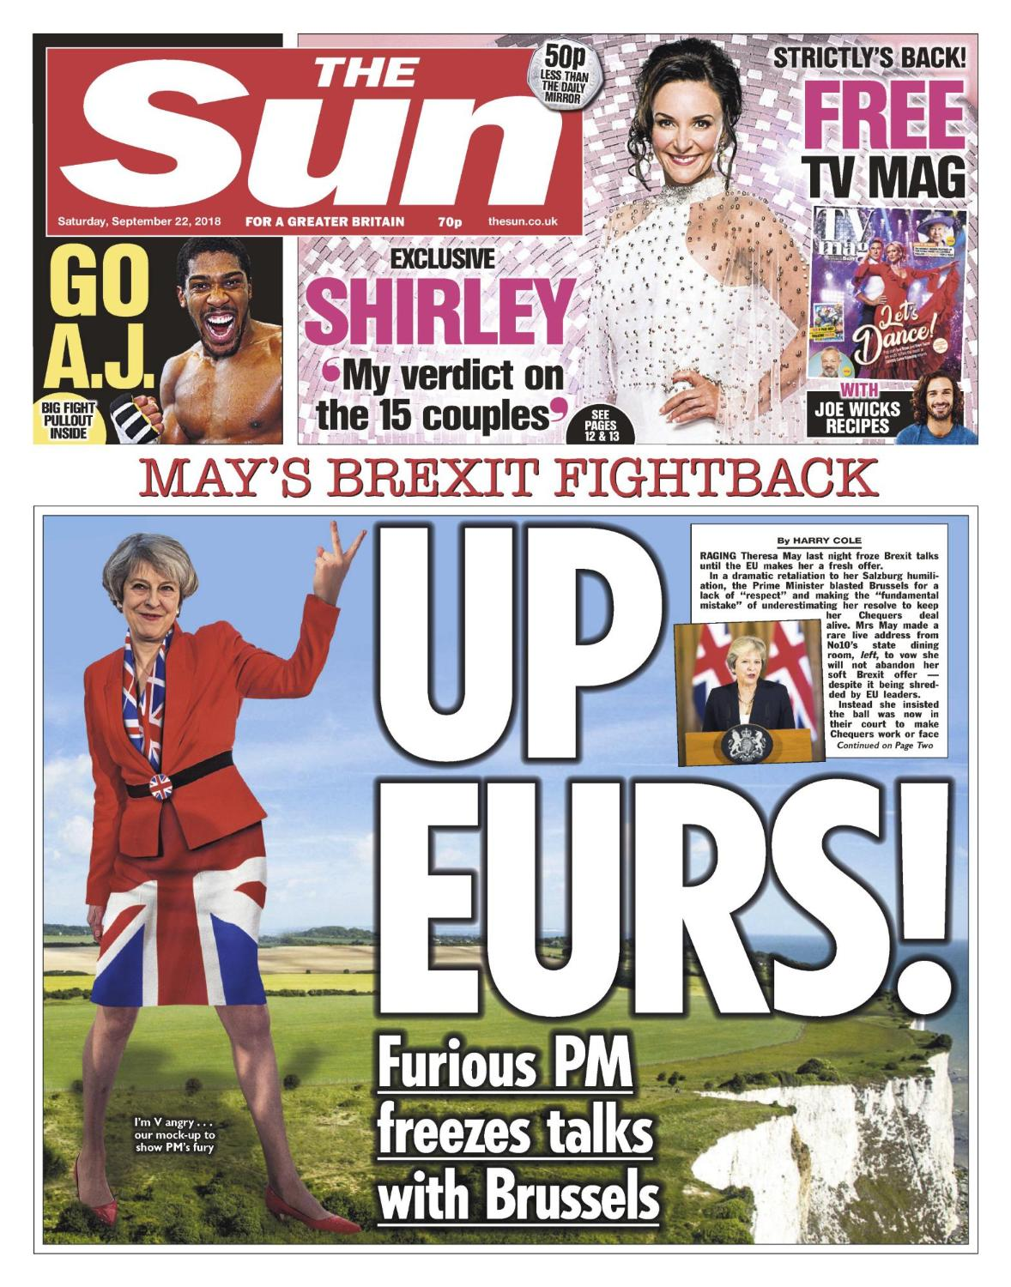
Deeply rooted distrust of Brussels

Slide 22
From Super-Market to Orwellian Super-State: growth of newspaper scepticism

Slide 23
The 10 best Euro myths – from custard creams to condoms
Just in case a Brexit vote today marks the beginning of the end of the euro-myth, we celebrate the most inventive red herrings of all and judge just how truthful they were
If Britain votes Brexit today, it will not only be the end of 40 years of EU membership. It could also mark the beginning of the end of that prolific media staple, a Brussels hardy perennial that has coloured the way Britons view Europe - the euro-myth.
Heard the one about the EU banning bagpipes? Bendy cucumbers? Children blowing up balloons? Or the one about it renaming yoghurt “fermented milk pudding”? What about the madness of the EU’s directives on eggs which, if you believe the various rumours, have to be stamped with the home address of the farmer, must not be sold by the dozen and can no longer be called “eggs”.

Slide 24
May 9,2016 Boris Johnson’s Speech on EU Referendum - Extracts
For many of us who are now deeply sceptical, the evolution has been roughly the same: we began decades ago to query the anti-democratic absurdities of the EU. Then we began to campaign for reform, and were excited in 2013 by the Prime Minister’s Bloomberg speech; and then quietly despaired as no reform was forthcoming. And then thanks to the referendum given to this country by David Cameron we find that a door has magically opened in our lives.
We can see the sunlit meadows beyond. I believe we would be mad not to take this once in a lifetime chance to walk through that door because the truth is it is not we who have changed. It is the EU that has changed out of all recognition; and to keep insisting that the EU is about economics is like saying the Italian Mafia is interested in olive oil and real estate.
It is true, but profoundly uninformative about the real aims of that organization. What was once the EEC has undergone a spectacular metamorphosis in the last 30 years, and the crucial point is that it is still becoming ever more centralizing, interfering and anti-democratic.

Slide 25
Role of the media
Rhetoric of excess / Strong personalities
Myths versus facts: Post-factual democracy
Very influential popular press

Slide 26
Populist rebellion?
Elite and aloof
The Elites versus the people
Bullingdon club

Slide 27
The migration factor

Slide 28
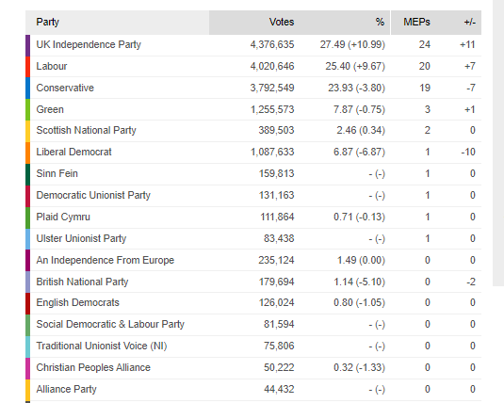
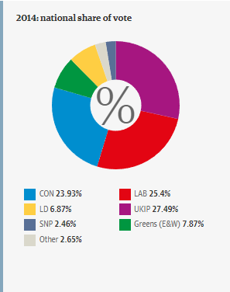
The UKIP Factor

Slide 29
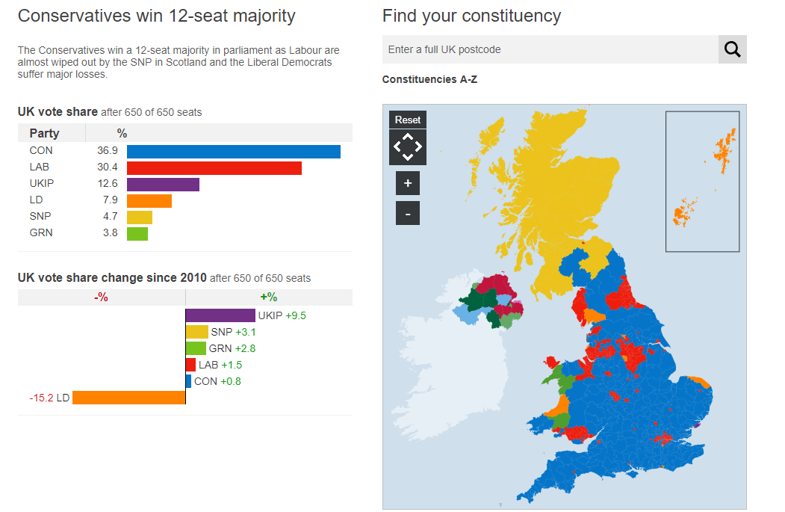

Slide 30
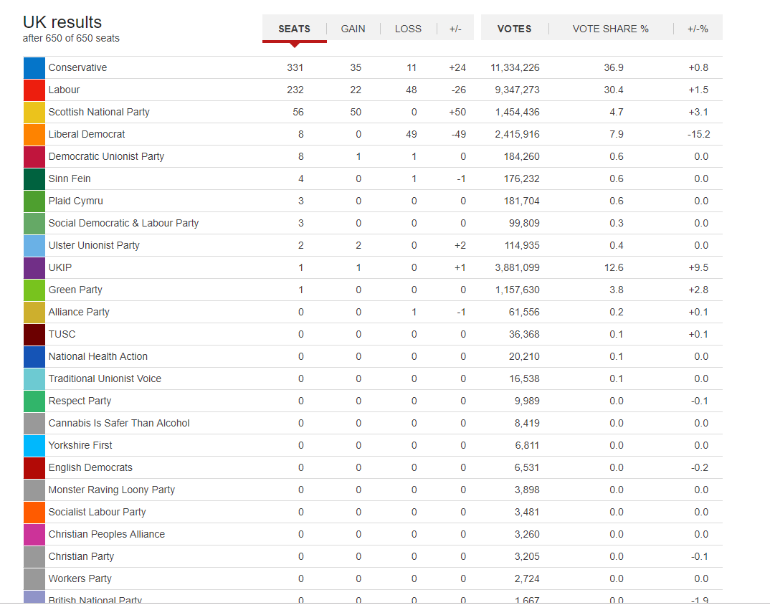

Slide 31
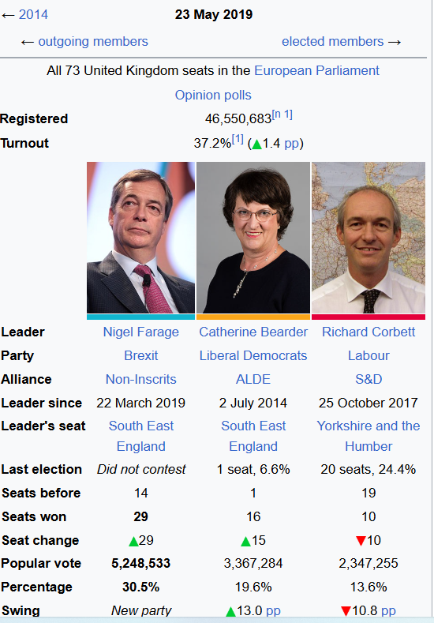
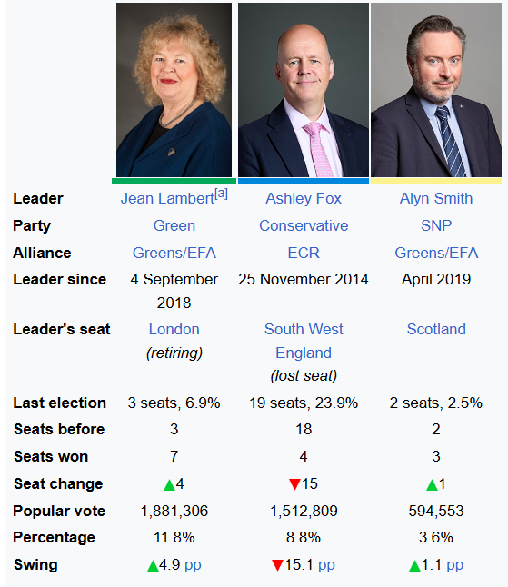

Slide 32
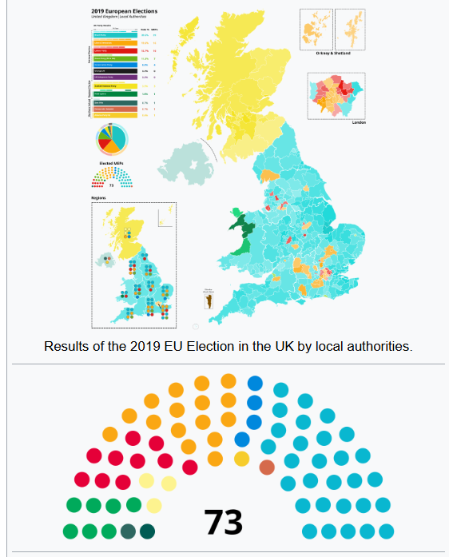

Slide 33
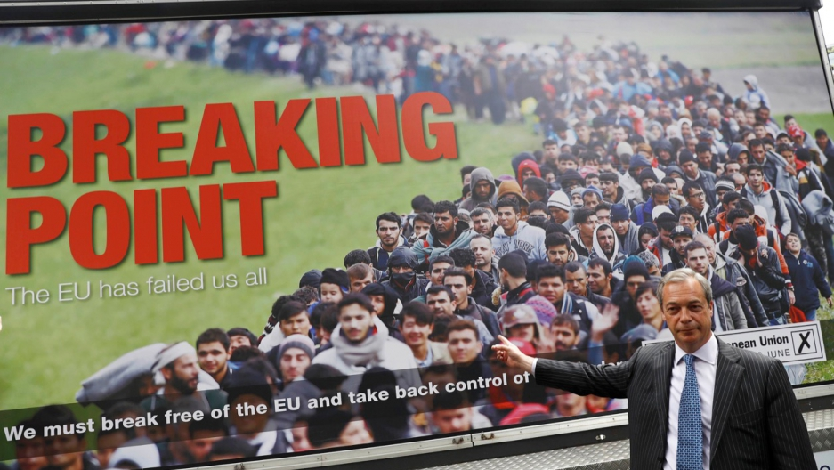

Slide 34
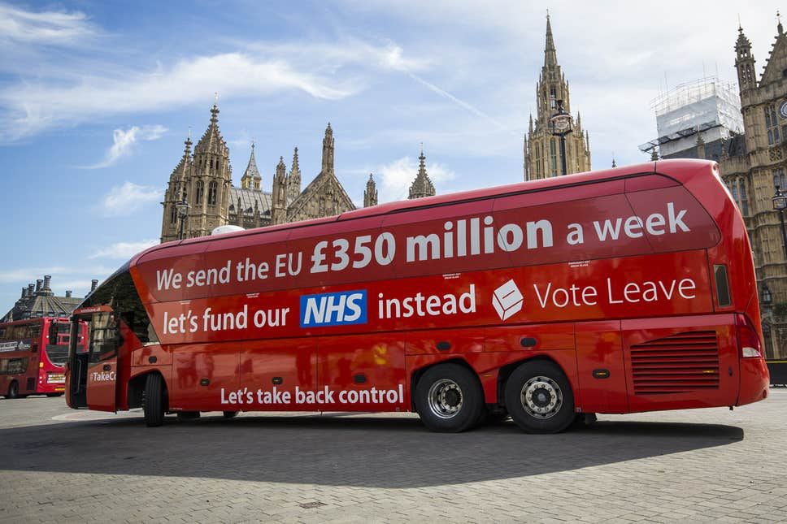

Slide 35
A « botched campaign »?
Officially started on April 15
David Cameron’s Great Miscalculation
Boris Johnson and Michael Gove for leave
Equivocating on the part of Labour

Slide 36
Brexit timeline: events leading to the UK’s exit from the European Union
Published Wednesday, 06 January, 2021
In a referendum held on 23 June 2016, the majority of those who voted chose to leave the European Union.
On 29 March 2017, in writing to European Council President Donald Tusk, the Prime Minister formally triggered Article 50 and began the two-year countdown to the UK formally leaving the EU (commonly known as ‘Brexit’).
The UK had long been expected to leave the European Union at 11pm on 29 March 2019. However, following a House of Commons vote on 14 March 2019, the Government sought permission from the EU to extend Article 50 and agree a later Brexit date.
On 20 March 2019 the Prime Minister wrote to European Council President Donald Tusk, asking to extend Article 50 until 30 June 2019.
Following a European Council meeting the next day, EU27 leaders agreed to grant an extension.
On 2 April 2019, the Prime Minister announced she will seek a further extension to the Article 50 process and offered to meet the Leader of the Opposition to agree a deal that can win the support of MPs.
At a meeting of the European Council on 10 April 2019, the UK and EU27 agreed to extend Article 50 until 31 October 2019.
On 19 October 2019, the Prime Minister’s new Brexit deal was lost on amendment in the Commons. In accordance with the European Union (Withdrawal) (No. 2) Act 2019 – commonly known as the ‘Benn Act’ – the Prime Minister wrote to European Council president Donald Tusk, to request an extension to the Brexit process.
On 28 October 2019, EU Ambassadors agreed a further Brexit extension to 31 January 2020.
On 12 December 2019, Boris Johnson won a majority in the UK General Election and reaffirmed his commitment to ‘get Brexit done‘ by 31 January 2020.
On 23 January 2020, the European Union (Withdrawal Agreement) Act 2020 received Royal Assent. This is the legislation that will implement the withdrawal agreement negotiated by the UK and the EU.
At 11pm on 31 January 2020, the UK left the EU and entered a transition period.
At 11pm on 31 December 2020, the transition period ended and the United Kingdom left the EU single market and customs union.

Slide 37
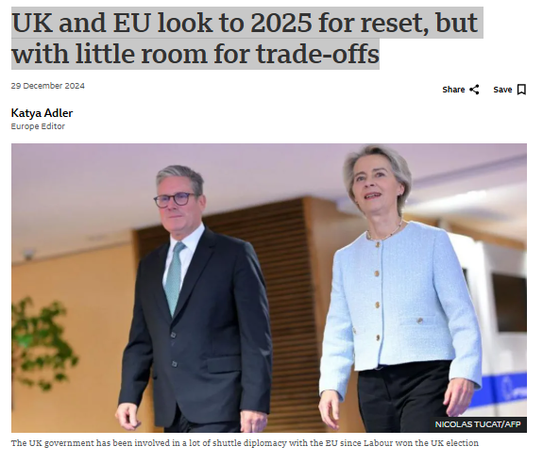
What Next ?

Slide 38
Early in 2025, Prime Minister Sir Keir Starmer has been invited to an informal summit of EU leaders. It's the first such invitation for the UK since the bitter days of the Brexit negotiations.
The focus of the February meeting is future security and defence co-operation. The backdrop: the volatile state of the world from Europe's perspective.
Wars rage in the Middle East and in Europe - with Russia aided in its assault on Ukraine by Iran, North Korea and China.
Adding to the uncertainty haunting this continent, Donald Trump is poised to re-enter the White House.
He threatens Western cohesion with his pledge to slap punitive tariffs on imports - a big worry to the EU and the UK - and to potentially walk away from Nato, the transatlantic defence alliance Europeans have relied on for security, since its founding after World War Two.

Slide 39
Threats a reminder of shared values
These threats to security and to trade revenues have helped remind the EU and the UK of the common values they share in unpredictable times.
The EU felt weakened by Brexit in 2016. It meant losing a big economy and its only significant military power apart from France.
As for post-Brexit UK, now free from the rules of EU membership, it's also now a far smaller power on the world stage.
And, closer to home, the Labour government has realised Europe is key to delivering on a number of priority pledges to the UK public.
"The economy, defence, migration... there's a European element to all of this, making EU relations important for the whole government agenda. Things which will make a success of this government are tied up with Europe," says Mark Leonard, the director of the European Council on Foreign Relations.
Labour has repeatedly promised an "ambitious reset" of EU-UK relations.
There has been lots of shuttle diplomacy and symbolism since it won the general election in the summer.
Foreign Secretary David Lammy attended a meeting of EU Foreign Ministers, Chancellor Rachel Reeves gave a speech at a summit of EU finance ministers, and the prime minister popped over to Brussels for a sit-down with EU Commission Chief Ursula von der Leyen.

Slide 40
Goodwill in Brussels but scepticism too
But what does this "reset" really mean? What can we expect in 2025?
Might the UK government allow some freedom of movement in exchange for economic benefits on EU trade?
An EU-UK summit is planned for spring, and a number of political figures and high-level diplomats from EU member states and the UK spoke to me on condition of anonymity ahead of bilateral negotiations getting started.
I kept hearing of the "enormous amount of goodwill" in the EU towards the new Labour government with its oft-repeated "reset" enthusiasm.
At the same time though, there is a clear note of Brussels scepticism the Labour government would do well to take heed of, if it wants to see tangible results.
"The headspace is there. The appetite is there in Europe for closer UK relations," one EU figure told me.
"What's less clear is what London is really interested in - and what trade-offs it's willing to make to get there. That's key and that appears not to have been bottomed out in London yet."

Slide 41
Defence and security a win-win agreement
The defence and security arrangement I have mentioned is the proverbial "low-hanging fruit" as far as an EU-UK reset is concerned.
It's relatively easy to formalise what is already happening: co-operation over Russia sanctions for example, as well as discussions - already taking place inside Nato - over military and defence capabilities and how to best protect Europe against cyber-attacks and attacks on key installations like energy infrastructure in the North Sea.
It's seen as a win-win agreement.
And there is no proposal to make a defence pact legally binding.
The Labour government does not have to worry here about being seen - by the political opposition or those in the UK who voted Leave - as attempting to "roll back Brexit". And it is sensitive about this potential accusation.
But Labour has also made promises on trade and the economy: to "make Brexit work" and to "tear down" the trade barriers hard Brexit imposed. The Office for Budget Responsibility reckons Brexit will cost the UK economy 4% of GDP in the long term.
Labour wants to avoid that, but that's not as straightforward as it might sound.

Slide 42
No 'backdoor' for UK to EU trade deals
EU figures say they're confused by the UK government proclaiming an "ambitious" reset while insisting on maintaining restrictive post-Brexit red lines.
A recent working paper setting out EU interests noted there were "limited economic gains on offer" because of the UK ruling out rejoining the EU's customs union or single market or accepting the free movement of people.
Some in the EU suspect the UK government believes it can get a quid pro quo on trade for defence. That they say, is never going to happen.
"The UK is mistaken if it thinks it can use an agreement on defence as a backdoor to getting sweet deals with us on trade," an EU diplomat told me.
"For us, it's like being in a weird tug of war. With the devil on one EU shoulder and an angel on the other. In terms of values, there is more that unites us than divides us with the UK.
"The EU wants to take action to get the UK closer, but on the other hand, we can't do away with technical minutiae that are the foundation of the EU. We can't make special deals, even if that limits the relationship with the UK."

Slide 43
EU looks for return of youth mobility scheme
The key to any compromise that Labour might make with the EU going forward will be: Can they sell the result back home as a win for the British public?
The EU will push hard for long term fishing rights in UK waters.
It also wants a Youth Mobility Scheme, allowing 18-30 year olds to work and/or study in the UK or the EU for up to three years, paying local fees at university if they choose the study option.
The UK government insists there will be no return to freedom of movement with the EU.
Migration is a hot button issue. But it's notable that Labour has not explicitly ruled out the youth scheme. They've only said they've "no plans" to go for it.
On youth mobility, the assumption is that more EU youngsters would take advantage of a mobility scheme than UK citizens because of language barriers.

Slide 44
Climate change and illegal migration
The EU and UK are both interested in better co-operation and coordination on energy and climate.
Sir Keir also labelled this a priority.
Linking carbon emissions trading schemes, as the EU does with a number of other countries, would mean the UK avoiding EU carbon border adjustment mechanism (CBAM) implications - a cost feared by UK businesses.
And removing post-Brexit blockages on the electricity market would deliver €44bn (£36bn) in savings to EU and UK consumers by 2040 and reduce investment costs in North Sea wind by 16%, according to Baringa business consultancy.
The North Sea basin comprises the UK plus EU member states Belgium, Denmark, Germany and the Netherlands and Single Market member Norway. It's one of the most promising regions in the world for offshore wind.
On illegal migration, the EU says it's open to co-operating more closely with the UK. It wants the UK to crack down more on people working illegally in the country.
France complains that the ease with which it says irregular migrants can disappear and make a living is a major a pull-factor to the UK for economic migrants.
The EU has ruled out the UK being able to send migrants, arriving illegally on its shores aboard small boats, back to the EU countries they set off from.

Slide 45
Voters moving faster than their governments
Whatever the developments in EU-UK relations in 2025 and beyond, they are likely to happen slowly because of political concerns and because negotiations have a habit of getting bogged down in detail.
In direct contrast, a recent poll by YouGov and Datapraxis for the European Council of Foreign Relations suggests voters in the EU and UK are far more gung-ho than leaders in Brussels and London about jumping over previous political taboos to strengthen ties.
The poll found that around half of those asked in the UK believe greater engagement with the EU is the best way to boost the UK economy (50%), strengthen its security (53%) and effectively manage migration (58%).
When asked who the UK government should prioritise relations with, 50% choose Europe and only 17% the US.
A huge 68% of respondents in Britain see a benefit in reintroducing cross-Channel freedom of movement in exchange for access to the European single market.
The desire for co-operation, and willingness to forgo previous red lines, is also reciprocated in Europe.
A majority of voters in Poland (54%) and Germany (53%) – and a prevailing opinion in Spain (43%), Italy (42%) and France (41%) – believe the EU should grant the UK special access to certain parts of the European single market to secure a closer security-based relationship.
Geopolitical threats and uncertainties appear to be shifting public opinion dramatically. Will the political class in the UK and EU choose to keep up?

