Slide 1
Local Elections - Devolution

Slide 2
What elections were held and where?
IN BRIEF
In England, there were first-past-the-post votes for members of more than 130 councils of various types – metropolitan, unitary, county, district and 32 London boroughs – as well as for six mayors. Some authorities are re-electing all councillors, some a third of them.
In Scotland, voters selected 129 members of the country’s parliament, via a mix of first-past-the-post constituency voting and proportional regional voting.
In Wales, a revised proportional system will pick 96 members of an expanded Senedd.

Slide 3
Local Elections 2026
Take place every year on the first Thursday of May

Slide 4
In a nutshell

Slide 5
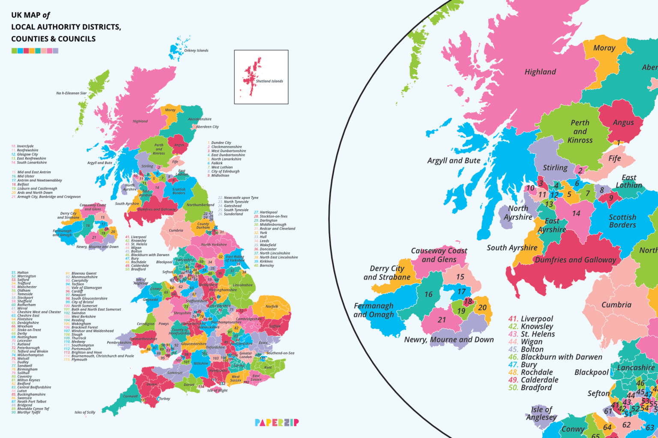

Slide 6
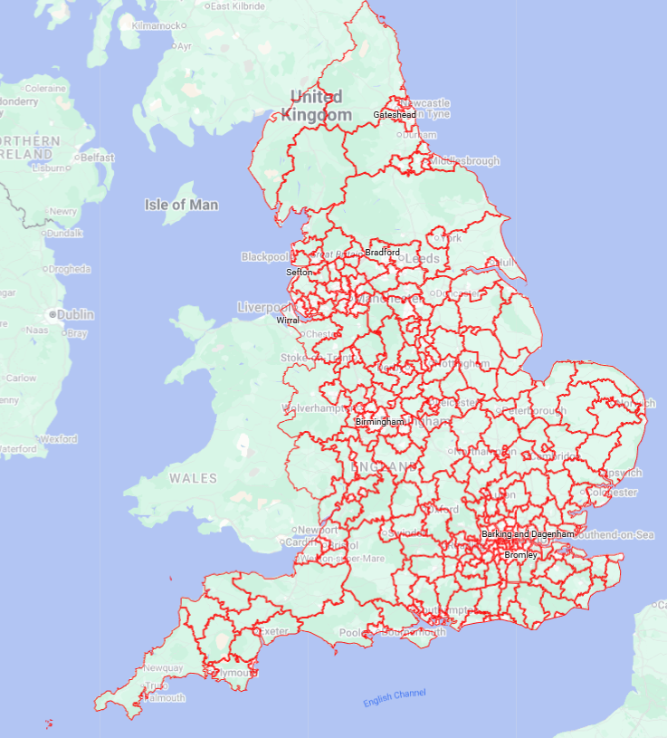
Interactive detailed map
Location of the 317 councils in England
34 874 communes en France(34 745 en métropole)

Slide 7
What is the current system of local governement?
Currently, local areas in England can have single-tier local government (known as ‘unitary authorities’) or two-tier local government (composed of district councils and county councils). Each county council area has multiple district councils within it.

Slide 8
What is the difference between the types of authorities?
A county council is part of a two-tier local government system, taking care of things that affect the whole county, such as:
• Education
• Transport
• Planning
• Fire and public safety
• Social care
• Libraries
• Waste management
• Trading standards
They work alongside the other, lower-tier councils - district, borough or city - that take care of things on a smaller scale, such as:
• Rubbish collection
• Recycling
• Council tax collections
• Housing
• Planning applications

Slide 9
What is the difference between the types of authorities?
A unitary authority is a one-tier local government, where the services of a county council and the other smaller councils listed above are combined.
A metropolitan district has a council that oversees all services, similar to a unitary authority - but has a mayor with a role similar to that of local councils.

Slide 10
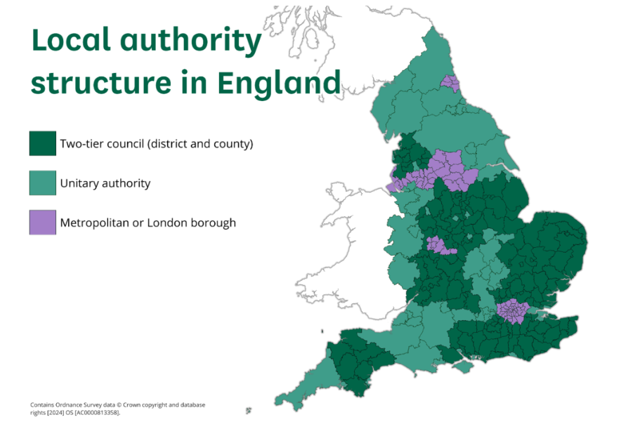

Slide 11
A reform is pending…
The government’s English Devolution White Paper, Power and Partnership: Foundations for Growth, published on 16 December 2024, stated that the government wants all remaining two-tier areas in England to be eventually restructured into single-tier unitary authorities.
This continues a trend of several decades towards larger single-tier local government in England. Previous rounds of restructuring took place in 1992 to 1995, 2008 to 2009 and 2018 to 2021.
The Representation of the People Bill is under examination in Parliament (cf File 1)
https://bills.parliament.uk/bills/4080

Slide 12
The Results

Slide 13
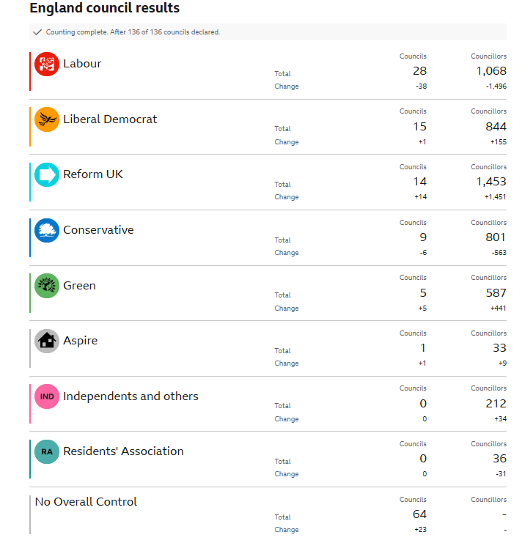

Slide 14
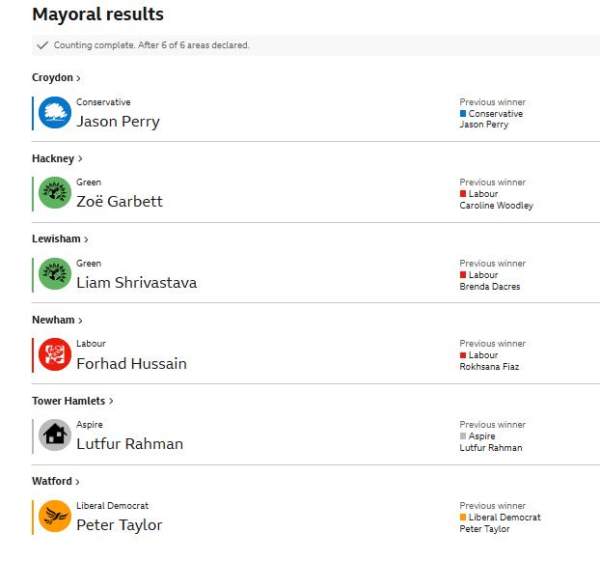

Slide 15
Interactive map from The Guardian
https://www.theguardian.com/politics/ng-interactive/2026/may/08/2026-elections-mapped-labour-reform-uk-greens-scotland-wales-england-local

Slide 16
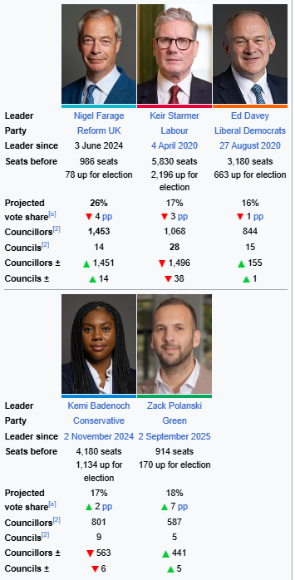

Slide 17
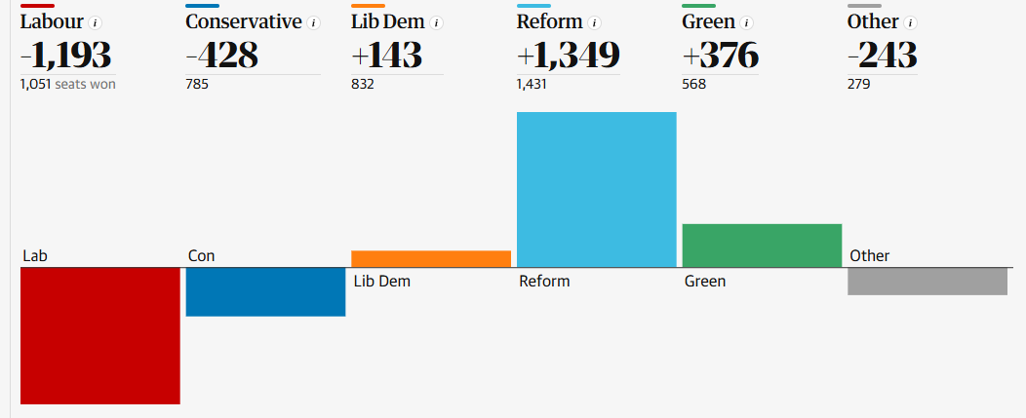

Slide 18
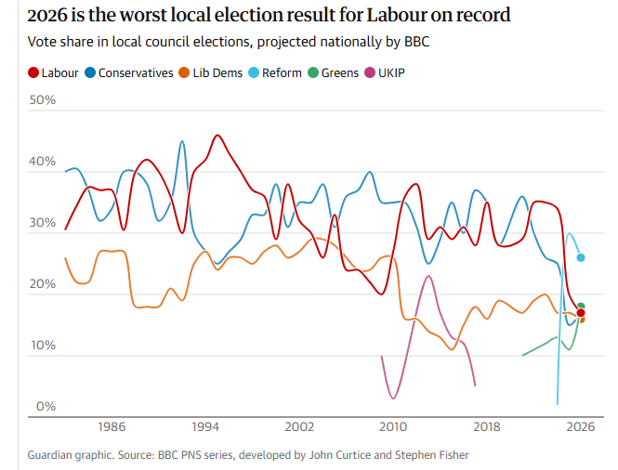

Slide 19
No Metro mayor election this year
Key ones took place in 2025
There are six mayoral elections taking place on Thursday. Four areas are voting where there is already a mayor in place:
• West of England
• Cambridgeshire and Peterborough
• Doncaster
• North Tyneside
And the other two are holding mayoral elections for the first time:
• Hull and East Yorkshire
• Greater Lincolnshire

Slide 20
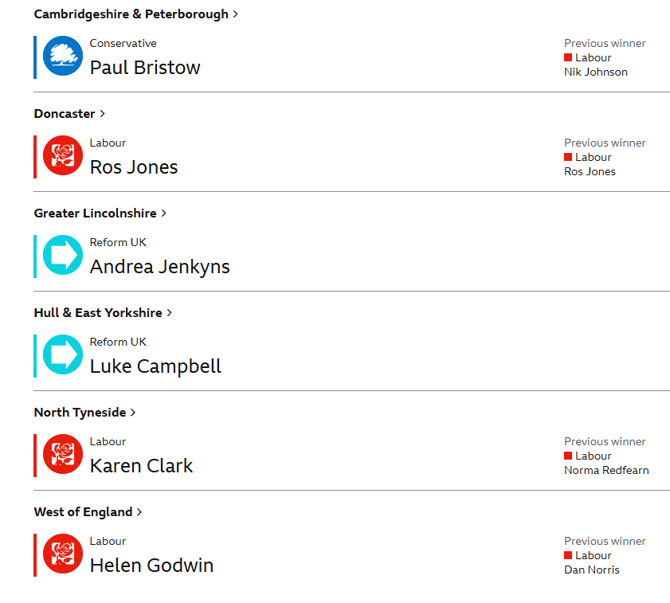

Slide 21
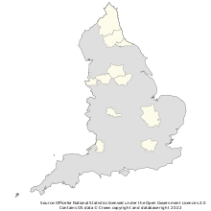
The Greater London Authority and 10 combined authorities of England, as of December 2021.

Slide 22
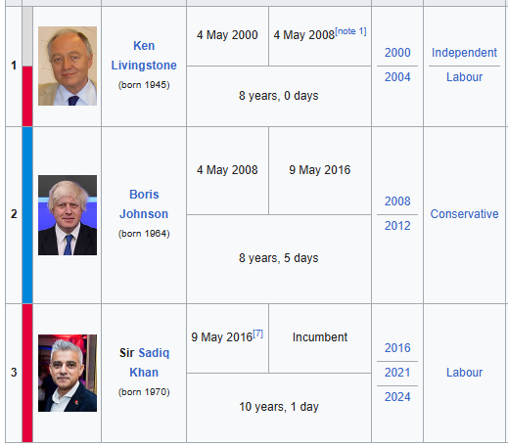
In some cities, The Greater London Authority, Greater Manchester and a few others, the mayor is elected. For four years.

Slide 23
Key takeaways - Analysis

Slide 24
Key takeaways (NY Times)
Nigel Farage, leader of the populist Reform U.K. party, is on a roll
Britain has entered an era of multiparty politics
Keir Starmer’s in trouble — but he may hold on for now
The Greens gained ground

Slide 25
UK local elections delivered record-breaking fragmentation of the vote
Rise of both left-wing and right-wing populism
Video link https://www.youtube.com/watch?v=t7AiKWwg1K0
Early England election results make it clear: we are in an era of five-party politics
Paula Surridge, The Guardian May 6 2025
Starmer will hope he’s dodged the axe for now – but these elections leave Britain more fragmented than ever
Jonathan Freedland The Guardian, Fri 8 May 2026
Extremists are taking control of swathes of Britain
The Greens’ ascent is a code red for ordinary voters who already fear the country is in trouble
The Telegraph, May 8 2026

Slide 26
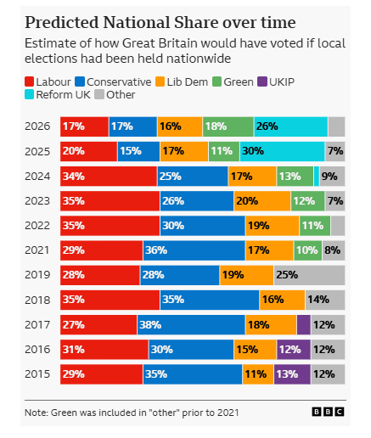
UK local elections delivered record-breaking fragmentation of the vote

Slide 27
Holyrood ? The Senedd? Stormont ?
Unionists? Nationalists? The Good Friday Agreement?
The Taoiseach? The First Minister?
Why were elections held in Scotland and Wales and not Ireland?
Let’s clarify a few key points about Devolution and the devolved powers

Slide 28
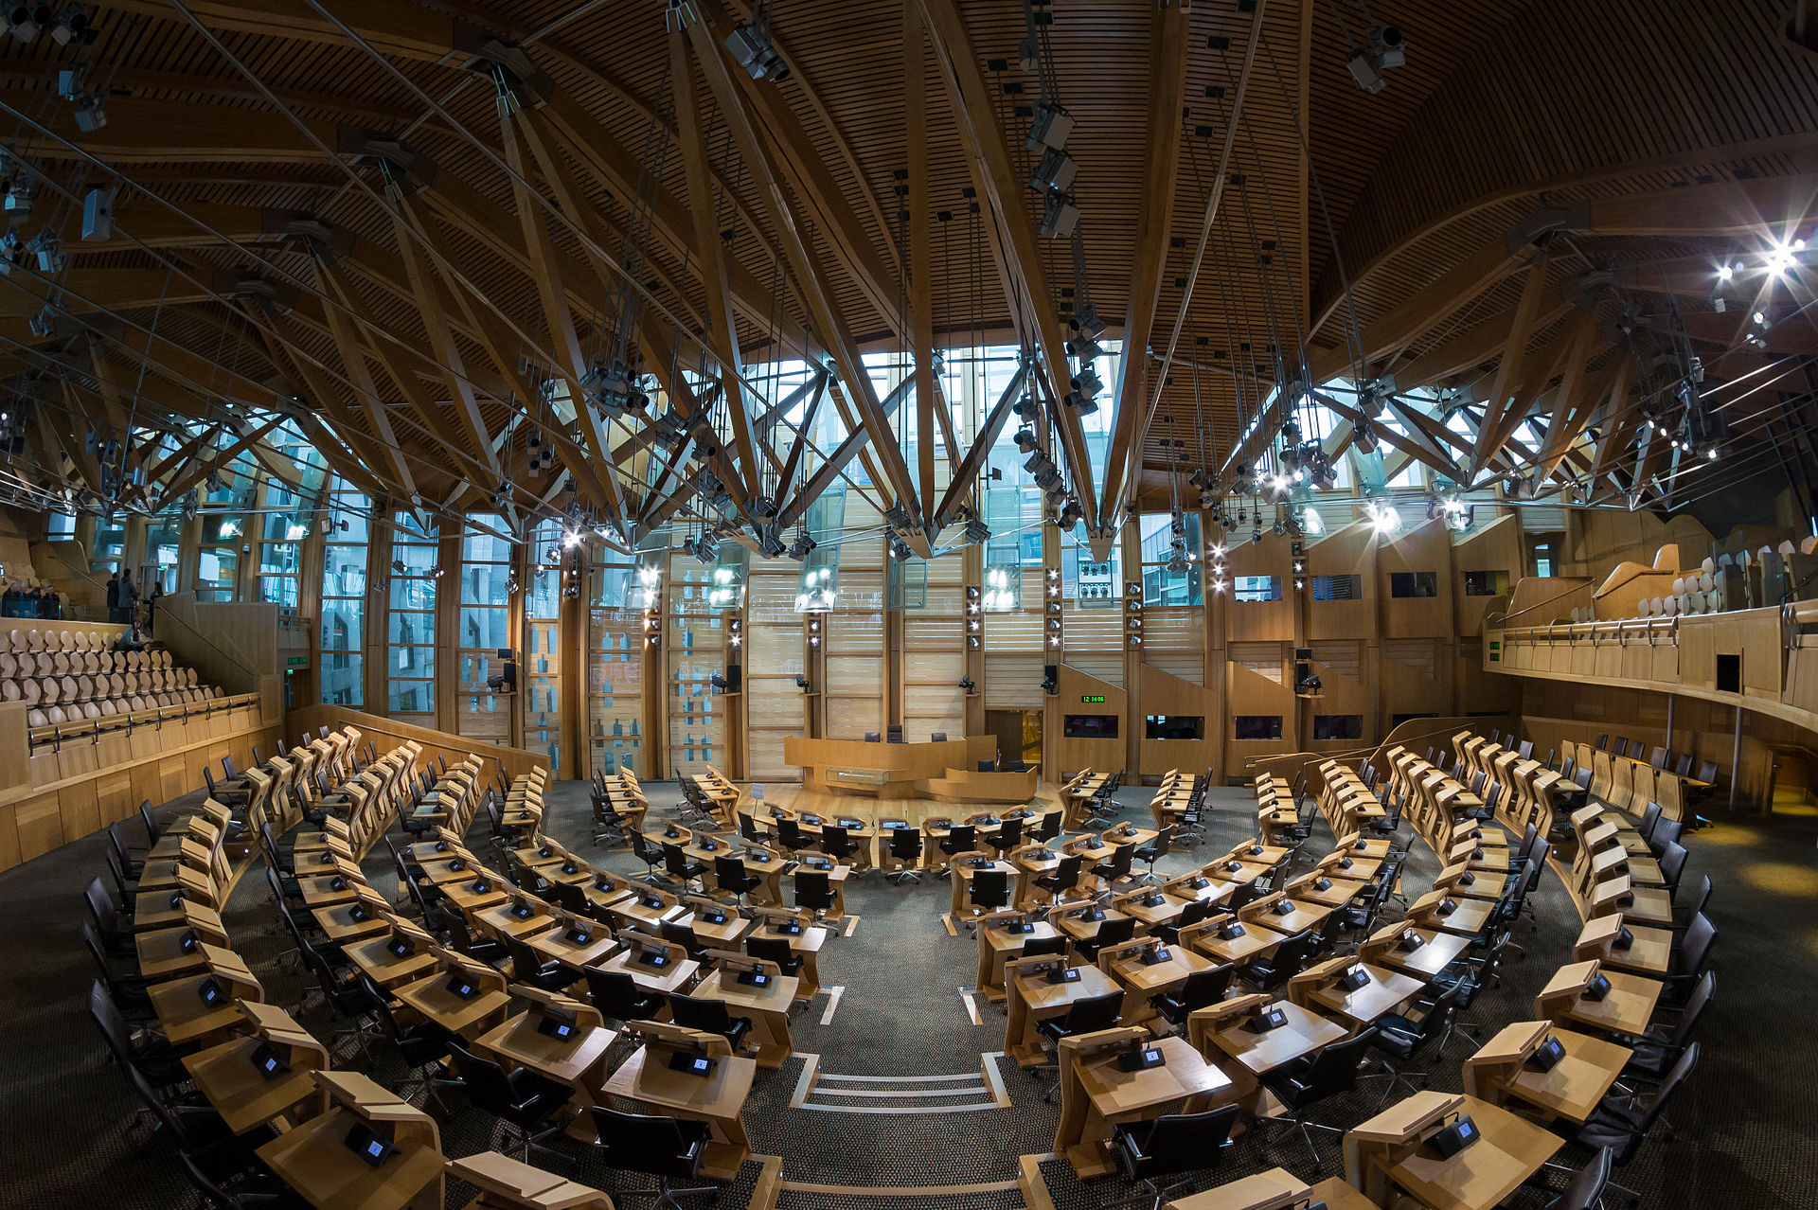
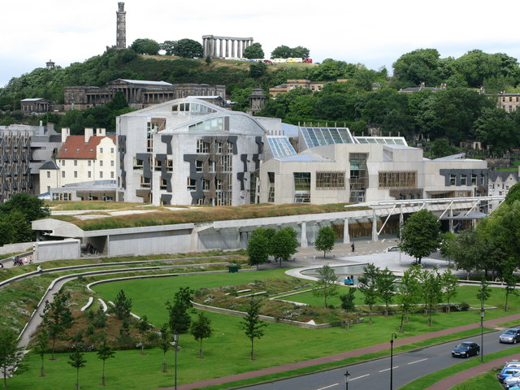
Holyrood in Edinburgh

Slide 29
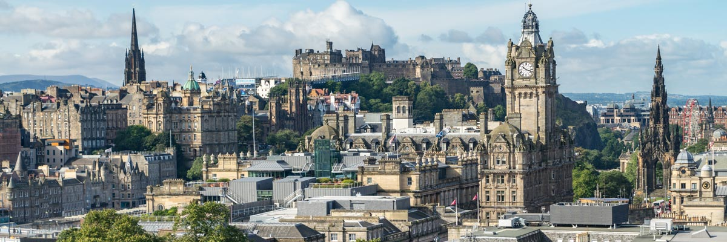

Slide 30
The Scottish Parliament (Scottish Gaelic: Pàrlamaid na h-Alba; Scots: Scots Pairlament) is the devolved, unicameral legislature of Scotland. Located in the Holyrood area of the capital city, Edinburgh, it is frequently referred to by the metonym Holyrood.
The Parliament is a democratically elected body comprising 129 members known as Members of the Scottish Parliament (MSPs), elected for five-year terms under the additional member system:
The previous general election to the Parliament was held on 5 May 2021, with the Scottish National Party winning a plurality.

Slide 31
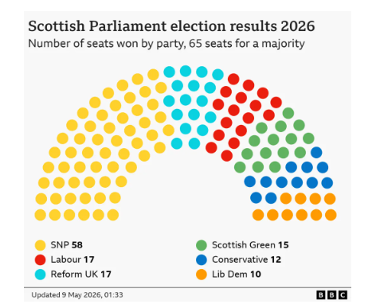
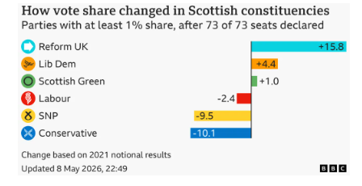
2026 Scottish Parliament Election

Slide 32
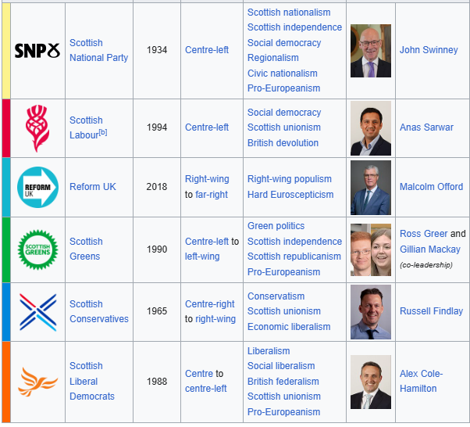

Slide 33
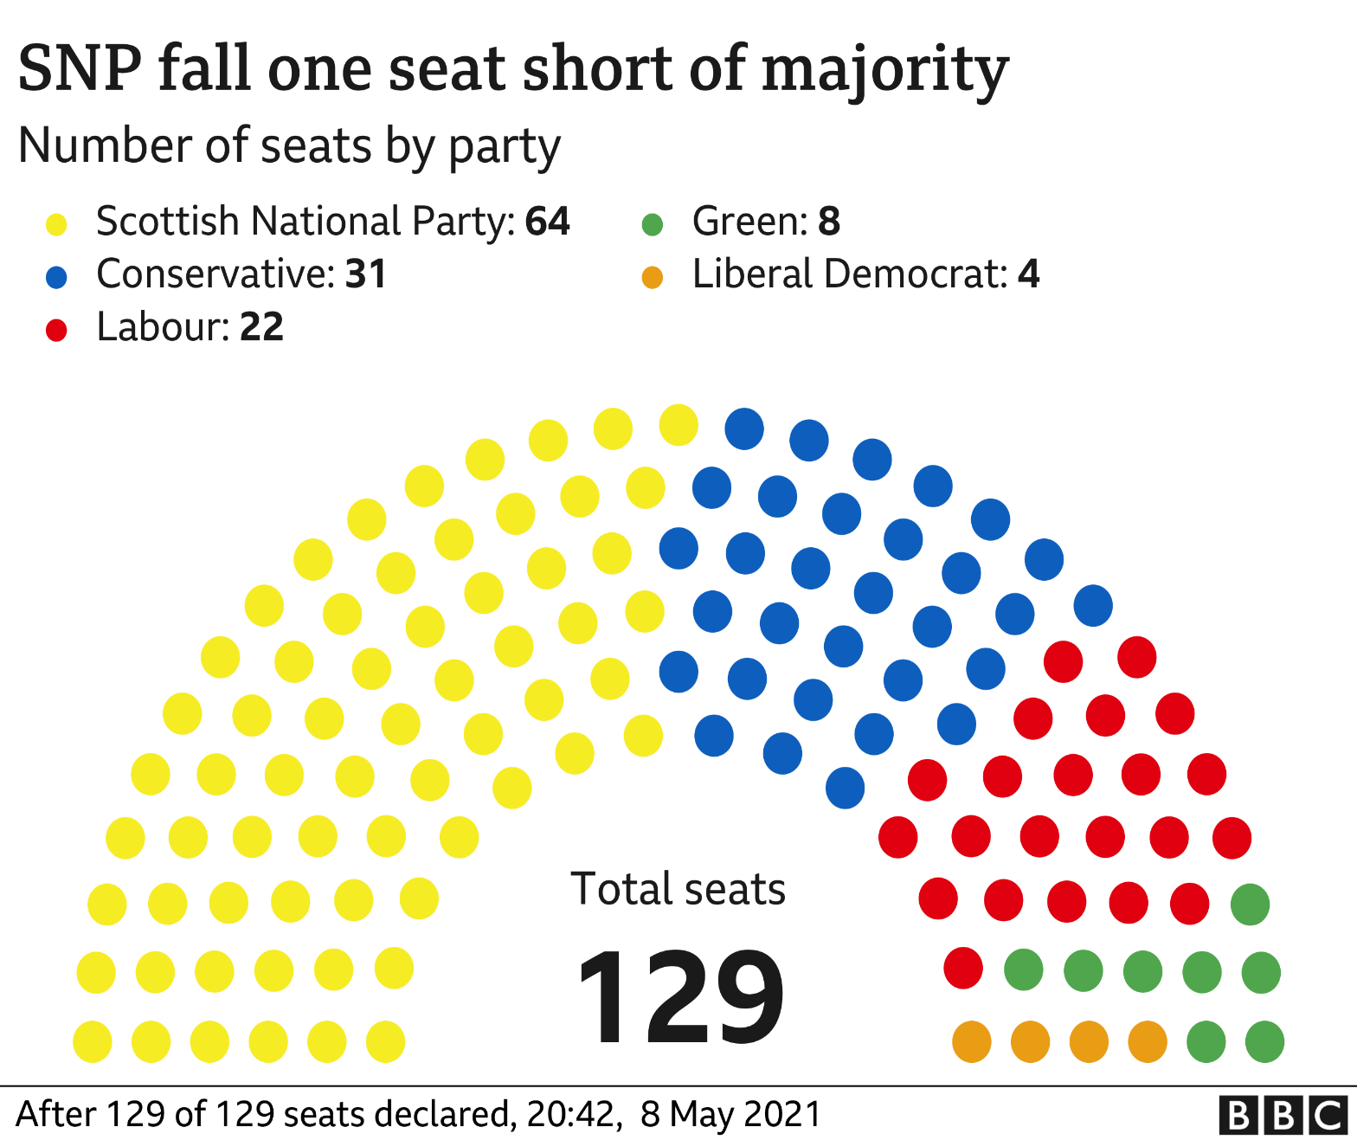
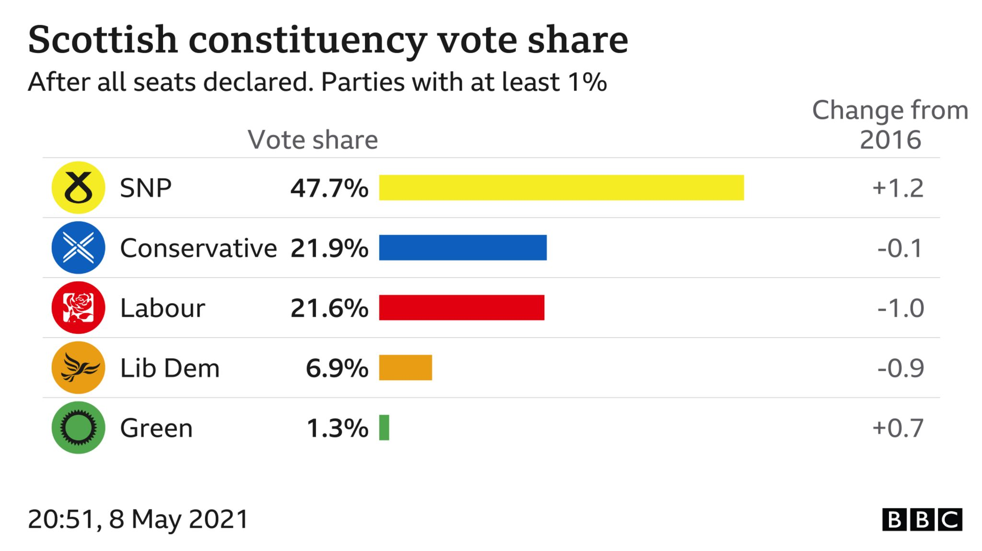
2021 Scottish Parliament Election

Slide 34
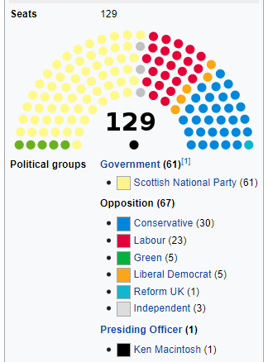

Slide 35
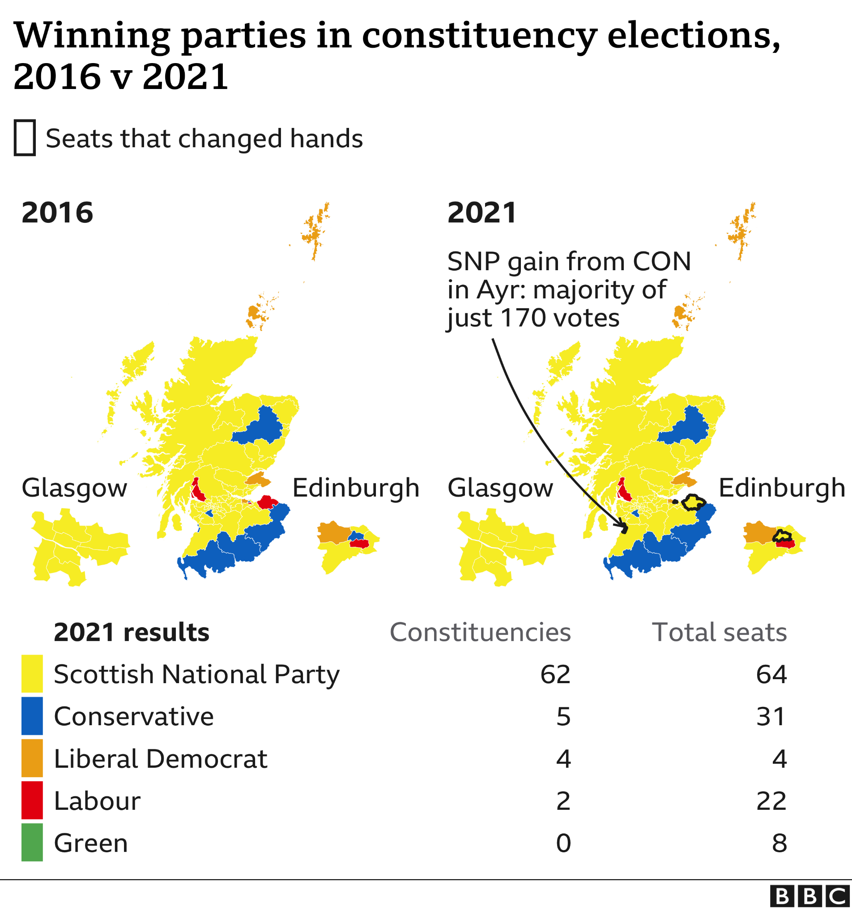

Slide 36
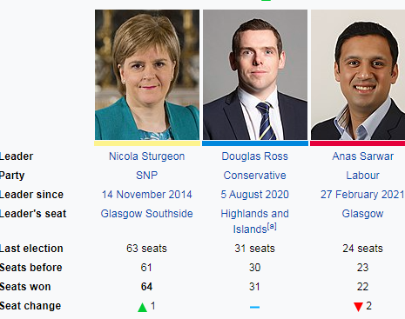
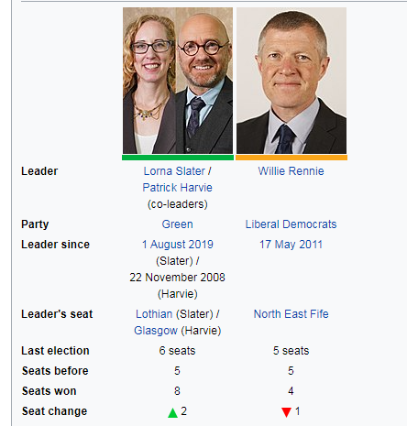

Slide 37
The original Parliament of Scotland was the national legislature of the independent Kingdom of Scotland, and existed from the early 13th century until the Kingdom of Scotland merged with the Kingdom of England under the Acts of Union 1707 to form the Kingdom of Great Britain.
As a consequence, both the Parliament of Scotland and the Parliament of England ceased to exist, and the Parliament of Great Britain, which sat at Westminster in London was formed.
Following a referendum in 1997, in which the Scottish electorate voted for devolution, the powers of the devolved legislature were specified by the Scotland Act 1998.
Elections were held in 1999 – 2003 – 2007 – 2011 – 2016 – 2021. Next elections: May 2026
The SNP has held a majority since 2011

Slide 38
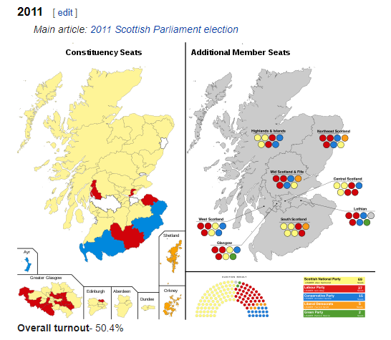

Slide 39
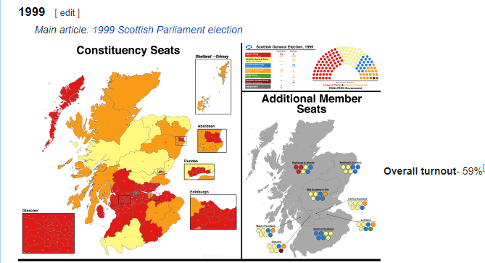

Slide 41
Timeline Devolution
Scotland Wales

Slide 42
1536 An Act of Union effectively makes Wales a region of England.
1707 The Act of Union establishes Great Britain by uniting Scotland and England, but devolves legal powers to Scotland.
1885 The office of Secretary of State for Scotland is re-established for the first time since 1746.
1925 Plaid Cymru, the Welsh nationalist party, is founded.
1934 John MacCormack founds the Scottish National Party (SNP).
1950s Conservative government appoints Ministers for Welsh Affairs following a surge in support for Plaid Cymru.
1964 Labour government establishes the Welsh Office with a seat in the Cabinet.
Late 1960s The discovery of North Sea oil off the Scottish coast leads to considerable resentment of London's exploitation of a "Scottish" asset. Support for the SNP grows.
1969 Royal Commission on the Constitution set up to report on nationalism and the possibility of local and regional government.
1973 The commission recommends legislation and executive devolution for Scotland and Wales. The proposals are rejected as unworkable.
1978 Revised recommendations from the commission lead to the Scotland Act and the Wales Act, both subject to referendums.
March 1979 Scottish and Welsh voters both reject devolution in the referendums; more than 40 per cent of Scots do not bother to vote. Shortly afterwards, the incoming Conservative government repeals both acts. Devolution is declared "dead for a generation".

Slide 43
July 1997
White paper on devolution published by the new Labour government.
September 1997
Referendums held in Scotland and Wales. Both endorse proposals for an assembly in their country, the Welsh by a very small majority.
1998
Scotland Act 1998 and the Government of Wales Bill introduced.
6 May 1999
Elections to the Welsh and Scottish Assemblies.
12 May 1999
First meeting of the Scottish Parliament.
1 July 1999
Devolution Day. The Scottish Parliament assumes its full powers in the presence of the Queen.

Slide 44
Senedd Cymru – Welsh Parliament

Slide 45
Senedd Cymru (Welsh pronunciation: [ˈsɛnɛð ˈkəm.rɨ]), or the Welsh Parliament in English
(commonly referred to as simply "the Senedd" /ˈsɛnɛð/ in both English and Welsh)
From its creation in 1999 until May 2020, the Senedd was known as the National Assembly for Wales
(Welsh: Cynulliad Cenedlaethol Cymru).
The Senedd comprises 60 members who are known as Members of the Senedd (Welsh: Aelodau o'r Senedd), abbreviated as "MS" (Welsh: AS). members are elected for a five-year term of office
Typically, the largest party in the Senedd forms the Welsh Government.
The National Assembly for Wales was created by the Government of Wales Act 1998, upon the result of the 1997 referendum. The National Assembly for Wales initially had no powers to initiate primary legislation. Limited law-making powers were gained through the Government of Wales Act 2006.

Slide 46
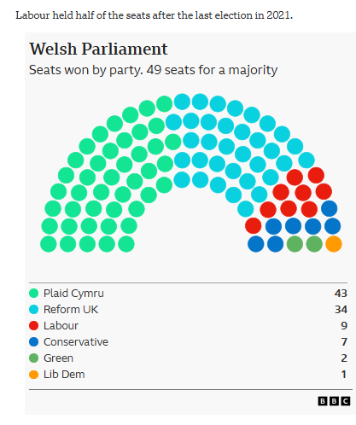
2026 Elections Welsh Assembly

Slide 47
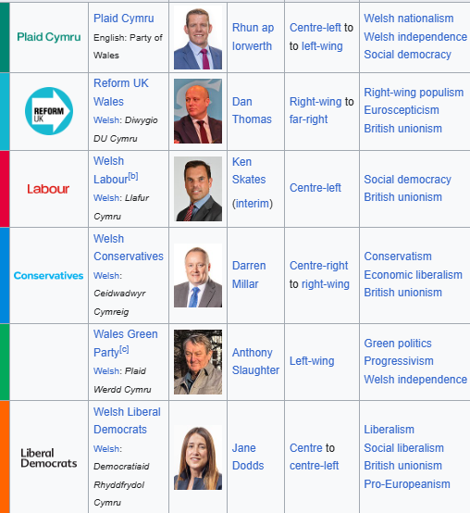

Slide 48
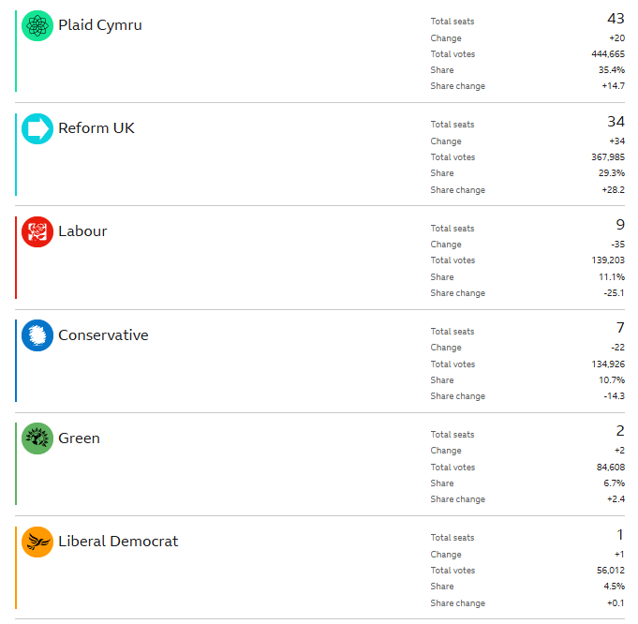

Slide 49
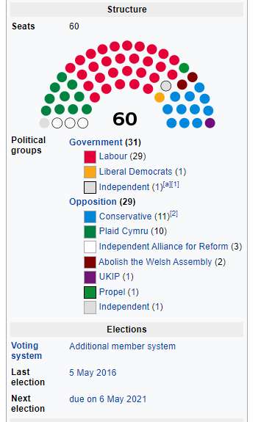

Slide 50
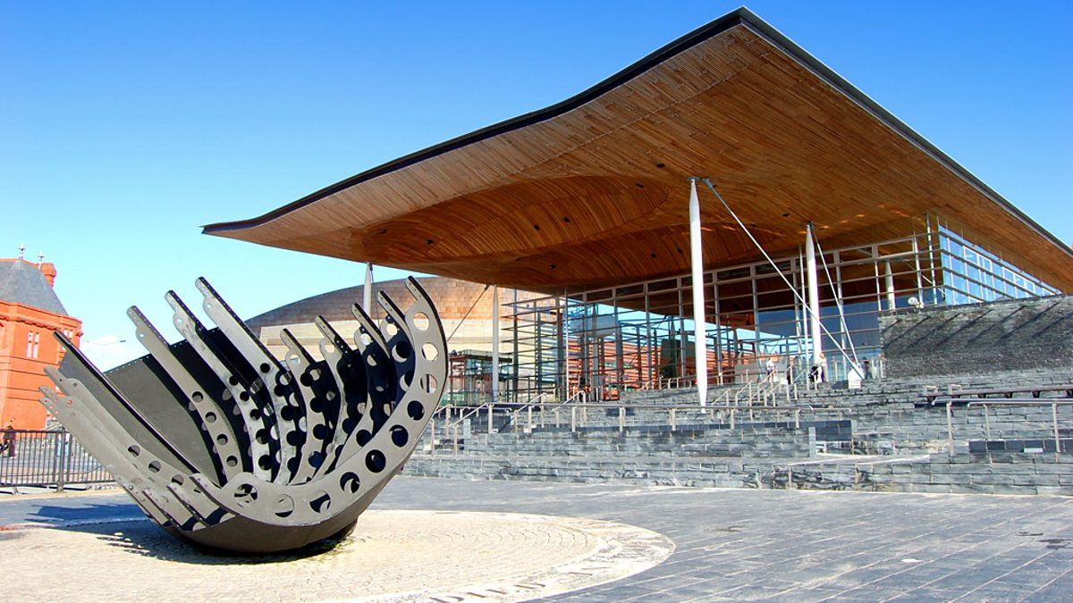

Slide 51
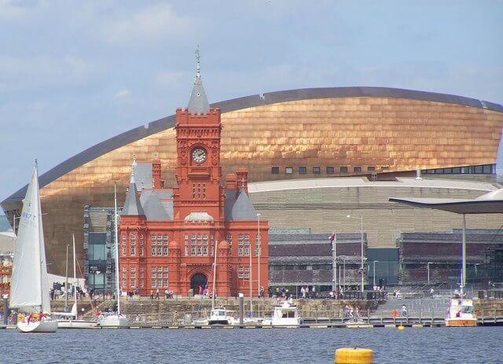

Slide 52
What are the devolved powers?

Slide 53
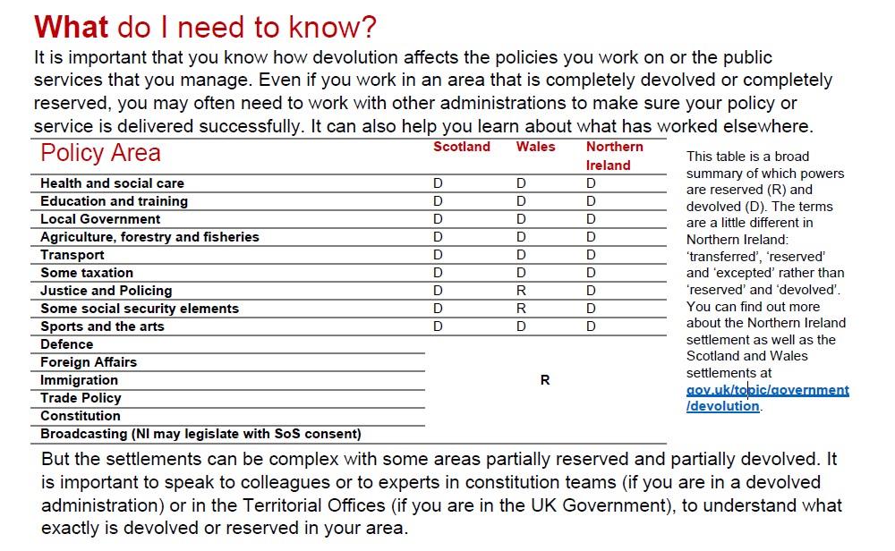

Slide 54
Northern Ireland – Stormont

Slide 55
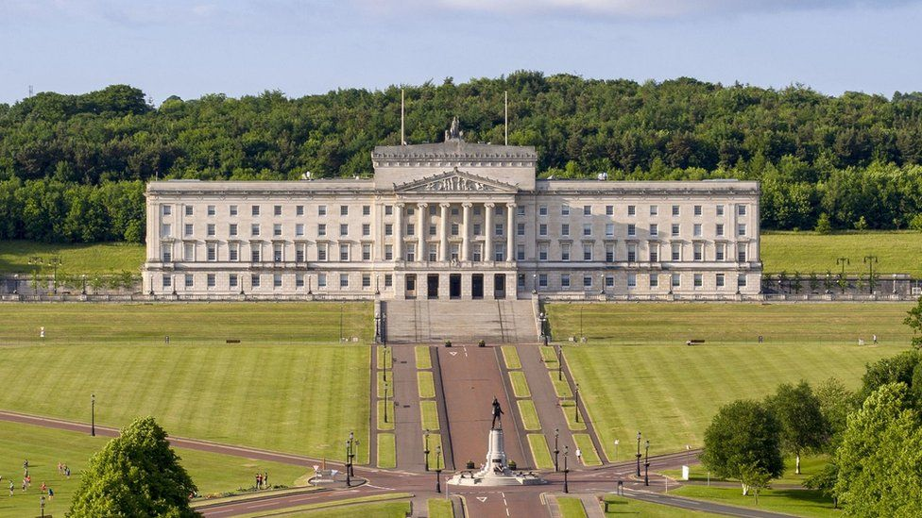

Slide 56
2022 Northern Ireland Election
Stormont Assembly

Slide 57
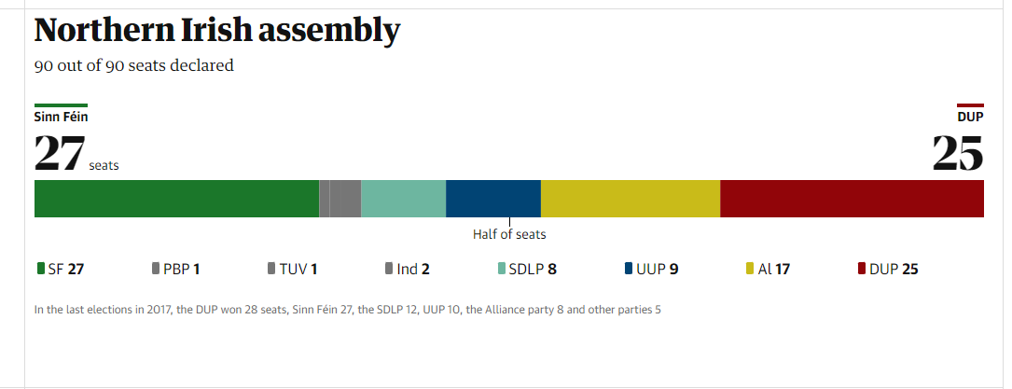
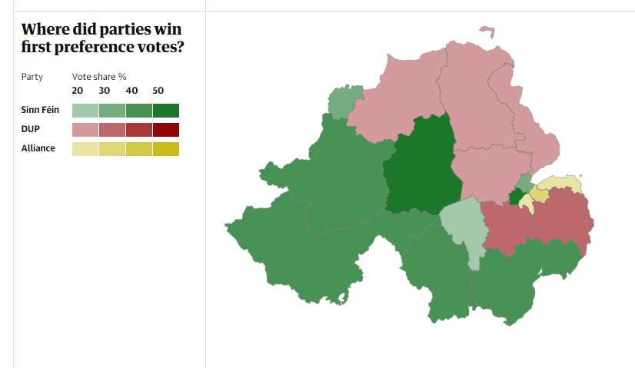

Slide 58
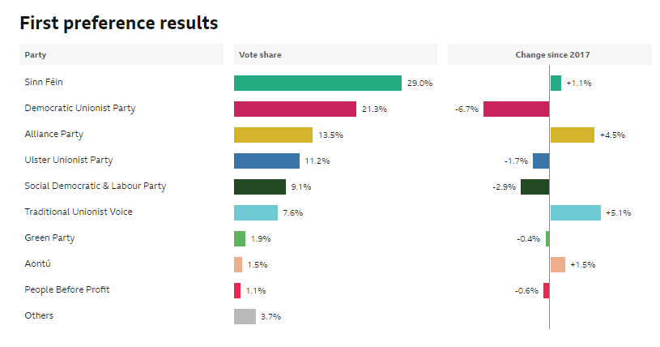

Slide 59
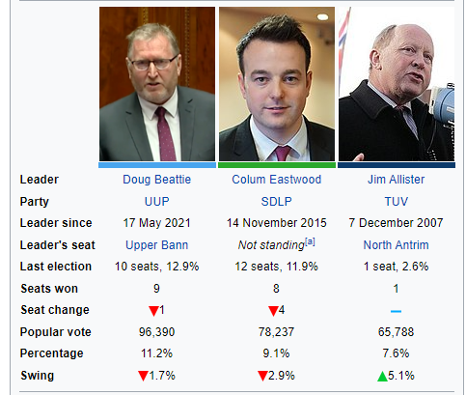
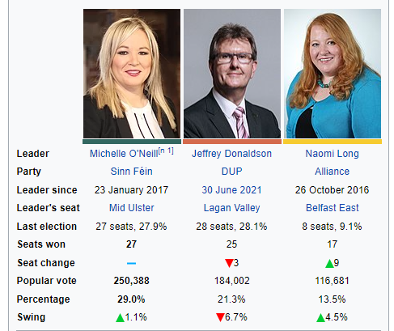
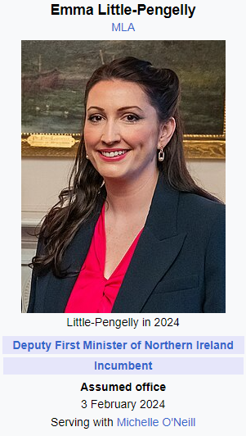
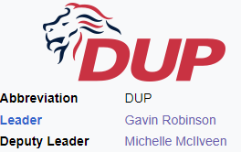
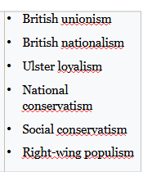


Slide 60
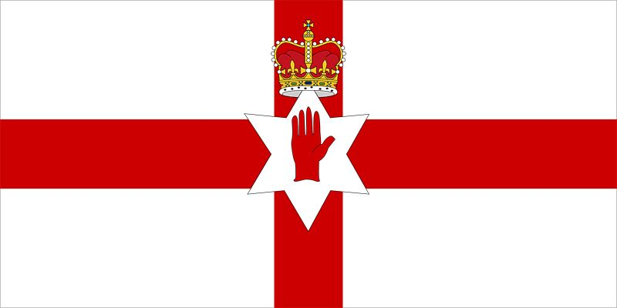
Britannica.com
The island of Ireland was historically divided into four provinces, the northernmost of which was Ulster. The Ulster coat of arms, which included a red cross, supposedly was used by earls from the de Burgh family centuries ago. The inescutcheon (small central shield) of the Ulster coat of arms bore a red right hand, the symbol of the O’Neill (Uí Néill) family since the mid-17th century, although myth attributes the symbol to King Heremon O’Neill in 1015 BC.
In 1924 the inescutcheon was redesigned as a six-pointed star, presumably referring to the six Ulster counties (out of nine) that now form Northern Ireland. The imperial crown was placed over the star to show the loyalty of Northern Ireland to the United Kingdom.

Slide 61
The Partition Of Ireland: A Short History
The official division of the country of Ireland into two separate regions – Northern and Southern Ireland – took place in May 1921, through an act passed by the British Parliament. The original intention was for both regions to remain within the United Kingdom, but the Irish War of Independence led to the south seceding from the UK in 1922, while Northern Ireland opted to remain.
The Government of Ireland Act 1920
With attempts at this legislation having begun in 1886, the Government of Ireland Act of 1920 was the fourth try at establishing Home Rule in Ireland – that is, affording the country a certain amount of freedom to self-govern while retaining its position as part of the United Kingdom.
Up to that point Ireland had been ruled by the UK Parliament via their administration at Dublin Castle, ever since the Irish Parliament was abolished through the Acts of Union 1800.

Slide 62
Reasons For Partition
The potential division of the country into six Northern Irish counties and twenty-six Southern Irish counties was included in the Fourth Irish Home Rule Bill of 1920 in order to try to reconcile the conflicting wishes of Irish nationalists and unionists, which had caused the earlier three bills to fail and led to the Home Rule Crisis.
Irish unionists – concentrated in the Northern Ireland province of Ulster and mainly of Protestant origin – wished to remain part of Great Britain, while nationalists were eager to achieve whatever independence from the UK they could.

Slide 63
The Home Rule Crisis
After the Third Home Rule Bill was passed in 1912, Ulster unionists had founded a paramilitary force, named the Ulster Volunteer Force, with the intention of resisting the bill’s implementation by violent means. Many British Army officers stationed in Ireland resigned, and with nationalists having established their own military arm in response to the UVF and both sides importing arms, a civil war seemed imminent.
King George V was forced to hold the Buckingham Palace Conference on Ireland, bringing representatives of both groups together to discuss potential solutions.

Slide 64
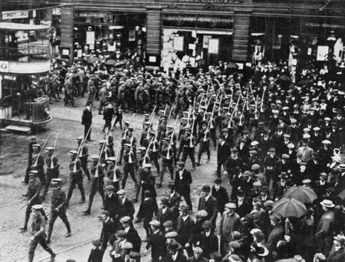
Members of the Ulster Volunteer Force in Belfast, 1914 | © Imperial War Museum/WikiCommons

Slide 65
The Partition of Ireland
A Short History

Slide 66
The Irish War of Independence
Eventually, a trial period of partition was also included in the third version of the Irish Home Rule Bill to appease unionists, but when World War I broke out in 1914, the bill was suspended.
A newly radicalised splinter group of nationalists went on to take advantage of Britain’s distraction with the war by launching the uprising of Easter 1916. Following this rebellion, more attempts were made to reach a compromise, such as the 1917–18 Irish Convention in Dublin, with little success.
In 1919, the Irish War of Independence officially began.

Slide 67
Official Partition
The Government of Ireland Act was enacted in 1920, and the island was partitioned into Southern and Northern Ireland the following year, but Home Rule never came into effect in the South. Instead, the Anglo-Irish Treaty of 1921, which ended the war in Ireland, allowed the self-governing Irish Free State to be created.
As part of the treaty, Northern Ireland was entitled to opt out of the new Irish Free State, which it did.
With Northern and Southern Ireland now separated into two jurisdictions by an almost 500-kilometre border, the ratification of the treaty led to a renewed period of civil war and years of hostility and violence between unionists and nationalists in Northern Ireland, known as The Troubles.

Slide 68
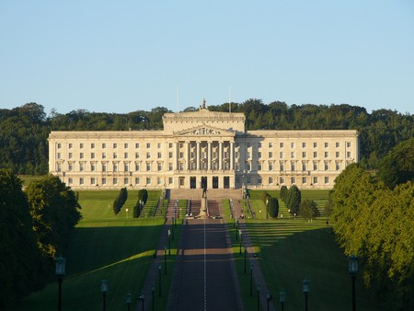

Slide 69
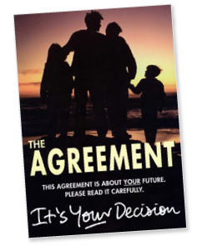
The Belfast Agreement/Good Friday Agreement 1998

Slide 70
The Belfast Agreement was a pivotal point in the development of peace in Northern Ireland during the 1990s, following the partition of Ireland earlier in the 20th century. It is named the Good Friday Agreement due to the time period; the agreement between the Irish and British governments took place on Good Friday, April 10, 1998.
After the partition of Ireland, which gave the British government jurisdiction over the northern six counties of Northern Ireland, six of the nine counties which make up the province of Ulster, civil conflict evolved between the Unionist population and Irish Nationalist population (who wished to reunite with the Republic of Ireland).
Since there were strict trends between religion and political affiliation or community association, Protestant demographics in the region were often Unionists and controlled institutions, outnumbering Northern Ireland’s Catholic population.

Slide 71
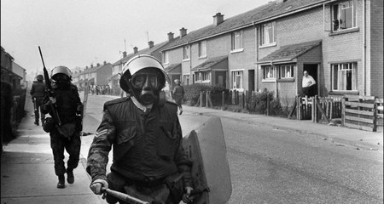
During the 1970s, violence broke out between the Irish Republican Army, a paramilitary group, and the British Army, with a spread of violence throughout the region which became concentrated in Belfast’s Centre. A Unionist paramilitary group, the Ulster Volunteer Force, complicated matters, fighting the IRA in a guerrilla war amidst the conflict.
While a cease-fire was declared in 1994 between British and Northern Irish forces, milder violence continued until the Agreement was in place.

Slide 72
Those involved
The IRA and UVF were the primary paramilitary groups engaged in conflict. The IRA eventually committed themselves to peace in Northern Ireland, with many members taking up roles in Stormont and working for political peace in Belfast and beyond. The Provisional IRA broke off from this section, continuing violent acts throughout the early 2000s.
The Royal Ulster Constabulary, Northern Ireland’s police force during the Troubles, was replaced by the PSNI as they were increasingly seen as a Unionist ally. The British Army were also heavily involved in the conflict between the two paramilitary groups.
Sinn Fein and the Democratic Unionist Party make up the dominant Nationalist and Unionist parties, respectively, in parliament headquarters today.

Slide 73
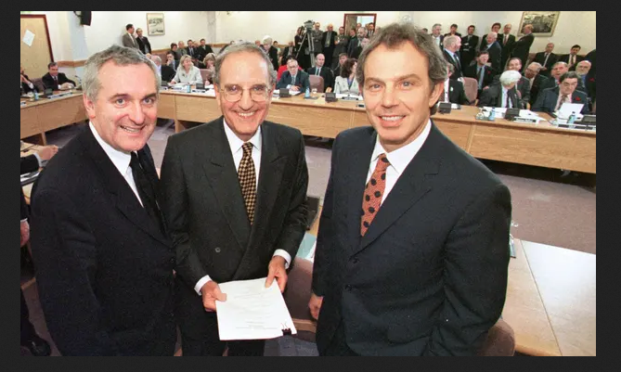
The Agreement
Aiming to establish civilised and political governance in Northern Ireland, the Good Friday Agreement was signed once all parties, including the Republic of Ireland and Westminster, negotiated terms of peace in the region. Both Ireland and Northern Ireland ratified the agreement on May 22, 1998, by a referendum of a popular vote.
A massive 94% of voters in Ireland and 71% in Northern Ireland ratified the treaty into action, creating the devolved government in Stormont, the same parliament which exists today.

Slide 75
Decommissioning in Northern Ireland was a process in the Belfast Agreement as part of the Northern Ireland peace process.
Under the Belfast Agreement, all paramilitary groups fighting in the Troubles would decommission.
Decommissioning was a defining issue in the effort to negotiate peace in Northern Ireland.
Timeline
10 April 1998 (Good Friday): Belfast Agreement is signed, which agrees to have all paramilitary groups in Northern Ireland decommission by May 2000.
May 2000: Deadline to disarm passes. Independent International Commission on Decommissioning agrees on a new deadline, 30 June 2001.
30 June 2001: Deadline to disarm passes.
July 2001: Ulster Unionist leader David Trimble resigns as First Minister because the Provisional Irish Republican Army (IRA) refuses to disarm.
7 August 2001: The IRA agrees on a method to decommission.

Slide 76
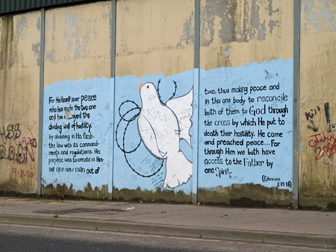

Slide 77
The road to peace
Northern Ireland continues to operate their parliament with a power-sharing clause, a system also active in Lebanon, which ensures that the First Minister and Deputy First Minister positions be filled with both a Nationalist Party and Unionist Party member, to avoid any one community from monopolising the executive branch. Community division is no longer violent in Belfast; however, streets or districts, recognisable by the flag affiliations decorating each area, still divide communities.
In a recent development, the Union Jack flag sparked a wide debate between political parties. The UK flag was present at all times on the top of Belfast City Hall but has since been removed, and only appears on significant days as required by the British government; this is also required of Scotland and Wales, as devolved regions.

Slide 78
Northern Ireland Protocol and Potential flaring up of Tensions
https://www.bbc.com/news/explainers-53724381
See videos

Slide 79
Regional inequalities

Slide 80
The best place to visualise them
(for the geography geeks)
https://www.ons.gov.uk/visualisations/dvc1370/

Slide 81
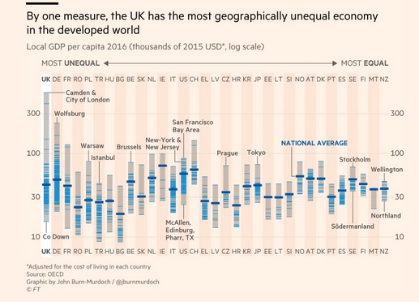

Slide 82


