Slide 1
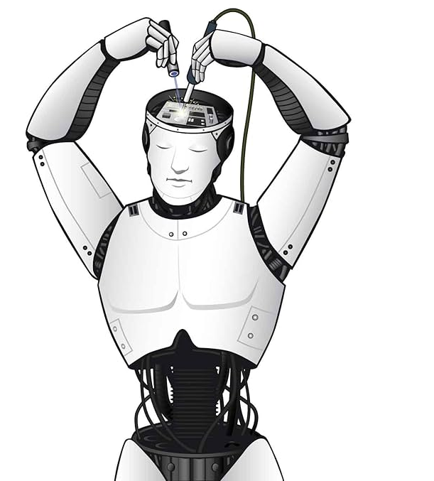
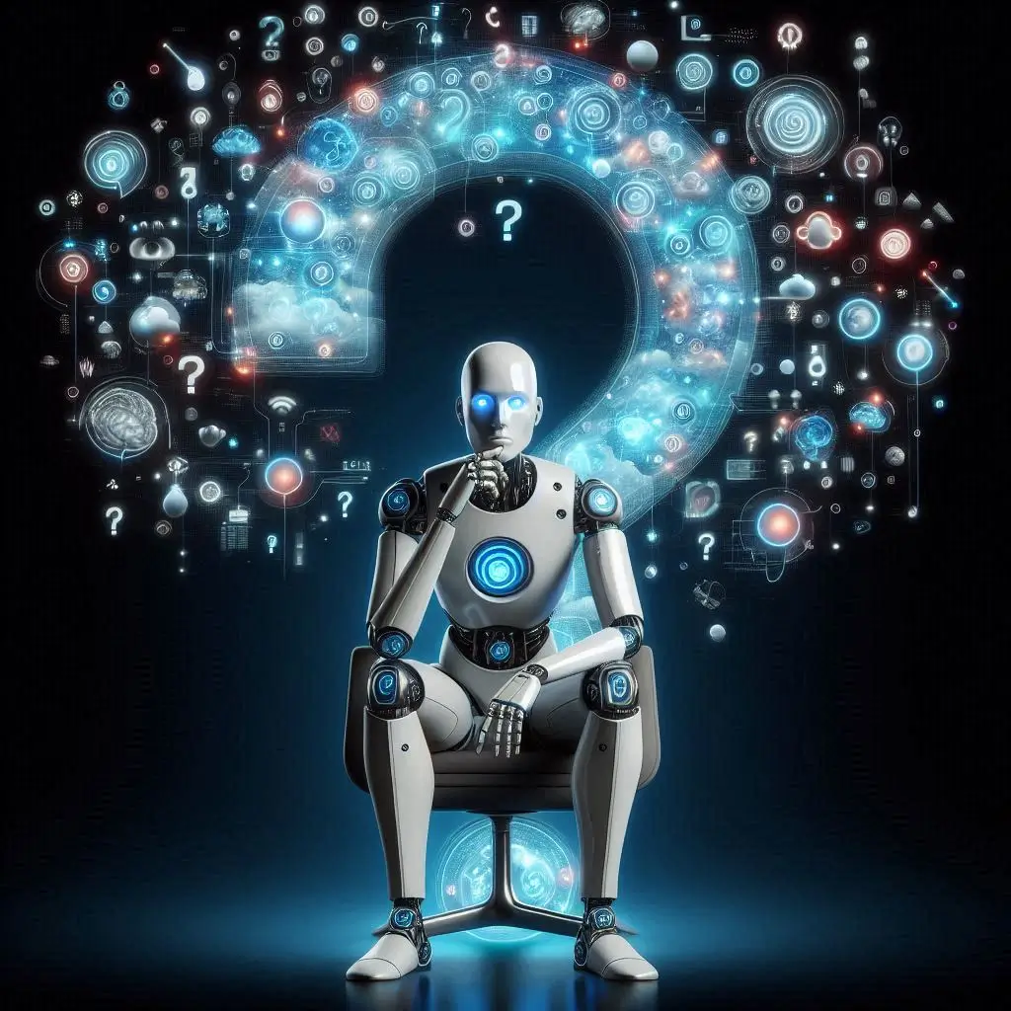
Recap – AI DEBATES : beyond the algorithm
part 1 : CHEAT GPT?
Transformative / disruptive power of AI : efficiency; productivity; creativity (democratization video)
Challenges and cautions : overreliance; job losses ; influence/misinformation ; slop/blurring reality
Future direction : responsible use; digital sovereignty; regulation

Slide 2

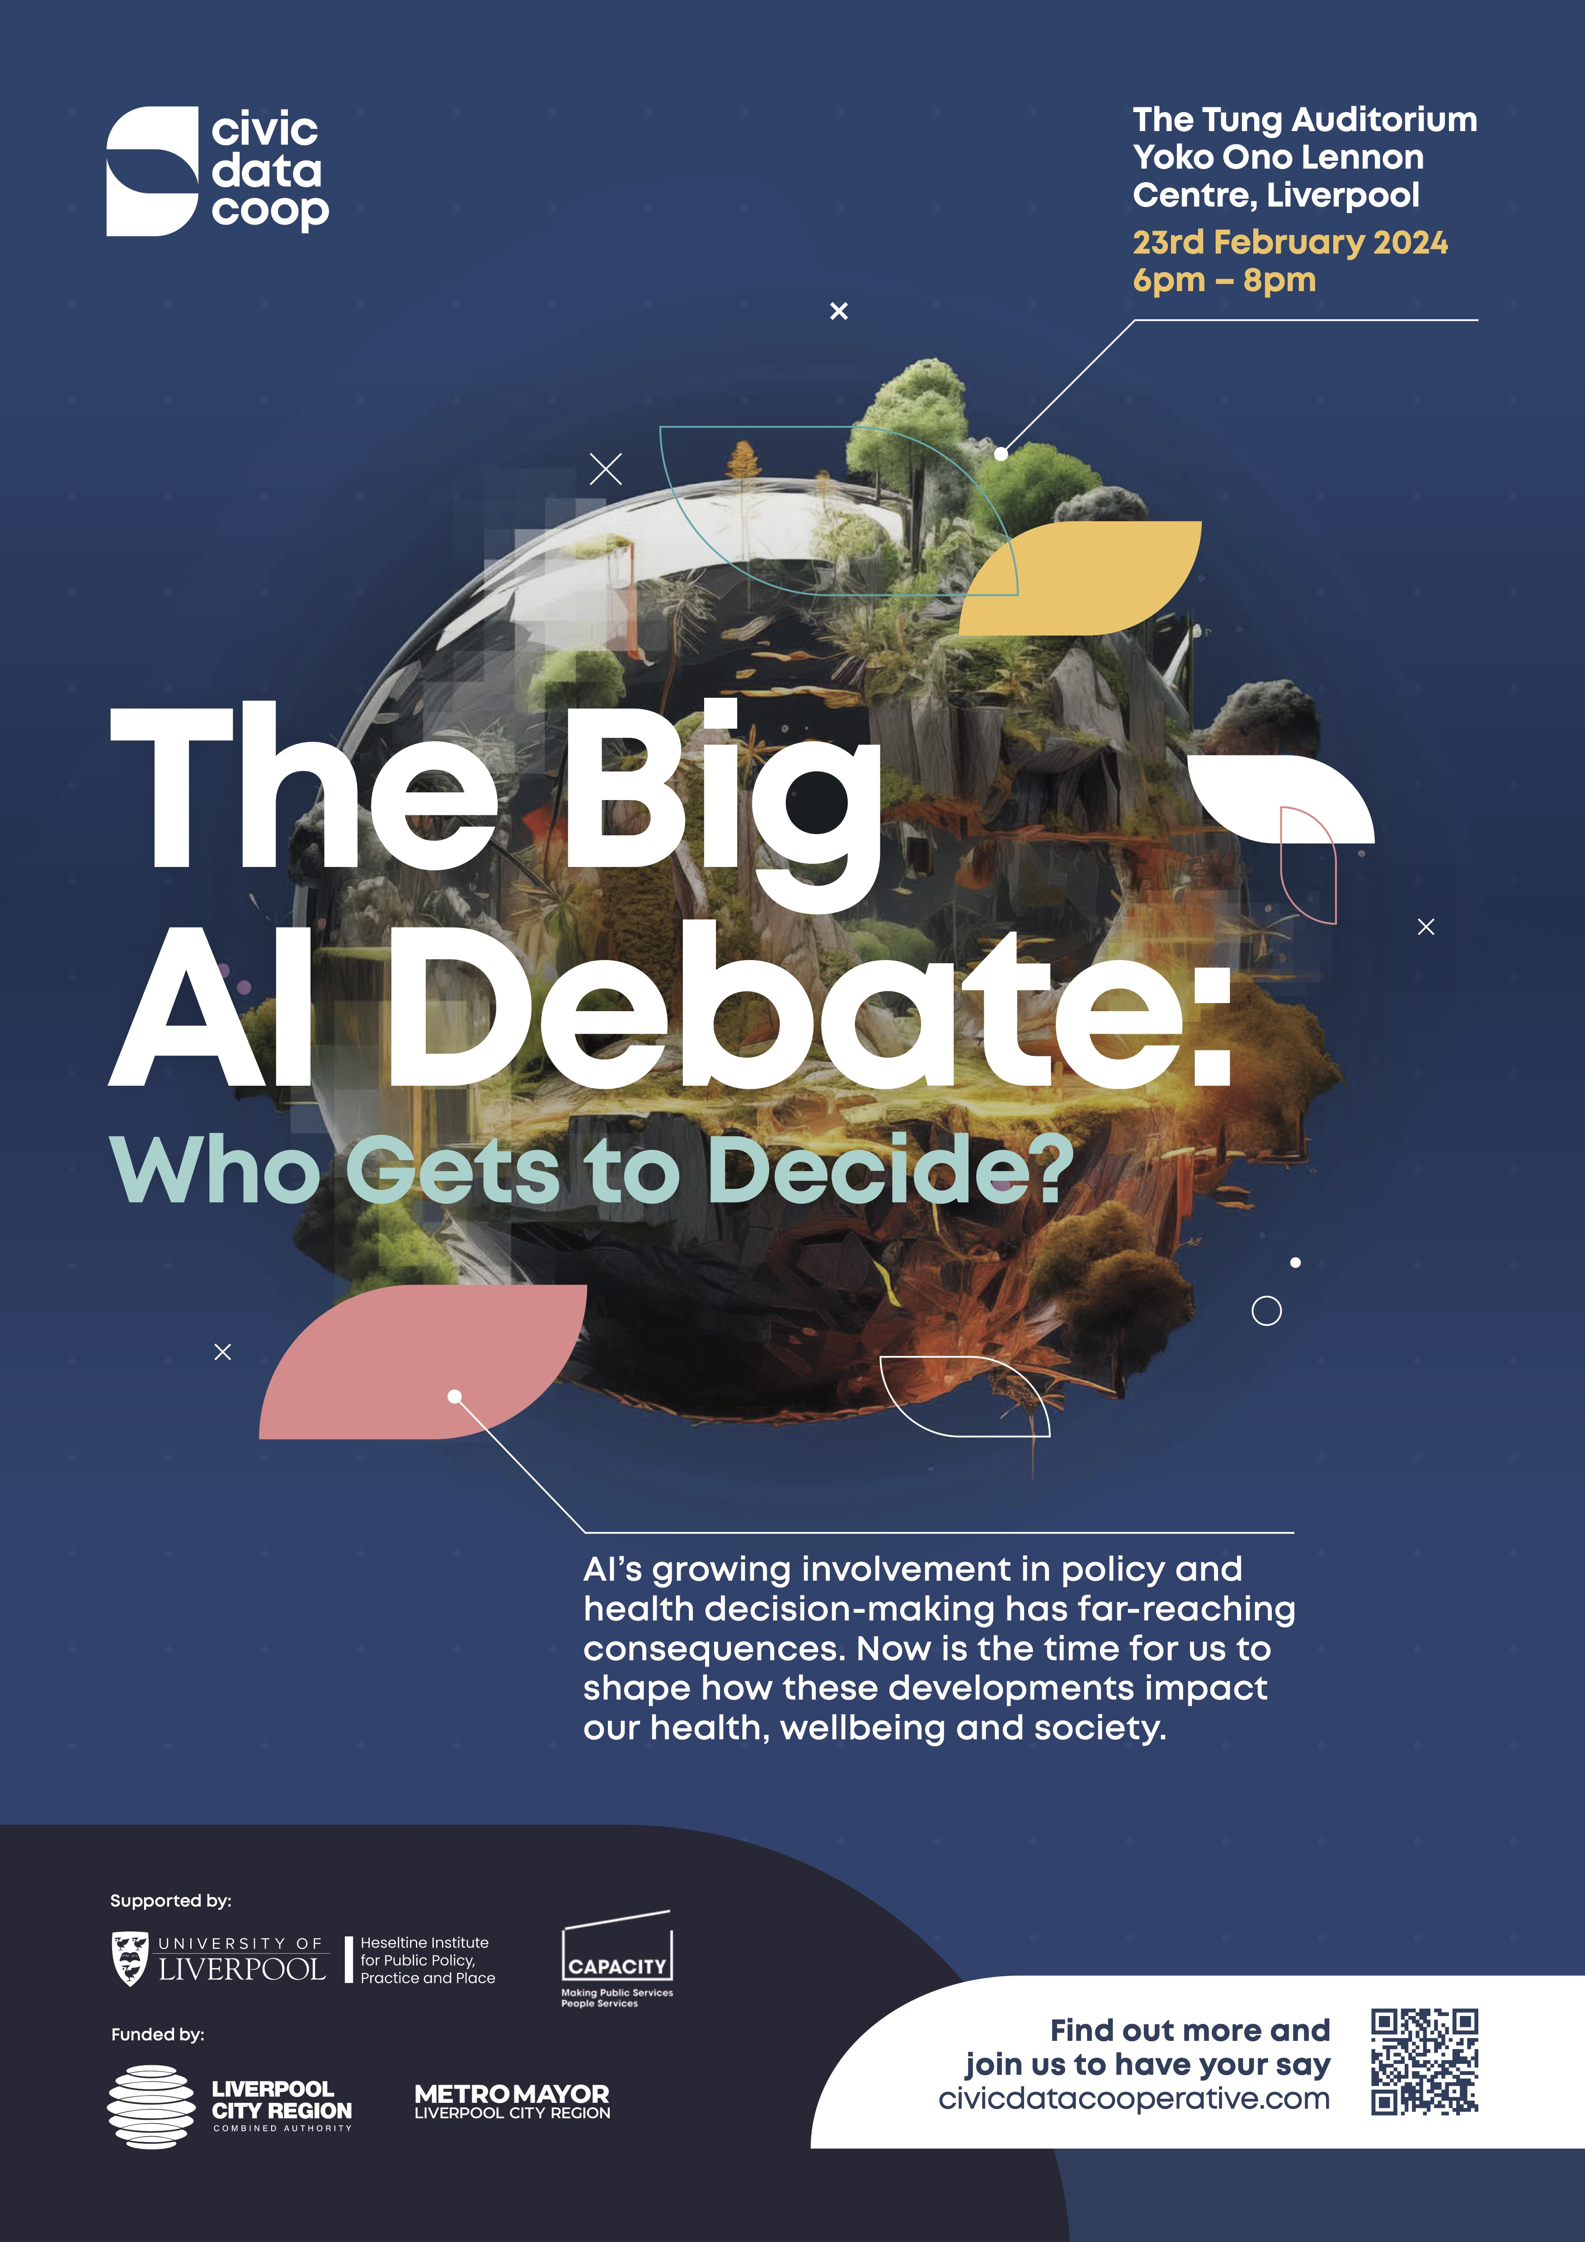
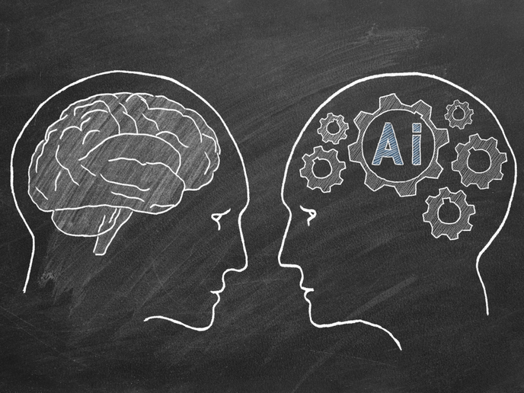
Objectives
Study and analyse the debate around AI, its risks and challenges, its benefits and potential => PART 1
Study AI-human interactions, discuss solutions and reflect more thoroughly on the issue => PART 2

Slide 3




DOC 1 – Why falling in love with an AI isn’t laughable, it’s inevitable
Alex Wilkins, New Scientist, 9 July 2025
DOC 2 – We need a new ethics for a world of AI agents
Gabriel, I., Keeling, G., Manzini, A., & Evans, J., Nature, 4 August 2025
DOC 3 – Clankers, Grokkers and bot-lickers: AI slurs are here to stay
Thom Waite, Dazed.com, August 1, 2025
DOC 4 - Is AI more empathetic than your doctor?
By Nathan Gray, The Los Angeles Times, Nov. 12, 2023

Slide 4
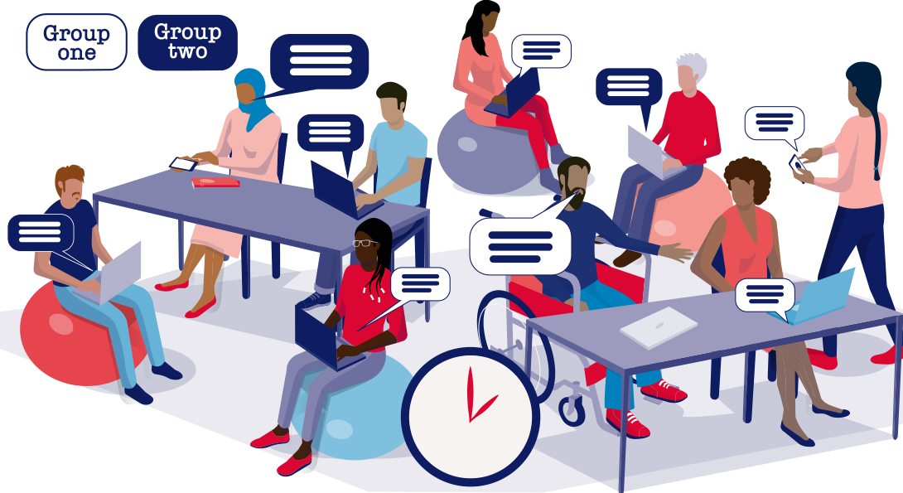
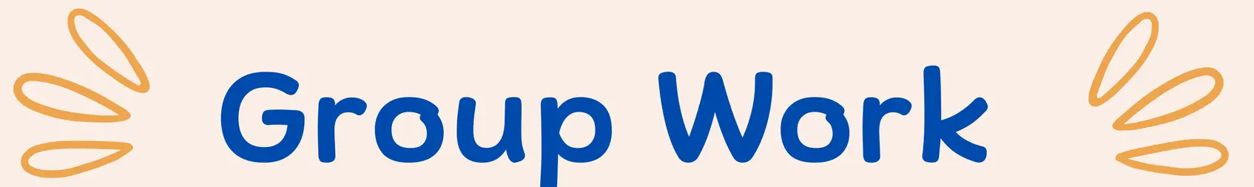
Analyse the title: What do you expect ?
The WH- questions: WHO? WHAT? WHY? HOW?
Information => Numbers? Dates?
Focus on - Linking words (but/yet/however/ nevertheless)
        Modals (will/should/could/may/might…)
        Punctuation (question marks ?)
Audio / video document - Focus on:
        key words / stressed words
        repetitions
        tone of voice

Slide 5

DOC 1
Growing sense of loneliness / isolation => reason why people turn to AI
Overreliance on SM to communicate / interact with other people
AI chatbots are designed / created to be responsive / kind to encourage emotional attachment. Empathy. Anthropomorphism. AI = substitute.
Emotional / social dimension of AI.
Tech solutionism => easy / cheap fix for a complex societal problem.

Slide 6
DOC 2
-great power to companies
Anthroporphism to create bonding. => they are made to be sycophantic. Flattering
ETHICAL CHALLENGE : they must be controlled.
Accountability / transparency / trust / data protection / influence
Agentic capabilities => in the real world + more and more independent. *
This won’t satisfy us / make us happy.

Slide 7
DOC 3
AI = a friend. Increasing use of AI. => raises concerns / criticism
Solution : social stigma / shame. Slurs / insults are invented to describe bots and bot-users.
BUT slurs => aggressive + reproduce stereotypes / robophobia.
Concerns about the slurs + treating AI with hostility since it will become so powerful .

Slide 8
DOC 4
Comparison around the concept of empathy the between AI and doctors.
- doctors’ mental health => they suffer from burn outs / overwork . They display less empathy.
Surprisingly chat bots show more empathy towards patients.
Podium => the dog => comic relief : “Dogs are men’s best friend” => now it’s AI!

