Slide 1
Minneapolis
A case in Point

Slide 2
A transformative presidency

Slide 3
“Donald Trump Is What Some Historians Call a ‘Transformative President’”
Whatever one feels about Trump’s return to the White House, he is what some historians call a "transformational" or "transformative" president, whose victories serve as a forceful indictment of the status quo, and who has reshaped politics, ensuring that they will be played on new terms for decades to come.
This reality becomes easier to see when looking at the similarities between Trump and another transformative president: Franklin D. Roosevelt. Politically, Roosevelt had little in common with Trump. Yet, like Roosevelt’s first election in 1932, Trump’s success potentially signals the overturning of decades of political orthodoxies and the beginning of a new era.
TIME, Made by History, Justin Peck, March 14,2025

Slide 4
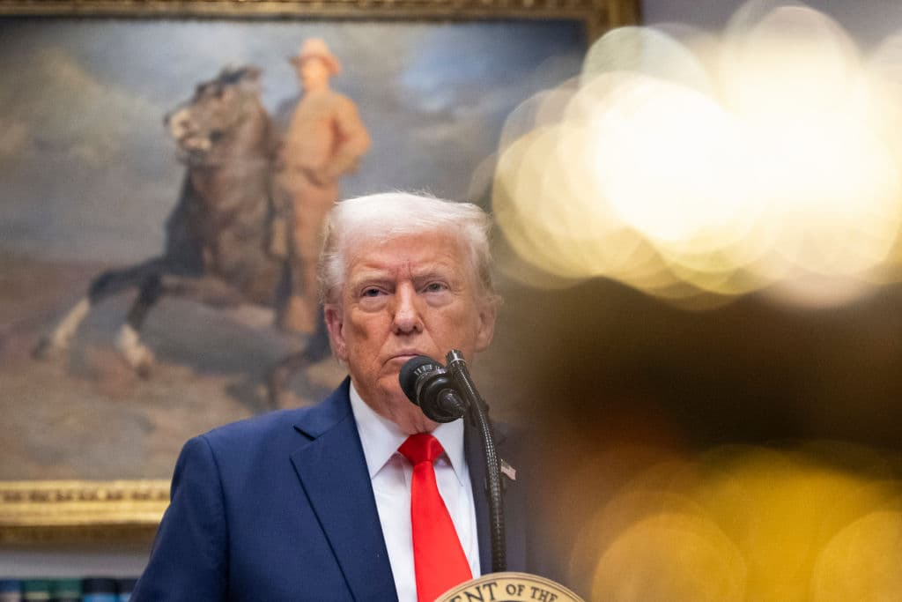
Changes to…
The US foreign policy and imperialism
The executive power and the federal government
Immigration policy enforcement
Culture (the press, social media, higher education, museums, Diversity and Equity)
it has rocked (or just revealed cracks in) the system of checks and balances

Slide 5
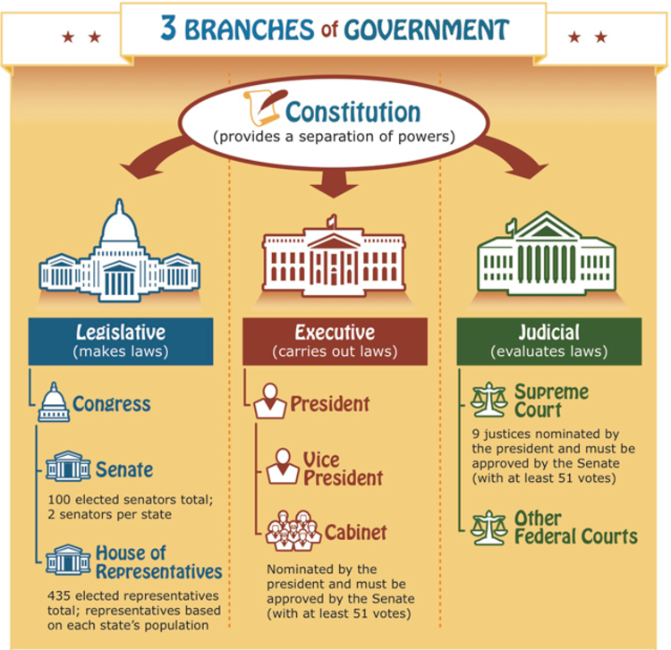
The System of checks and balances

Slide 6
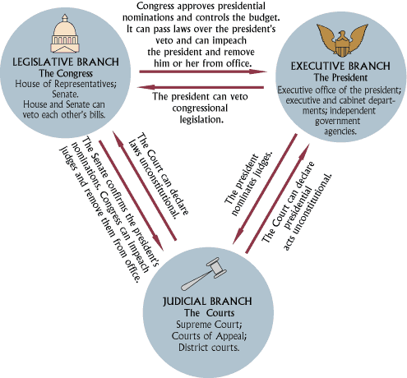

Slide 7
IMMIGRATION
The Case of Minneapolis

Slide 8
Who’s Who?

Slide 9
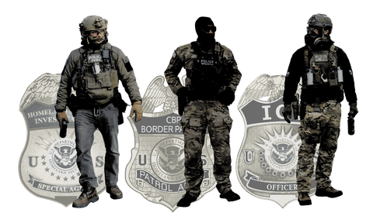
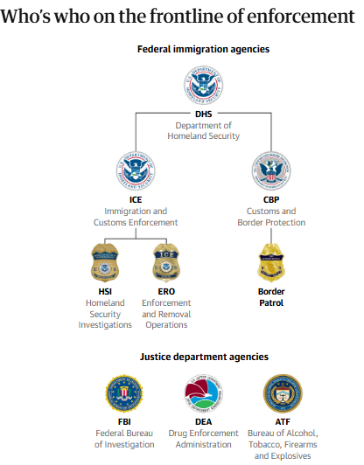

Slide 10
ICE
The federal agents deployed in Trump’s immigration crackdown – visualized
https://www.theguardian.com/us-news/2026/jan/19/donald-trump-immigration-crackdown

Slide 11
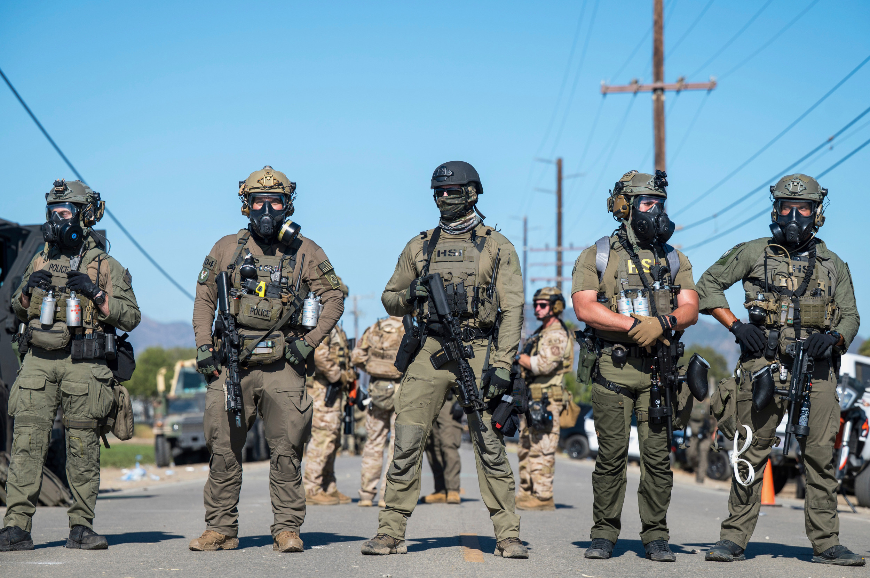
Why such deployment in the Twin Cities?
Minnesota Social Services Scandal
Cf document
It’s a Democratic-led city
In a state led by Governor Tim Walz
A sanctuary city

Slide 12
Deployment of FEDERAL forces
The case of Minneapolis

Slide 13
See doc 4 and 5
Different from « Conventional » deployment of National Gard
Taking advantage of legal void or rather absence of litigation
Acting with or without local authorities’ consent
A show of force
Turning soldiers into cops was once a last resort. How far might he go?

Slide 14
Justice (Retaliation)
The case of Minneapolis

Slide 15
Weaponising the DoJ
How Trump is weaponising the Department of Justice - The Conversation March 2025
How has Trump's second term transformed the Justice Department?
Critics fear the ideal of 'prosecutorial independence' has been jettisoned in favour of partisan goals during the first year of Trump's second term.
Aljazeera, Dec 2025

Slide 16
It’s hard to keep track of US President Donald Trump’s many notable acts since returning to the White House. His recent pro-Russia stance on the war in Ukraine has, rightly, received a lot of attention.
But for every big moment, there are others that fly under the radar. One such issue is the politicisation of the Department of Justice (DoJ).
Although there is longstanding precedent that the DoJ remains politically neutral in its operations, recent events have indicated a dramatic break from that tradition.
And, importantly, Trump has been laying the groundwork to justify this for nearly two years, using a propaganda tactic that’s been employed by authoritarian governments throughout history.
Strategic sidelining
The current administration has attempted to fire or sideline anyone at the DoJ who was involved with prior investigations and prosecutions of the now-president.

Slide 17
The media
The case of Minneapolis

Slide 18
Blue states banning cooperation with ICE will backfire
The Trump administration’s immigration excesses are no excuse for Democrats to adopt their own.
February 4, 2026 The Washington Post
Border czar Tom Homan announced Wednesday that 700 federal agents are leaving Minnesota thanks to “unprecedented” cooperation from local law enforcement. While about 2,000 federal officers will remain, the drawdown is a welcome concession to political reality—and an opportunity for a reset at the Department of Homeland Security.
President Donald Trump arrived in office with a mandate to secure the border and deport illegal immigrants who had committed crimes. Immigration and Customs Enforcement could have focused primarily on apprehending dangerous criminals, which would have been an easy win for Trump and, more importantly, made America safer. Instead, DHS prioritized quantity over quality. The ensuing dragnet, combined with the needless demonization of immigrants and unprofessional behavior from many agents, turned immigration into a liability for Republicans.
At the same time, blue-state leaders have advanced policies to block local law enforcement’s cooperation with immigration enforcement. Maryland’s House and Senate advanced a bill this week to end 287(g) agreements, which are formal partnerships between local law enforcement and ICE. Virginia, New Mexico, New York and Hawaii are considering similar bans. Maine and Delaware did so last year. But without state and local cooperation, ICE gets a strong justification to deploy force in pursuit of the violent criminals whom the overwhelming majority of Americans don’t want on the streets.
Handing over criminals in the security of a jail is safer not just for agents but also for the people they’re apprehending. Democrats will come to regret adopting policies that shield criminals and, as a result, push ICE agents into neighborhoods.

Slide 19
The « anti-trump resistance »
The case of Minneapolis

Slide 20
Tensions in the democratic party
The case of Minneapolis

