Slide 1
May June 2026

Slide 2
Connecting the dots
To prepare a commentary and react to questions

Slide 3
250 years
Moon
Channel crossings
Ban in schools
No smoking
Gerrymandering
King
Reform UK
Voting Rights Act
Shooting
Rally

Slide 4
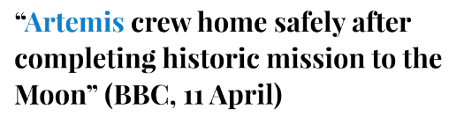
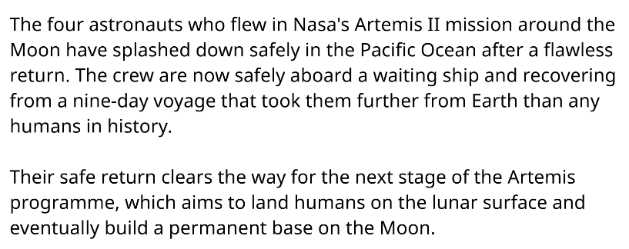

Slide 5
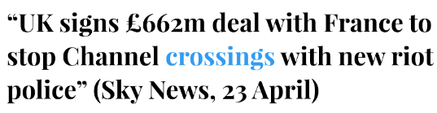
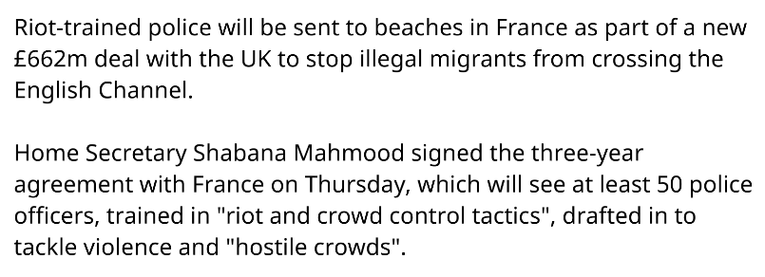

Slide 6
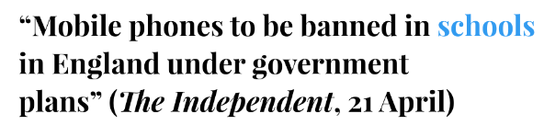
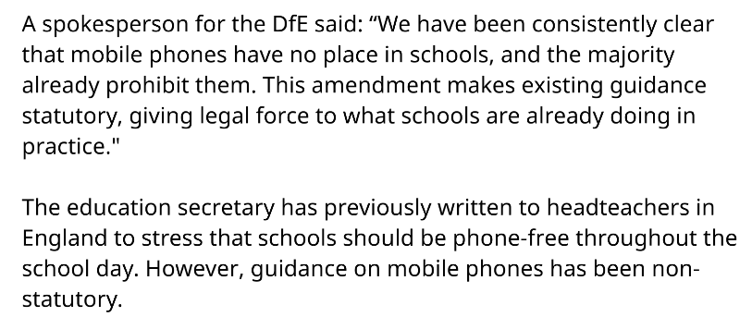

Slide 7
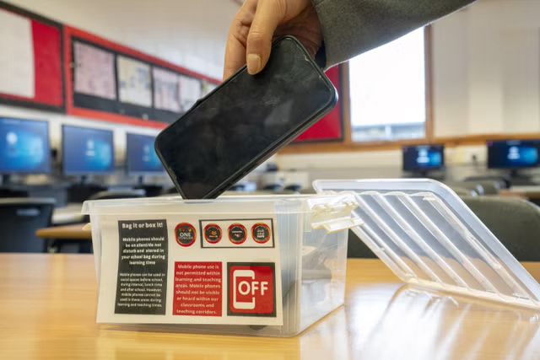

Slide 8
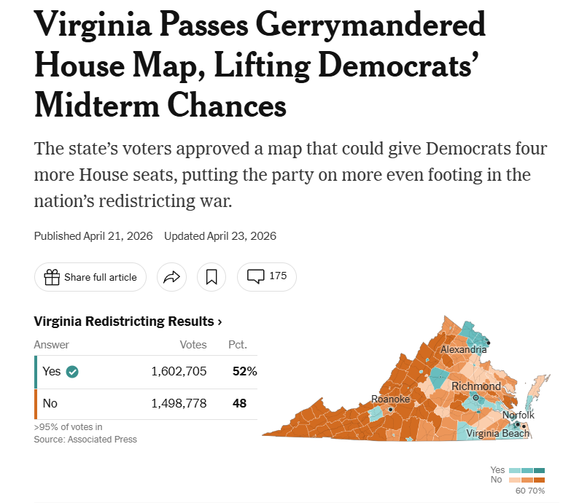

Slide 9

Gerrymandering explained

Slide 10

Virginia Supreme Court strikes down gerrymandered maps in ‘massive’ loss for Dems’ attempt to take 4 more House seats
May 8, 2026 - WASHINGTON — The Virginia Supreme Court gave Republicans a massive victory Friday by ruling that Democrats unlawfully ratified a lopsided congressional map to give themselves four more House seats in the midterm elections.
The 4-3 decision declares the recently voter-approved gerrymander “null and void” — giving Republicans a clear advantage in the nationwide redistricting war.
Virginia is currently represented by six Democrats and five Republicans in the House. The ruling dashes Democratic dreams of cruising to a 10-1 delegation.

Slide 11
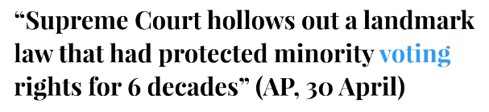
— President Lyndon B. Johnson knew the legislation he was about to sign was momentous, one that took courage for certain members of Congress to pass since the vote could cost them their seats.
To honor that, he took the unusual step of leaving the Oval Office and going to Capitol Hill for the signing ceremony. It was Aug. 6, 1965, five months after the “Bloody Sunday” attack on civil rights marchers in Selma, Alabama, gave momentum to the bill that became known as the Voting Rights Act.

Slide 12
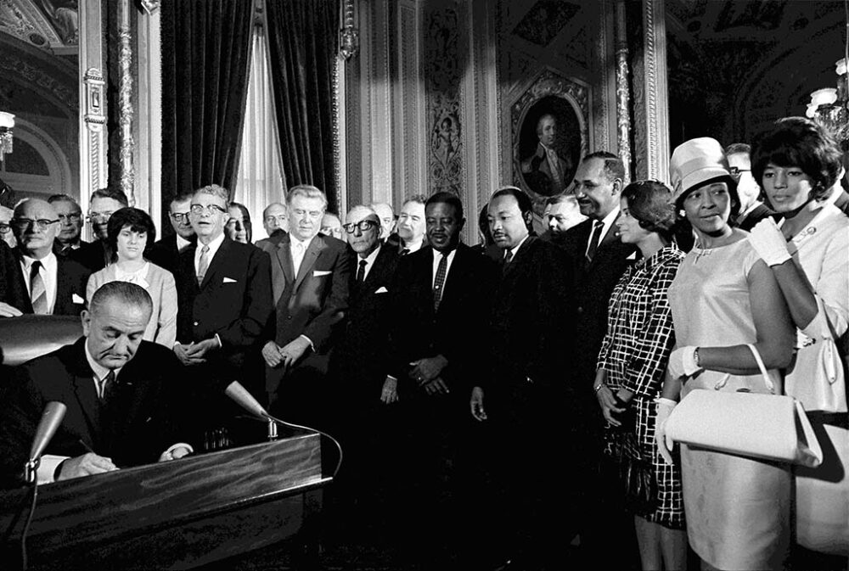

Slide 13
In the six decades since, it became one of the most consequential laws in the nation’s history, preventing discrimination against minorities at the ballot box and helping to elect thousands of Black and Hispanic representatives at all levels of government.

Slide 14
On Wednesday, the U.S. Supreme Court knocked out a major pillar of the law that had protected against racial discrimination in voting and representation. It was a decision that came more than a decade after the court undermined another key tenet of the law and led to restrictive voting laws in a number of states. Voting and civil rights advocates were left fearful of what lies ahead for minority communities.

Slide 15
“It means that you have entire communities that can go without having representation,” said Cliff Albright, a co-founder of the group Black Voters Matter. “It is literally throwing us back to the Jim Crow era unapologetically, and that’s not exaggeration.”
Kareem Crayton, vice president of the Brennan Center for Justice’s Washington office, said the court’s steady work to erode the Voting Rights Act, culminating in Wednesday’s decision, amounted to “burying it without the funeral.”

Slide 16
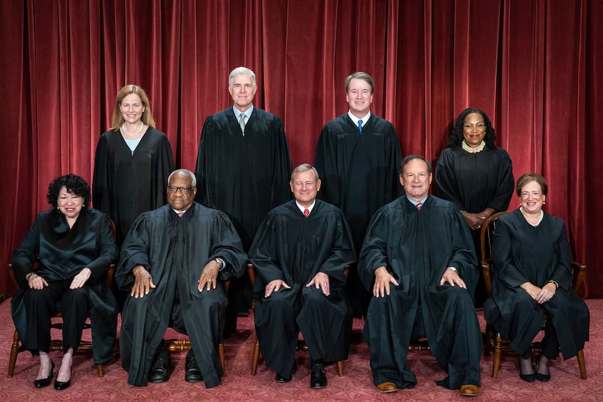
Chief Justice John G. Roberts, Jr.
Clarence Thomas
Samuel A. Alito, Jr.
Sonia Sotomayor
Elena Kagan
Neil M. Gorsuch
Brett M. Kavanaugh
Amy Coney Barrett
Ketanji Brown Jackson

Slide 17
CNN -May 19, 2026 — Three people killed in Islamic Center of San Diego shooting tried to draw gunmen away from mosque, police say
The two teenage shooters in yesterday’s deadly shooting at the Islamic Center of San Diego have been identified by police after killing three people who are being remembered as vital members of the mosque’s community whose actions prevented further tragedy.
Gunmen radicalized: Authorities believe the shooters “exchanged radicalized ideology,” police said. Remily said authorities are working to figure out how the radicalization happened. A “manifesto” was recovered by law enforcement, which covered “a wide aspect of races and religions,” according to Remily. Hate speech was also found scrawled on one of the weapons used in the attack, and a suicide note contained writings about racial pride, officials said.

Slide 18
Weapons seized: Law enforcement seized more than 30 guns, including numerous pistols, rifles and shotguns, a crossbow, tactical gear, ammunition and electronics, while executing three search warrants at residences associated with the suspects, Remily said.
American Jewish communal organisations have expressed their solidarity with the Muslim community in the wake of a shooting
The ADL, America’s foremost organisation targeting antisemitism, said: “We are devastated by the deadly shooting at the Islamic Centre of San Diego. No one should fear for their safety while attending a house of worship or school.
Community leaders speak out: Muslim community and faith leaders held a news briefing, during which they condemned Islamophobia and hate speech following the attack. The executive director of the city’s Council on American-Islamic Relations chapter urged community members and politicians to take action against Islamophobic rhetoric. Abdullah Tahiri, president of the Muslim Leadership Council of San Diego, said the shooters “did not act in a vacuum,” saying the attack was a “direct and predictable consequence of a political climate” tolerant of anti-Muslim sentiment.

Slide 19
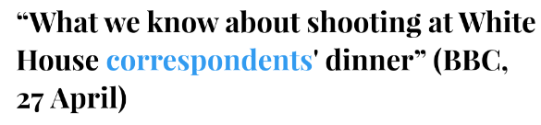
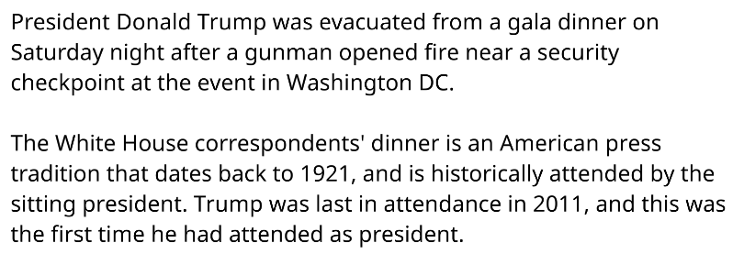

Slide 20

Key facts about America and Guns
Juley 24 2024
Guns are deeply ingrained in American society and the nation’s political debates.
The Second Amendment to the United States Constitution guarantees the right to bear arms, and about a third of U.S. adults say they personally own a gun. At the same time, in response to concerns such as rising gun death rates and mass shootings, the U.S. surgeon general has taken the unprecedented step of declaring gun violence a public health crisis.

Slide 21
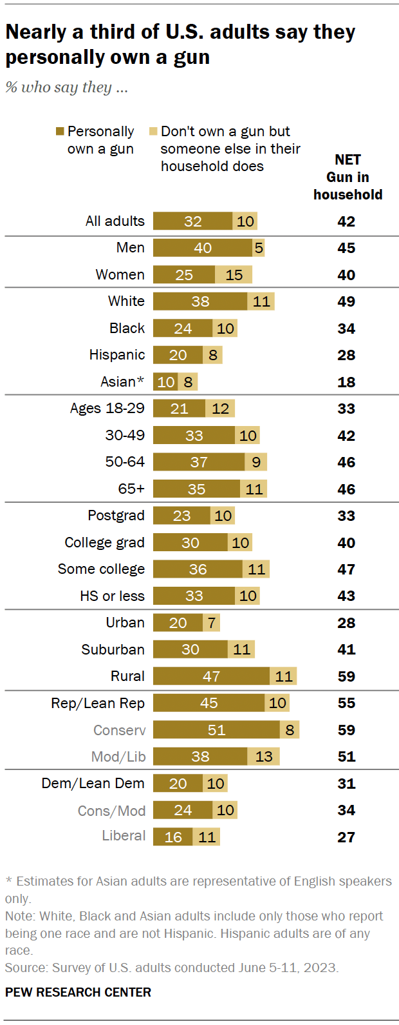

Slide 22
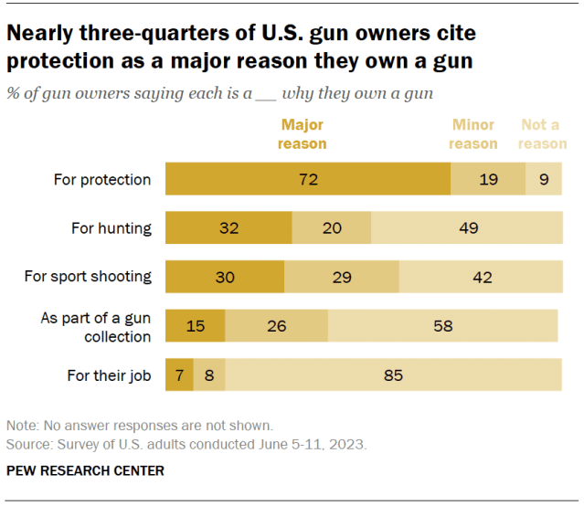

Slide 23
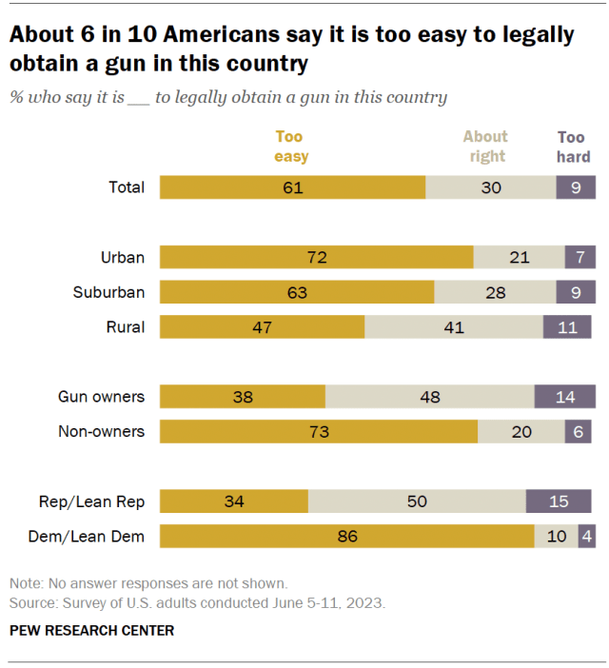

Slide 24
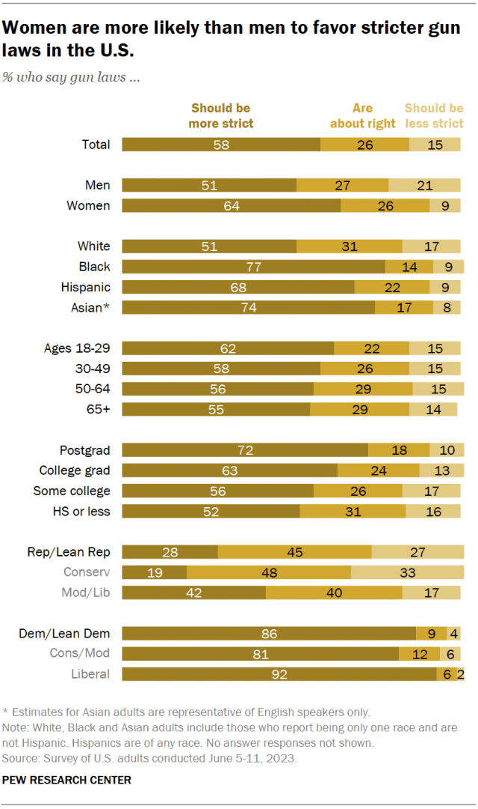

Slide 25
A few key words:
Gun activists
Gun control
2nd Amendement
NRA
Stand your ground

Slide 26
A few key words:
Gun activists – Gun control – 2nd Amendement – NRA – Stand your ground
A well regulated Militia, being necessary to the security of a free State, the right of the people to keep and bear Arms, shall not be infringed.

Slide 27
A few key words:
Gun activists – Gun control – 2nd Amendement – NRA – Stand your ground
What are ‘red flag laws’?
A red flag law refers to a civil proceeding that allows people – usually police officers and family members – to petition a judge for an emergency order that would temporarily remove firearms from a person found to be at risk of harming themselves or someone else. Depending on the state, these are also called extreme risk protection orders (Erpos), extreme risk laws or gun violence restraining orders. Though names vary, they broadly operate in the same ways and are modeled after domestic violence restraining orders (DVROs) that are meant to protect victims of household or intimate partner violence.
While research shows they lead to significant drops in firearm suicides, and may also have prevented dozens of mass shootings, the concept is frequently rebuffed by Republican politicians, who say they infringe on due process rights.

Slide 28
Nigel Farage hails ‘historic shift in politics’ after Reform UK election gains
The Guardian, May 8 2026
Nigel Farage hailed sweeping election wins for Reform UK as a “historic shift in British politics” on a day when the populist party made gains at the expense of Labour and the Conservatives.
Reform made advances in heartland areas of both parties, clocking up substantial early results in the English local elections

Slide 29
What elections were held and where?
IN BRIEF
In England, there were first-past-the-post votes for members of more than 130 councils of various types – metropolitan, unitary, county, district and 32 London boroughs – as well as for six mayors. Some authorities are re-electing all councillors, some a third of them.
In Scotland, voters selected 129 members of the country’s parliament, via a mix of first-past-the-post constituency voting and proportional regional voting.
In Wales, a revised proportional system will pick 96 members of an expanded Senedd.

Slide 30
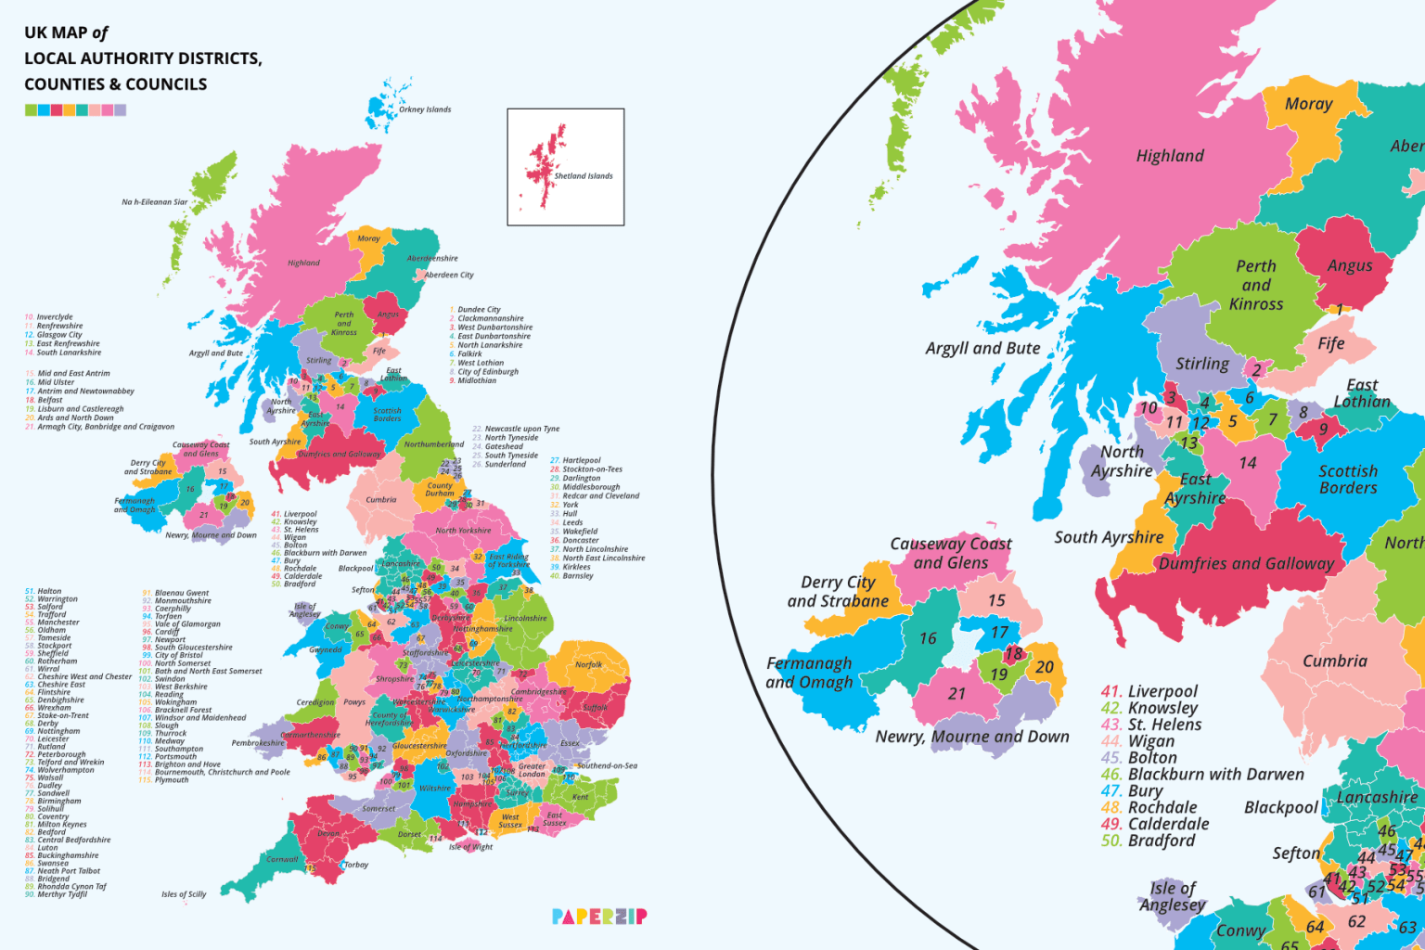

Slide 31
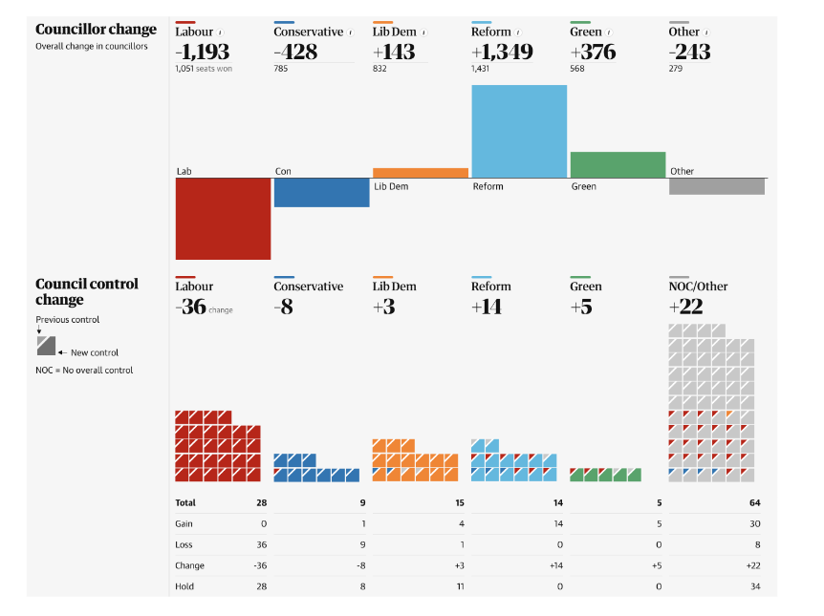

Slide 32
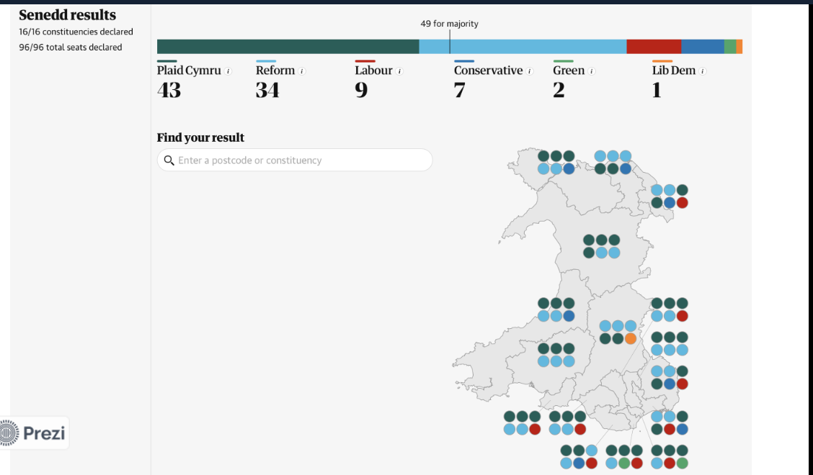

Slide 33
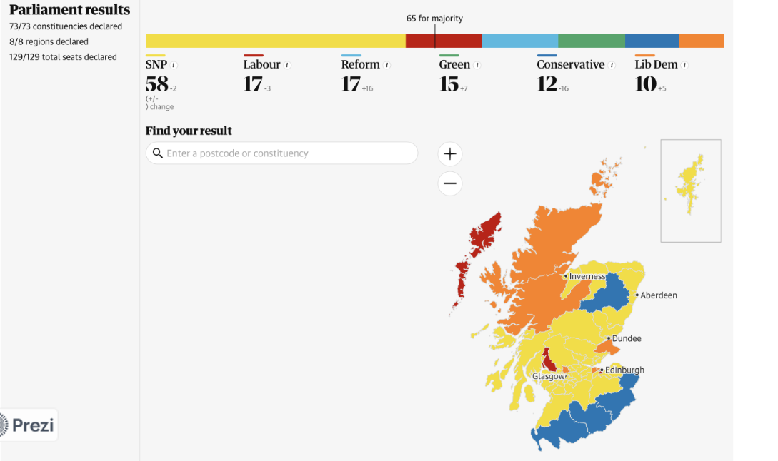

Slide 34
Thousands hit London streets for "Unite the Kingdom" march organized by far-right activist Tommy Robinson
CBS News May 16, 2026
Tens of thousands of demonstrators descended on central London on Saturday for a rally organized by far-right activist Tommy Robinson, with supporters framing the event as a protest against the erosion of British identity.
Police estimated that around 60,000 people attended the "Unite the Kingdom" march, making it one of the largest right-wing mobilizations seen in Britain in recent years, though smaller than a similar Robinson-led rally last September. Robinson is the founder of the nationalist and anti-Islamist English Defence League and is one of the most influential far-right figures in Britain.
Crowds carrying St. George's Cross and Union flags marched through central London chanting "we want Starmer out" and "Christ is King." Some wore red "Make England Great Again" hats, echoing President Trump's Make America Great Again movement.
People cited a range of reasons for attending, but many described feeling ignored by the government and alarmed by the direction of the country.

Slide 35
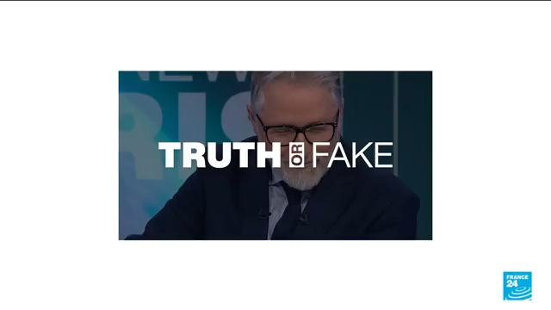
Far-right rally turnout inflated by AI

Slide 36
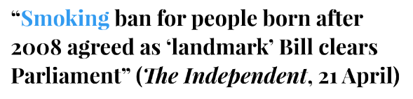
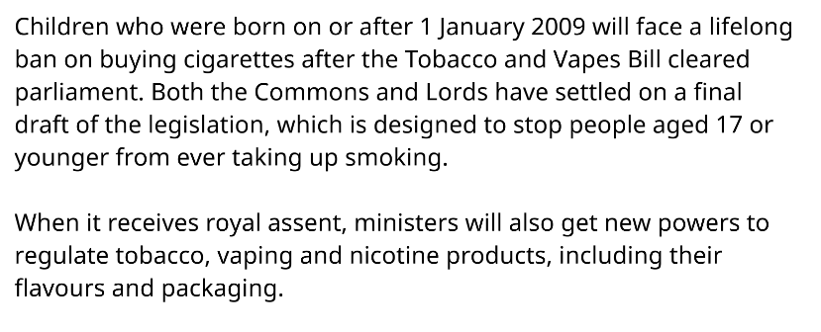

Slide 37
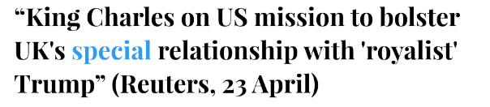
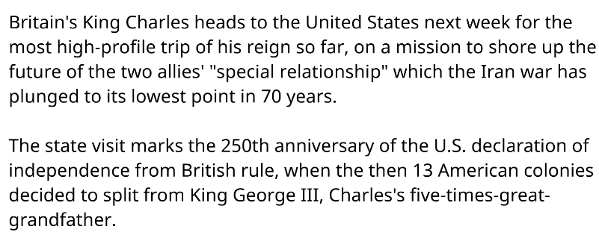

Slide 38
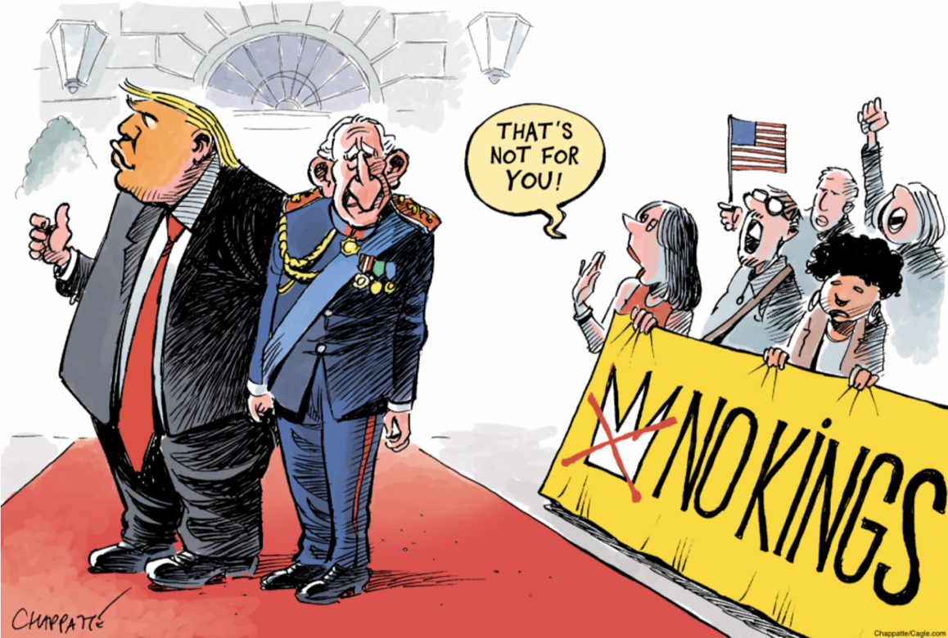

Slide 39
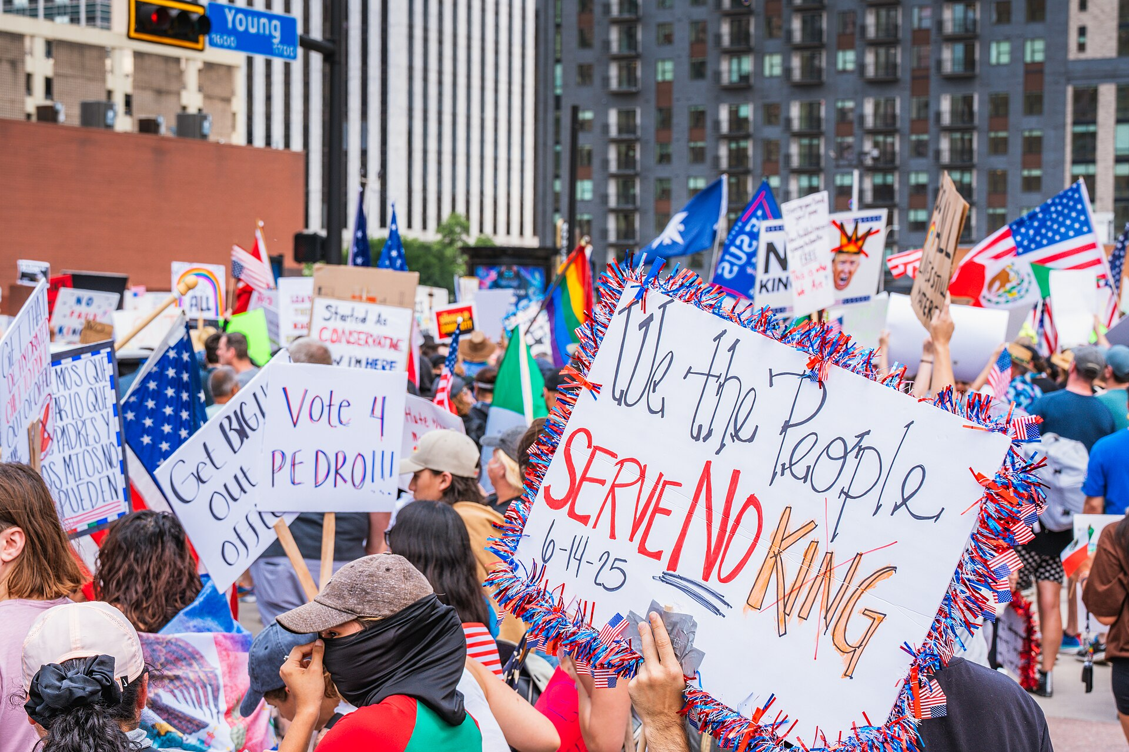
The No Kings protests are a series of three protests (June 2025, October 2025, and March 2026) mainly held in the United States opposing the actions and policies of the second Trump administration.

Slide 40

The United States Semiquincentennial will be the 250th anniversary of the United States Declaration of Independence. Festivities will mark various events leading up to the Declaration's anniversary on the 250th Independence Day: July 4, 2026.

Slide 41
- Les 250 ans des Etats-Unis en 2026, l’occasion pour Trump de célébrer une histoire expurgée de ses aspects « négatifs »
Une gigantesque foire dans le centre de Washington, une compétition d’arts martiaux mixtes à la Maison Blanche, un monument à la gloire des héros nationaux : le président américain entend donner aux célébrations un tour résolument patriotique, en passant sous silence les épisodes sombres de l’histoire du pays.
Par Corine Lesnes (San Francisco, correspondante) , Le Monde, 07 juillet 2025
https://www.whitehouse.gov/freedom250/story-of-america/

Slide 42
