Slide 1
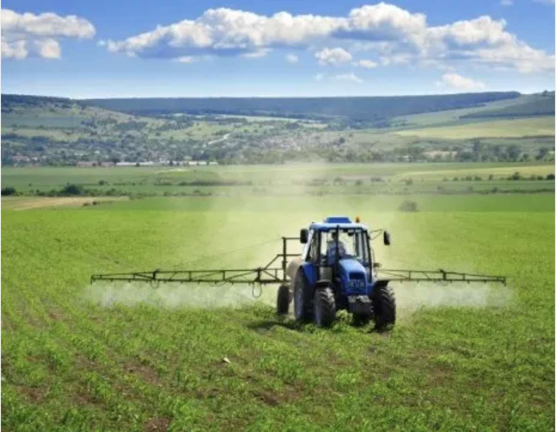
GMOs

Slide 2
Around the world, farmers face different problems:
drought (lack of rain)
floods (too much rain)
pests (insects, rodents etc.)
weeds (invasive plants)
=> Those can lead to lower yields (= rendements)

Slide 3
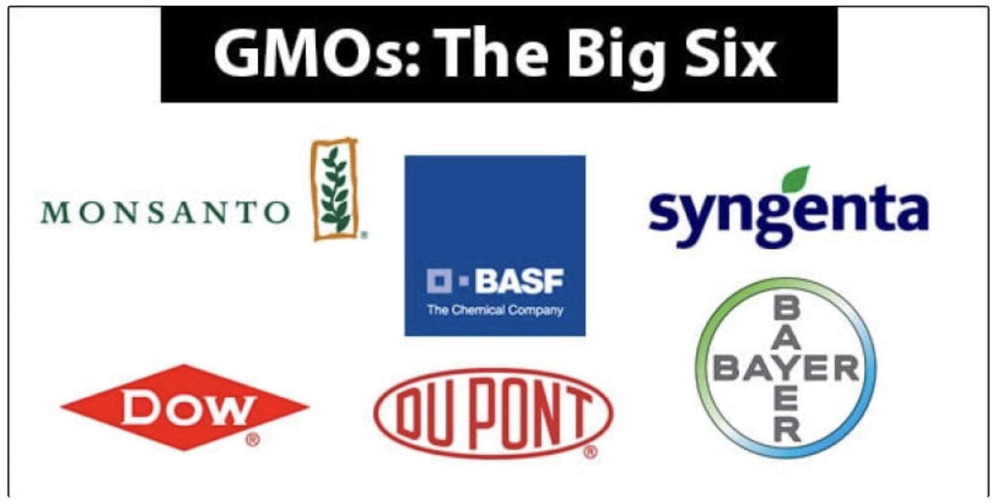
To try to maintain stable yields (or to increase them), biotechnology companies have invented GMOs

Slide 4
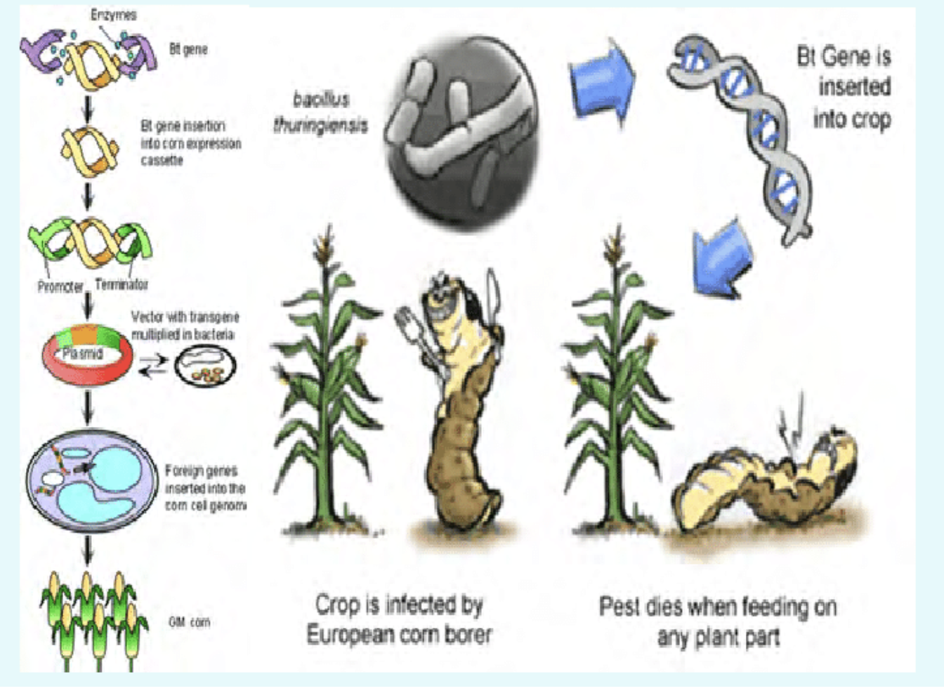
How can GMOs help?
=> the example of Bt Corn (Monsanto)

Slide 5
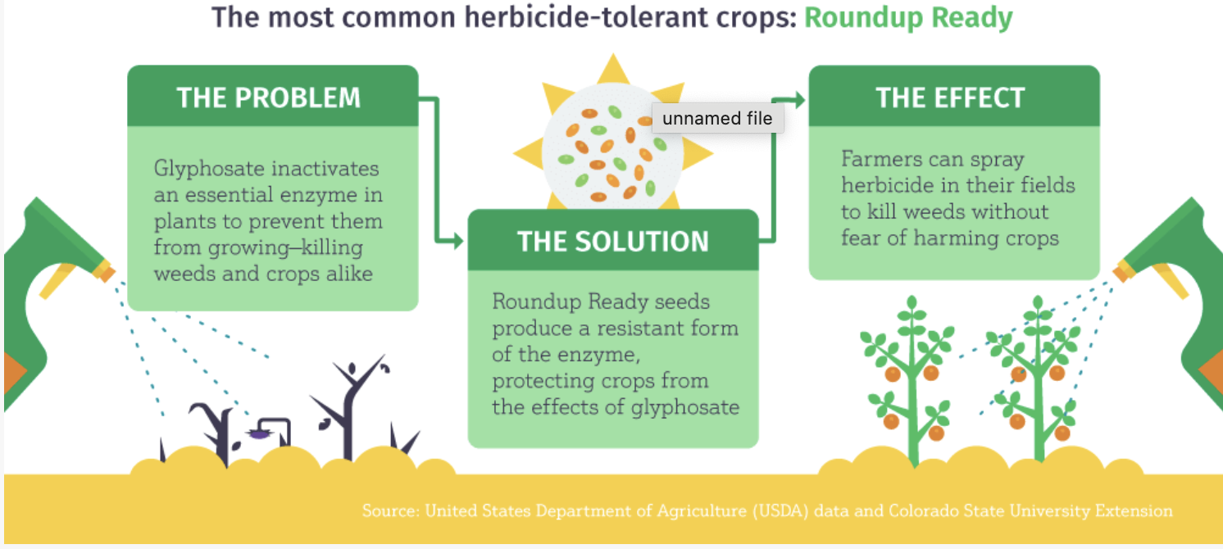
Another example: Round-Up ready cotton

Slide 6
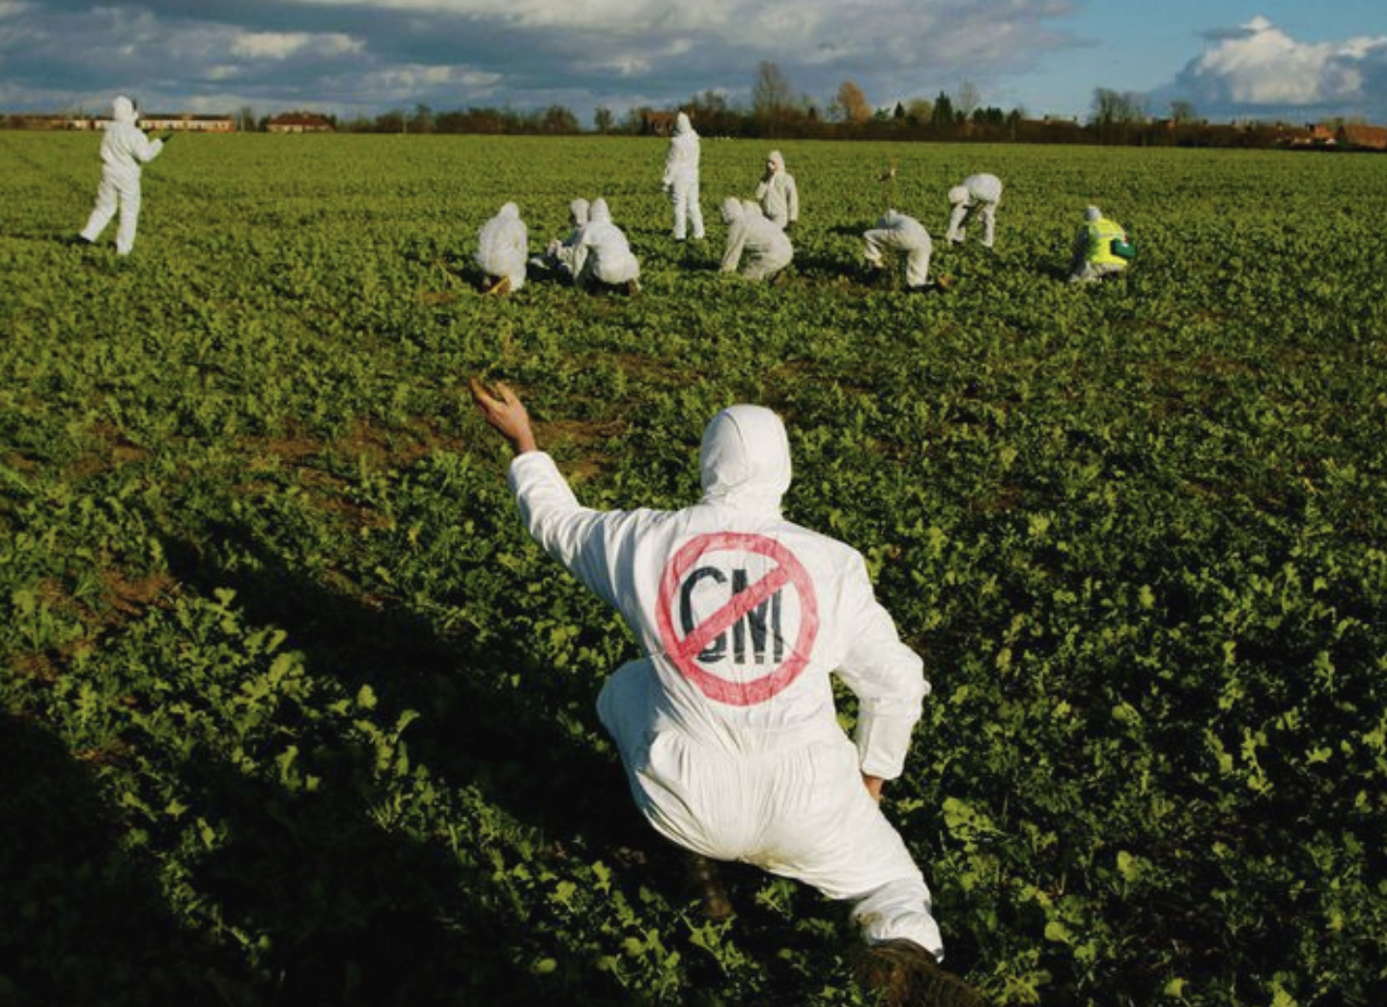
Is genetic modification a danger for human health and/or for the environment?

Slide 7
Concerns
There no scientific evidence on the actual effects of GM foods on the human body
=> but uncertainty + concerned public opinion in the EU
+ prevention of « gene flow » (= contamination) to non-GM crops
=> precautionary principle: EU countries’ bans/regulations for food consumed by humans (<0.9% or labels). No ban on cattle feed

Slide 8
GM seed corporations have worked to expand to markets all around the world
(often using lobbying and unethical practices: prices start low then skyrocket, creation of monopolies etc.)

Slide 9
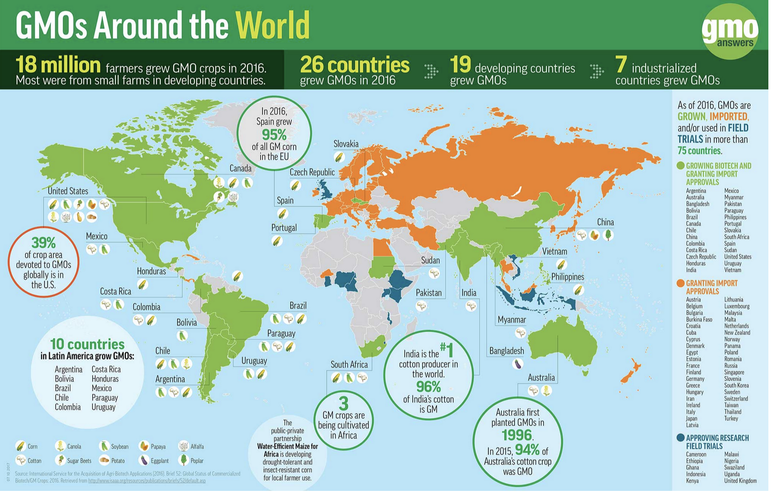

Slide 10

Concerns for farmers
GM seeds have been patented (= brevetées)
GM companies have intellectual property (« copyright ») on the seeds
They cannot be re-used, reproduced by the farmers (= buy new seeds every year)

Slide 11
and
GM seeds are, in the end, more expensive + have to be bought with expensive chemical products and require tools (tractors, sprayers etc.)
more expensive than traditional farming practices
In India, this led to higher debt for farmers, even bankruptcy as well as a wave of suicides (400,000 between 1995 and 2018)

Slide 12
Concerns about the environment and health
Round Up ready crops = higher herbicide use
=> pollution of ecosystems (water, soil organisms, bees etc.)
=> higher risks of cancers (farmers have sued Monsanto from 2017 on)

Slide 13
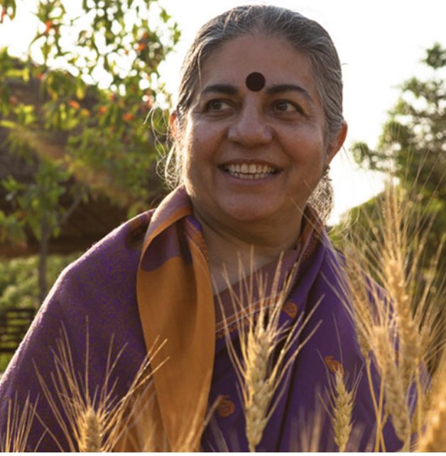
Note: why does Vandana Shiva, in her video, accuses Monsanto of violence against women?
- The interview takes place on March 8th, therefore V. Shiva
doesn’t only talk about the environment but also about women.
In the Hindu community in India, being a widow = being rejected by your family and community. Many widows end up begging on the streets or being sex workers.
a widowed woman’s life is seen as having no value (see the former « Sati » ritual)
In traditional farming cultures, it is the women who are often seen as the « guardians of seeds » (fertility symbol): they keep the seeds to be planted the following season, they select the best seeds etc.
=> it is as if Monsanto had robbed Indian women of this power

Slide 14
Note 2: why does Vandana Shiva mention « agent orange » in her interview?
Agent orange is a chemical herbicide (in)famously used by the US army during the Vietnam war (to destroy the jungle and find hiding Vietcongs).
Monsanto is one of the chemical companies which produced Agent orange. It has been condemned for its impact on the environment and the health of soldiers and civilians.
Since then, its main component (2,4-D) has been used in agriculture as a herbicide.

