Slide 1
WORLD OF WORK
NEW FORMS OF ECONOMY

Slide 2
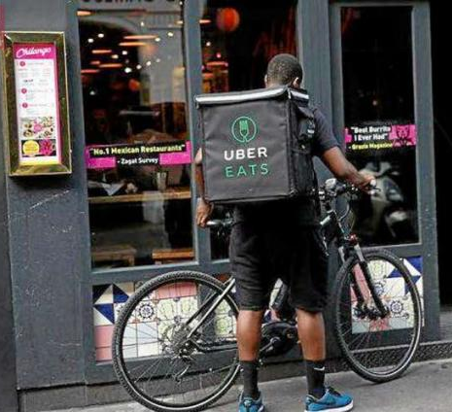
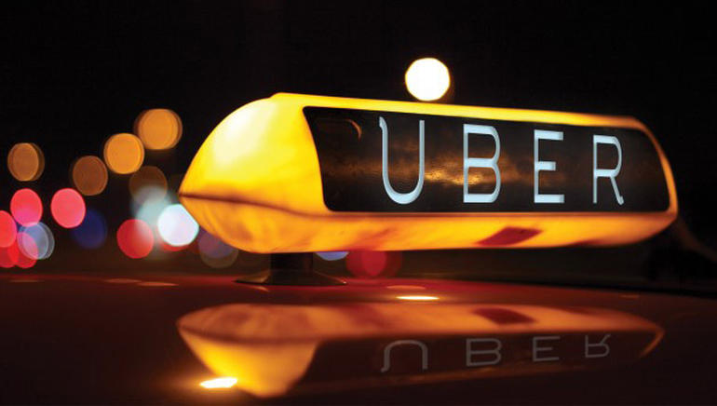
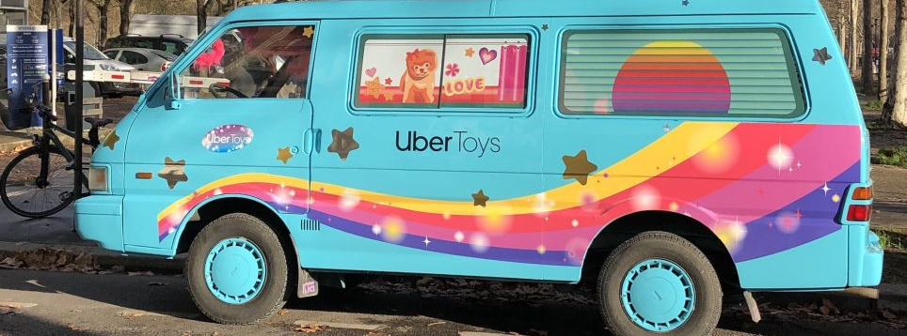

Slide 3
"gig economy"
noun noun: gig economy; plural noun: gig economies a labour market characterized by the prevalence of short-term contracts or freelance work as opposed to permanent jobs. "working in the gig economy means constantly being subjected to last-minute scheduling"

Slide 4
WATCH THE VIDEO AND Pick out the keywords having to do with the gig economy

Slide 5
debate
Half the class will be the LIBERAL THINKERS and will try to gather all the arguments in favour of the development of the gig economy.
Half the class will be the SOCIAL THINKERS and will try to gather all the arguments in favour of limiting the development of the gig economy.
HELP
To help both groups build up their arguments you will see a word cloud you can get your inspiration from.
PREPARARTION TIME
10 mn

Slide 7
ONE SPECILAIST’S VIEW ON THE GIG ECONOMY

Slide 10
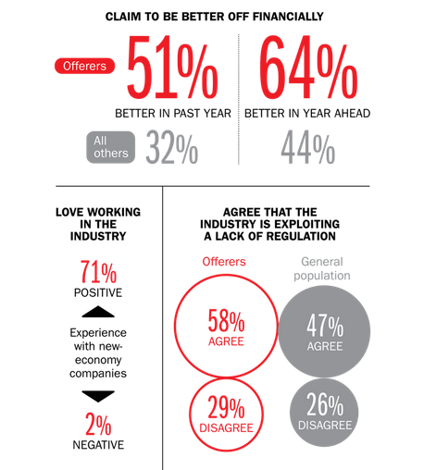
The Rise of the Entrepreneur — The Gig Economy

Slide 11
New tools to boost the work flexibility
The Zero Hour Contract.
The zero dollar paycheck.

Slide 12
The Zero hour contract
It was invented in the UK.
With those contracts workers are called workers not employees as they do not benefit from the same social benefits as someone employed with amore traditional form of contract.
Zero-hour contracts are a type of contract between a worker and an employer, whereby, the worker is not obliged to accept any work offered by an employer whom is not obliged to provide any minimum working hours. You have to be ready to work whenever the employer wants you to.
On the long terms, and if your company feels like it, you may see your contract turned into a long term one as you have acquired the necessary skills.
Trade Unions consider it Workforce exploitation.
Big trade corps are using those contracts extensively

Slide 13
Number of employees on a zero-hours contract in the United Kingdom from 2000 to 2021 (in 1,000s)

Slide 14
THE ZERO DOLLAR PAYCHECK
Invented in the US.
Initially meant for contracts between the state and bodies using but also maintaining State facilities. Basically firms were paid to use and maintain state facilities for free.
It has been extended recently to contracts between private companies and their workers (Wallmart being a notorious example).
You are employed by your company just enough hours to cover the social charges (In the US your contract maybe attached to a private social security contract, the financing of which is deduced from your salary). Consequently you receive zero $ for paycheck.
The employee has to be very flexible as the company may choose when he or she has to work.
Obviously workers need several jobs to survive.
Actually, the zero $ paycheck is just an avatar from the zero hour contract, therefore it tends to disappear.

Slide 15
THIS LEADS TO GROWING IN-WORK POVERTY
Individuals are at risk of in-work poverty when their equivalised yearly disposable income is below 60% of the national household median income level. The working poor represent a substantial group in Europe. Latest Eurostat figures show that in 2019, 9% of all workers lived in households that are at risk of poverty. Factors contributing to working poverty are low pay, household characteristics, quality of employment and gender, and other individual characteristics.

Slide 16
Now is the time to read articles

