Slide 1
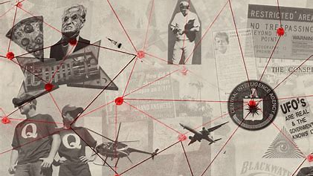
CONSPIRACY THEORIES
WHAT? WHERE FROM? WHAT FOR?

Slide 2
WHAT IS YOUR DEFINITION OF A CONSPIRACY THEORY?

Slide 3
Definition:
A belief that some secret but influential organization is responsible for an event or phenomenon.
It is an attempt to explain harmful or tragic events as the result of the actions of a small powerful group.
Such explanations reject the accepted narrative surrounding those events; indeed, the official version may be seen as further proof of the conspiracy.

Slide 4
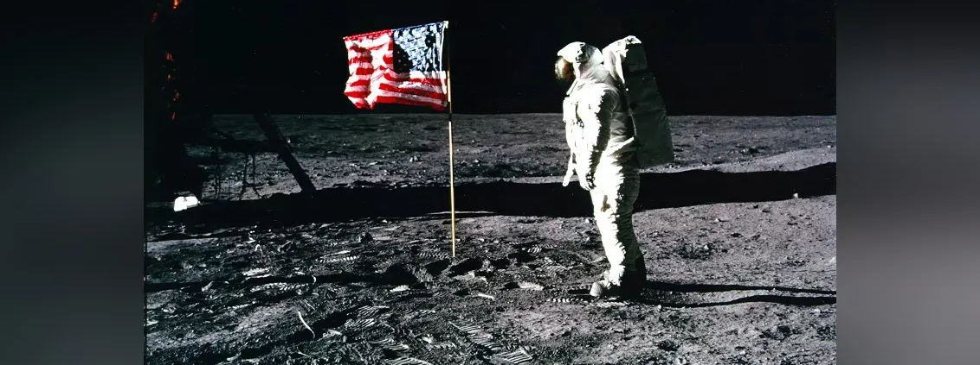
Dou you know your conspiracy theories?
NASA landed astronauts on the moon in 1969. By the 1970s, a bizarre conspiracy emerged — that the moon landing never happened.

Slide 5
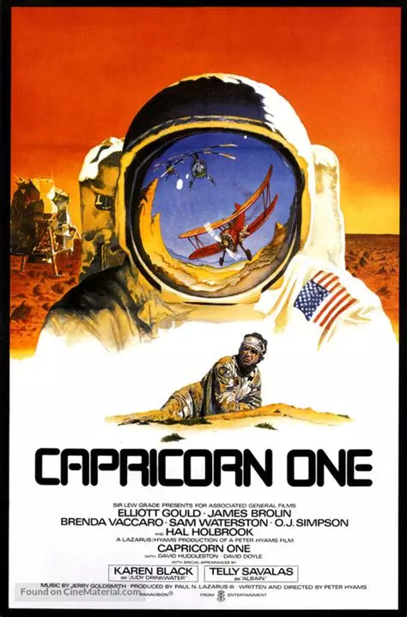
The conspiracy was described in a 1976 self-published book, "We Never Went to the Moon: America's Thirty Billion Dollar Swindle," and a 1978 movie, "Capricorn One." Even as late as 2001, there was a Fox documentary, "Conspiracy Theory: Did We Land on the Moon?" that gave air time to the claims that the whole Apollo moon-landing program was faked.

Slide 6
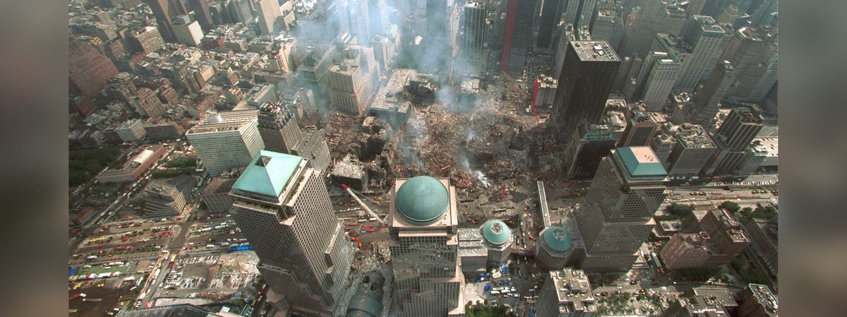
Dou you know your conspiracy theories?
The terrorist attacks of Sept. 11, 2001, was not the result of the conspiracy of Osama bin Laden and a crew of mostly Saudi hijackers.

Slide 7
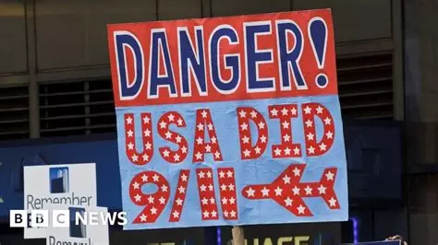
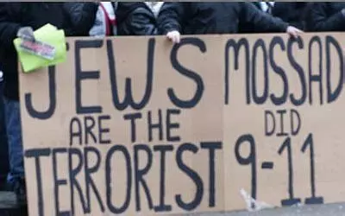
This is too simple for some, though. Conspiracy theorists have a variety of much more complex explanations for what happened at the World Trade Center and Pentagon that day, often involving insider knowledge by President George Bush, Vice President Dick Cheney and top Bush advisors.
Some famous conspiracy theories rely on anti-Semitic tropes, such as the attacks being orchestrated by Israel. Many claim that because "jet fuel can't melt steel beams," the Twin Towers must have been brought down by controlled demolition from bombs planted before the planes hit.

Slide 8
Dou you know your conspiracy theories?
The accident was in fact an assassination by British intelligence agencies, at the request of the Royal Family

Slide 9
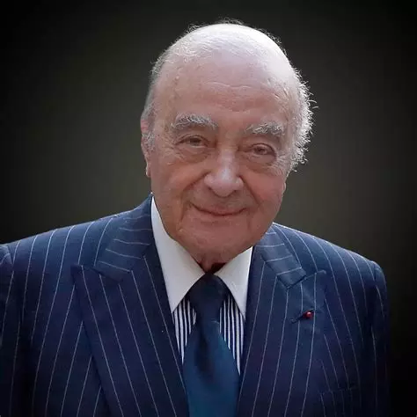
Unlike many conspiracy theories, though, this one had a billionaire promoting it: Mohamed Al-Fayed, the father of Dodi Al-Fayed, who was killed along with Diana. Al-Fayed's claims were examined and dismissed as baseless by a 2006 inquiry; the following year, at Diana's inquest, the coroner stated that "The conspiracy theory advanced by Mohamed Al Fayed has been minutely examined and shown to be without any substance." On April 7, 2008, the coroner's jury concluded that Diana and Al-Fayed were unlawfully killed due to negligence by their drunken chauffeur and pursuing paparazzi, The New York Times reported.

Slide 10
Dou you know your conspiracy theories?
The subliminal advertising conspiracy!

Slide 11
Ever been watching a movie and suddenly get the munchies? Or sitting on your sofa watching TV and suddenly get the irresistible urge to buy a new car? If so, you may be the victim of a subliminal advertising conspiracy! Proponents of this conspiracy theory include Wilson Bryan Key (author of "Subliminal Seduction") and Vance Packard (author of "The Hidden Persuaders"), both of whom claimed that subliminal (subconscious) messages in advertising were rampant and damaging.
Though the books caused a public outcry and led to FCC hearings, much of both books have since been discredited, and several key "studies" of the effects of subliminal advertising were revealed to have been faked.

Slide 12
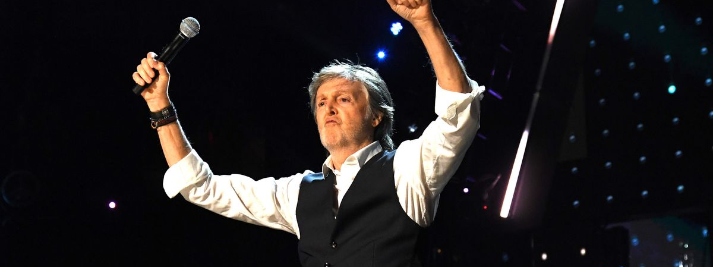
Dou you know your conspiracy theories?
Paul McCartney is dead.

Slide 13
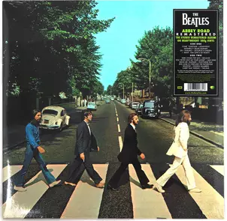
After going through all this trouble, though, the band then took great pains to drop clues in their album covers and lyrics to hint to the public that something was amiss. For example, on the cover of the Abbey Road album, all four Beatles are photographed striding across a zebra crossing, but only McCartney is barefoot and out of step with the other three. This must mean something, right? Despite public denials by the band (and many, many public appearances by McCartney), fans couldn't just let it be, and came together to look for more clues.
The "Paul is dead" conspiracy goes something like this: On Nov. 9, 1966, Paul McCartney got into an argument with the other Beatles, stormed out of the studio and was promptly decapitated in a car accident. To cover the whole thing up, the band hired a look-alike (and sound-alike).

Slide 14
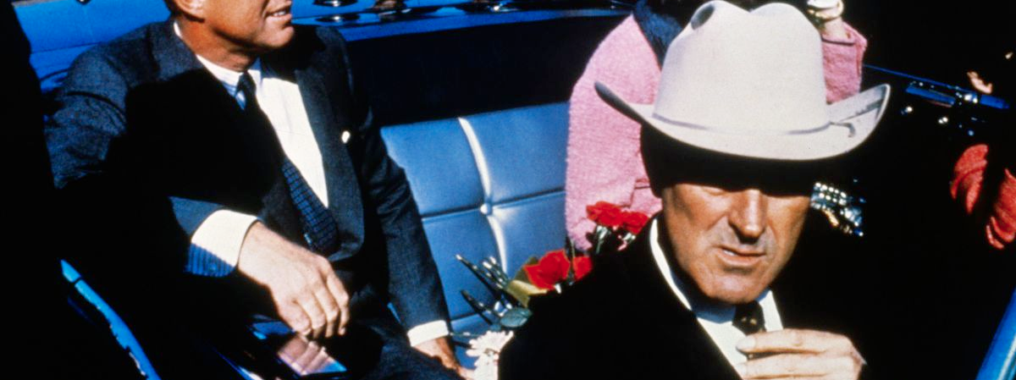
Dou you know your conspiracy theories?
John F. Kennedy was shot in 1963 in a Dallas motorcade. But did Lee Harvey Oswald act alone? Or was there a second gunman on the grassy knoll?

Slide 15
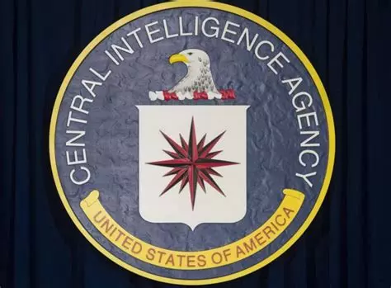
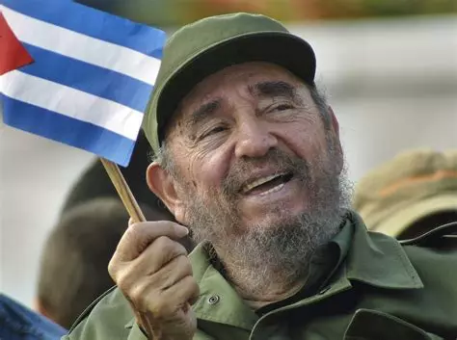
These questions are the gateway to a vast arena of conspiracy theories that have spawned endless speculation and hundreds of books, articles and films. It didn't help that Lee Harvey Oswald was murdered in the basement of Dallas Police Headquarters while surrounded by police officers only two days after the assassination — and by a guy with ties to the Mob. The whole thing stunk, people figured.
Plenty of shadowy culprits have been suggested as the masterminds of the Kennedy assassination: Fidel Castro's government, or maybe anti-Castro activists, or organized crime, or the CIA, or Vice President Lyndon Johnson, or … Well, the thing about presidents is, it turns out, they have a lot of enemies. The Warren Commission report, produced by the official investigation into Kennedy's death, found no evidence of overarching conspiracies, though plenty of theories still flourish.

Slide 16
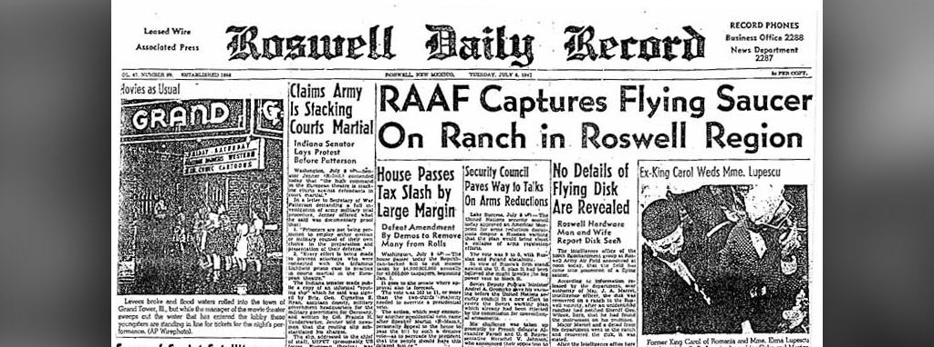
Dou you know your conspiracy theories?
The US government covered up the capture of an extra-terrestrial flying saucer.

Slide 17
There is one fact that almost all skeptics and believers agree on: Something crashed on a remote ranch outside of Roswell, New Mexico in 1947. The government at first claimed it was some sort of saucer, then retracted the statement and claimed it was really a weather balloon. Yet the best evidence suggests that it was neither a flying saucer nor a weather balloon, but instead a high-altitude, top-secret military balloon dubbed Project Mogul.
There was indeed a cover-up, but it did not hide a crashed saucer. Instead, it hid a Cold War-era spying program.

Slide 18
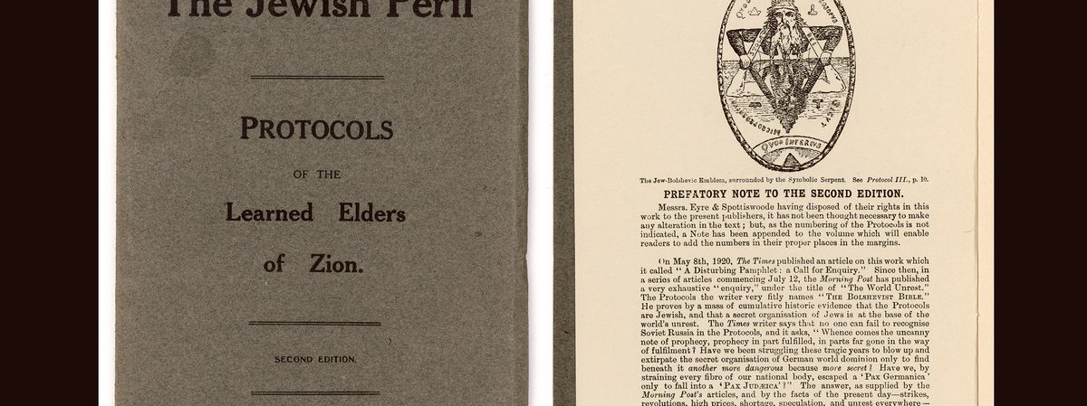
Dou you know your conspiracy theories?
"The Protocols of the Learned Elders of Zion" is a book that revealed a Jewish conspiracy to achieve world domination.

Slide 19
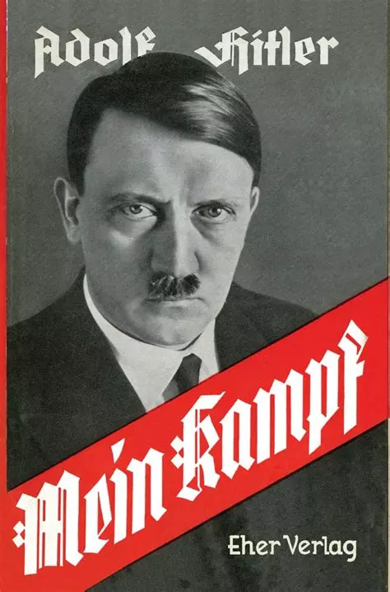
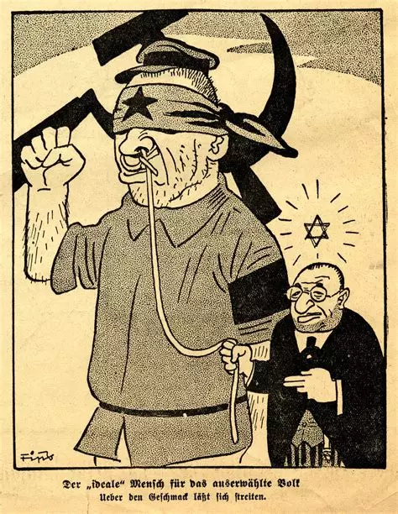
"The Protocols of the Learned Elders of Zion" is a hoaxed antisemitic book that purported to reveal a Jewish conspiracy to achieve world domination. It first appeared in Russia in 1905, and described how Christians' morality, finances, and health would be targeted by a small group of powerful Jews. The antisemitic idea that there is a Jewish conspiracy is nothing new, of course, and has been repeated by many prominent people including Henry Ford and Mel Gibson. In 1920, Henry Ford paid to have half a million copies of "The Protocols of the Elders of Zion" published, and in the 1930s, the book was used by the Nazis as justification for its genocide against Jews (in fact, Adolf Hitler referred to the "Protocols" in his book "Mein Kampf").
Though the book has been completely discredited as a hoax and forgery, it is still in print and remains widely circulated around the world.

Slide 20
Dou you know your conspiracy theories?
For years during the 1980s and 1990s, America became convinced that an underground network of Satanists was working together to kidnap, torture and abuse children.

Slide 21
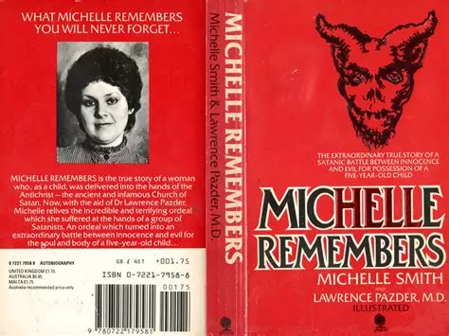
None of it was real, but the conspiracy theories destroyed lives and livelihoods.
The pinnacle was Geraldo Rivera's infamous NBC special "Devil Worship: Exposing Satan's Underground," which aired on Oct. 28, 1988. Rivera relied on self-proclaimed "Satanism experts," misleading and inaccurate statistics, crimes with only tenuous links to Satanism, and sensationalized media reports. It was the most-viewed documentary in television history. "There are over one million Satanists in this country," Rivera said, adding that "The odds are, [they] are in your town."
The panic grew out of the idea that memories of abuse were often repressed and could be recovered with the help of hypnosis and a therapist. This idea was popularized in the 1980 book "Michelle Remembers," co-written by a Canadian psychiatrist and the patient he eventually married (ethics red flag), in which the eponymous Michelle recovers memories of supposed ritual Satanic abuse conducted by her mother.

Slide 22
Dou you know your conspiracy theories?
The "Chemtrails" conspiracy theory holds that condensation trails are full of other chemicals that scientists and governments are seeding into the atmosphere.

Slide 23
WHY?
Researchers who study things like clouds' impact on global temperatures are often harassed by Chemtrails believers, who think they're part of a large-scale conspiracy to secretly spray unknown chemicals into the atmosphere, according to Harvard University's David Keith. A 2016 study even debunked chemtrails scientifically, finding no evidence of unusual contrails or unexplained contamination in the environment. But true believers aren't swayed, as The Guardian reported in 2017.
Pick your reason. It might be biological warfare or population control or geoengineering or an attempt to manipulate the weather.

Slide 24
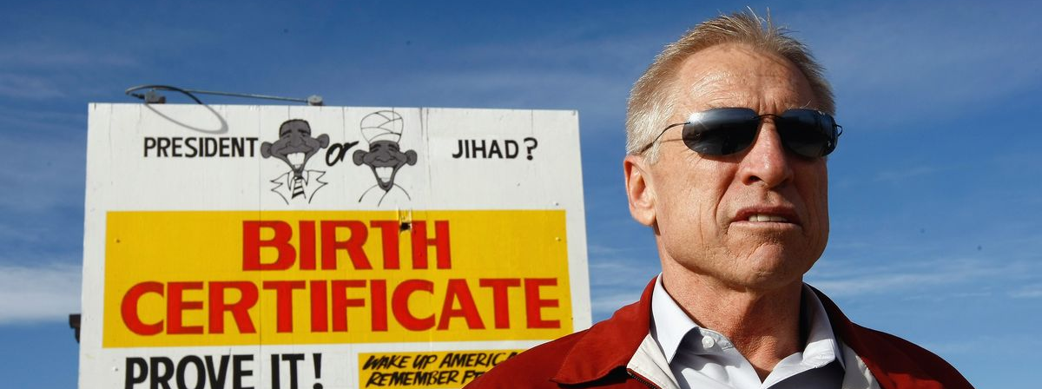
Dou you know your conspiracy theories?
As soon as Obama began his campaign for president in 2008, "birthers" began to circulate the conspiracy theory that Obama had actually been born in Kenya, the country of his father.

Slide 25
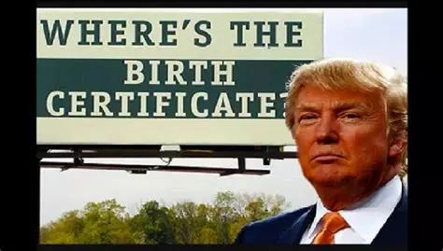
They argued that this meant Obama was not "a natural-born citizen of the U.S." — even though his mother was an American citizen — and thus he could not be president.
Nevermind that there were announcements of Obama's birth in the Honolulu newspaper, or that friends of Obama's mother remembered the day she went into labor. To combat the conspiracies, Obama not only had to release a copy of his birth certificate in 2008, he had to follow up with a release of the original "long form" document in 2011, contrary to the hospital's usual policy of issuing computer copies of birth certificates as acceptable identification.
The 2011 release reduced the number of Americans who believed in birtherism, according to Gallup polling. But many conservative political activists and pundits raised their profiles by advocating for birtherism. Among them? Donald Trump, who was at the time the soon-to-be-president.

Slide 26
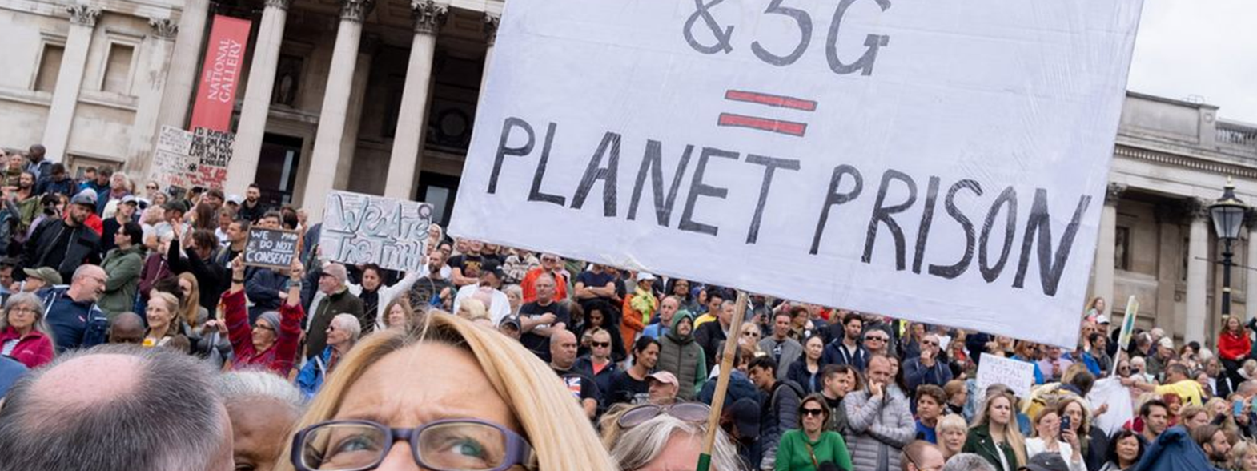
Dou you know your conspiracy theories?
According to the COVID 5G conspiracy, electromagnetic frequencies from cell phone towers undermine the immune system, making people sick with COVID, researchers reported in 2020 in the journal Media International Australia.

Slide 27
Dou you know your conspiracy theories?
Birds aren’t real!

Slide 28
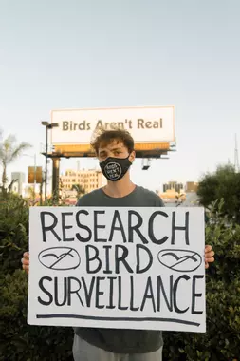
The Birds Aren't Real conspiracy is a movement developed by Peter McIndoe, 23, who started spreading the idea in 2017. Until a December 2021 interview in the New York Times, McIndoe stayed in-character as a true believer, insisting in media interviews and online that birds aren't real, but rather they are surveillance drones made by the U.S. government. Birds Aren't Real has a staff; it has organized real-life protests; it bought real-life billboards; and it emblazoned vans with their claim. The goal, says McIndoe, is to parody the misinformation that Gen Z finds itself stewing in.
"Birds Aren't Real is not a shallow satire of conspiracies from the outside. It is from the deep inside," he told The New York Times. "A lot of people in our generation feel the lunacy in all this, and Birds Aren't Real has been a way for people to process that."
When is a conspiracy not a conspiracy? When it's an elaborate piece of performance art.
Or… does that make it even more of a conspiracy theory?

Slide 29
Dou you know your conspiracy theories?

Slide 30
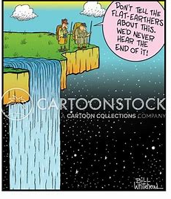
Flat-Earth conspiracy theories first arose in the 1950s and have been given new life in the Internet age. They’re bizarre, almost quaint. After all, even ancient people knew the Earth was round. The Greeks even figured out the planet’s circumference in the 3rd century. Since then, astronauts have launched into space and seen the “Blue Marble” with their own eyes.
But Flat Earth believers don’t see beyond their own horizon: The line between Earth and sky looks pretty flat, they figure, and all the rest of the evidence gets tossed out the window. On YouTube and message boards, Flat-Earthers spend their time inventing weird physics to try to explain how things like gravity and lunar eclipses could possibly work if Earth were a flat disk. Many are motivated by religious belief or the desire to see the universe as a more caring, human-centered place, Michael Wood, a lecturer in psychology at the University in Winchester in England, told Live Science in 2018.

Slide 31
Dou you know your conspiracy theories?
The idea that the U.S. government (or perhaps the entire world government) is run by reptilian humanoids is … out there, to say the least.

Slide 32
And yet, people holding this belief have done real damage. For example, a man who detonated a bomb in downtown Nashville, Tennessee, on Christmas Day 2020 had written a friend about his belief that lizard people walked the planet, disguised as humans. Warner killed himself, damaged 41 buildings, and injured three in the bombing.
The idea of half-lizard, half-human beings goes way back, with one academic tracing it to a pulp fiction magazine story from 1929. British conspiracy theorist David Icke has been a key spreader of the “reptilian shapeshifters control the world” conspiracy, which sometimes overlaps with New World Order conspiracy theories that suggest that an elite cabal plan to institute authoritarian global government. These conspiracies often overlap with anti-Semitism, assigning this supposed cabal Jewish roots.
The reptilian conspiracy theory got a small signal-boost with the death of Queen Elizabeth II in September 2022. According to Politifact, Facebook flagged and removed multiple posts after the queen’s death calling the monarch a reptile and linking to strange videos claiming the entire royal family is reptilian.

Slide 33
Dou you know your conspiracy theories?
Health authorities are hiding natural cures

Slide 34
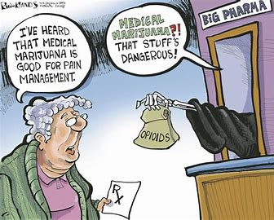
Conspiratorial thinking about health is widespread. A 2014 research letter published in JAMA Internal Medicine found that 37% of Americans believe that the Food and Drug Administration is suppressing natural cures for cancer because of drug company pressure. This was the most-believed health conspiracy in the study. Twenty percent also said they believed public health officials to be hiding data showing that cell phones cause cancer, and 20% said that doctors vaccinate children with risky immunizations, knowing them to be dangerous.
The National Cancer Institute reports that there has been no link found between cell phone use and cancer, and the 1998 study that first linked vaccines with autism was retracted by the journal for research misconduct. And as for natural cures for cancer? Respected oncologists actually do support treatment such as massage and music therapy for cancer patients — but alongside pharmaceuticals that are tested in clinical trials and have a proven track record.
Many "natural health" promoters get rich selling their own (unregulated) supplements and vitamins, making their financial conflict of interest just as pressing as any pharmaceutical company's. Kevin Trudeau, author of the book "Natural Cures 'They' Don't Want You to Know About" and "Diet Cures 'They Don't Want You to Know About," was convicted of fraud in 2013 for making false claims in his infomercials and books. Despite spending eight years in prison, he's still giving talks and raising money from his fan club — money the federal government is currently trying to trace, as Trudeau owes nearly $37 million as a settlement for the people who bought his falsehood-filled diet book.

Slide 35
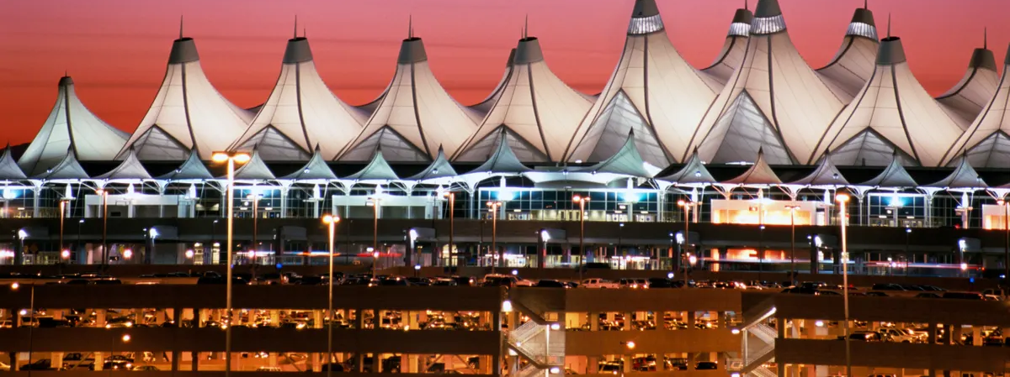
Dou you know your conspiracy theories?
Denver International Airport is a hub for the illuminati.

Slide 36
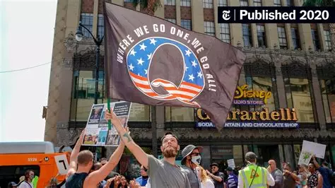
The Denver International Airport is a quirky place, known for its offbeat art: Gargoyles overlook the baggage claims, murals depict scenes of war and horror, and there's a 32-foot (9.75 meter) blue horse with red eyes presiding over the road leading in and out of the terminal.
All of this weirdness, combined with the municipal drama surrounding the airport's construction (the project went almost $3 billion over budget), sparked an array of conspiracy theories. The most common, according to the Denver Public Library, is that the airport is secretly the headquarters of the New World Order, the Illuminati, the Reptilians or some other shadowy groups with plans to take over the world.
To bolster these beliefs, theorists spin alternative explanations of the airport's odd decor. For example, an inlay in the floor with the symbols for "gold" (Au) and "silver," (Ag) referencing Colorado's mining history, become a secret message about a made-up pathogen known as the Australian Antigen. A mural decrying war and wishing for world peace becomes a warning about a totalitarian future.
"Conspiracy theories historically have been linked with prejudice, genocide, risky health behaviour, climate denial, and more recently some quite disturbing behaviour related to QAnon and COVID-19 conspiracy theories. They can turn people away from mainstream politics and science," Douglas said.

Slide 37
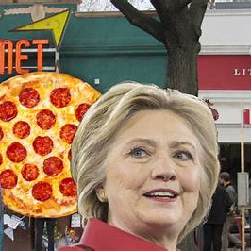
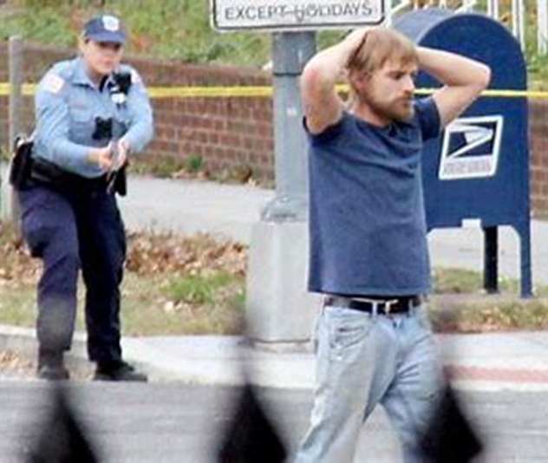
Dou you know your conspiracy theories?
During the 2016 presidential election Democrats and Hilary Clinton, their candidate, were accused of abducting children, and in a Pizza restaurant (Comet PinPong in Brooklynn.NY) they would be sexually abusing those children, then drinking their blood and eating them so as to get eternal youth.

Slide 38
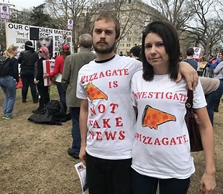
The conspiracy theory that prominent members of the Democratic Party are somehow involved in a global child-trafficking ring took root on far-right conservative websites. According to the BBC, the conspiracy theory linking this very false theory to Comet (Pizzeria) kicked around 4Chan (a website user) until someone posted a long document with "evidence" to a now-banned alt-right section of Reddit several days before the U.S. election. The alt right is a fringe group of far-right extremists—comprised, mostly, of white supremacists and old-fashioned racists—who share their views and various forms of propaganda online.
Around mid-November, the BBC explained, a pro-government media outlet in Turkey started tweeting the conspiracy theory using the hashtag #pizzagate. The reason, according to The Daily Dot, is that supporters of Turkish President Recep Tayyip Erdogan were trying to accuse opponents of hypocrisy. In other words, it was meant as a distraction.
On the afternoon of Sunday, December 4 2016, 28-year-old Edgar Maddison Welch, of Salisbury, North Carolina, walked through the front door of Comet Ping Pong and pointed an assault rifle in the direction of an employee, according to the Associated Press. The employee fled and called police, but Welch fired his gun, possibly striking the walls, door, and a computer. No one was hurt.

Slide 39
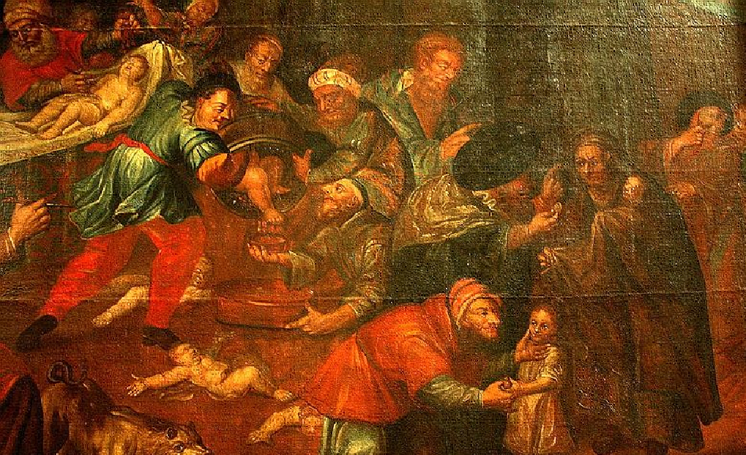
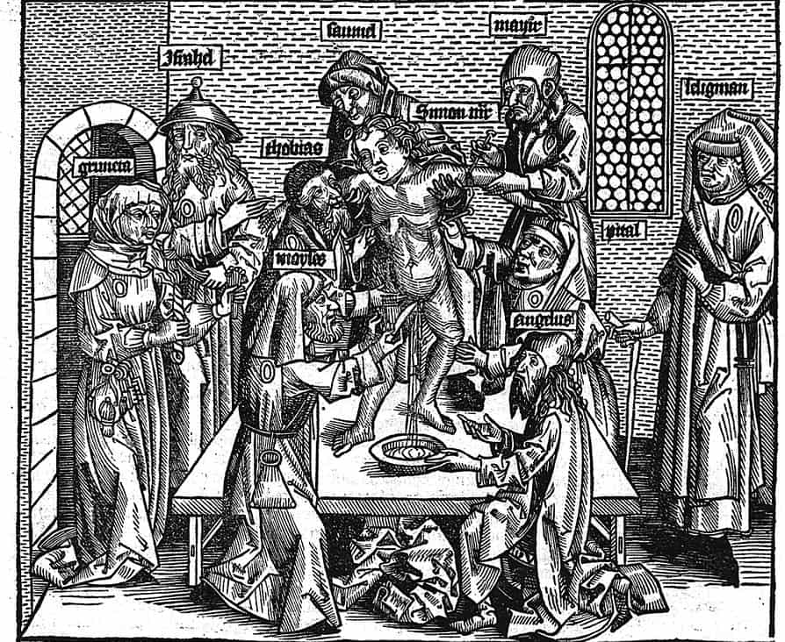
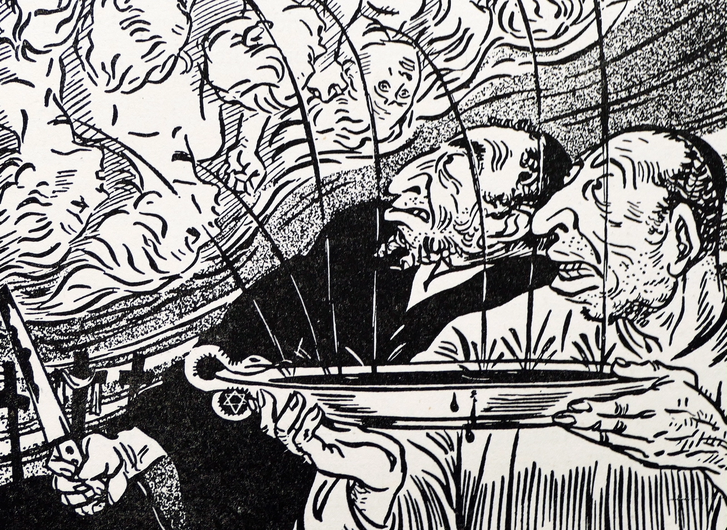
A painting that still hangs in a cathedral in Sandomierz, Poland, depicts Jews murdering Christian children for their blood. (Courtesy of Zygmunt Miłoszewski).
Museum of Jewish Heritage — A Living Memorial to the Holocaust
The front page of the German newspaper Der Sturmer, from 1934, illustrates the blood libel against the Jews. (Universal History Archive/Universal Images Group via Getty Images)

Slide 40

https://www.youtube.com/watch?v=ru4yrQFH1Uc
Listen to the video an find out the science behind the fame of conspiracy theories.

Slide 41
WHAT DO ALL THOSE THEORIES HAVE IN COMMON?
They very often take a fact for base and then find spurious/fabricated “facts” to prove the theory right.
They fuel on nefarious clichés/cultures (antisemitism, racism, sexism, homophobia, etc).
A sufficient amount of doubt is needed “around” the issue at hand.
They are motivated (financial motivation, political motivation, etc).
Social media are their conduits and act as anonymous loudspeakers (echo chambers).
They sprawl in troubled times (i.e: the democratic crises worldwide or the alleged “end of the American dream”).
To some extent they are also the sign of poor education or dogmatic education (absence of a critical mind, acting according to emotions rather logic, rejecting scientific facts as they contradict religious beliefs).

Slide 42
TEXT: Elon Musk is now boosting the ‘pizzagate’ conspiracy theory.
How is this text representative of the issue of conspiracy theories?

Slide 43
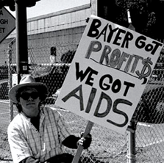
The outrageous world of Aids conspiracies
How does this text exemplify the different elements that trigger, fuel and maintain conspiracy theories?

