Slide 2
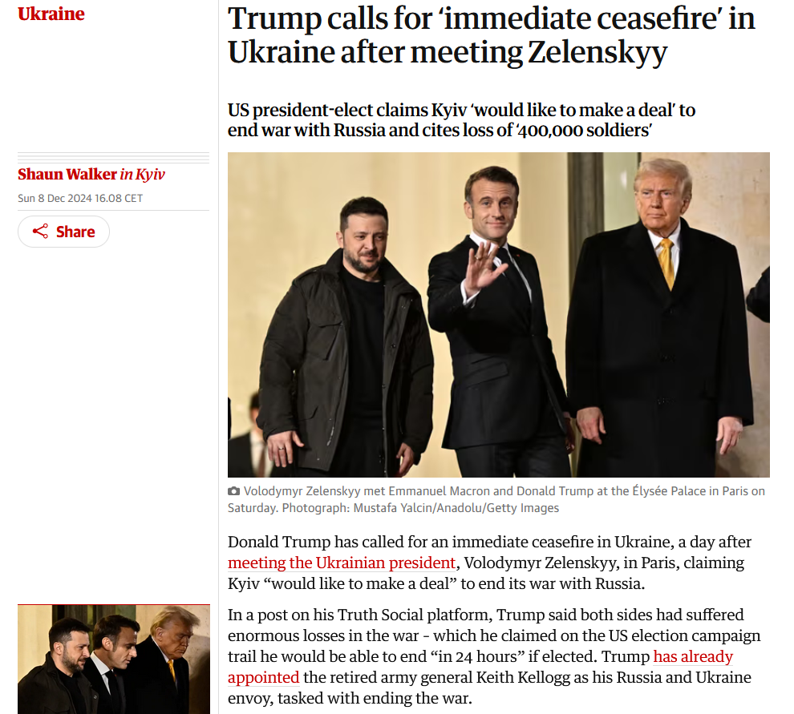

Slide 3
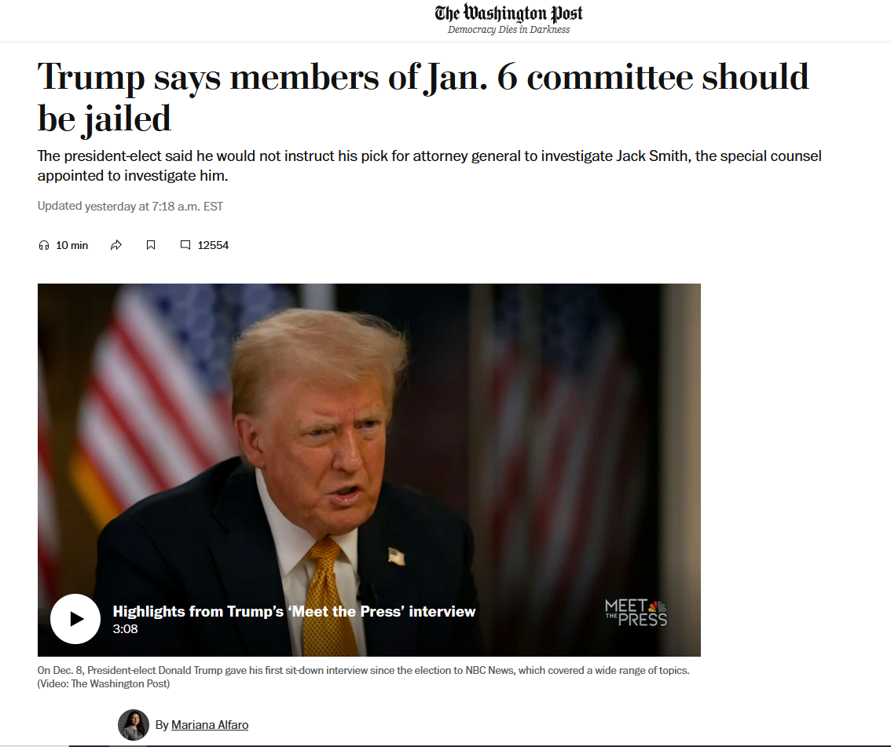

Slide 4
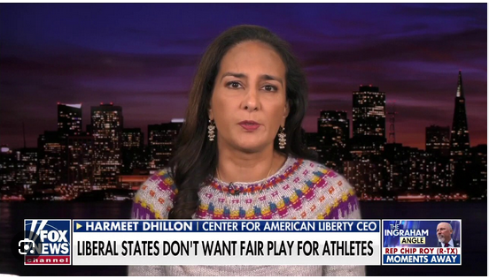
Harmeet Dhillon: lawyer, Trump loyalist who backed baseless claims of election fraud in 2020 → assistant Attorney General, in charge of voting rights cases…

Slide 5
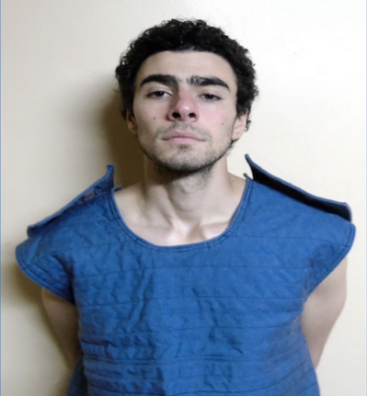
Luigi Mangione
→ suspected shooter of United Healthcare CEO Brian Thompson
26 years old
Arrested in Pennsylvania, charged on gun and forgery charges
→ then charged with murder by NY prosecutors

Slide 6
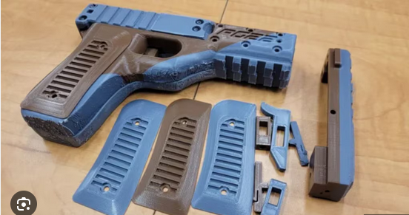
Ghost guns: 3D-printed, no serial number → untraceable

Slide 7
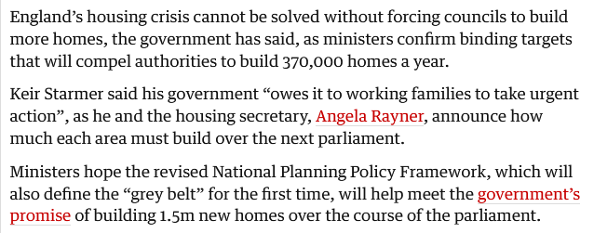

Slide 9
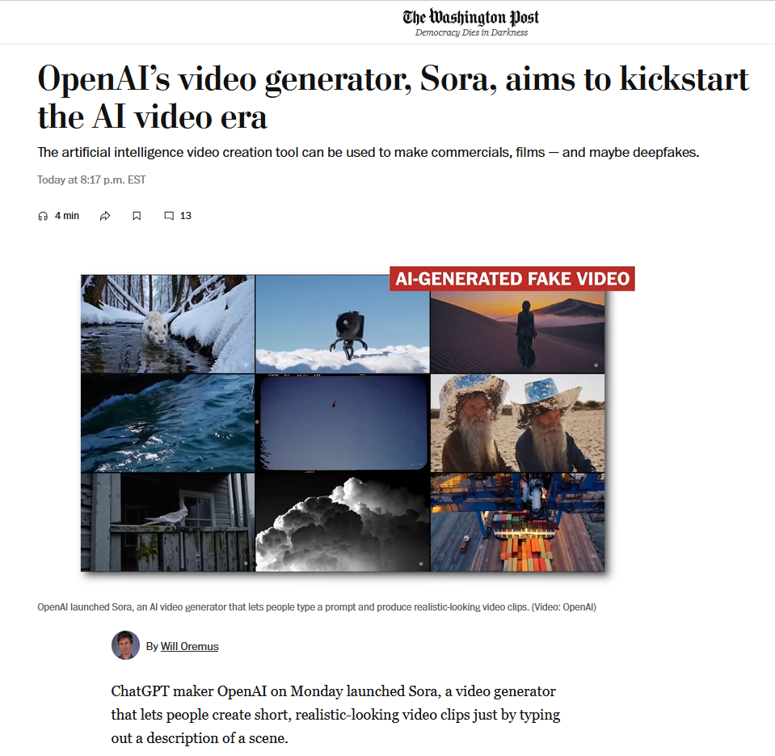

Slide 10
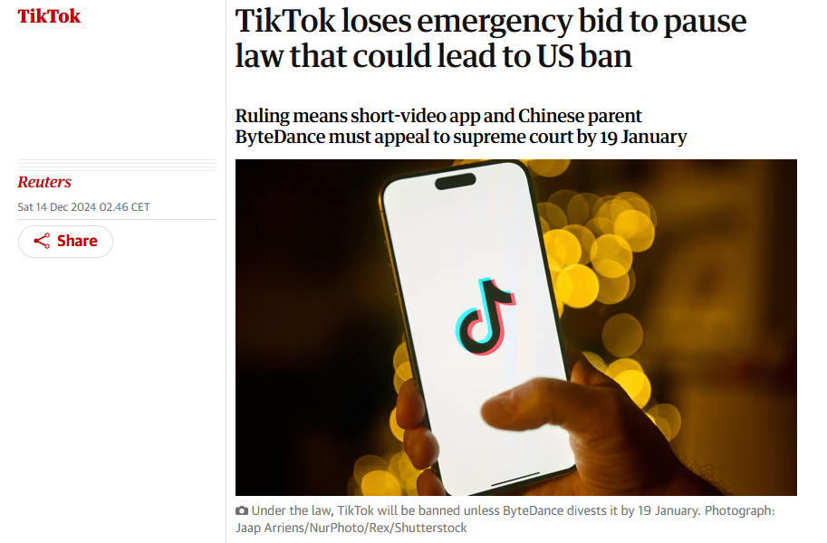

Slide 11
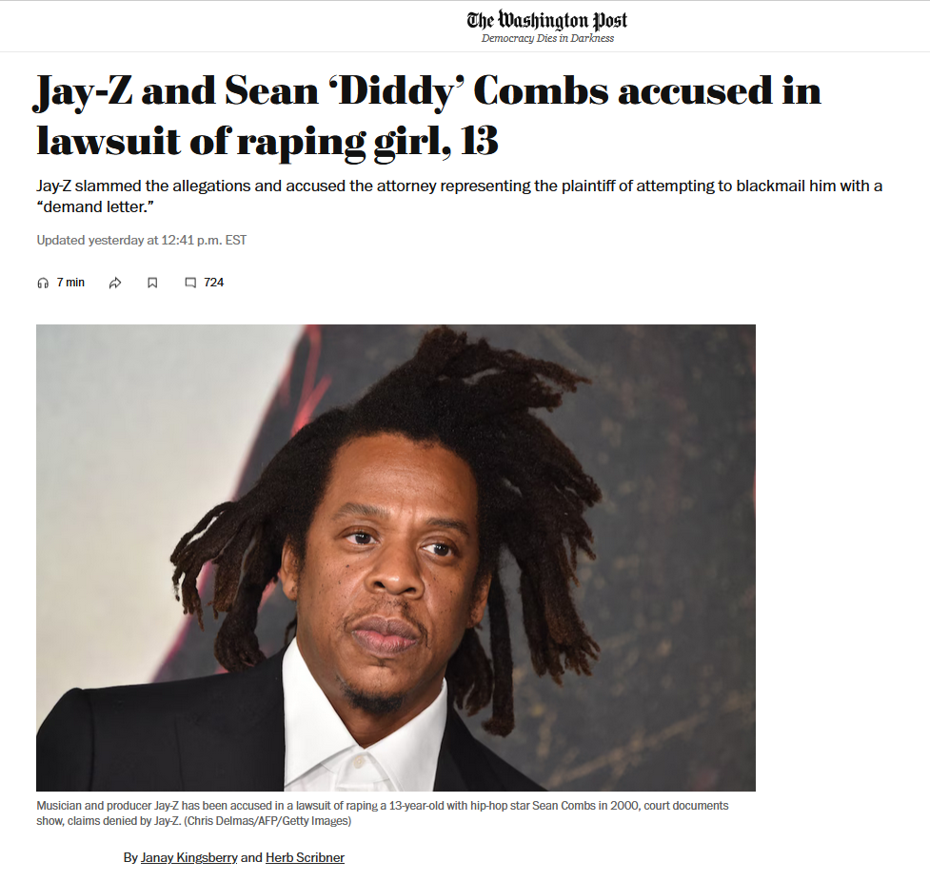

Slide 12
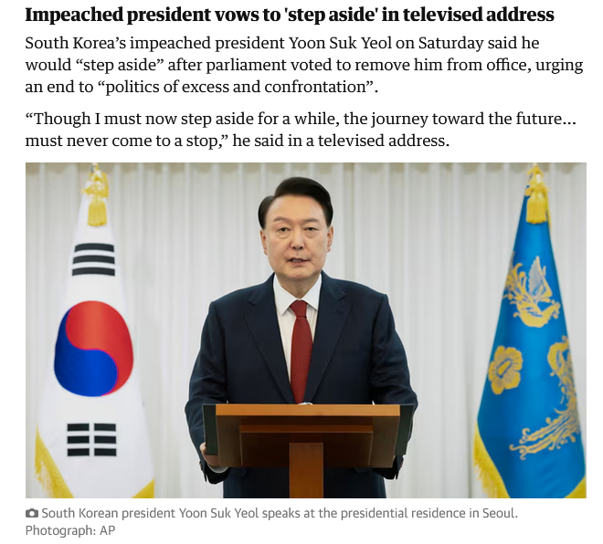

Slide 13
