Slide 1
Monday, Sept. 16th

Slide 2
https://www.youtube.com/watch?v=3MRs6KUqhpE
Notes:
https://www.theguardian.com/tv-and-radio/2024/sep/15/emmys-shogun-hacks-the-bear-baby-reindeer?utm_term=66e7cbbb41597c4a55542100c0bab2c1&utm_campaign=FirstEdition&utm_source=esp&utm_medium=Email&CMP=firstedition_email

Slide 4
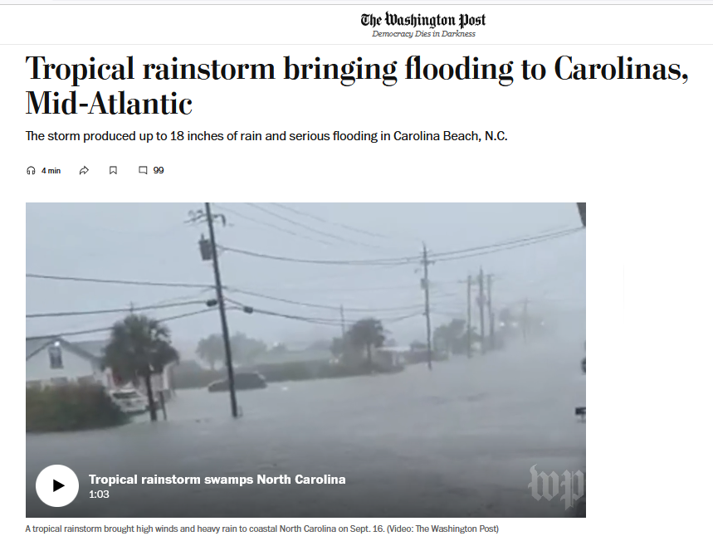

Slide 5
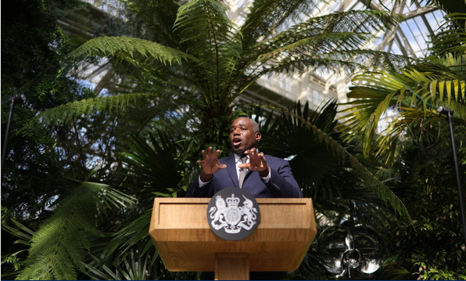
Tuesday, Sept. 17th

Slide 6
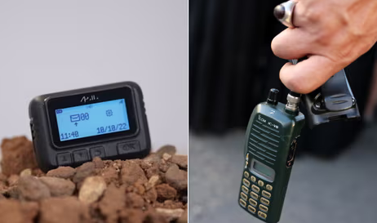

Slide 7
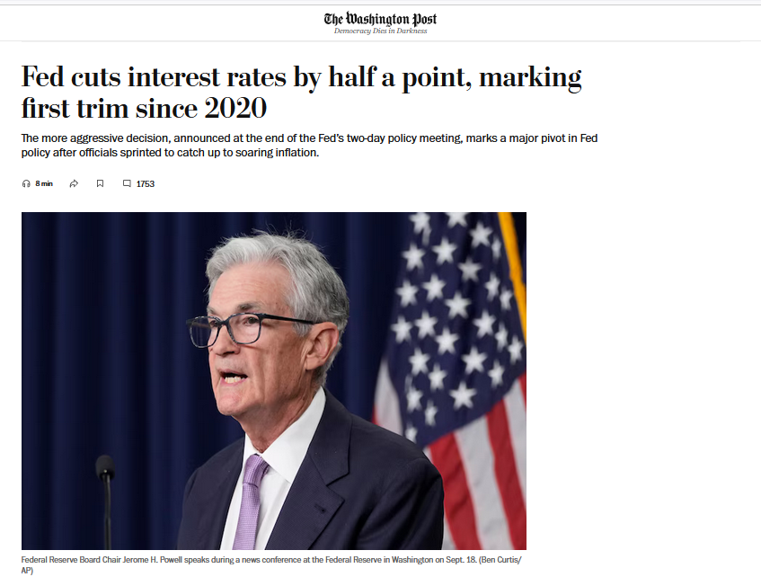

Slide 8
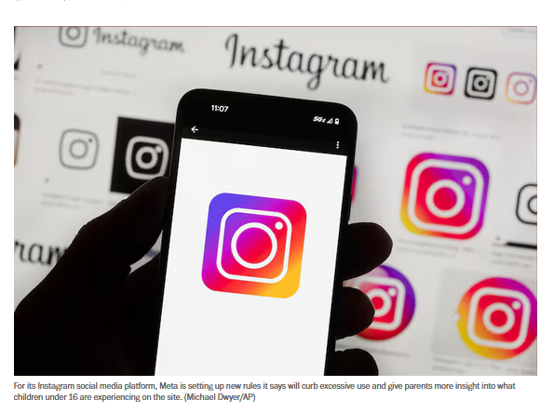

Slide 9
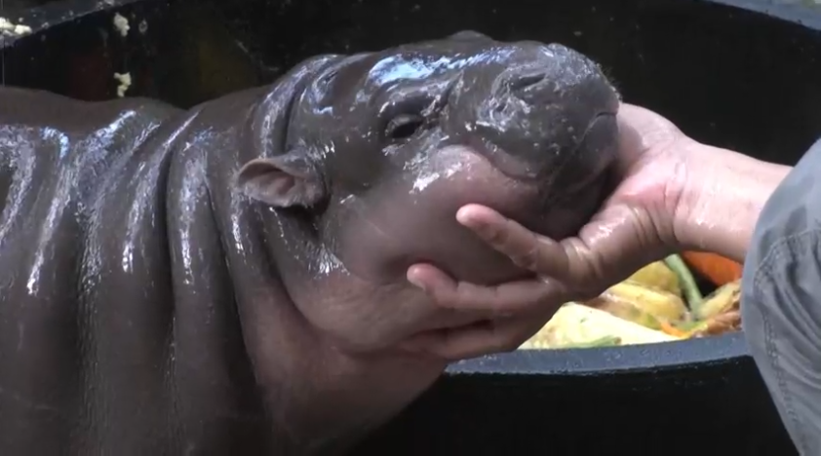
Wednesday, Sept. 18th

Slide 10
