Slide 1
Press review November 11th – November 17th

Slide 2
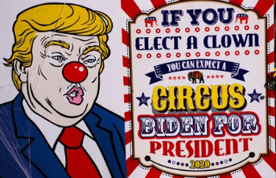

Slide 3
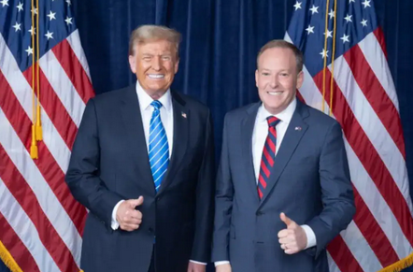
Lee Zeldin
Member of the House of Representatives from the state of New York
Nominated to lead the EPA (Environmental Government Agency)
Trump’s ‘Drill, baby, drill!’
→ expected to take deregulatory decisions

Slide 4
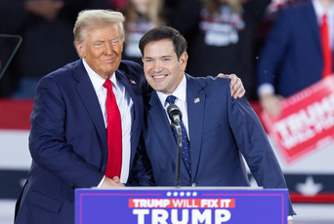
Marco Rubio
Senator for Florida
+ candidate for the Republican primary in 2016 (during which he traded insults with D. Trump)
Nominated to be Secretary of State
Voted against financial help for Ukraine

Slide 5
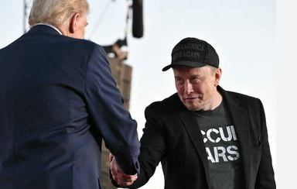
Elon who?
Owner of SpaceX (which is a contractor for NASA) + Starlink
Owner of X (formerly Twitter)
Owner of Tesla, Neuralink…
Said during the campaign that $2tn could be cut from the $6,5tn federal budget…
Nominated to lead the ‘Department of Government Efficiency’

Slide 6
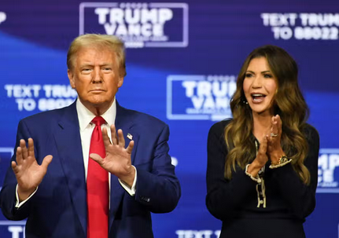
Kristi Noem
South Dakota governor
VP hopeful
Famously bragged about killing her 14-month-old puppy for not being properly trained
Nominated to be the head of the Department of Homeland Security
Notes:
https://www.youtube.com/watch?v=M2mnIB5_Crw

Slide 7
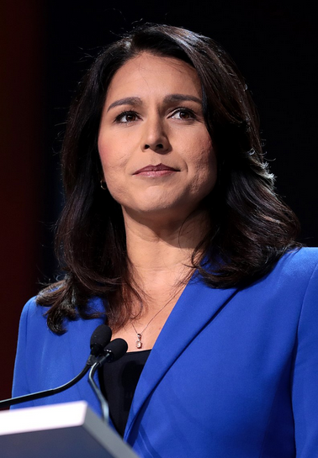
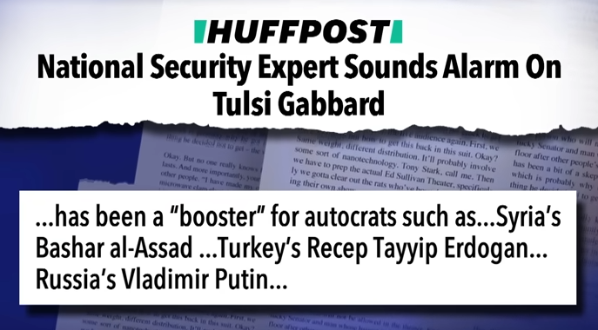
Tulsi Gabbard
Former member of the House of Representatives from Hawaii
Former candidate to the Democratic primary for the 2020 election
Then became independent, before joining the Trump campaign in 2024
Nominated to be the new head of the National Intelligence Agency
Notes:
https://www.youtube.com/watch?v=M2mnIB5_Crw

Slide 8
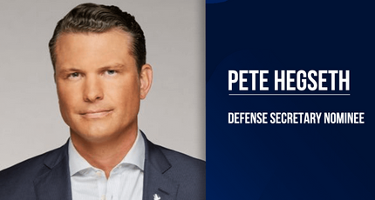
Pete Hegseth
Member of the National Guard of Minnesota
Served in Iraq and Afghanistan
TV host on Fox and Friends Weekend
Accused of sexual assault in 2017 (but no complaint filed against him)
Notes:
https://www.youtube.com/watch?v=J7yF8KJwR0c&list=PLiZxWe0ejyv-j3jr2tFC-G-7pJiHUQKIh&index=2

Slide 9
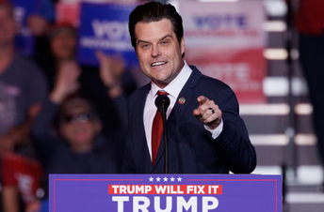
Matt Gaetz
Member of the House of Representatives from Florida
Hardcore Trump supporter
Conspiracy theorist
Mysoginistic
Currently under investigation of the House Ethics Committee for having sexual relations with a minor + for illegal drug use
Nominated to be the new Attorney General
Notes:
https://www.youtube.com/watch?v=J7yF8KJwR0c&list=PLiZxWe0ejyv-j3jr2tFC-G-7pJiHUQKIh&index=2

Slide 10
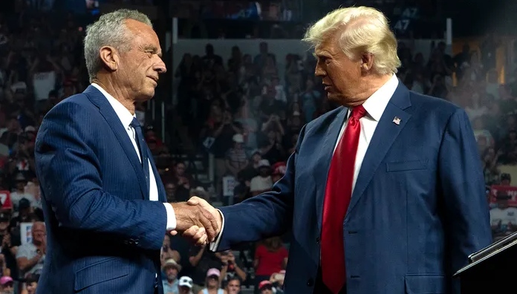
Robert F Kennedy Jr.
Former 3rd party candidate to the 2024 presidential election
Claimed that a worm had eaten part of his brain
Antivaxxer + wants to remove fluoride from drinking water
Wants to improve American people’s diet with more fruits and vegetables + pro-abortion
Nominated to be the new head of the Health Department
Notes:
https://www.youtube.com/results?search_query=john+oliver+rfk

Slide 11
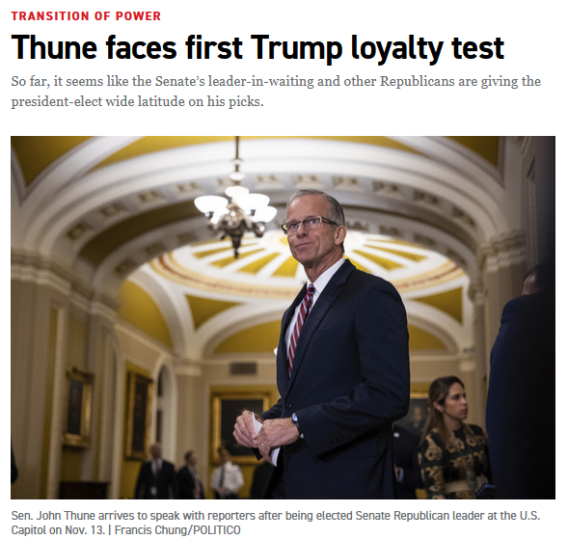
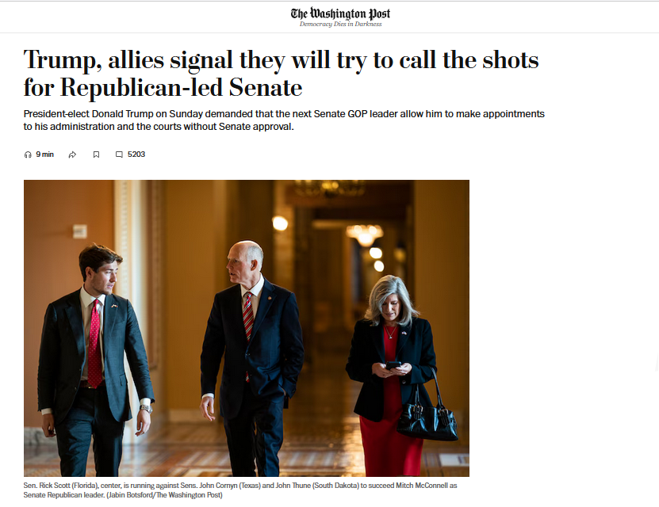

Slide 12
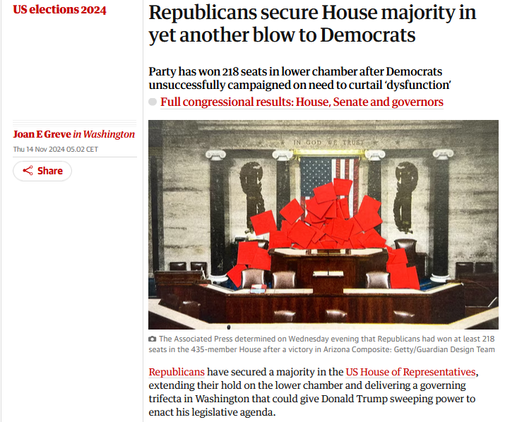

Slide 14
Controversial because:
- conflict with Armenia over the Karabakh territory
an authoritarian regime: same family (Aliyev) in power for 31 years
- a massive oil and gas producer, with an economy depending heavily on fossil fuels:
→ 92% of the country’s exports
→ 45% of the country’s GDP
listed 14 propositions, none of which mention the words ‘fossil fuels’

Slide 15
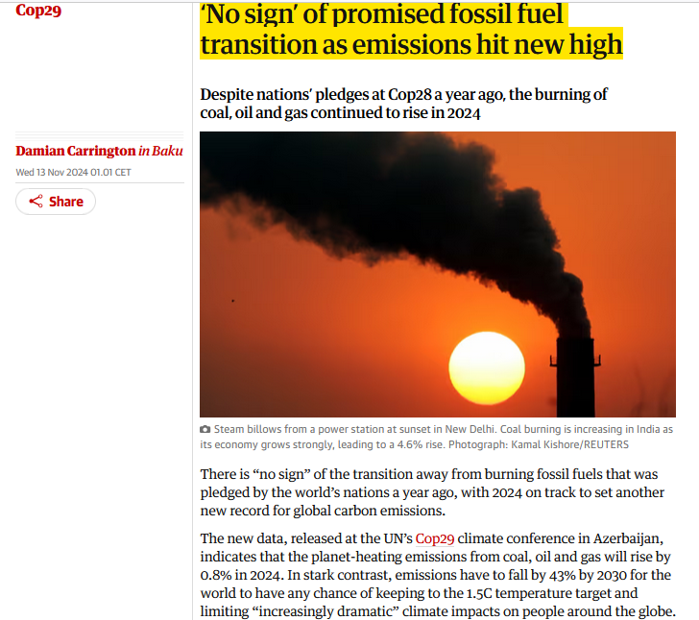

Slide 16
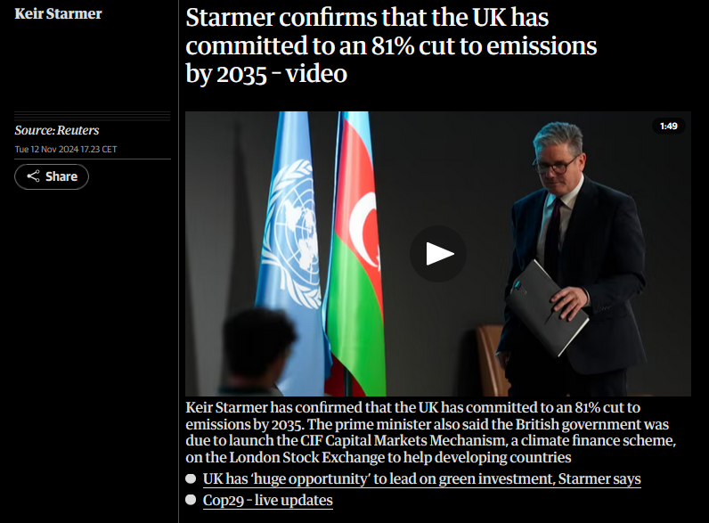
Notes:
https://www.theguardian.com/politics/video/2024/nov/12/starmer-confirms-that-the-uk-has-committed-to-an-81-cut-to-emissions-by-2035-video

Slide 17
- a ‘financial’ COP whose goal is to determine how much money developed countries should collect every year to help developing countries in their green transition
a ‘moral’ obligation since developed countries got rich thanks to the extremely polluting industrial revolution
right now, $100bn a year
but experts say $1tn a year would actually be necessary
developed countries clearly not ready to pay that amount of money + since the previous agreement (2009), China became the 2nd economy in the world + the largest polluter → developed countries want it to contribute

Slide 18
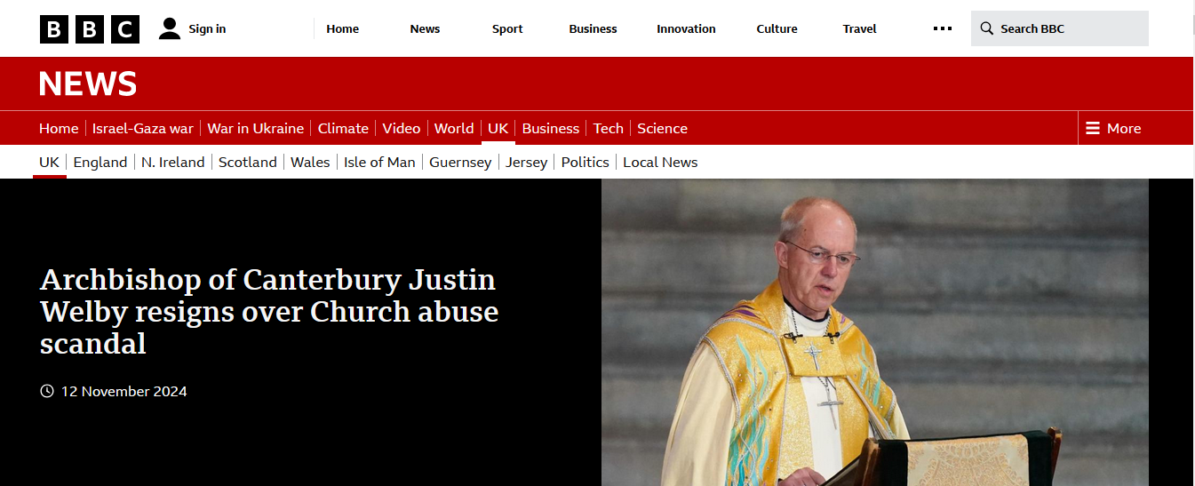

Slide 19
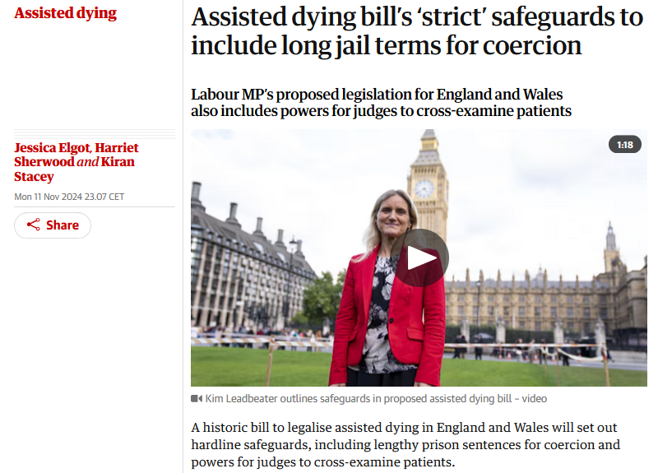
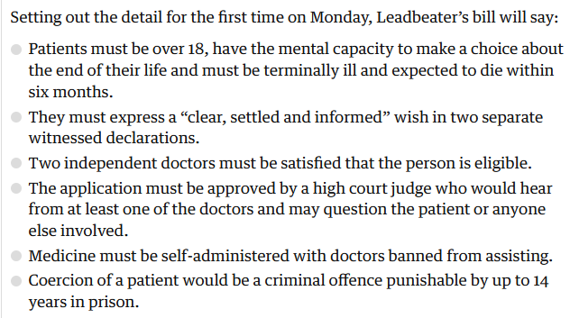

Slide 20
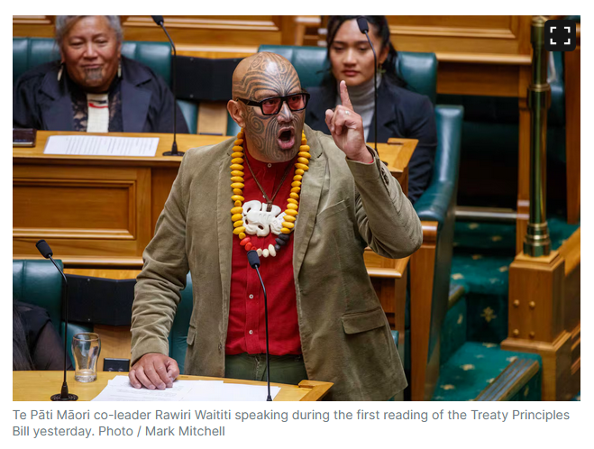
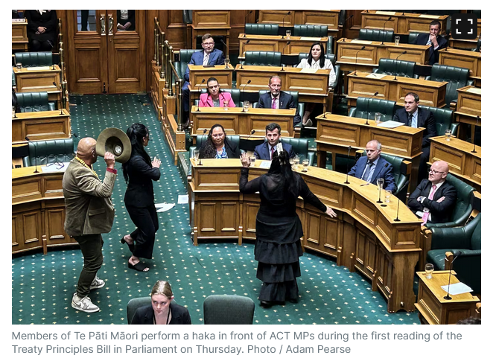
Notes:
https://www.nzherald.co.nz/nz/house-suspended-after-te-pati-maori-mps-start-haka-in-parliament/LUPWVIEFDVS4OPPCXAAP7N5XCY/

Slide 21
Treaty Principles bill (introduced by ACT, a party of the current right-wing coalition)
Its leader, David Seymour, argues that there is a need to legally define the principles of the 1840 Treaty of Waitangi, which has been fundamental to race relations in New Zealand.
The core values of the treaty have, over time, been woven into New Zealand's laws in an effort to redress the wrong done to Māori during colonisation.
Seymour says this has resulted in the country being divided by race, and the bill will allow the treaty to be interpreted more fairly through parliament, rather than the courts.
→ massive protests gathering thousands of people

