Slide 1
Press review May 19-25, 2025

Slide 2
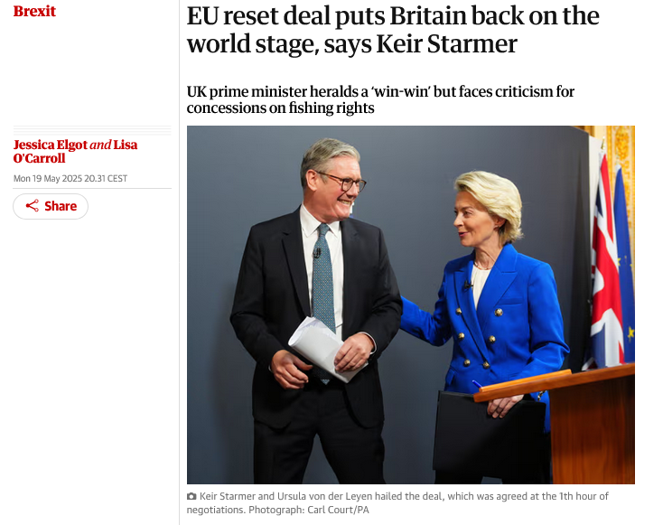

Slide 3
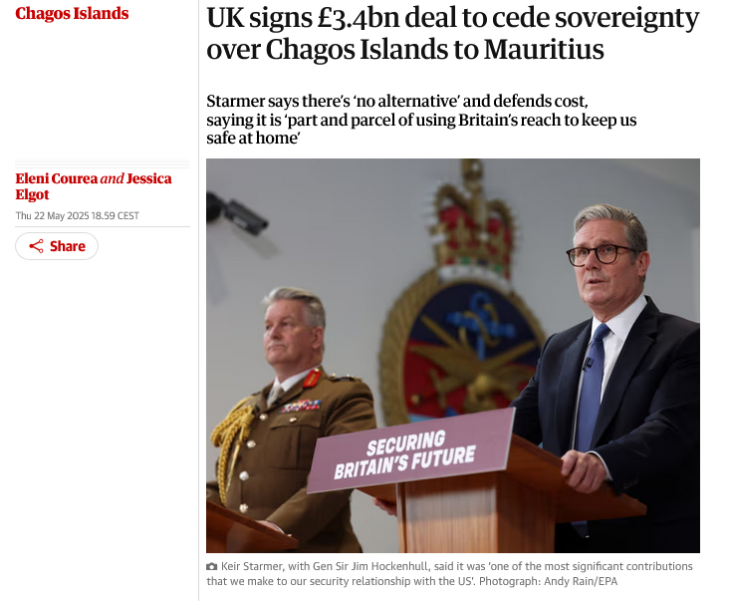

Slide 4
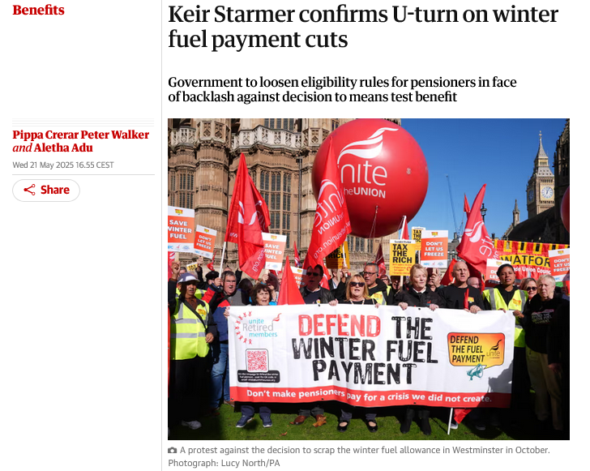

Slide 5
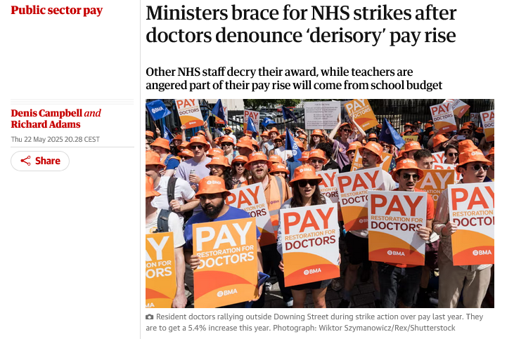
Notes:
Ministers are bracing themselves for a potential wave of NHS strikes in England after doctors denounced pay rises of up to 5.4% this year as “derisory” and threatened to take action in protest.
Teaching unions, after teachers were awarded a 4% increase, also responded angrily at the government’s refusal to fully fund the deal and warned that it would damage the quality of education that pupils received. The largest union said it planned to take the first step towards possible industrial action.

Slide 6
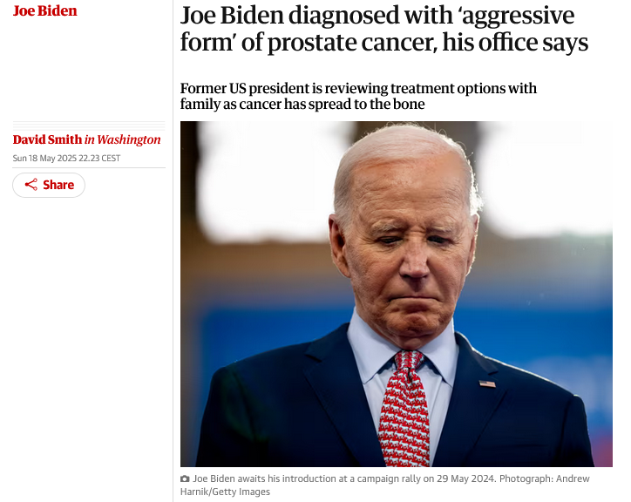
Notes:
Joe Biden, the former US president, has been diagnosed with an “aggressive form” of prostate cancer that has spread to his bones, his personal office announced on Sunday, May 18th.
The 82-year-old was seen last week by doctors after urinary symptoms and a prostate nodule were found. Biden and his family are considering options for treatment.
“While this represents a more aggressive form of the disease, the cancer appears to be hormone-sensitive which allows for effective management,” his office said. “The President and his family are reviewing treatment options with his physicians.”
This announcement came as Biden’s initial decision to seek re-election has come under renewed criticism ahead of Tuesday, May 20th’s publication of Original Sin, a book by the journalists Jake Tapper and Alex Thompson that alleges a White House cover-up of the former president’s declining health and cognitive abilities.

Slide 7
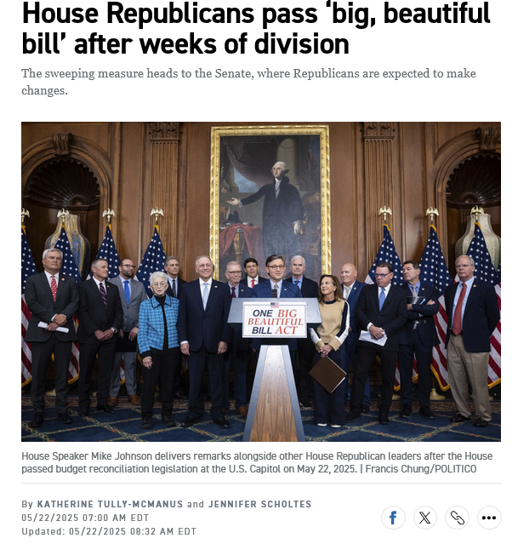

Slide 8
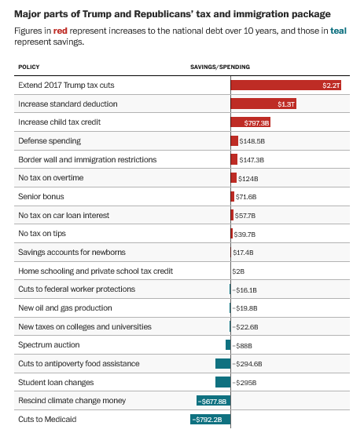

Slide 9
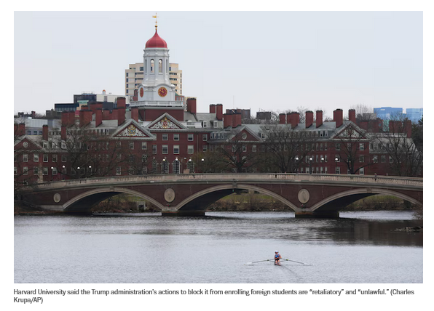
Notes:
Homeland Security Secretary Kristi L. Noem ordered the agency to terminate Harvard’s Student and Exchange Visitor Program (SEVP) certification, which allows U.S. universities to admit international students, for allegedly allowing “anti-American, pro-terrorist” foreigners “to harass and physically assault individuals … and obstruct its once-venerable learning environment.” The secretary also accused the university of working with the Chinese Communist Party by hosting and training members of its paramilitary group.

Slide 10
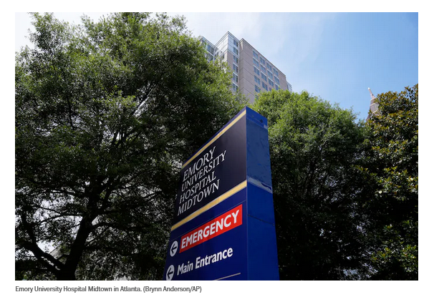

Slide 11
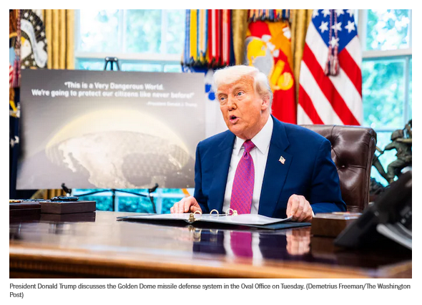
Notes:
The plan is to create a multibillion-dollar constellation of satellites and space-based weapons to intercept attacks. It would be similar to Israel’s “Iron Dome,”

Slide 12
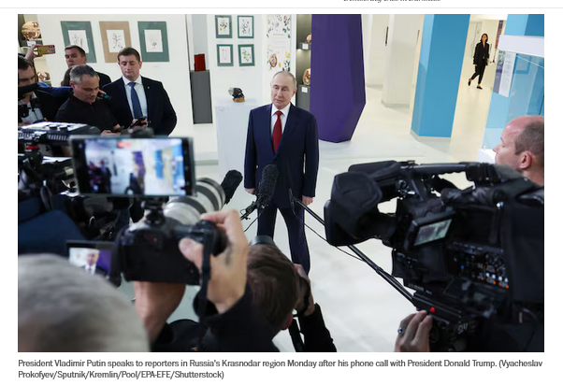

Slide 13
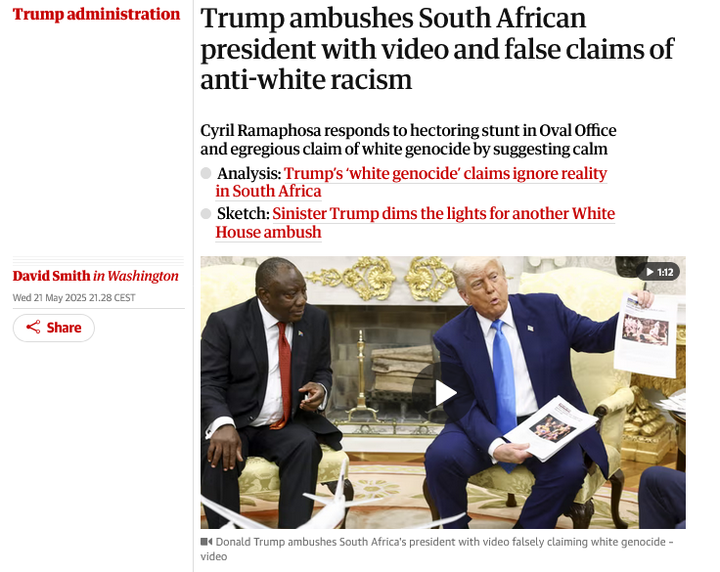
Notes:
Donald Trump ambushed the South African president, Cyril Ramaphosa, by playing him a video that he falsely claimed proved genocide was being committed against white people under “the opposite of apartheid”. The stunt set up the most tense Oval Office encounter since Trump’s encounter with Volodymyr Zelenskyy in February.
https://www.theguardian.com/us-news/2025/may/21/trump-south-africa-president-meeting?utm_term=682ebd62b84dc35f33b3ea4eae162879&utm_campaign=FirstEdition&utm_source=esp&utm_medium=Email&CMP=firstedition_email

Slide 14
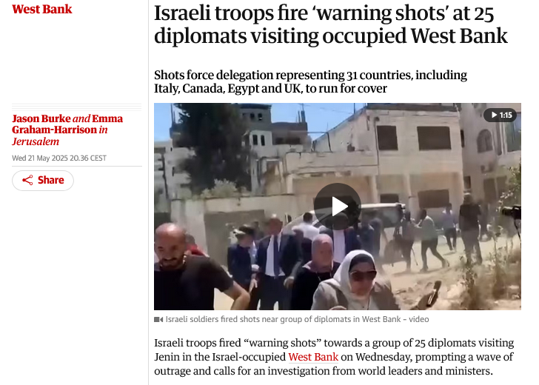

Slide 15
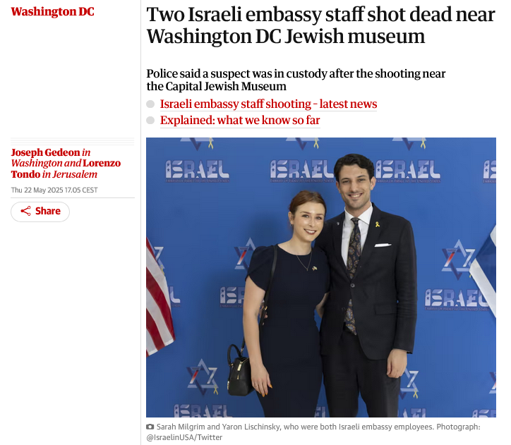
Notes:
A suspect is in custody after shooting dead two Israeli embassy staff, said to be a couple about to become engaged, outside a Jewish museum in Washington. The suspect yelled “Free, free Palestine” after he was arrested, police said.

Slide 17
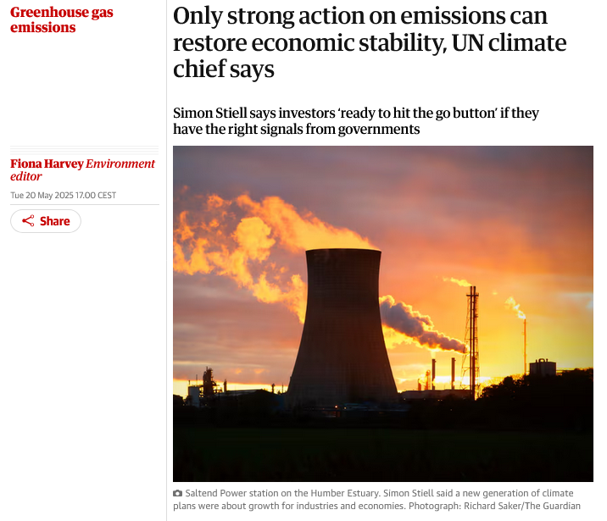

Slide 18
