Slide 1
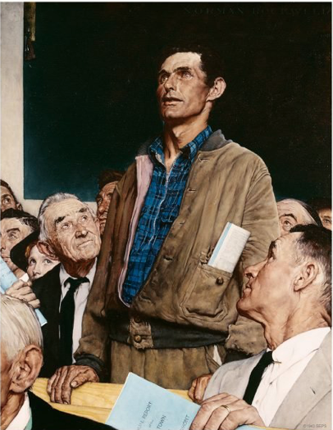
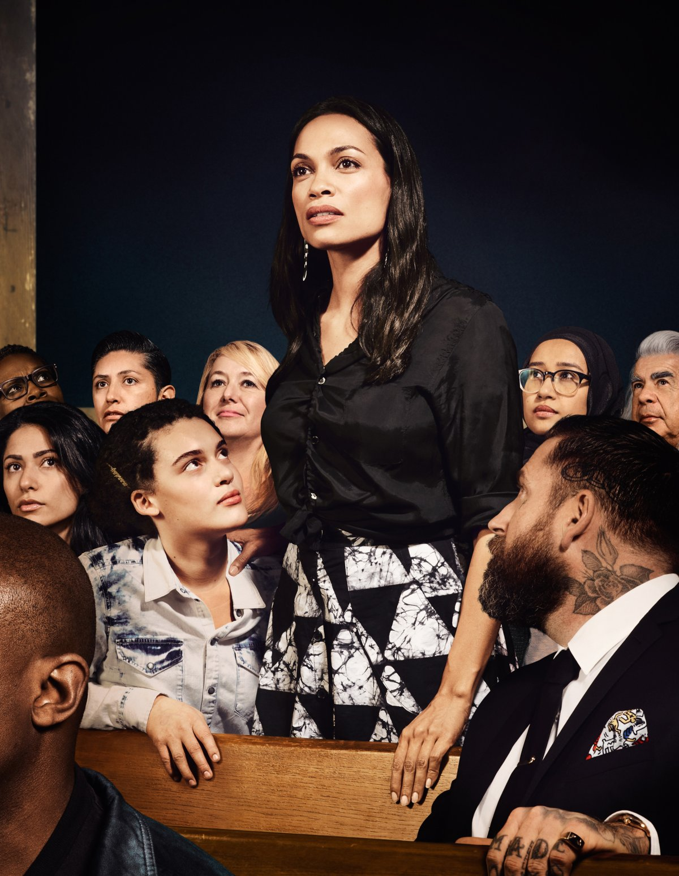
Free speech on the move
Norman Rockwell's “Freedom of Speech” (1943)
H Willis Thomas and E Shur’s reinterpretation of “Freedom of Speech” (2018)
CPGE 1A - Natacha Dunn
Notes:
Left: Norman Rockwell's "Four Freedoms" illustrations, originally published in The Saturday Evening Post. “Freedom of Speech” (1943)
Right: A reinterpretation of Norman Rockwell's “Freedom of Speech” illustration featuring actor and activist Rosario Dawson. Hank Willis Thomas and Emily Shur—For Freedoms – 2018
Defining the frame:
2 definitions: Merriam Webster and Cambridge – ask which is which ;-)
“the right to express your opinions publicly”
“the right to express information, ideas, and opinions free of government restrictions based on content and subject only to reasonable limitations (as the power of the government to avoid a clear and present danger) especially as guaranteed by the First and Fourteenth Amendments to the U.S. Constitution”
Across the ages and cultures, as our societies change, freedom of speech is likely to both advance and suffer setback, be clarified and become all the more blurry. These paradoxes open a Pandora box that leads to numerous and complex questions. What is free speech? What are the stakes behind free speech? Why and how should it be protected? Is free speech allowed to be offensive? Should free speech be regulated? If so, by whom?

Slide 2
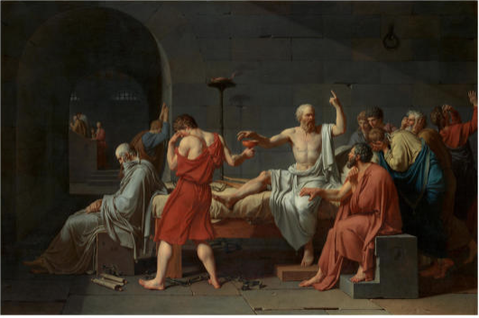
Facts
Jacques-Louis David, 1787 – The Death of Socrates – Metropolitan Museum of Art (New York)
Notes:
Setting the background
Expression is part of human nature and such it is a natural right.
Freedom of speech is something people have died for, and this has been the case most probably since time immemorial.
Socrates in 399BC was sentenced to death by drinking hemlock (=a poison) for having been found guilty of both corrupting the minds of the youth of Athens and of impiety (not believing in the gods of the state).
Since then many have died for more or less the same reasons. The examples that come to my mind the most immediately are Samuel Paty, the victims of the Charlie Hebdo attack and Jamal Kashoggi. Some people have also got a bounty over their heads such as Salman Rushdie, Julian Assange, Edward Snowden, Mila.
And yet, since Socrates there have been many attempts to highlight free speech as one of the beacons of our humanity, enabling societies to develop and improve themselves.

Slide 3
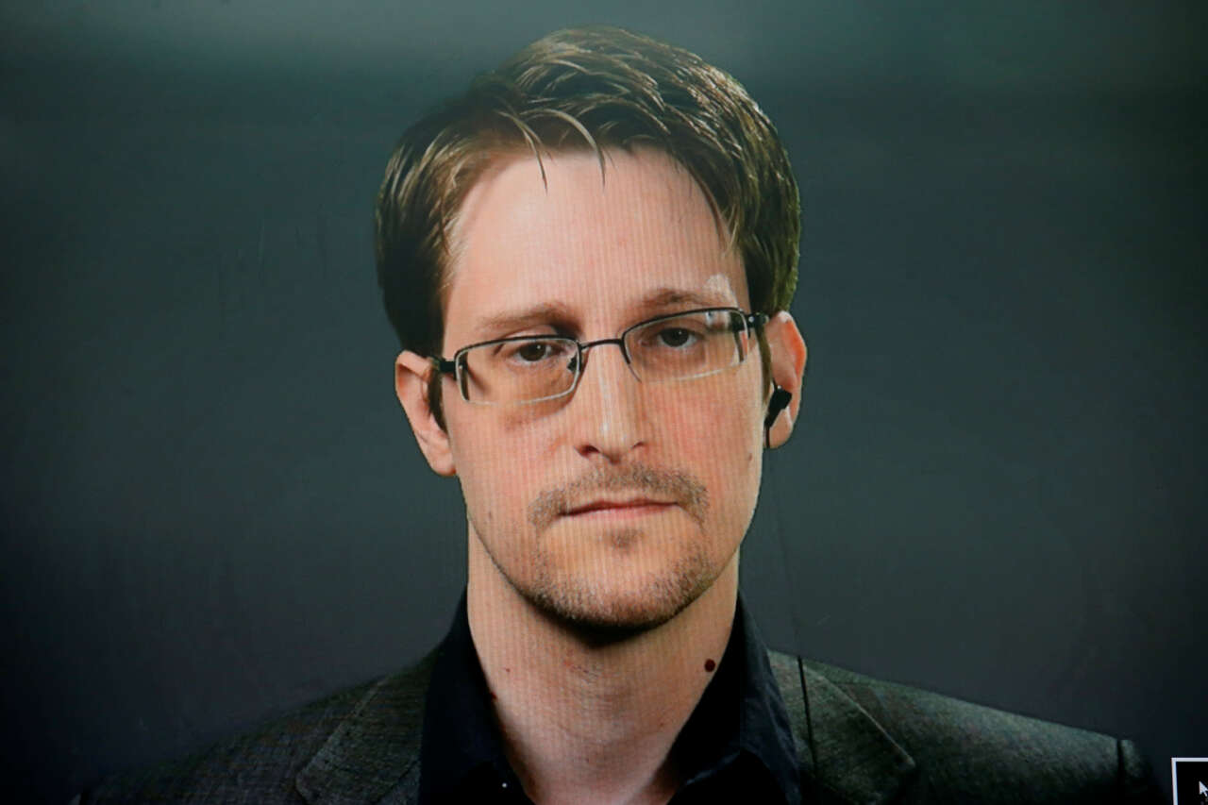
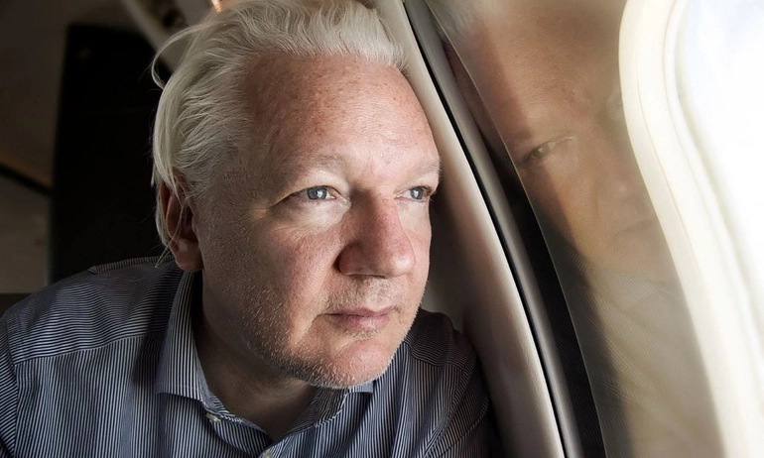
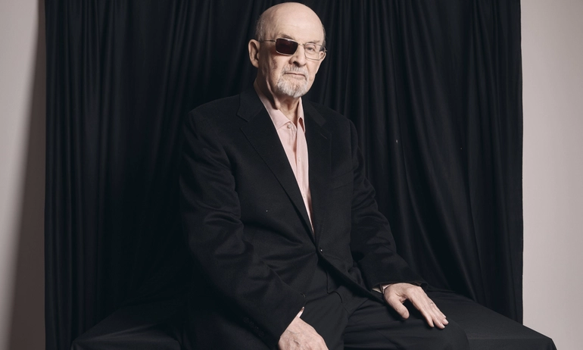
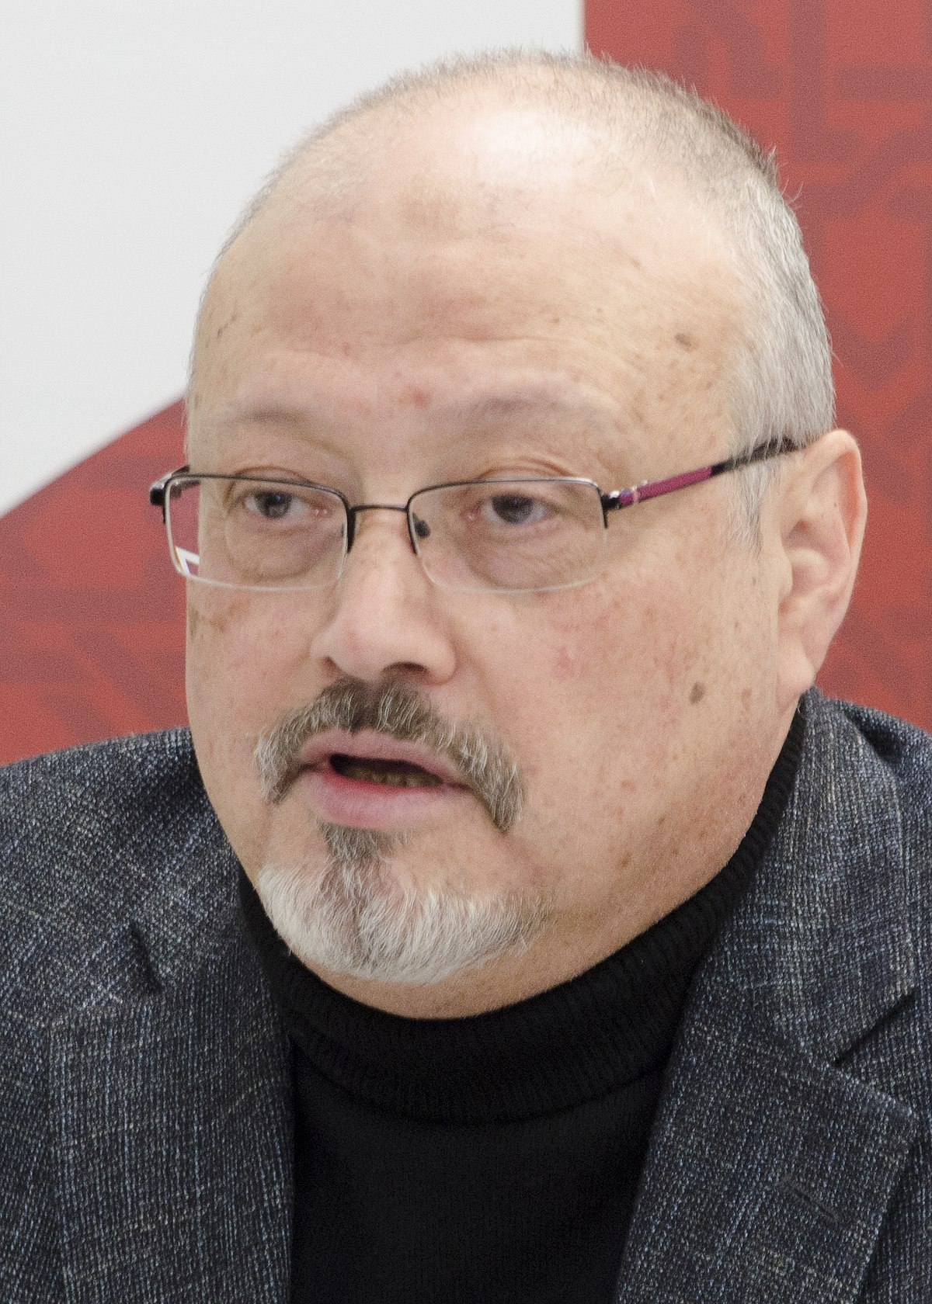
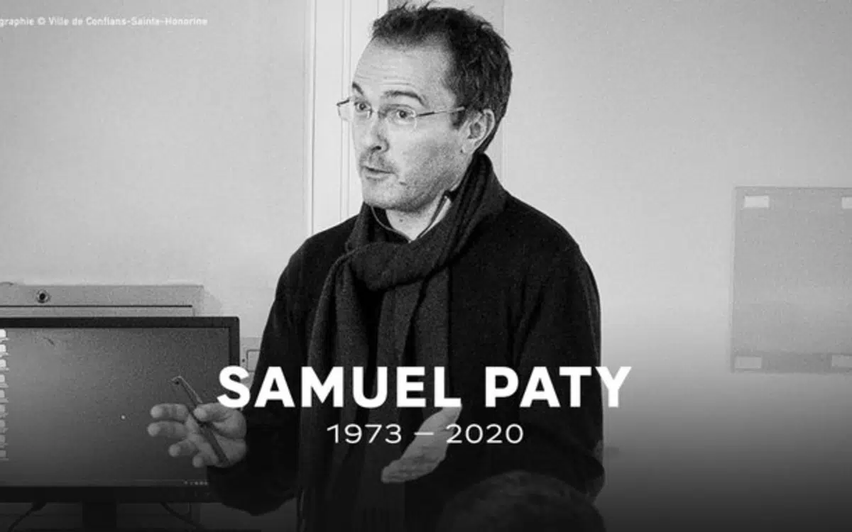

Slide 4
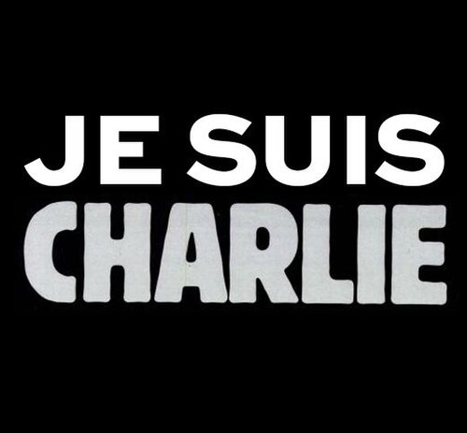
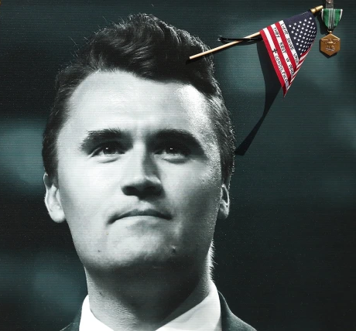
Notes:
From Charlie Hebdo attacks to Charlie Kirk!

Slide 5
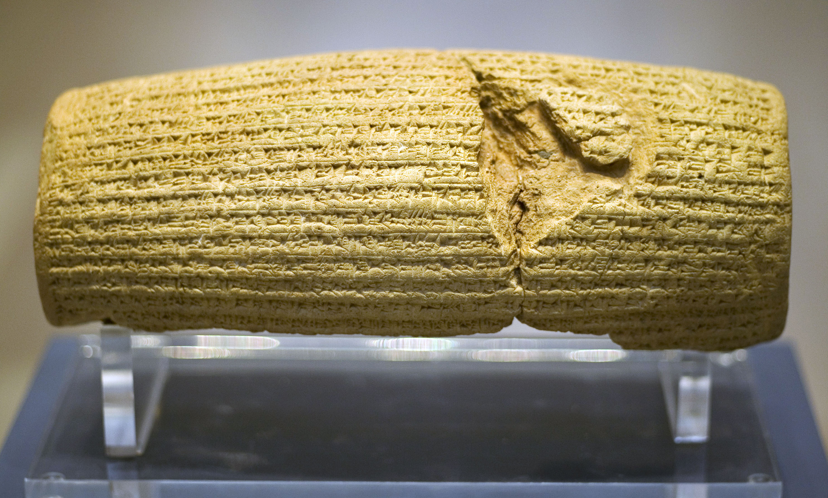
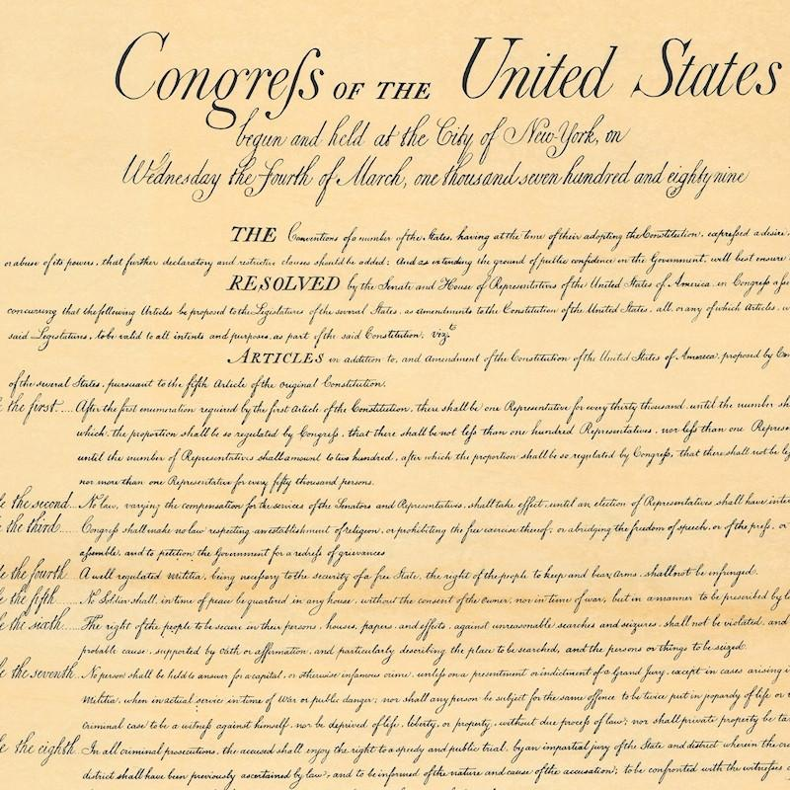
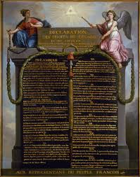
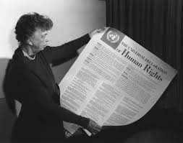
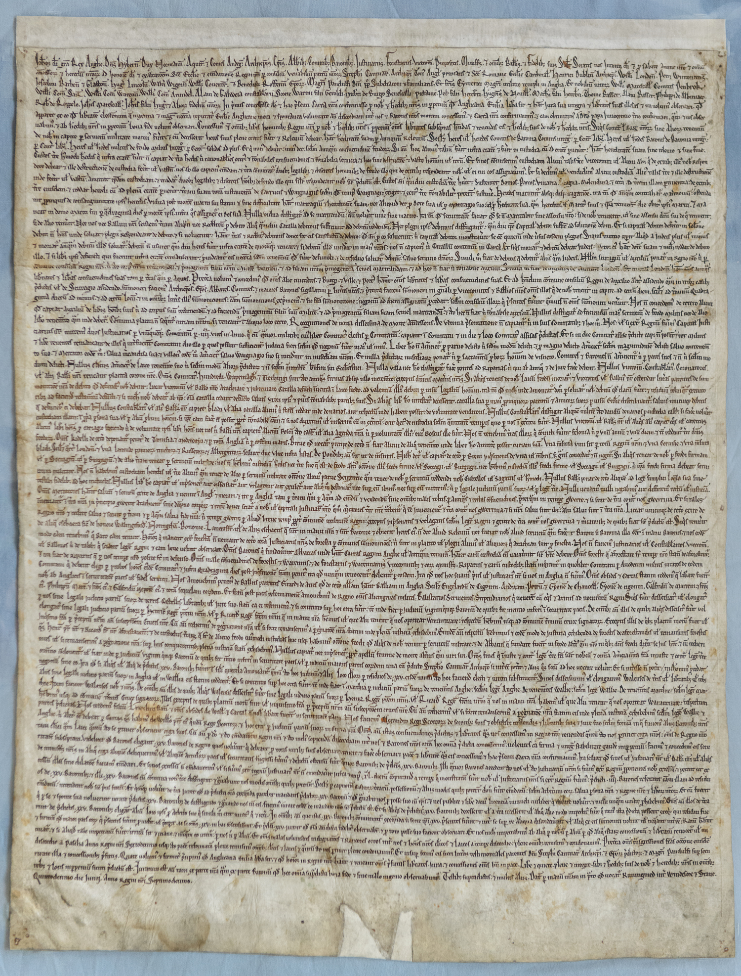
Laws throughout history
Cyrus Cylinder and Magna Carta
the French Declaration of human rights
The Universal Declaration of Human Rights
The US Constitution
Notes:
The Cyrus Cylinder 539 BC (Babylone) and beginning of notion of individual freedoms in general
Magna Carta 1215
The US Constitution – 1791 – The Bill of Rights – Amendment 1
“Congress shall make no law respecting an establishment of religion, or prohibiting the free exercise thereof; or abridging the freedom of speech, or of the press; or the right of the people peaceably to assemble, and to petition the Government for a redress of grievances.”
French Declaration of Human Rights 1793 – article 7 – A natural right of man – notion of secularity is developed there and then
Article 7
Le droit de manifester sa pensée et ses opinions, soit par la voie de la presse, soit de toute autre manière, le droit de s'assembler paisiblement, le libre exercice des cultes, ne peuvent être interdits.
The Universal declaration of Human Right 10 December 1948
– 193 members today + 2 observers (Vatican and Palestine) + 2 unrecognised + quite a few self-proclaimed states (areas where there are conflicts) // the ISO Standard List counts 249 Country Codes – but this list known as ISO 3166-1 includes countries and territories.
Article 18
Everyone has the right to freedom of thought, conscience and religion; this right includes freedom to change his religion or belief, and freedom, either alone or in community with others and in public or private, to manifest his religion or belief in teaching, practice, worship and observance.
Article 19
Everyone has the right to freedom of opinion and expression; this right includes freedom to hold opinions without interference and to seek, receive and impart information and ideas through any media and regardless of frontiers.
In British Common Law
Interesting fact: freedom of expression in the Common Law appears in the section on “censorship.”.
wikipedia= a negative right (Negative and positive rights are rights that oblige either inaction (negative rights) or action (positive rights)) - to freedom of expression under the common law.^{[1]} In 1998, the United Kingdomincorporated the European Convention into its domestic law under the Human Rights Act. However, there is a broad sweep of exceptions including threatening or abusive words or behaviour intending or likely to cause harassment, alarm or distress or cause a breach of the peace (which has been used to prohibit racist speech targeted at individuals),^{[2][3][4]}sending another any article which is indecent or grossly offensive with an intent to cause distress or anxiety (which has been used to prohibit speech of a racist or anti-religious nature),^{[5][6][7]} incitement,^{[8]} incitement to racial hatred,^{[9]}incitement to religious hatred, incitement to terrorism including encouragement of terrorism and dissemination of terrorist publications,^{[8][10][11]} glorifying terrorism,^{[12][13]} collection or possession of a document or record containing information likely to be of use to a terrorist,^{[14][15]} treason including advocating for the abolition of the monarchy or compassing or imagining the death of the monarch,^{[16][17][18][19][20]} sedition,^{[17]} obscenity,^{[21]} indecency including corruption of public morals and outraging public decency,^{[22]} defamation,^{[23]} prior restraint, restrictions on court reporting including names of victims and evidence and prejudicing or interfering with court proceedings,^{[24][25]} prohibition of post-trial interviews with jurors,^{[25]} time, manner, and place restrictions,^{[26]} harassment, privileged communications, trade secrets, classified material, copyright, patents, military conduct, and limitations on commercial speech such as advertising.

Slide 6
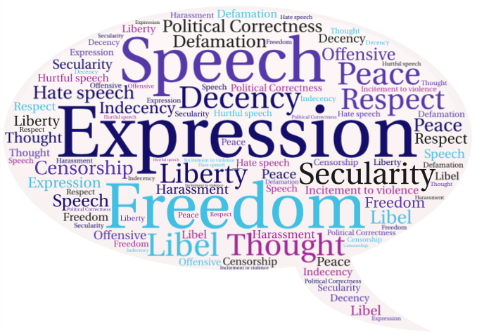
ContRoversies - A global problem
https://medium.com/s/liberal-illiberalisms/free-speech-in-a-global-context-c5534b5eec25
Notes:
Controversies
Freedom of expression is a natural right. Since man is able to express himself, he is meant to, and most of the time, compelled to do so.
What is speech? What is expression? What is freedom of expression? Thought? Hate speech? Libel? Defamation? Secularity? Secularism? Are we allowed to offend others when we express ourselves? What is offensive? Satire? Criticism? Obscenity? Blasphemy? Slur? Bigotry? Liability? Can we lie in public? Can we spread fake news?
Most democracies have created a frame to freedom of speech consistent with the idea that the limits of freedom of speech lie within its coming in conflict with other natural and liberal freedoms.
2 quotes from the article recommended:
“This has led to restrictions on speech that harms individual or public safety (incitement, some threats) and free exchange (defamation, intellectual property), as well as time and place restrictions (for example, I can’t blast my political opinion from loudspeakers in a residential neighborhood at 3 a.m.).”
“Liberal societies also impose restrictions on obscenity and pornography.”

Slide 7
Food For thought
The Speaker’s corner https://www.youtube.com/watch?v=_Fm4fBW9qUs (first 3 minutes max) https://www.youtube.com/watch?v=iw6h7ghRHsA https://www.royalparks.org.uk/parks/hyde-park/things-to-see-and-do/speakers-corner
The philosophical debate and evolution of ideas (from ancient Greece to the 17th/18th/19th/20th/21st vision of things) https://theconversation.com/freedom-of-speech-a-history-from-the-forbidden-fruit-to-facebook-119597
Notes:
Speaker’s corner – philosophical views

Slide 8
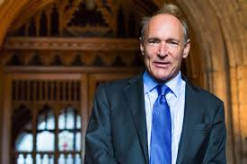
Freedom of Speech 2.0
A utopia or dystopia?
Sir Tim Berners Lee
Section 230 today
https://theconversation.com/what-would-happen-if-section-230-went-away-a-legal-expert-explains-the-consequences-of-repealing-the-law-that-built-the-internet-253326
Notes:
Just when we are under the impression that free speech is getting clearer, we need to focus on what the effects the advent of the Internet era has had on free speech, thus bringing up the subject of:
Freedom of Speech 2.0.
Utopia or dystopia? The internet has certainly liberated individuals from their shackles, liberating communication to an unprecedented level. It has almost provided people with the gift of ubiquity, making their communication more efficient than ever before. Or has it?
Arab springs vs the possibility to enhance organised crime online.
Tim Berners Lee invented the www in 1989 while he was working at CERN.
The ideology behind the internet is one of “a universal space of information” /“to work together better”. To enable the technology to grow, it had to be open-source (the access to the algorithm was free and available to everyone). Note that TBL did not make any profit from his invention, unlike the big internet moguls.
Since then he has written open letters on the date of the anniversary of his creation to make an overview of its evolution. He has been calling for regulation over the past few years, because his creation is now starting to get out of control.
In 2019 he started a project called A contract for the web - https://contractfortheweb.org
Principle 6 is of interest to us: “Develop technologies that support the best in humanity and challenge the worst” section 1a: “by supporting human rights, as outlined by the UN”
Grammar: what should / ought to / had better be done to prevent chaos?
What should we have done sooner?
If TBL had patented his creation, …
Section 230 of the US Communications Decency Act, a law passed in 1996.
Extracts from Time Jan 2020, The Growing Threat to Free Speech Online, by David French.
“What is Section 230? One of the early challenges of the internet was how to import the well-developed law of free speech to the online world. Were the principles of law developed for physical space also applicable to virtual space? And one of the first points of contention was over user-generated content. If I write a comment and post it on an online chat room or a comment board, is it my speech, the internet service’s speech, or did we both speak?”
“In two early cases, the courts started to provide an extremely unsatisfactory answer to the questions above. In 1991, a federal court in New York dismissed a lawsuit against an early internet service provider named CompuServe on the grounds that CompuServe couldn’t be held liable for users’ speech because they didn’t exercise any control at all over posted content. Then, in 1995, a New York state court ruled that Prodigy – a competing internet service provider– could be held liable for a user comment because it moderated the message board, removing comments that violated Prodigy’s posting guidelines. Even that small level of control rendered Prodigy liable for its users’ speech.”
“Taken together, the two rulings put online providers in a difficult dilemma. Let everything in and your service would be quickly swamped with the worst, most vile forms of expression. But if you imposed even modest controls on user content, then you’d be liable for their words. Internet companies were on the verge of being forced to make a stark choice – dive into the sewer or dive into censorship.
So, Congress acted. In 1996, it passed Section 230. The law did two things. First, it declared that “No provider or user of an interactive computer service shall be treated as the publisher or speaker of any information provided by another information content provider.” In plain English, this means that my comments on Twitter or Google or Yelp or the comments section of my favorite website are my comments, and my comments only.
But Section 230 went farther, it also declared that an internet provider can “restrict access to or availability of material that the provider or user considers to be obscene, lewd, lascivious, filthy, excessively violent, harassing, or otherwise objectionable” without being held liable for user content. This is what allows virtually all mainstream social media companies to remove obscene or pornographic content. This allows websites to take down racial slurs – all without suddenly also becoming liable for all the rest of their users’ speech.”
Where we stand now on section 230: Both Republicans and Democrats are against it. Biden wants to repeal the act while Trump wants to regulate it.
Thus, the internet having unleashed a whole new array of possibilities for freedom of expression, it is bound to broaden the debate and make even more more fraught than it already was back in the 1980’s.
Other cultural refences of interest
John Perry Barlow – a declaration of the independence of cybersapce
Eric Schmidt and Jared Cohen Google leaders call the Internet “the world’s largest ungoverned space,” in their book, “The New Digital Age: Reshaping the Future of People, Nations and Business.” released in 2013

Slide 9
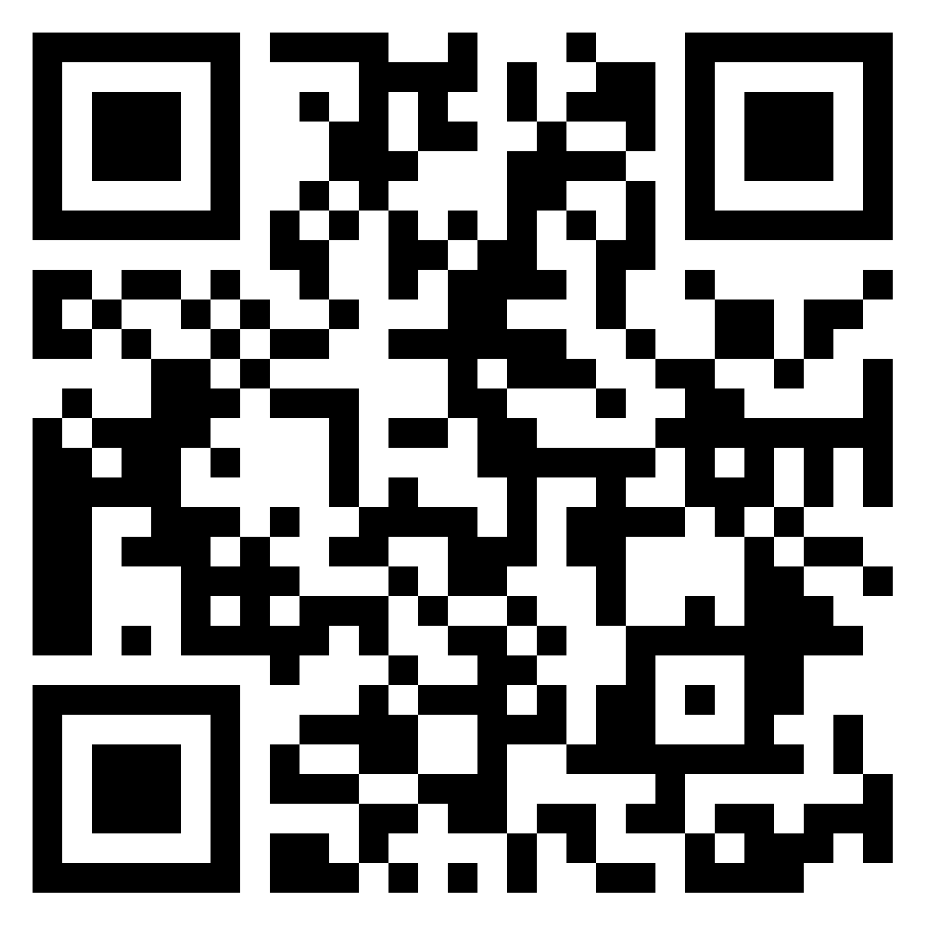
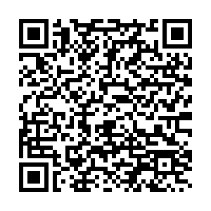
Conclusion
Complex, complicated, fraught and paradoxical
On the move!
https://padlet.com/ece_prepa/ptsi1-your-view-about-either-democracy-or-freedom-of-speech-a68lqil87ggi77l2
Notes:
Freedom of speech is a complex, controversial and fraught subject matter which enables to bring out the best and the worst in humanity. Through debate and collaboration, societies can both thrive and destroy themselves. This paradoxical potential leads to consider the issue as being on the move, in constant evolution.

