Slide 1
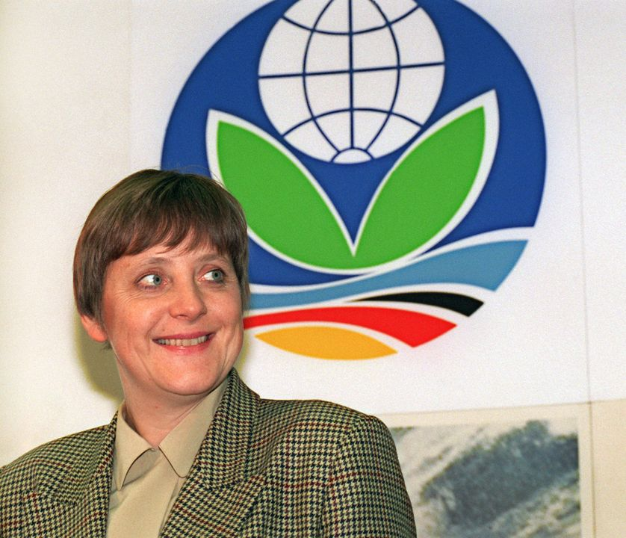
Conference of the PArties
Notes:
Picture : Angela Merkel at the COP1 in 1995 as Minister for the Environment :-D
It is well-known amongst most scientists that global warming is man made and due to human activity, despite the claims of climate-sceptics / climate-deniers. This rise in temperatures started during the industrial revolution and the curve of temperatures on the surface of the planet has not stopped rising ever since.
In 2021, the IPCC (International Panel on Climate Change) report (Climate Change – the physical science basis) stated that:
“The scale of recent changes across the climate system as a whole – and the present state of many aspects of the climate system – are unprecedented over many centuries to many thousands of years.”
“Global surface temperature will continue to increase until at least mid-century under all emissions scenarios considered. Global warming of 1.5°C and 2°C will be exceeded during the 21st century unless deep reductions in CO2 and other greenhouse gas emissions occur in the coming decades.”
“Many changes in the climate system become larger in direct relation to increasing global warming. They include increases in the frequency and intensity of hot extremes, marine heatwaves, heavy precipitation, and, in some regions, agricultural and ecological droughts; an increase in the proportion of intense tropical cyclones; and reductions in Arctic sea ice, snow cover and permafrost”.
“Many changes due to past and future greenhouse gas emissions are irreversible for centuries to millennia, especially changes in the ocean, ice sheets and global sea level.”
IPPC August 2021
In the light of this report and in the wake of the election of Joe Biden, the world was scrutinising the COP26 summit this year.

Slide 2
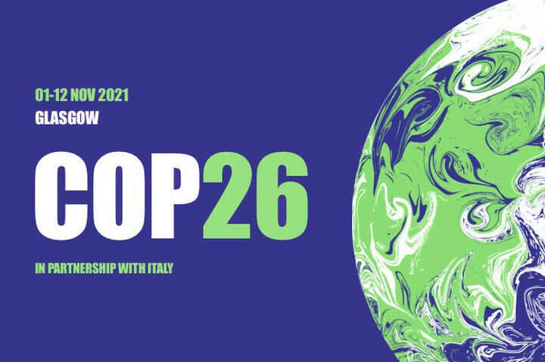

What is a COP?
Yearly venue since 1995
30,000 participants approximately
197 parties (196 countries + the EU)
2 parts (https://www.youtube.com/watch?v=4e7stuyuuRU)
Notes:
Conference of Parties
Organised by the UN
Generally organised in 2 sections

Slide 3

Landmark Venues – COP Timeline
Kyoto (1997)
Paris 2015 (COP21)
Glasgow 2021 (COP 26) https://www.ft.com/content/03d7609b-decc-40fc-8029-a6cdebb11752
Sharm El Sheikh 2022 (COP 27)
COP 28 Dubaï – COP 29 Baku
Belem – COP 30
Notes:
Kyoto =curbing the emissions of greenhouse gases by 5% of 55 countries by 2015 – limits?
Paris = containing global warming below the 2°C threshold of pre-industrial era
Glasgow = scaling up efforts towards net neutrality and increasing financial aid towards developing countries
Sharm El Sheikh failure
Dubaï and Baku (Azerbaijan)
COP 30

Slide 4
Goals?
A roadmap for the future to curb global warming, cut the emissions of greenhouse gases and tend towards carbon net neutrality
An empty shell?
Controversies

Slide 5
Conclusions on this year’s COP30?
Notes:
Written comprehension!

