Slide 1
Meet the press Review!

Slide 2
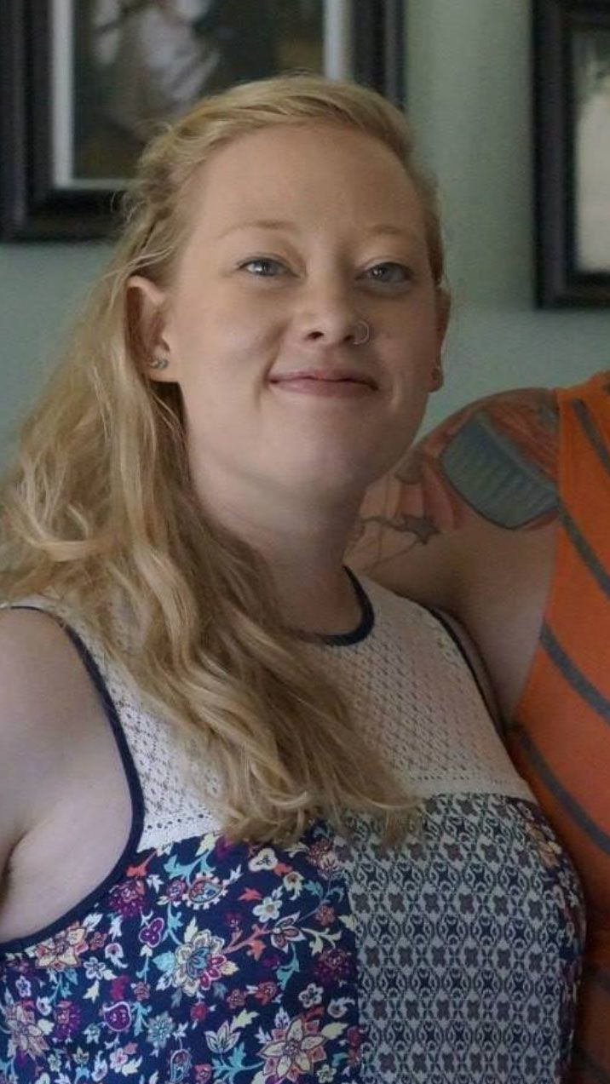
Notes:
Renne Nicole Good – shot at in Minneapolis by ICE

Slide 3
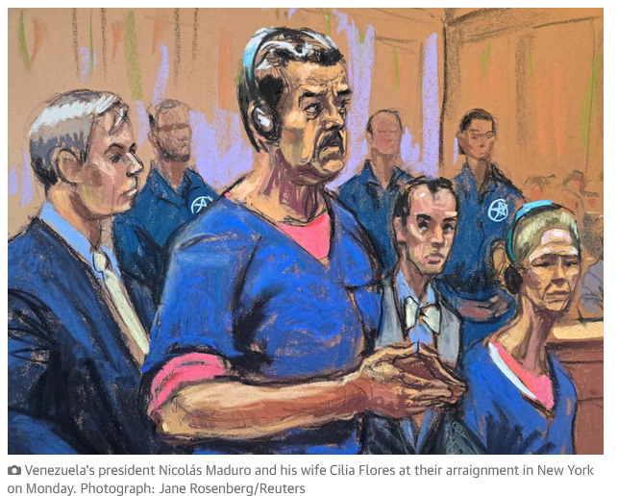

Slide 4
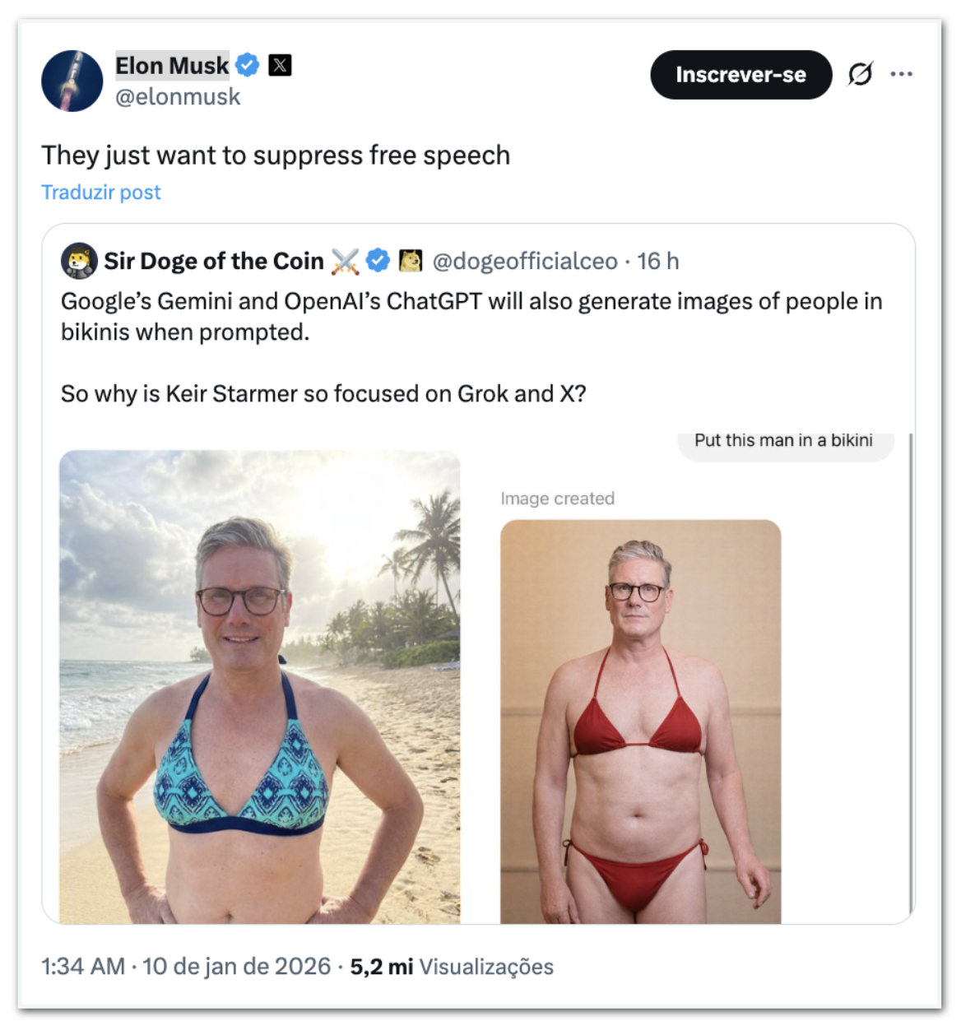

Slide 5
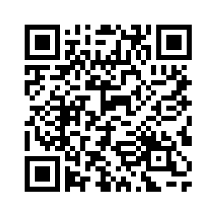
SAVE TO YOUR FAVORITES!
https://nuage11.apps.education.fr/index.php/s/7BQaDbWiANJ4DZn

