Slide 1

The LA Times - 2016
Notes:
Have culture wars turned into a chimera / a mirage or are they still a reality in 2025-26?

Slide 2
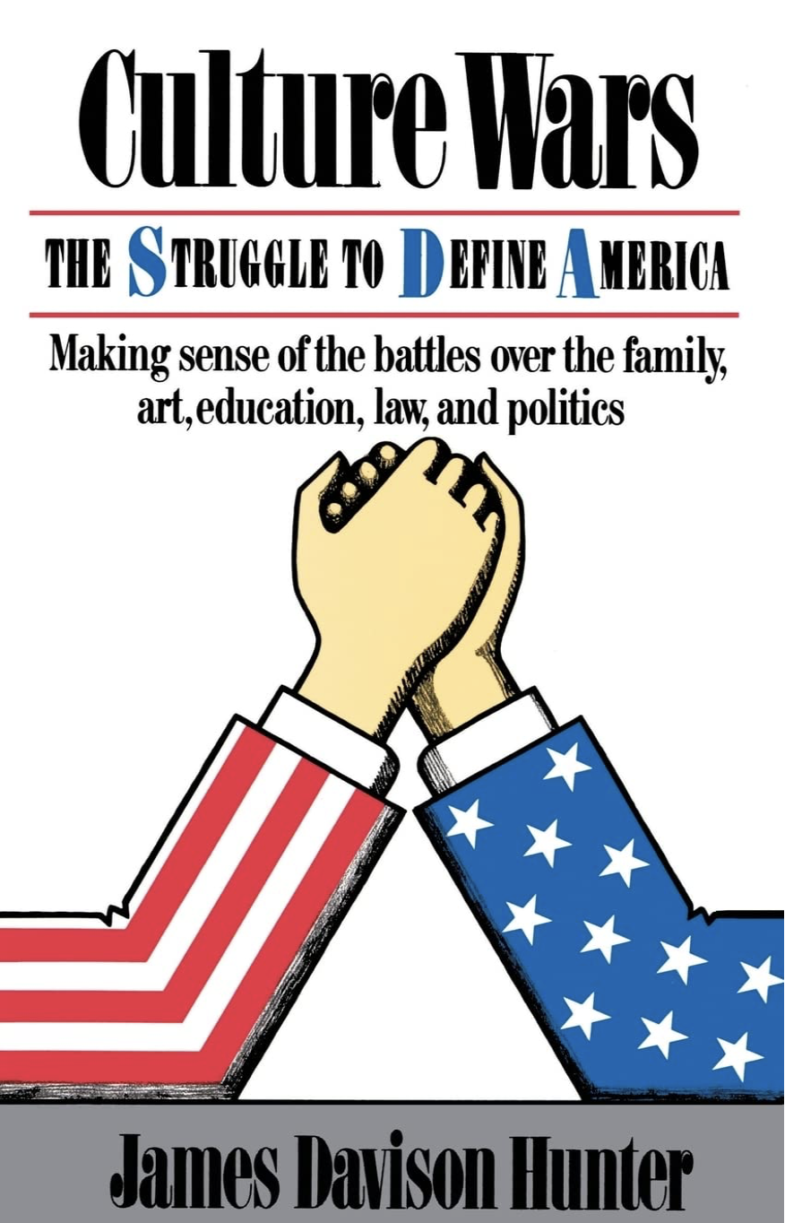
1991
The Financial times - 2022

Slide 3
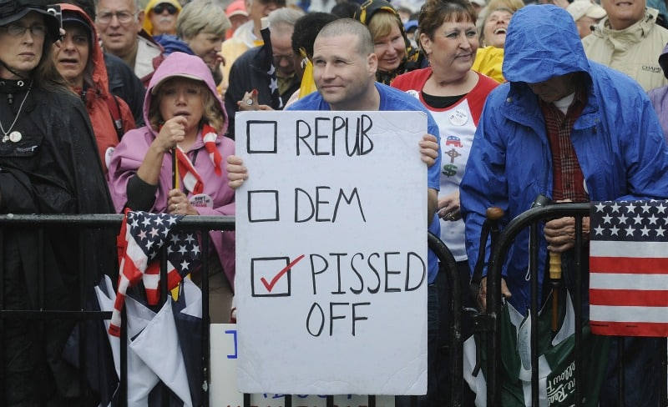


Notes:
The span of culture wars is wide, from political demonstrations in the sterets, to identifying political correctness, displaying humoristically items in cultural monuments or downright attacking them, educational debates, cancel culture vs censorship, contentious terms which are used sometimes as pejorative or derogatory and sometimes as ideas to be proud of (woke/ wokism / DEI / CRT / ESG = Environmental, Social and Governance).

Slide 4
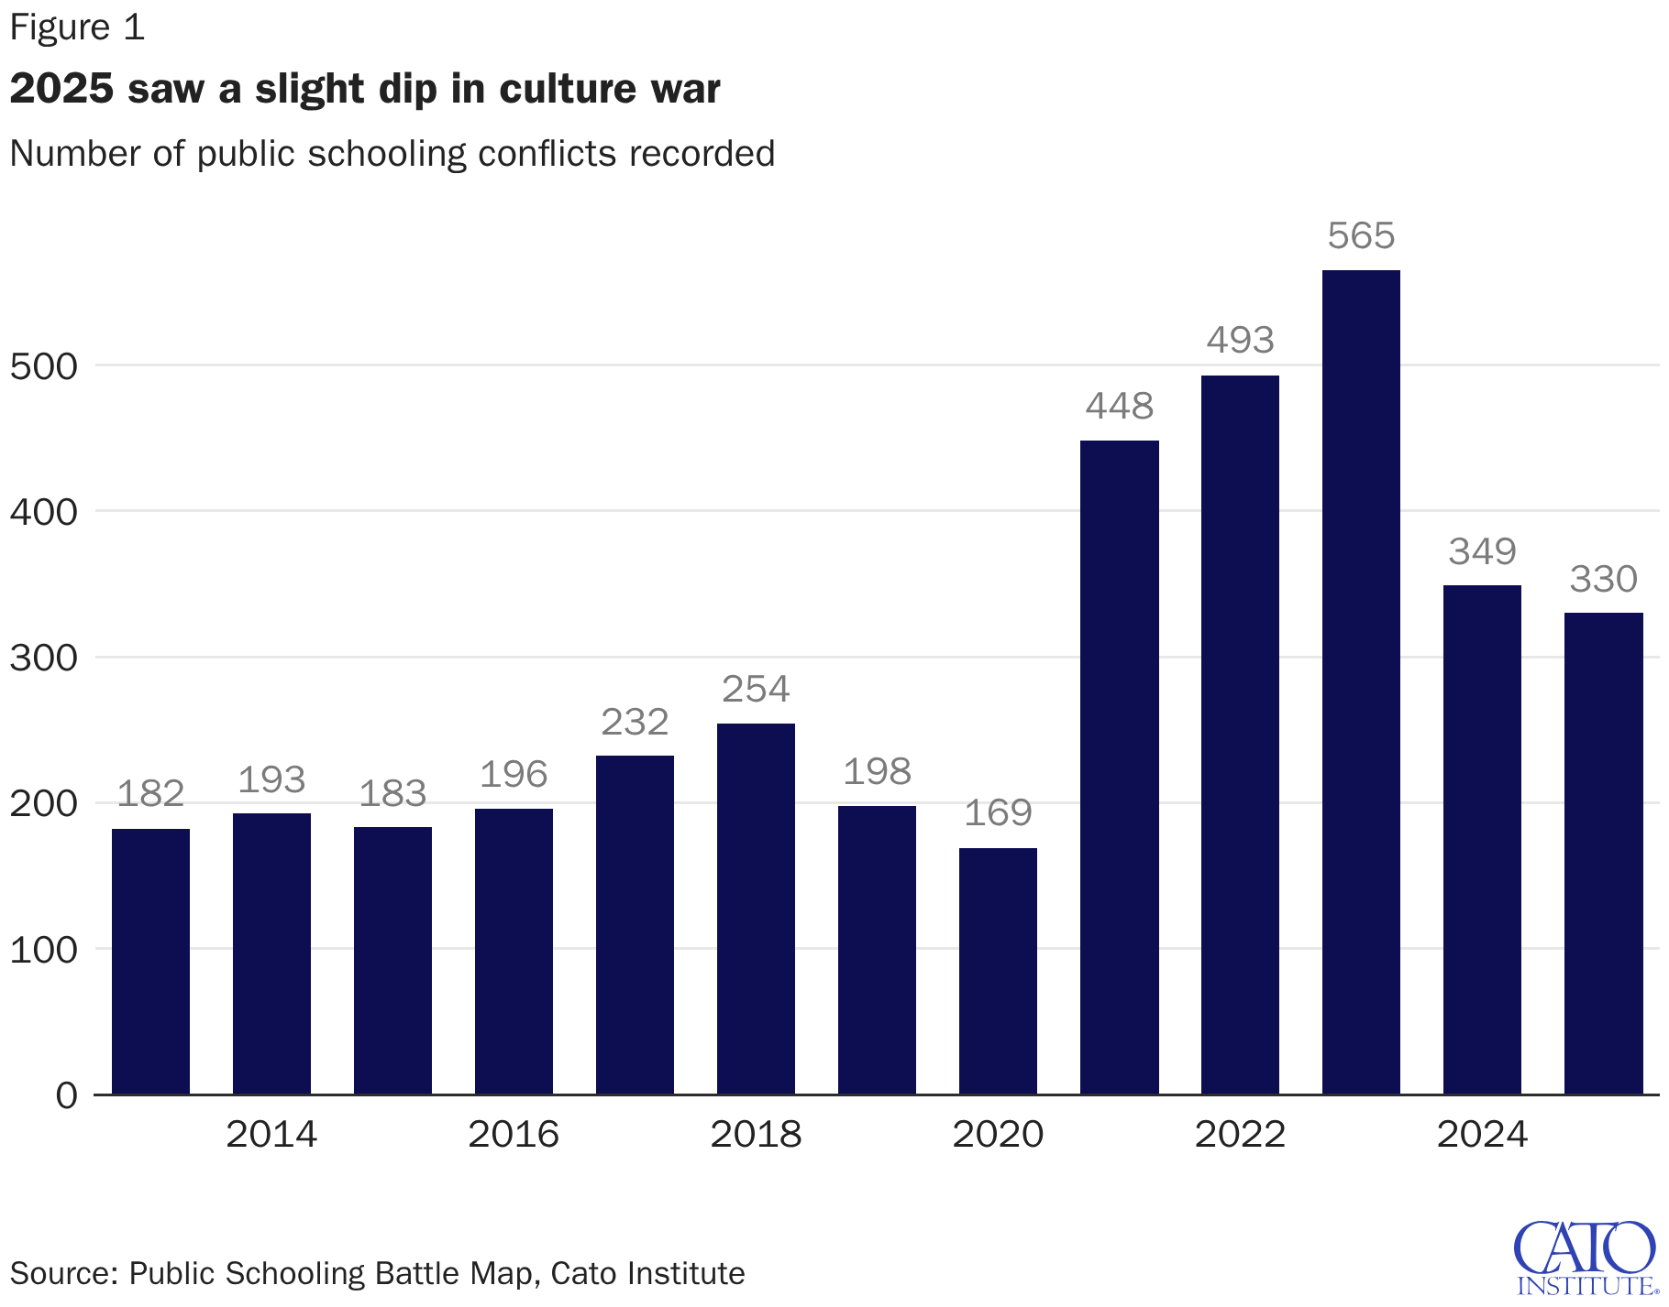

Notes:
US CATO Uni figures – Which terms are used mostly to day in the field of culture wars? CRT / WOKE / WOKISM / DEI / ESG

Slide 5
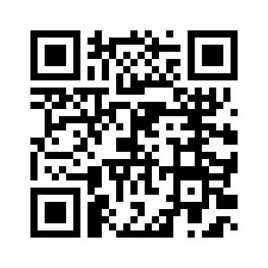
Meet the sensitivity readers…
https://www.youtube.com/watch?v=rNgc65_kDNw
Fiction in the UK – 2023 – Sky News
Notes:
The term "sensitivity reader" began to emerge more prominently on the internet around the early 2010s. Although the practice of sensitivity reading—where readers review manuscripts for cultural sensitivity—has been around longer, it gained traction and became more recognized as a distinct role within the publishing industry around this time.
Notably, discussions about sensitivity readers started to proliferate on social media platforms, blogs, and forums in the mid-2010s, especially as conversations about representation and inclusivity in literature gained momentum. The rise of social media allowed authors and publishers to discuss the importance of this role more openly, leading to the term becoming part of mainstream publishing vocabulary by the late 2010s.
Overall, while the concept may have existed before, its visibility and the official designation "sensitivity reader" became more relevant and discussed within the writing and publishing communities during the 2010s, particularly as societal conversations around diversity and representation evolved.
Number of Declared Sensitivity Readers in 2025
There is no official census or central registry that tracks the exact number of "declared" sensitivity readers working in the publishing industry as of 2025. Because the role is often freelance and lacks a standardized professional certification or governing body, it is impossible to provide a definitive count of how many individuals held this title during that year.midnighteditorstheguardian
Key Findings
Sensitivity reading remains a decentralized, freelance-based field, meaning there is no unified database or membership organization that records every active practitioner.midnighteditors
While the demand for these services has grown, some publishers and agencies maintain their own internal lists of vetted readers rather than relying on a public registry.medium
Individual editorial firms, such as Bookmarten Editorial, often list their own specific consultants, but these are private rosters rather than industry-wide statistics.alexandrawriters
The role has become a significant point of debate within the literary world, leading to varying levels of transparency regarding who identifies as a sensitivity reader and how they are hired.france24
Because many sensitivity readers operate as independent contractors, their "declaration" of the role is typically limited to personal websites, social media profiles, or agency listings, preventing a comprehensive industry count.antares
Details
Background and Context
Sensitivity readers are independent consultants hired by authors or publishers to review manuscripts for potential stereotypes, misrepresentations, or cultural inaccuracies, particularly regarding marginalized groups.lemonde While the practice has gained significant visibility in recent years, it remains a fluid, market-driven profession rather than a formal or regulated trade. As a result, data on the total number of practitioners is unavailable.
Caveats and Uncertainties
The lack of data is primarily due to the following factors:
Lack of Regulation: There is no professional licensing or mandatory "declaration" process required to work as a sensitivity reader.
Freelance Nature: Most readers are self-employed and may only perform this work sporadically, making it difficult to differentiate between full-time professionals and those who take on occasional projects.
Industry Privacy: Many publishers treat their lists of consultants as proprietary information to protect their editorial processes and the privacy of the readers themselves.
Practical Takeaway
If you are looking for a sensitivity reader, it is most effective to search through reputable editorial service platforms or contact literary agencies for their recommendations.midnighteditors
Do not rely on public counts or "official" lists, as these do not accurately represent the size or reach of the field.
Always verify the experience and background of a potential reader by requesting a portfolio or professional references rather than relying on a self-declared title alone.
This input comes from questions asked to Claude 4.2

Slide 6
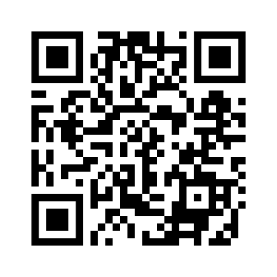
MEET PRAGER U
https://www.youtube.com/watch?v=EELkJetKz9Y
MSNBC Report – July 2023

Slide 7
DID CULTURE and POLITICS REMAIN SEPARATE IN 2025?
IN WHAT WAYS WAS THE EXPRESSION ‘CULTURE WARS’ STILL PERVASIVE IN 2025?

