Slide 1
Midterm elections 2026

Slide 2
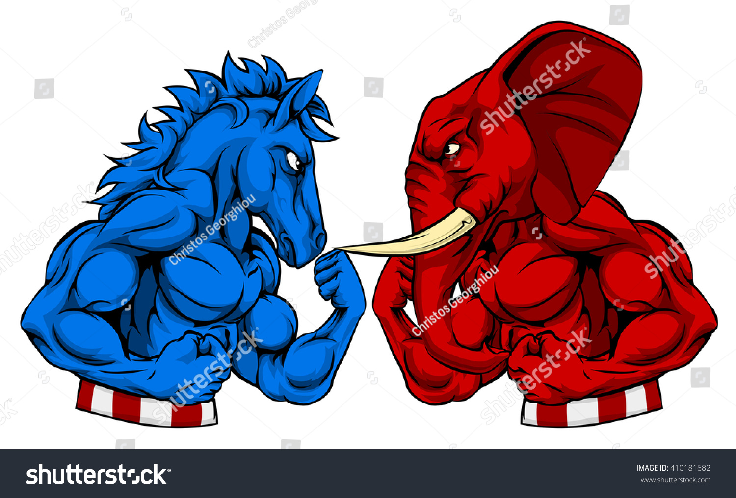
Notes:
Red / Republican
Donkey / Democrat

Slide 3
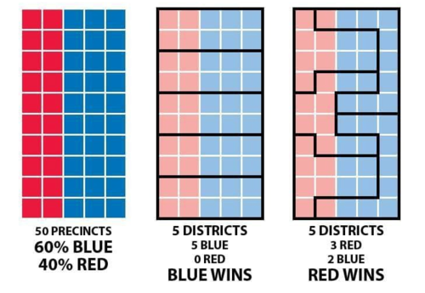
Gerrymandering
Notes:
An example of how redistricting works

Slide 4
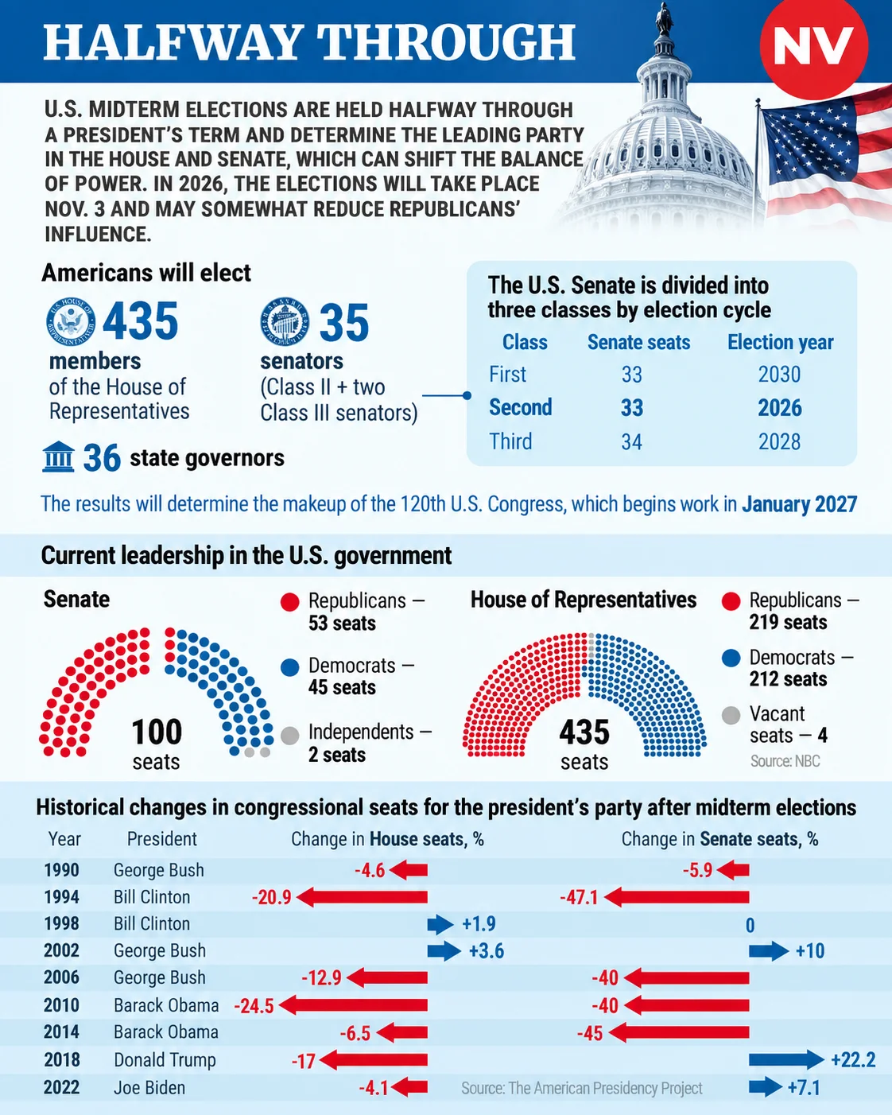
https://english.nv.ua/nation/u-s-midterms-will-decide-control-of-congress-halfway-through-trump-s-term-50644582.html
Notes:
What Congress looks like now

